Slide 1
P1 Chapter 13: Integration
Definite Functions

Slide 2

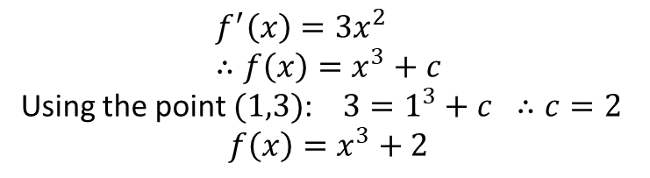


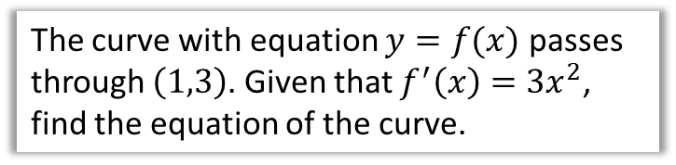







Finding constant of integration
Recall that when we integrate, we get a constant of integration, which could be any real value. This means we don’t know what the exact original function was.
$$y$$
$$y$$
$$f\left(x\right)=x^{3}+c$$
$$f^{′}\left(x\right)=3x^{2}$$
$$∫$$
$$\left(1,3\right)$$
$$f\left(x\right)=x^{3}$$
$$f\left(x\right)=x^{3}−1$$
?
$$x$$
$$x$$
But if we know one point on the curve, it leaves only one possibility.
The curve with equation $y=f(x)$ passes through $\left(1,3\right)$. Given that $f^{′}\left(x\right)=3x^{2}$, find the equation of the curve.
$$f^{′}\left(x\right)=3x^{2} \\ ∴f\left(x\right)=x^{3}+c$$
Using the point $(1,3)$: $3=1^{3}+c ∴c=2$
$$f\left(x\right)=x^{3}+2$$
?

Slide 3
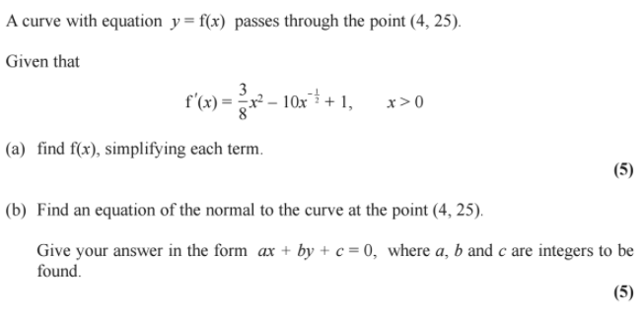
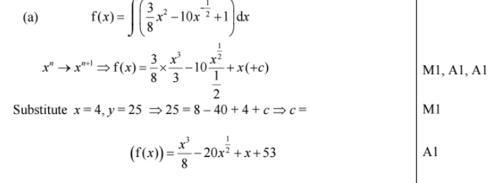
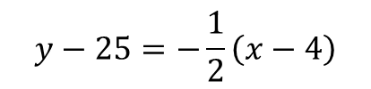
Test Your Understanding
Edexcel C1 May 2014 Q10
To keep you occupied if you finish (a) quickly!
? a
$$y−25=−\frac{1}{2}\left(x−4\right)$$
? b
(b)

Slide 4
Exercise 13.3
Pearson Pure Mathematics Year 1/AS
Page 105

Slide 5
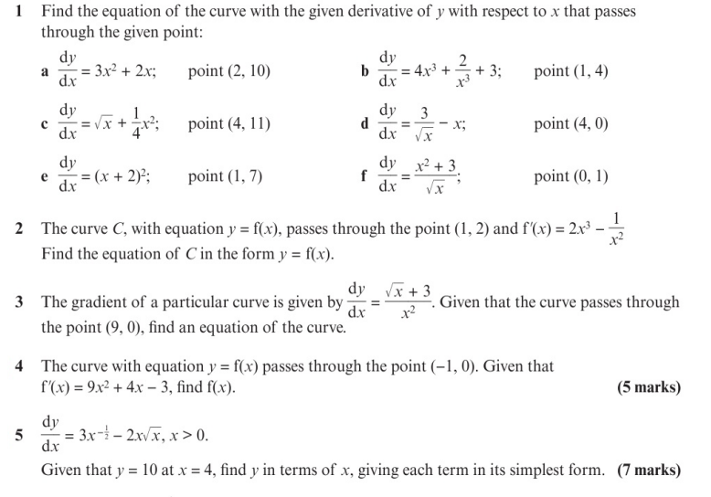
Homework Exercise

Slide 6
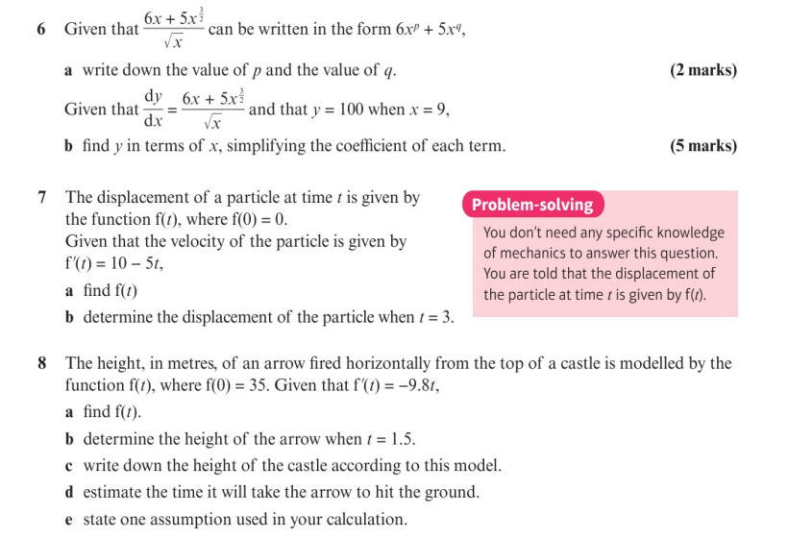
Homework Exercise

Slide 7
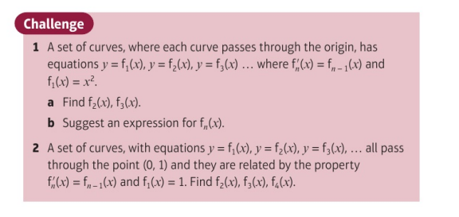
Homework Exercise

Slide 8
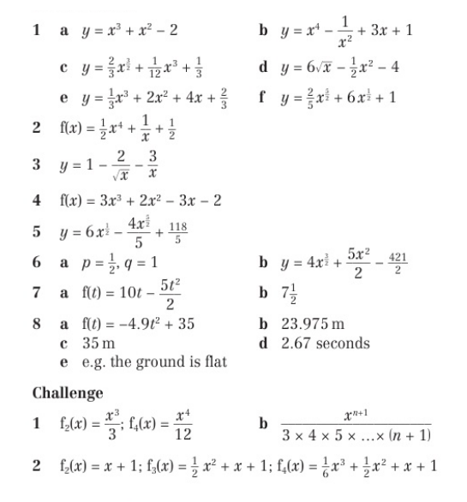
Homework Answers

Slide 9
Homework Answers

