Slide 1
P1 Chapter 1: Algebra Rationalising Denominators

Slide 2
Rationalising The Denominator
Here’s a surd. What could we multiply it by such that it’s no longer an irrational number?
?
?
$$\sqrt{5}×\sqrt{5}=5$$
$$\frac{1}{\sqrt{2}}×\frac{\sqrt{2}}{\sqrt{2}}=\frac{\sqrt{2}}{2}$$
?
?
In this fraction, the denominator is irrational. ‘Rationalising the denominator’ means making the denominator a rational number.
What could we multiply this fraction by to both rationalise the denominator, but leave the value of the fraction unchanged?
Side note: There’s two reasons why we might want to do this:
For aesthetic reasons, it makes more sense to say “half of root 2” rather than “one root two-th of 1”. It’s nice to divide by something whole!
It makes it easier for us to add expressions involving surds.

Slide 3
Examples
$$\frac{3}{\sqrt{2}}=\frac{3\sqrt{2}}{2}$$
$$\frac{6}{\sqrt{3}}=\frac{6\sqrt{3}}{3}=2\sqrt{3}$$
$$\frac{7}{\sqrt{7}}=\frac{7\sqrt{7}}{7}=\sqrt{7}$$
$$\frac{15}{\sqrt{5}}+\sqrt{5}=3\sqrt{5}+\sqrt{5}=4\sqrt{5}$$
Test Your Understanding:
?
?
$$\frac{12}{\sqrt{3}}=4\sqrt{3}$$
$$\frac{2}{\sqrt{6}}=\frac{\sqrt{6}}{3}$$
$$\frac{4\sqrt{2}}{\sqrt{8}}=\frac{16}{8}=2$$
?
?
?
?
?

Slide 4
More Complex Denominators
You’ve seen ‘rationalising a denominator’, the idea being that we don’t like to divide things by an irrational number.
But what do we multiply the top and bottom by if we have a more complicated denominator?
$$\frac{1}{\sqrt{2}+1}×\frac{\sqrt{2}−1}{\sqrt{2}−1}=\frac{\sqrt{2}−1}{1}=\sqrt{2}−1$$
?
?
We basically use the same expression but with the sign reversed (this is known as the conjugate). That way, we obtain the difference of two squares. Since $\left(a+b\right)\left(a−b\right)=a^{2}−b^{2}$, any surds will be squared and thus we’ll end up with no surds in the denominator.

Slide 5
More Examples
$$\frac{3}{\sqrt{6}−2}×\frac{\sqrt{6}+2}{\sqrt{6}+2}=\frac{3\sqrt{6}+6}{2}$$
You can explicitly expand out $\left(\sqrt{6}−2\right)\left(\sqrt{6}+2\right)$ in the denominator, but remember that $\left(a−b\right)\left(a+b\right)=a^{2}−b^{2}$ so we can mentally obtain $6−4=2$
Just remember: ‘difference of two squares’!
?
?
$$\frac{4}{\sqrt{3}+1}×\frac{\sqrt{3}−1}{\sqrt{3}−1}=\frac{4\sqrt{3}−4}{2}=2\sqrt{3}−2$$
?
?
?
?
?
$$\frac{3\sqrt{2}+4}{5\sqrt{2}−7}×\frac{5\sqrt{2}+7}{5\sqrt{2}+7}=\frac{30+21\sqrt{2}+20\sqrt{2}+28}{1} \\ =58+41\sqrt{2}$$

Slide 6
Test Your Understanding
Rationalise the denominator and simplify
$$\frac{4}{\sqrt{5}−2}$$
?
$$8+4\sqrt{5}$$
Rationalise the denominator and simplify
$$\frac{2\sqrt{3}−1}{3\sqrt{3}+1}$$
AQA IGCSE FM June 2013 Paper 1
Solve $y\left(\sqrt{3}−1\right)=8$
Give your answer in the form $a+b\sqrt{3}$ where $a$ and $b$ are integers.
?
$$\frac{2\sqrt{3}−1}{3\sqrt{3}+1}×\frac{3\sqrt{3}−1}{3\sqrt{3}−1} \\ =\frac{18−2\sqrt{3}−3\sqrt{3}+1}{27−1} \\ =\frac{19−5\sqrt{3}}{26}$$
?
$$y=\frac{8}{\sqrt{3}−1}×\frac{\sqrt{3}+1}{\sqrt{3}+1} \\ =\frac{8\sqrt{3}+8}{2}=4+4\sqrt{3}$$

Slide 7
Writing surd expressions in power form
This is not in the textbook, but a common type of question in exams, often asked in conjunction with differentiation (a later chapter).
Express $\frac{{\left(2+\sqrt{x}\right)}^{2}}{x}$ as powers of $x$.
Test Your Understanding
Express $\frac{{\left(x+\sqrt{x}\right)}^{2}}{2\sqrt{x}}$ as powers of $x$.
?
$$\frac{4+4\sqrt{x}+x}{x}=\frac{4+4x^{\frac{1}{2}}+x}{x^{1}} \\ =\frac{4}{x^{1}}+\frac{4x^{\frac{1}{2}}}{x^{1}}+\frac{x}{x} \\ =4x^{−1}+4x^{−\frac{1}{2}}+1$$
Expand.
?
$$\frac{x^{2}+2x\sqrt{x}+x}{2\sqrt{x}} \\ =\frac{x^{2}+2x^{\frac{3}{2}}+x}{2x^{\frac{1}{2}}} \\ =\frac{1}{2}x^{\frac{3}{2}}+x+\frac{1}{2}x^{\frac{1}{2}}$$
Write any roots as powers of $x$.
Split fraction (some may wish to do this step mentally)

Slide 8
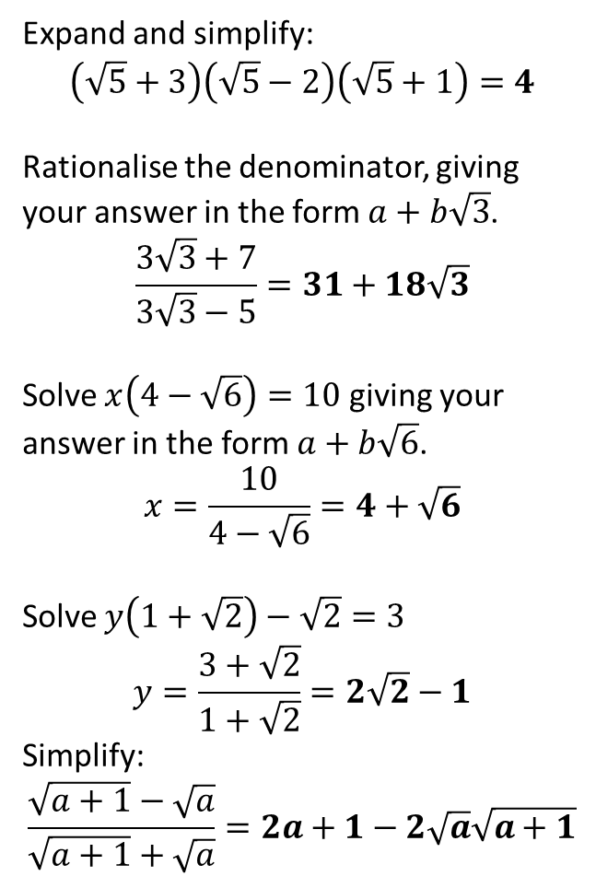
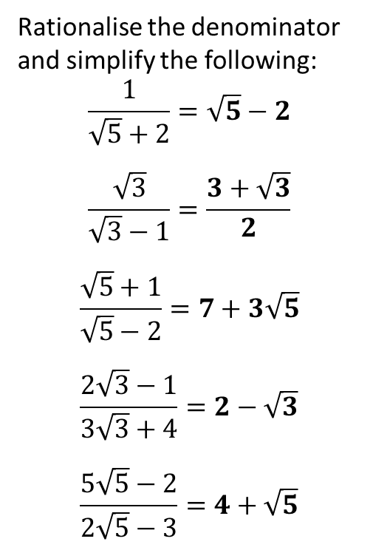
Exercise
1
Rationalise the denominator and simplify the following:
$$\frac{1}{\sqrt{5}+2}=\sqrt{5}−2$$
$$\frac{\sqrt{3}}{\sqrt{3}−1}=\frac{3+\sqrt{3}}{2}$$
$$\frac{\sqrt{5}+1}{\sqrt{5}−2}=7+3\sqrt{5}$$
$$\frac{2\sqrt{3}−1}{3\sqrt{3}+4}=2−\sqrt{3}$$
$$\frac{5\sqrt{5}−2}{2\sqrt{5}−3}=4+\sqrt{5}$$
2
Expand and simplify:
$$\left(\sqrt{5}+3\right)\left(\sqrt{5}−2\right)\left(\sqrt{5}+1\right)=4$$
Rationalise the denominator, giving your answer in the form $a+b\sqrt{3}$.
$$\frac{3\sqrt{3}+7}{3\sqrt{3}−5}=31+18\sqrt{3}$$
Solve $x\left(4−\sqrt{6}\right)=10$ giving your answer in the form $a+b\sqrt{6}$.
$$x=\frac{10}{4−\sqrt{6}}=4+\sqrt{6}$$
Solve $y\left(1+\sqrt{2}\right)−\sqrt{2}=3$
$$y=\frac{3+\sqrt{2}}{1+\sqrt{2}}=2\sqrt{2}−1$$
Simplify:
$$\frac{\sqrt{a+1}−\sqrt{a}}{\sqrt{a+1}+\sqrt{a}}=2a+1−2\sqrt{a}\sqrt{a+1}$$
?
?
a
3
?
b
?
c
?
4
?
?
d
?
5
e
?
6
?

Slide 9
A final super hard puzzle
Solve $\frac{\sqrt[4]{9}}{\sqrt[5]{27}}=\sqrt[x]{3}$
N
$$\frac{\sqrt[4]{3^{2}}}{\sqrt[5]{3^{3}}}=\frac{{\left(3^{2}\right)}^{\frac{1}{4}}}{{\left(3^{3}\right)}^{\frac{1}{5}}}=\frac{3^{\frac{1}{2}}}{3^{\frac{3}{5}}}=3^{−\frac{1}{10}}$$
But $\sqrt[x]{3}=3^{\frac{1}{x}}$
$$∴\frac{1}{x}=−\frac{1}{10} → x=−10$$
?

Slide 10
Exercise 1.6
Pearson Pure Mathematics Year 2/AS
Pages 5

Slide 11
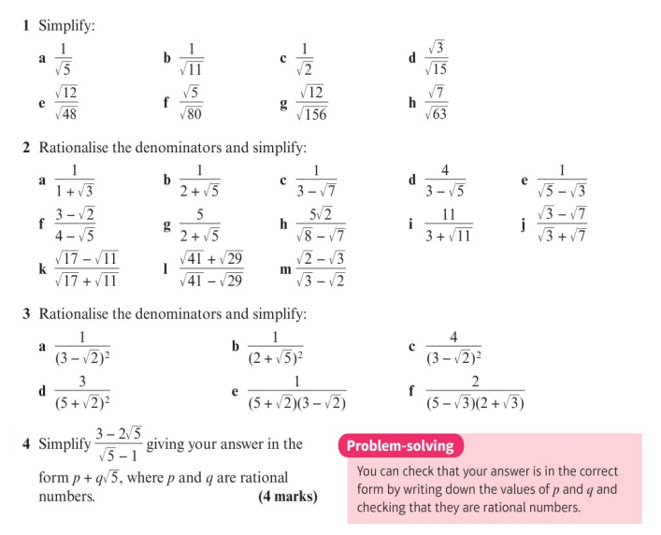
Homework Exercise

Slide 12
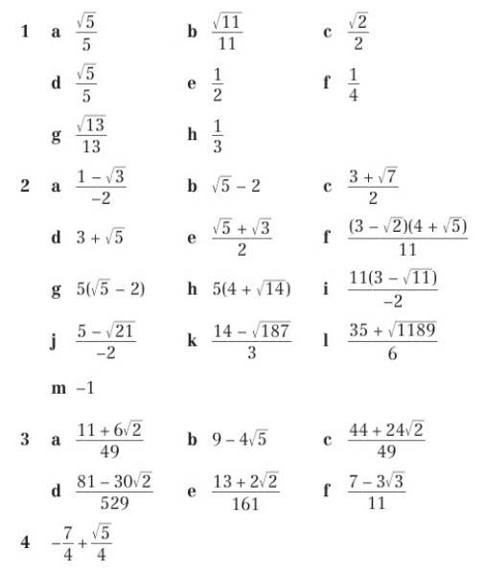
Homework Answers

