Slide 1
P2 Chapter 10: Numerical Methods Newton-Raphson

Slide 2


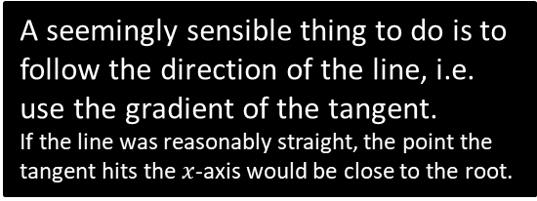




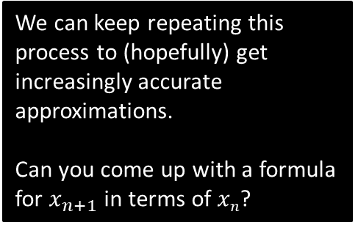


The Newton-Raphson Process
(also known as Newton’s method)
We wish to find the root $α$.
Suppose we start with the indicated approximation of the root, $x0$. Clearly this is well off the mark!
$$y$$
A seemingly sensible thing to do is to follow the direction of the line, i.e. use the gradient of the tangent.
If the line was reasonably straight, the point the tangent hits the $x$-axis would be close to the root.
$$y=f\left(x\right)$$
We can keep repeating this process to (hopefully) get increasingly accurate approximations.
Can you come up with a formula for $x_{n+1}$ in terms of $xn$?
$$α$$
$$x$$
$$x2$$
$$x1$$
$$x0$$

Slide 3

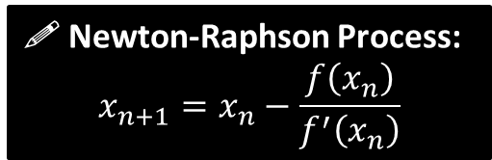




The Newton-Raphson Process
y
Formula:
?
Using Year 1 coordinate geometry:
$$y−f\left(x_{n}\right)=f^{′}\left(x_{n}\right)\left(x−x_{n}\right)$$
But we’re interested when
$x=x_{n+1}$ and $y=0$
$$−f\left(x_{n}\right)=f^{′}\left(x_{n}\right)\left(x_{n+1}−x_{n}\right)$$
which rearranges to give:
$$y=f\left(x\right)$$
! Newton-Raphson Process:
$$x_{n+1}=x_{n}−\frac{f\left(x_{n}\right)}{f^{′}\left(x_{n}\right)}$$
$$x$$
$$x_{n+1}$$
$$xn$$
Exam Note: Pearson didn’t include the above proof in their own textbook, so I can only presume you won’t be tested on the proof.

Slide 4
A nice animation…
Demo (Courtesy of Wikipedia)
This is German, but I’ll presume you’re not an idiot.

Slide 5

Example
Returning to our original example: $x=\cos\left(x\right)$, say letting $x_{0}=0.5$
(Note: Recall that differentiation assumes radians)
?
Let $f\left(x\right)=x−cos\left(x\right)$
$f^{′}\left(x\right)=1+sin x$
$$∴x_{n+1}=x_{n}−\frac{x_{n}−cos\left(x_{n}\right)}{1+sin\left(x_{n}\right)}$$
$$x_{1}=0.5−\frac{0.5−cos\left(0.5\right)}{1+sin\left(0.5\right)}=0.7552224171 \\ x_{2}=0.7391412 \\ x_{3}=0.7390851$$
After merely three iterations, our approximation is accurate to 7 decimal places. Holy smokes Batman!
This ensures we have an equation of the form $f\left(x\right)=0$
Tip: To perform iterations quickly, do the following on your calculator:
[0.5] [=]
[ANS] – (ANS – cos(ANS))/(1 + sin(ANS))
Then spam [=].

Slide 6
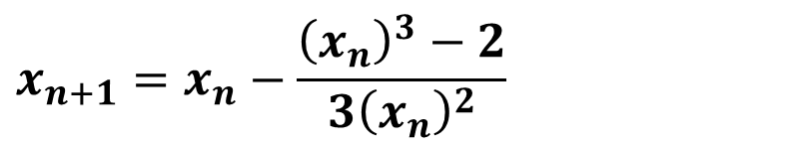
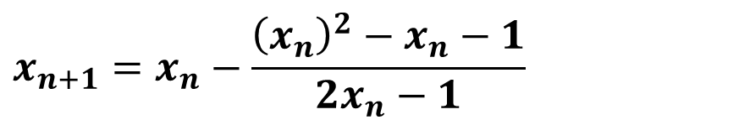


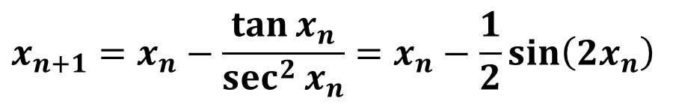

Quickfire Questions
Using the Newton-Raphson process, state the recurrence relation for the following functions:
$$x_{n+1}=x_{n}−\frac{{\left(x_{n}\right)}^{3}−2}{3{\left(x_{n}\right)}^{2}}$$
?
$$f\left(x\right)=x^{3}−2$$
$$x_{n+1}=x_{n}−\frac{\tan{x_{n}}}{\sec^{2}{x_{n}}}=x_{n}−\frac{1}{2}\sin\left(2x_{n}\right)$$
?
$$f\left(x\right)=\tan{x}$$
?
$$x_{n+1}=x_{n}−\frac{{\left(x_{n}\right)}^{2}−x_{n}−1}{2x_{n}−1}$$
$$f\left(x\right)=x^{2}−x−1$$

Slide 7
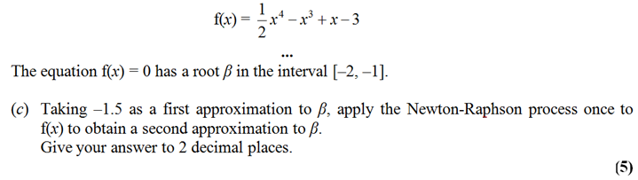


Example Exam Question
Edexcel FP1 June 2013(R) Q3c
?
$$x_{n+1}=x_{n}−\frac{\frac{1}{2}{\left(x_{n}\right)}^{4}−{\left(x_{n}\right)}^{3}+x_{n}−3}{2{\left(x_{n}\right)}^{3}−3{\left(x_{n}\right)}^{2}+1}$$
$$β_{1}=−1.5 −\frac{1.40625}{−12.5}=−1.3875$$

Slide 8
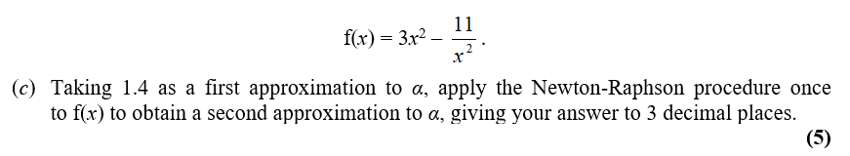

Test Your Understanding
Edexcel FP1 Jan 2010 Q2c
?

Slide 9

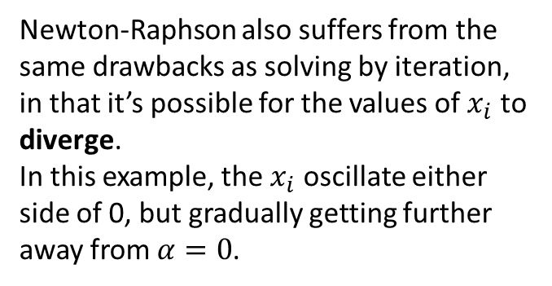




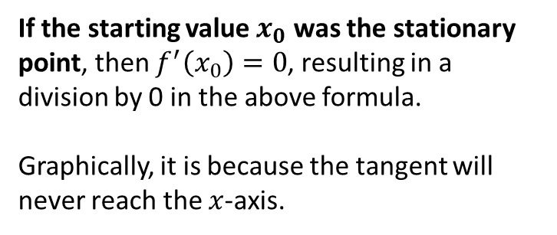




When does Newton-Raphson fail?
$$y$$
If the starting value $x_{0}$ was the stationary point, then $f^{′}\left(x_{0}\right)=0$, resulting in a division by 0 in the above formula.
Graphically, it is because the tangent will never reach the $x$-axis.
tangent
$$x_{0}$$
$$x$$
$$y=\frac{x}{\sqrt{1+x^{2}}}$$
$$y$$
Newton-Raphson also suffers from the same drawbacks as solving by iteration, in that it’s possible for the values of $x_{i}$ to diverge.
In this example, the $x_{i}$ oscillate either side of 0, but gradually getting further away from $α=0$.
$$x_{1}$$
$$x_{0}$$
$$x$$
$$x_{2}$$

Slide 10
Exercise 10.3
Pearson Pure Mathematics Year 2/AS
Page 84

Slide 11
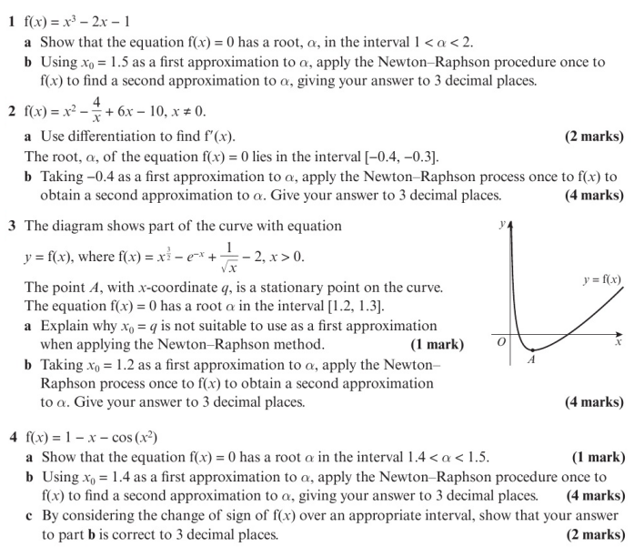
Homework Exercise

Slide 12
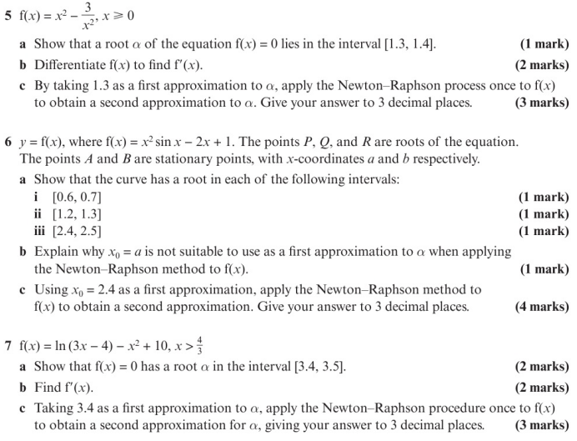
Homework Exercise

Slide 13
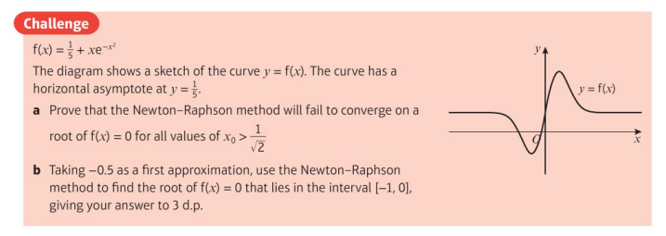
Homework Exercise

Slide 14
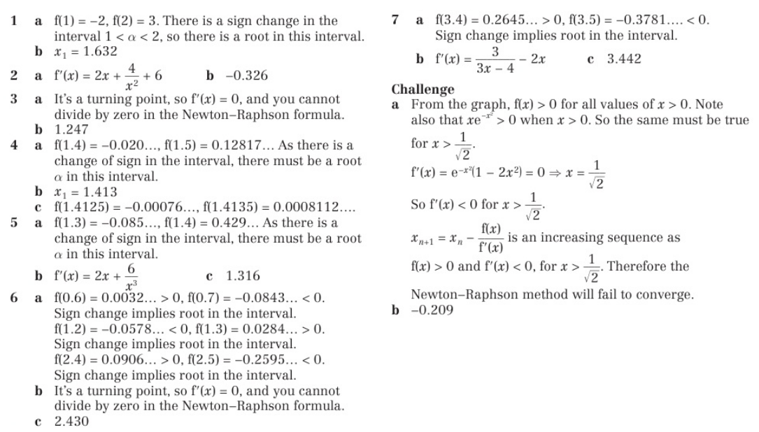
Homework Answers

