Slide 1
Stats1 Chapter 5: Probability Mutual Exclusion and Independence

Slide 2

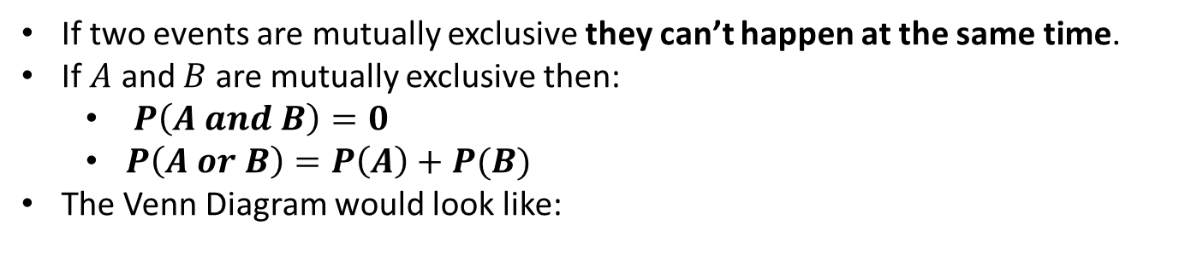
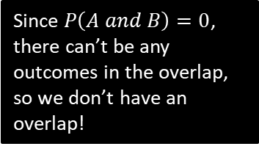


Mutually Exclusive Events
?
If two events are mutually exclusive they can’t happen at the same time.
If $A$ and $B$ are mutually exclusive then:
$P\left(A and B\right)=0$
$P\left(A or B\right)=P\left(A\right)+P(B)$
The Venn Diagram would look like:
?
?
$$S$$
?
$$A$$
$$B$$
Since $P\left(A and B\right)=0$, there can’t be any outcomes in the overlap, so we don’t have an overlap!

Slide 3
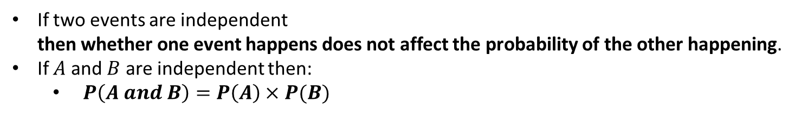

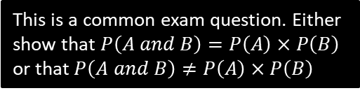
Independent Events
If two events are independent then whether one event happens does not affect the probability of the other happening.
If $A$ and $B$ are independent then:
$P\left(A and B\right)=P\left(A\right)×P(B)$
?
?
Note: Independence does not affect how the circles interact in a Venn Diagram.
1 2 3 4
Example
1
I pick one of the four numbers 1, 2, 3, 4 at random. What’s the probability that:
I pick a multiple of 2: $\frac{1}{2}$
I pick a multiple of 4: $\frac{1}{4}$
Explain (conceptually) why these two events are not independent.
If it is a multiple of 4, then it must also be a multiple of 2. But if it wasn’t a multiple of 4 then it may or may not be a multiple of 2. So the events are linked and whether one happened influences the probability of the other happening.
Show that the events are not independent.
$$P\left(multiple of 2\right)×P\left(multiple of 4\right)=\frac{1}{2}×\frac{1}{4}=\frac{1}{8} \\ P\left(multiple of 2 and multiple of 4\right)=\frac{1}{4}$$
But $\frac{1}{8}≠\frac{1}{4}$ therefore not independent.
?
?
2
?
3
?
This is a common exam question. Either show that $P\left(A and B\right)=P\left(A\right)×P\left(B\right)$ or that $P\left(A and B\right)≠P\left(A\right)×P\left(B\right)$

Slide 4


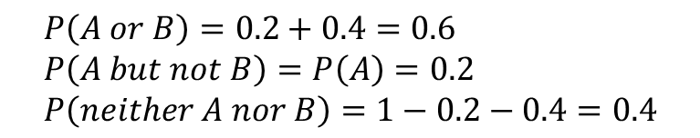



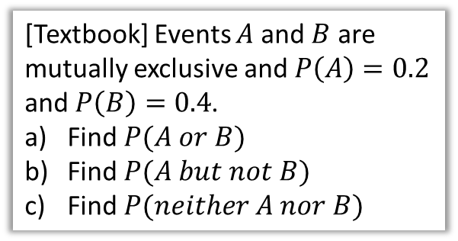

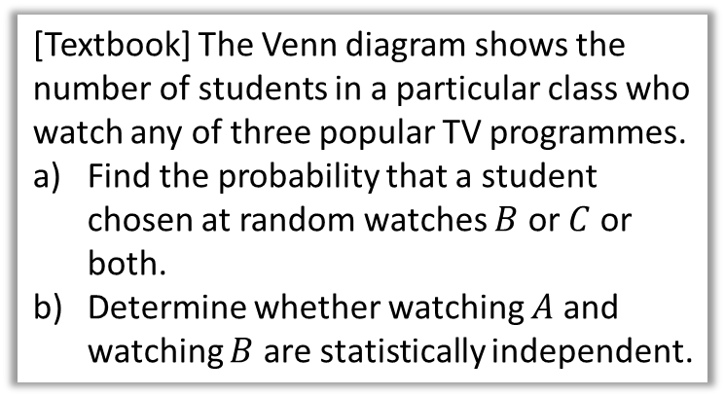

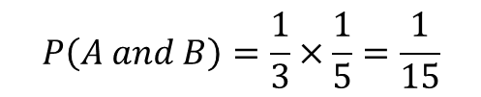


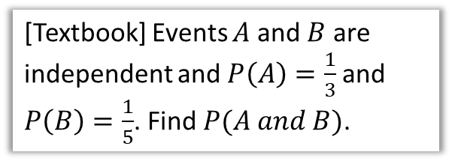


Further Examples
[Textbook] Events $A$ and $B$ are mutually exclusive and $P\left(A\right)=0.2$ and $P\left(B\right)=0.4$.
Find $P(A or B)$
Find $P(A but not B)$
Find $P(neither A nor B)$
[Textbook] The Venn diagram shows the number of students in a particular class who watch any of three popular TV programmes.
Find the probability that a student chosen at random watches $B$ or $C$ or both.
Determine whether watching $A$ and watching $B$ are statistically independent.
?
$$P\left(A or B\right)=0.2+0.4=0.6 \\ P\left(A but not B\right)=P\left(A\right)=0.2 \\ P\left(neither A nor B\right)=1−0.2−0.4=0.4$$
$$S$$
$$B$$
$$A$$
$$C$$
[Textbook] Events $A$ and $B$ are independent and $P\left(A\right)=\frac{1}{3}$ and $P\left(B\right)=\frac{1}{5}$. Find $P(A and B)$.
$$3$$
$$4$$
$$5$$
$$10$$
$$7$$
$$1$$
$$P\left(watches B or C\right)=\frac{26}{30}$$
$$P\left(A\right)=\frac{7}{30} P\left(B\right)=\frac{19}{30} \\ P\left(A and B\right)=\frac{4}{30} \\ P\left(A\right)×P\left(B\right)=\frac{7}{30}×\frac{19}{30}=\frac{133}{900}≠\frac{4}{30}$$ $∴$ not independent.
?
$$P\left(A and B\right)=\frac{1}{3}×\frac{1}{5}=\frac{1}{15}$$
?

Slide 5









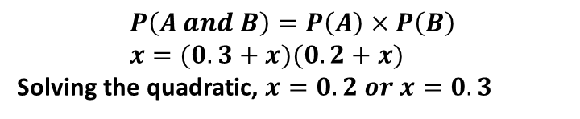

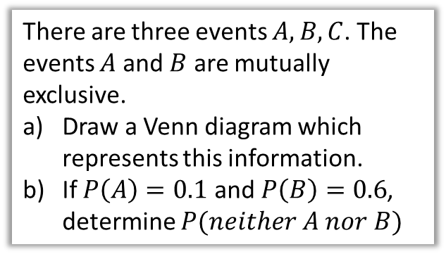

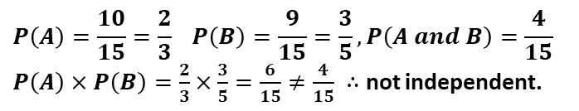






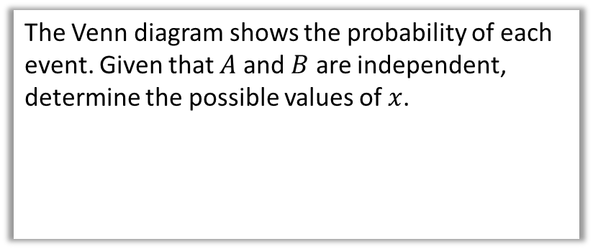


Test Your Understanding
There are three events $A,B,C$. The events $A$ and $B$ are mutually exclusive.
Draw a Venn diagram which represents this information.
If $P\left(A\right)=0.1$ and $P\left(B\right)=0.6$, determine $P(neither A nor B)$
The Venn diagram shows the number of people who like each of two different colours. Determine if $A$ and $B$ are independent.
$$A$$
$$B$$
$$6$$
$$4$$
$$5$$
$$0$$
$$P\left(A\right)=\frac{10}{15}=\frac{2}{3} P\left(B\right)=\frac{9}{15}=\frac{3}{5}, P\left(A and B\right)=\frac{4}{15}$$ $P\left(A\right)×P\left(B\right)=\frac{2}{3}×\frac{3}{5}=\frac{6}{15}≠\frac{4}{15} ∴$ not independent.
?
?
$$S$$
$$C$$
$$A$$
$$B$$
The Venn diagram shows the probability of each event. Given that $A$ and $B$ are independent, determine the possible values of $x$.
Note that $C$ may occur with $A$ or with $B$, as we’re not told otherwise.
$$A$$
$$B$$
$$0.3$$
$$x$$
$$0.2$$
$$y$$
$$P\left(neither A nor B\right) \\ =1−0.1−0.6=0.3$$
$$P\left(A and B\right)=P\left(A\right)×P\left(B\right) \\ x=(0.3+x)(0.2+x)$$
Solving the quadratic, $x=0.2 or x=0.3$
?

Slide 6
Exercise 5.3
Pearson Applied Year 1/AS
Pages 34-35

Slide 7
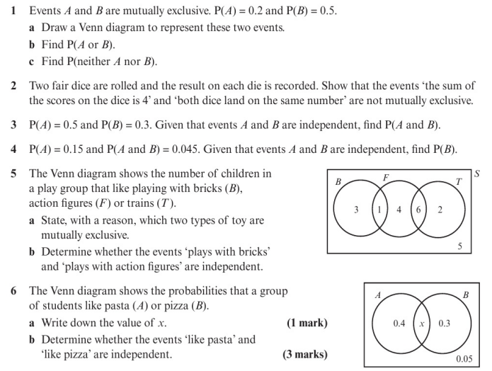
Homework Exercise

Slide 8
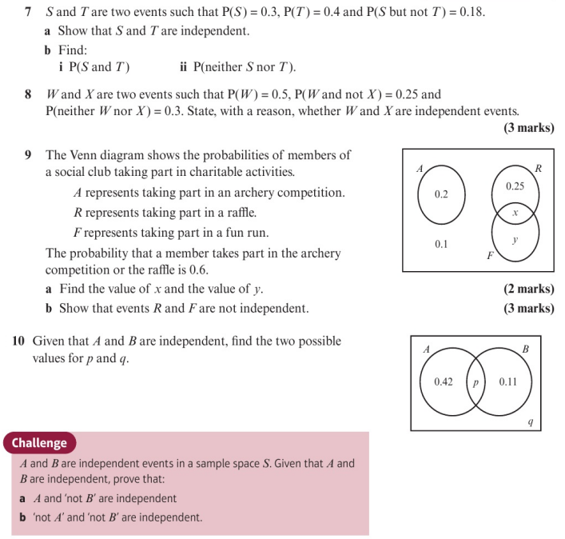
Homework Exercise

Slide 9
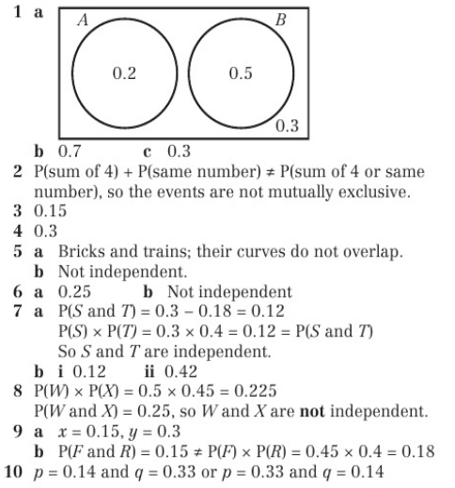
Homework Answers

Slide 10
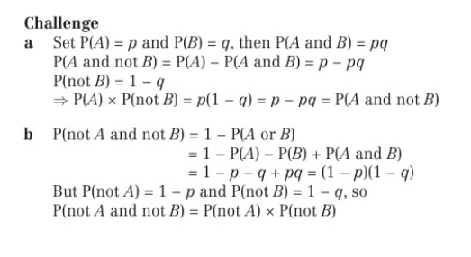
Homework Answers

