Slide 1
P1 Chapter 5: Linear Graphs Length and Area

Slide 2








Distances between points
Recall: $Δ$ (said ‘delta’) means “change in”.
How could we find the distance between these two points?
Hint: Pythagoras
Form a right-angled triangle using the change in $x$ and change in $y$, then use Pythagoras.
$$(5,9)$$
?
?
$$5$$
?
?
$$Δy=3$$
$$(1,6)$$
?
$$Δx=4$$
! Distance between two points:
$$\sqrt{{\left(Δx\right)}^{2}+{\left(Δy\right)}^{2}}$$

Slide 3
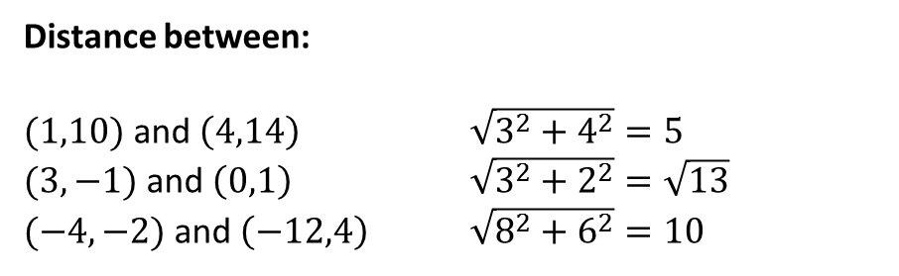
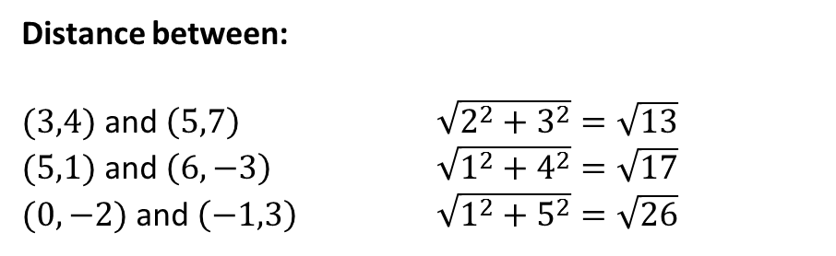
Examples
Distance between:
$(3,4)$ and $\left(5,7\right)$ $\sqrt{2^{2}+3^{2}}=\sqrt{13}$
$(5,1)$ and $\left(6,−3\right)$ $\sqrt{1^{2}+4^{2}}=\sqrt{17}$
$(0,−2)$ and $\left(−1,3\right)$ $\sqrt{1^{2}+5^{2}}=\sqrt{26}$
?
?
Fro Note: Unlike with gradient, we don’t care if the difference is positive or negative (it’s being squared to make it positive anyway!)
?
Quickfire Questions:
Distance between:
$(1,10)$ and $\left(4,14\right)$ $\sqrt{3^{2}+4^{2}}=5$
$(3,−1)$ and $\left(0,1\right)$ $\sqrt{3^{2}+2^{2}}=\sqrt{13}$
$(−4,−2)$ and $\left(−12,4\right)$ $\sqrt{8^{2}+6^{2}}=10$
?
?
?

Slide 4




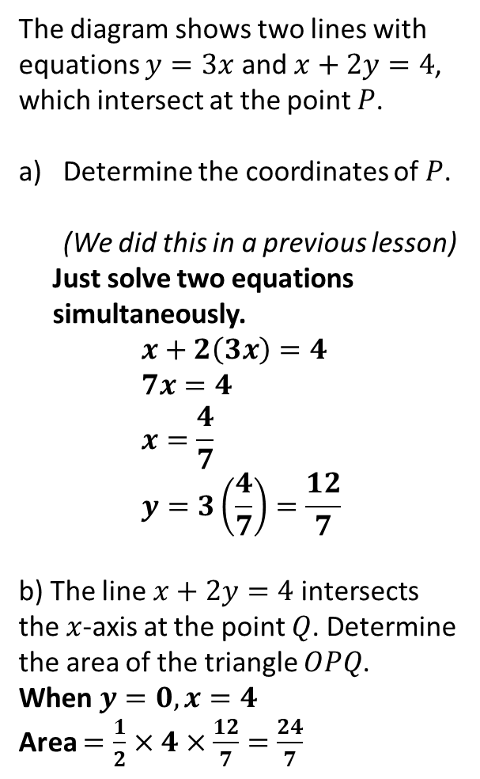



Area of Shapes
The diagram shows two lines with equations $y=3x$ and $x+2y=4$, which intersect at the point $P$.
Determine the coordinates of $P$. (We did this in a previous lesson)
Just solve two equations simultaneously. $$x+2\left(3x\right)=4 \\ 7x=4 \\ x=\frac{4}{7} \\ y=3\left(\frac{4}{7}\right)=\frac{12}{7}$$
b) The line $x+2y=4$ intersects the $x$-axis at the point $Q$. Determine the area of the triangle $OPQ$.
When $y=0, x=4$
Area $=\frac{1}{2}×4×\frac{12}{7}=\frac{24}{7}$
$$y$$
$$y=3x$$
$$P$$
$$x+2y=4$$
$$x$$
$$O$$
$$Q$$
?

Slide 5







Further Example
a
Determine the length of $PQ$.
$$x=8−y \\ 2y=8−y+4 \\ 3y=12 \\ y=4 → x=4 \\ P(4,4)$$
When $x=0$
$$2y=4 \\ y=2 \\ Q(0,2)$$
Distance $PQ$:
$$\sqrt{4^{2}+2^{2}}=\sqrt{20}$$
$$y$$
?
$$2y=x+4$$
$$R$$
$$P$$
$$Q$$
$$x+y=8$$
$$x$$
$$O$$
Fro Tip: When finding areas of triangles in exam questions, one line is often vertical or horizontal. You should generally choose this to be the ‘base’ of your triangle.
b
Determine the area $PQR$.
$$R\left(0,8\right)$$
Use $RQ$ as the base: $$∴Area=\frac{1}{2}×6×4=12$$
?

Slide 6






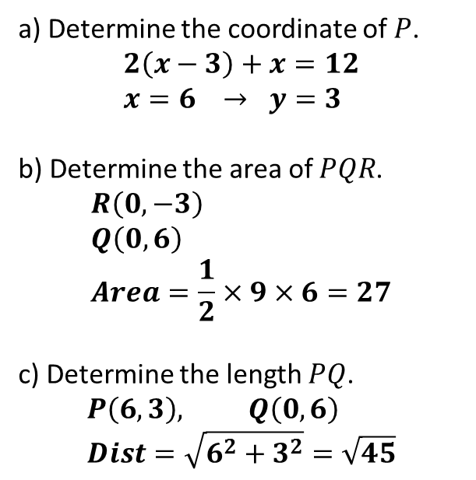
Test Your Understanding
$$y$$
a) Determine the coordinate of $P$.
$$2\left(x−3\right)+x=12 \\ x=6 → y=3$$
b) Determine the area of $PQR$.
$$R\left(0,−3\right) \\ Q\left(0,6\right) \\ Area=\frac{1}{2}×9×6=27$$
c) Determine the length $PQ$.
$$P\left(6,3\right), Q\left(0,6\right) \\ Dist=\sqrt{6^{2}+3^{2}}=\sqrt{45}$$
$$Q$$
$$2y+x=12$$
$$y=x−3$$
?
$$P$$
?
$$O$$
$$x$$
?
$$R$$

Slide 7
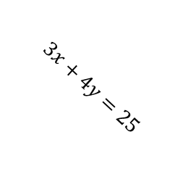


Exercise 5.4
Pearson Pure Mathematics Year 1/AS
Page 40
Extension Problems
1
[MAT 2001 1C]
The shortest distance from the origin to the line $3x+4y=25$ is what?
Gradient of $3x+4y=25$ is $−\frac{3}{4}$. Therefore gradient of line going through origin and closest point is $\frac{4}{3}$ (see diagram). This line therefore has equation $y=\frac{4}{3}x$
Solving two equations simultaneously, we get point of intersection $A(3,4)$.
Therefore distance $OA=\sqrt{3^{2}+4^{2}}=5$.
?
$$3x+4y=25$$
$$\left(0,0\right)$$

Slide 8
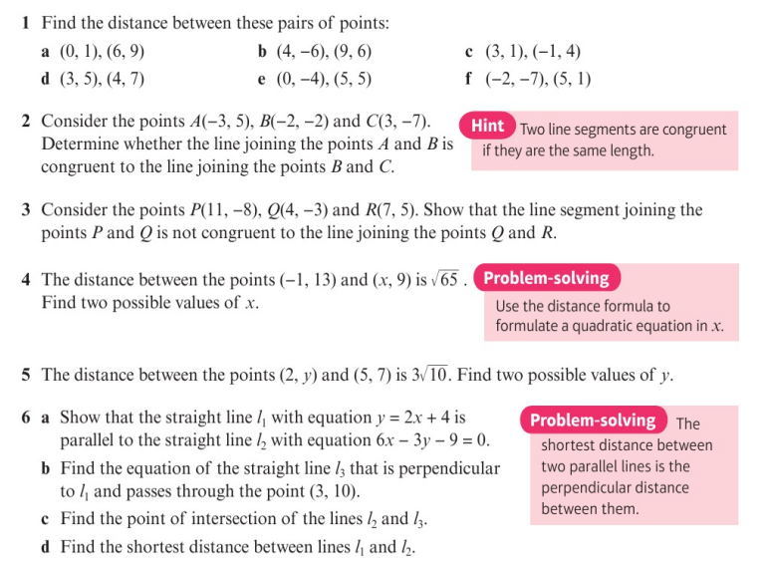
Homework Exercise

Slide 9
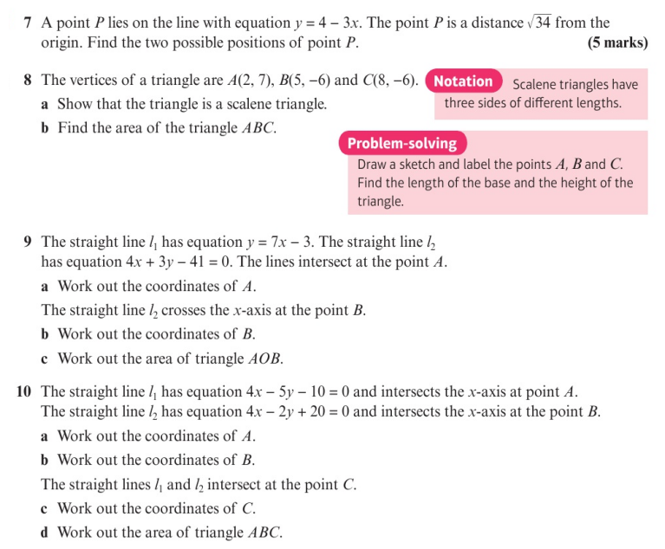
Homework Exercise

Slide 10
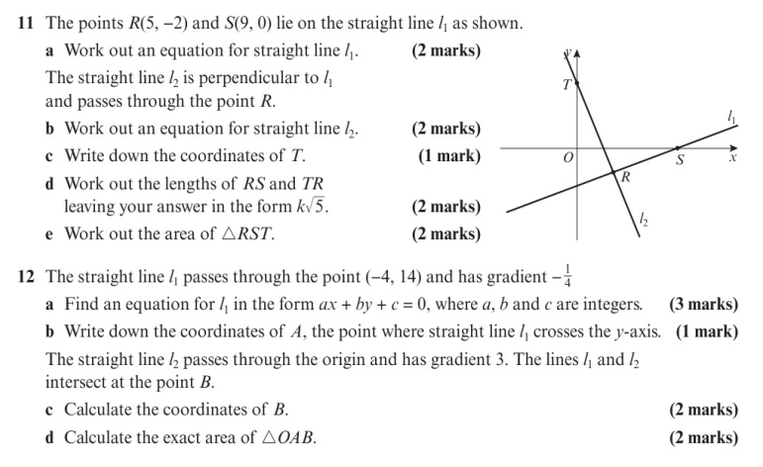
Homework Exercise

Slide 11
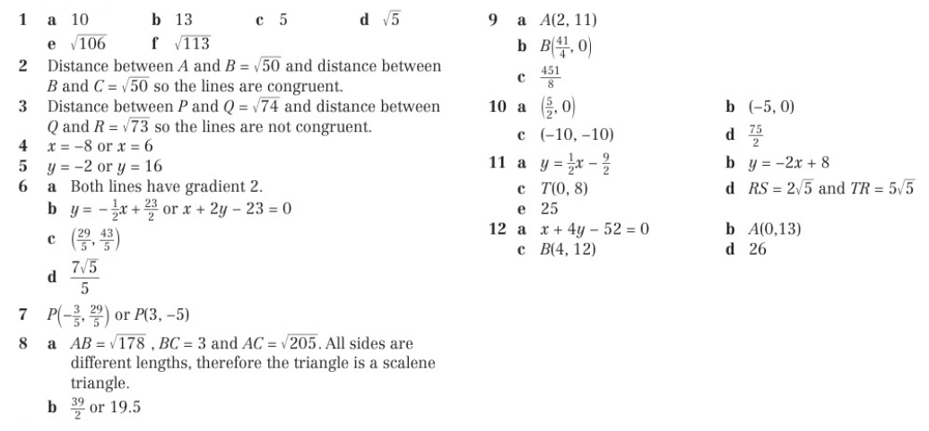
Homework Answers

