Slide 1
Stats1 Chapter 4: Correlation Correlated Variables

Slide 2
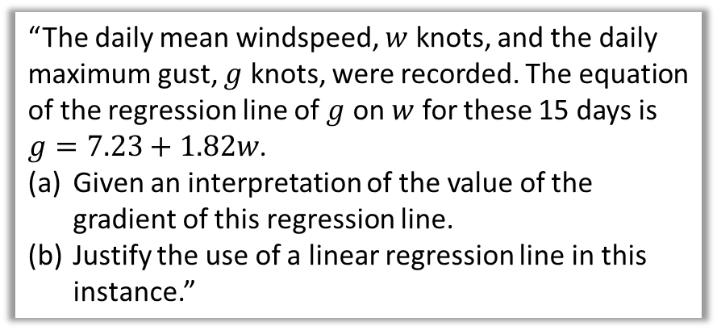
This Chapter Overview
Previously we have only considered one variable at a time. When we introduce a second variable (e.g. height with age), we might want to consider the relationship between them.
This is a short chapter!
Hourly pay at 25
“Describe the type of correlation.”
20
15
5
0
Hourly Pay (£)
“The daily mean windspeed, $w$ knots, and the daily maximum gust, $g$ knots, were recorded. The equation of the regression line of $g$ on $w$ for these 15 days is $g=7.23+1.82w$.
Given an interpretation of the value of the gradient of this regression line.
Justify the use of a linear regression line in this instance.”
15 20 25
Age (years)

Slide 3
Recap of correlation
Correlation gives the strength of the relationship (and the type of relationship) between two variables. Data with two variables is known as bivariate data.
Weak negative correlation
?
?
Type of correlation:
Weak positive correlation
?
?
strength
type
No correlation
?
?
Strong positive correlation
?
The vertical-axis variable usually depends on the horizontal-axis value. For this reason distance would be the independent/explanatory variable and cost the dependent/response variable.

Slide 4
Important correlation concepts
Important Point 1
To interpret the correlation between two variables is to give a worded description in the context of the problem.
State the correlation shown.
Describe/interpret the relationship between age and weekly time on the internet.
?
Negative correlation.
As age increases, the weekly time on the internet tends to decrease.
?
Important Point 2
[Textbook] Two variables have a causal relationship if a change in one variable directly causes a change in the other. Just because two variables show correlation it does not necessarily mean that they have a causal relationship.
Hourly pay at 25
20
15
5
0
Hideko was interested to see if there was a relationship between what people earn and the age which they left education or training. She says her data supports the conclusion that more education causes people to earn a lower hourly rate of pay. Give one reason why Hideko’s conclusion might not be valid.
Hourly Pay (£)
15 20 25
“Respondents who left education later would have significantly less work experience than those who left education earlier. This could be the cause of the reduced income shown in her results.”
?
Age (years)

Slide 5
Exercise 4.1
Pearson Statistics/Mechanics Year 1/AS
Pages 26-27

Slide 6
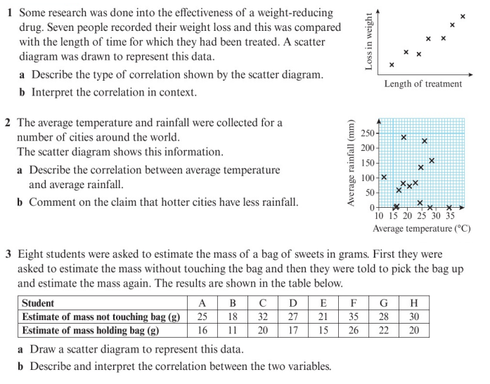
Homework Exercise

Slide 7
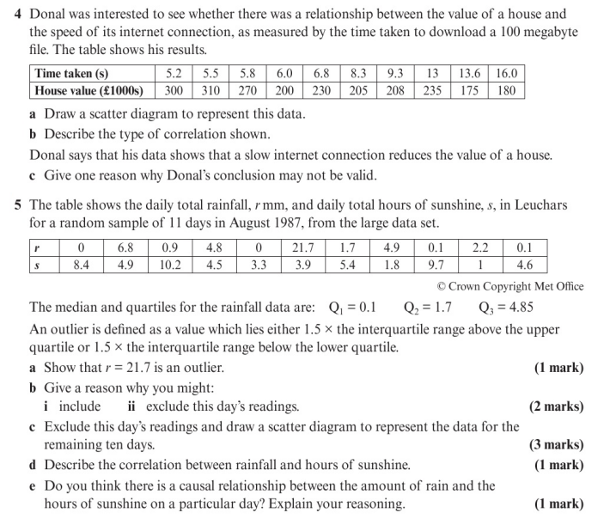
Homework Exercise

Slide 8
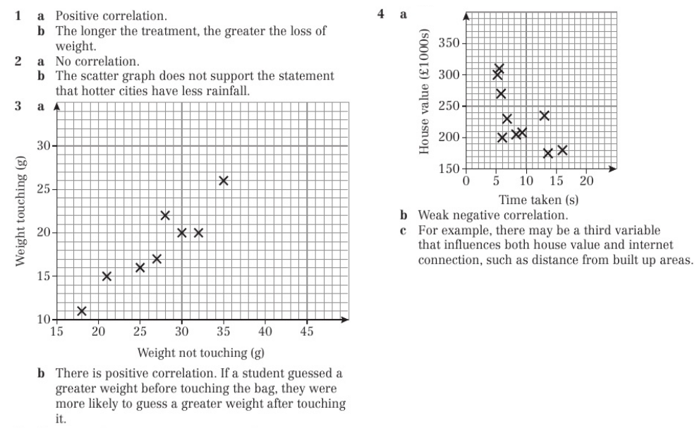
Homework Answers

Slide 9
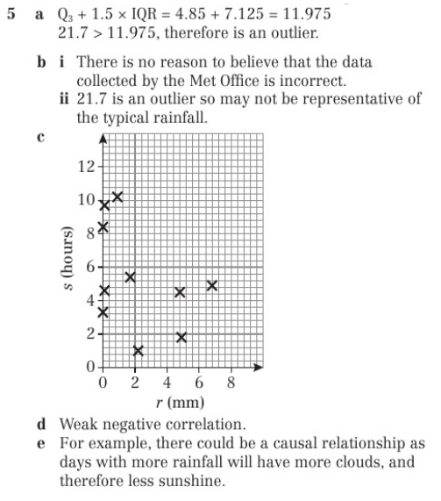
Homework Answers

