Slide 1
P2 Chapter 6: CoAngle Trigonometry
Using Cotangents

Slide 2

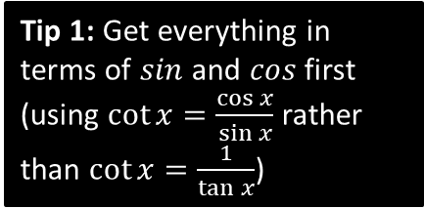
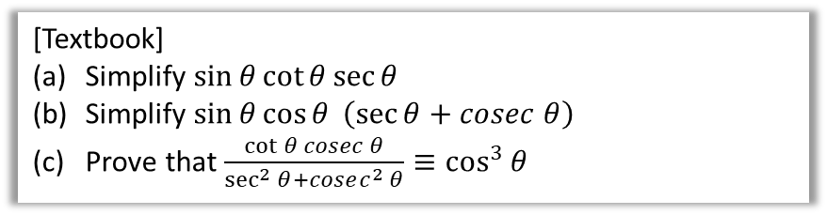

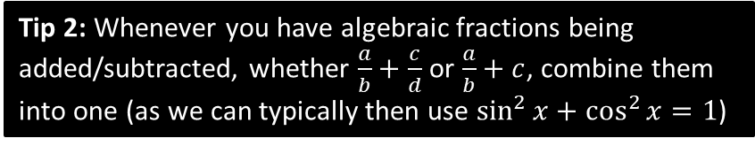

Using $sec,cosec,cot$
Questions in the exam usually come in two flavours: (a) ‘provey’ questions requiring to prove some identity and (b) ‘solvey’ questions.
[Textbook]
Simplify $\sin{θ}\cot{θ}\sec{θ}$
Simplify $\sin{θ}\cos{θ} \left(\sec{θ}+cosec θ\right)$
Prove that $\frac{\cot{θ} cosec θ}{\sec^{2}{θ}+cosec^{2} θ}≡\cos^{3}{θ}$
Tip 1: Get everything in terms of $sin$ and $cos$ first (using $\cot{x}=\frac{\cos{x}}{\sin{x}}$ rather than $\cot{x}=\frac{1}{\tan{x}}$)
Tip 2: Whenever you have algebraic fractions being added/subtracted, whether $\frac{a}{b}+\frac{c}{d}$ or $\frac{a}{b}+c$, combine them into one (as we can typically then use $\sin^{2}{x}+\cos^{2}{x}=1$)
$$\frac{\cot{θ} cosec θ}{\sec^{2}{θ}+cosec^{2} θ}≡\frac{\frac{\cos{θ}}{\sin{θ}}×\frac{1}{\sin{θ}}}{\frac{1}{\cos^{2}{θ}}+\frac{1}{\sin^{2}{θ}}} \\ ≡\frac{\left(\frac{\cos{θ}}{\sin^{2}{θ}}\right)}{\left(\frac{\sin^{2}{θ}+\cos^{2}{θ}}{\sin^{2}{θ}\cos^{2}{θ}}\right)}≡\frac{\left(\frac{\cos{θ}}{\sin^{2}{θ}}\right)}{\left(\frac{1}{\sin^{2}{θ}\cos^{2}{θ}}\right)} \\ ≡\frac{\cos^{3}{θ}}{1} \\ ≡\cos^{3}{θ}$$
$$\sin{θ}\cot{θ}\sec{θ}≡\sin{θ}×\frac{\cos{θ}}{\sin{θ}}×\frac{1}{\cos{θ}}≡1$$
$$\sin{θ}\cos{θ} \left(\sec{θ}+cosec θ\right) \\ =\sin{θ}\cos{θ}\left(\frac{1}{\cos{θ}}+\frac{1}{\sin{θ}}\right) \\ =\sin{θ}\cos{θ}\left(\frac{\sin{θ}+\cos{θ}}{\sin{θ}\cos{θ}}\right) \\ =\sin{θ}+\cos{θ}$$
c
?
a
?
b
?
Multiply top and bottom by $\sin^{2}{θ}\cos^{2}{θ}$

Slide 3
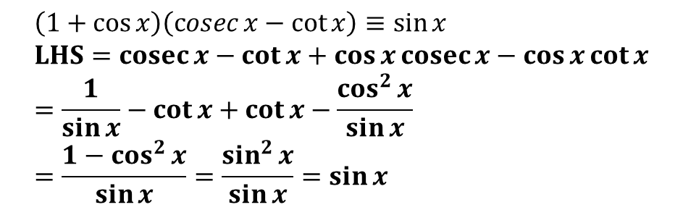

Test Your Understanding
$$\sec{x}−\cos{x}≡\sin{x}\tan{x} \\ LHS=\frac{1}{\cos{x}}−\cos{x} \\ =\frac{1−\cos^{2}{x}}{\cos{x}} \\ =\frac{\sin^{2}{x}}{\cos{x}} \\ =\sin{x}\tan{x}$$
1
?
2
$$\left(1+\cos{x}\right)\left(\operatorname{cosec}{x}−\cot{x}\right)≡\sin{x} \\ LHS=cosec{x}−\cot{x}+\cos{x}\operatorname{cosec}{x}−\cos{x}\cot{x} \\ =\frac{1}{\sin{x}}−\cot{x}+\cot{x}−\frac{\cos^{2}{x}}{\sin{x}} \\ =\frac{1−\cos^{2}{x}}{\sin{x}}=\frac{\sin^{2}{x}}{\sin{x}}=\sin{x}$$
?

Slide 4





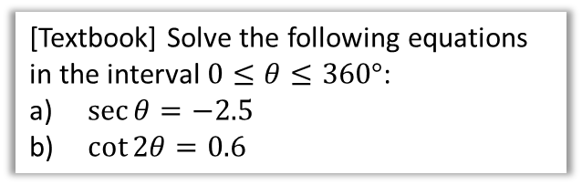

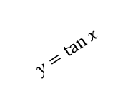

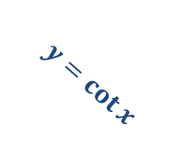


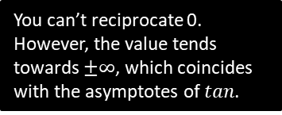
Solvey Questions
[Textbook] Solve the following equations in the interval $0≤θ≤360°$:
$\sec{θ}=−2.5$
$\cot{2θ}=0.6$
Solve $\cot{θ}=0$ in the interval $0≤θ≤2π$.
?
$$\cot{θ}=0 \\ ∴\tan{θ}→∞ \\ θ=\frac{π}{2},\frac{3π}{2}$$
You can’t reciprocate 0. However, the value tends towards $±∞$, which coincides with the asymptotes of $tan$.
a
$$\sec{θ}=−2.5 \\ \cos{θ}=−0.4 \\ θ=113.6°, 246.5°$$
$$\cot{2θ}=0.6 0≤2θ≤720° \\ \tan{2θ}=\frac{5}{3} \\ 2θ=59.0°, 239.0°, 419.0°, 599.0° \\ θ=29.5°, 120°, 210°, 300° (3sf)$$
?
Reciprocate both sides.
$$y$$
b
?
$$y=\tan{x}$$
$$y=\cot{x}$$
$$x$$
$$\frac{1}{2}π$$
$$π$$
$$\frac{3}{2}π$$
$$2π$$

Slide 5
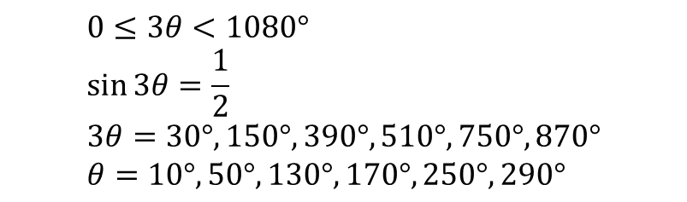
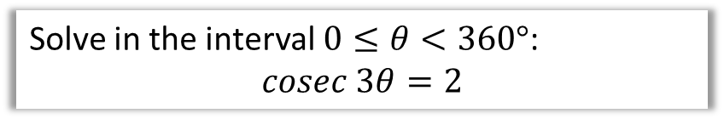
Test Your Understanding
Solve in the interval $0≤θ<360°$:
$$cosec 3θ=2$$
?
$$0≤3θ<1080° \\ \sin{3θ}=\frac{1}{2} \\ 3θ=30°, 150°, 390°, 510°,750°, 870° \\ θ=10°, 50°,130°, 170°,250°,290°$$

Slide 6
Exercise 6.3
Pearson Pure Mathematics Year 2/AS
Page 45

Slide 7
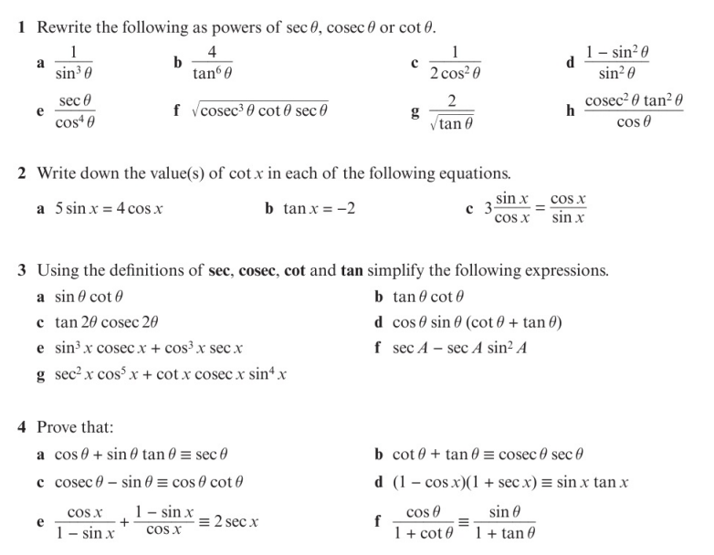
Homework Exercise

Slide 8
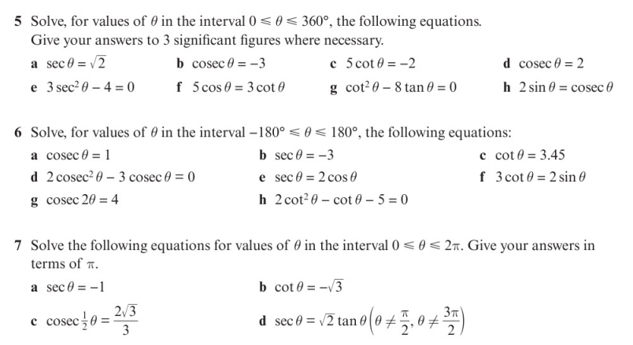
Homework Exercise

Slide 9
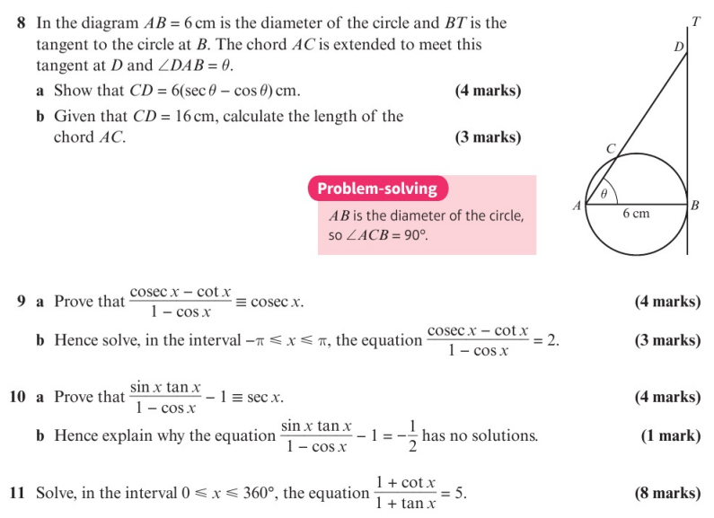
Homework Exercise

Slide 10
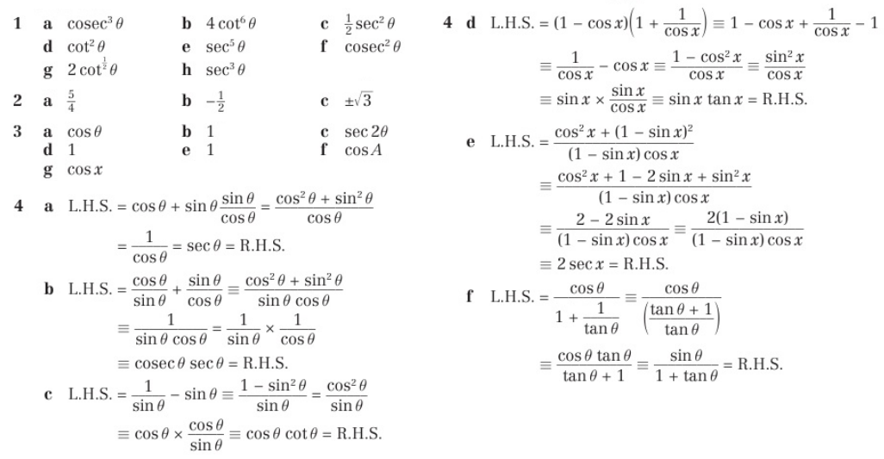
Homework Answers

Slide 11
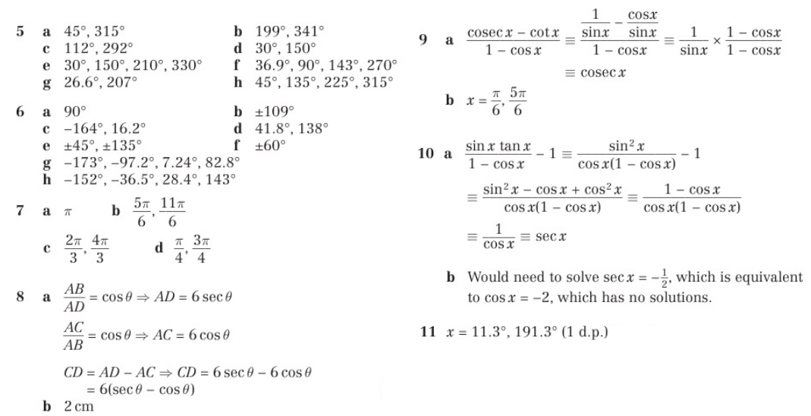
Homework Answers

