Slide 1
P2 Chapter 1: CoTrigonometry
Chapter Practice

Slide 2
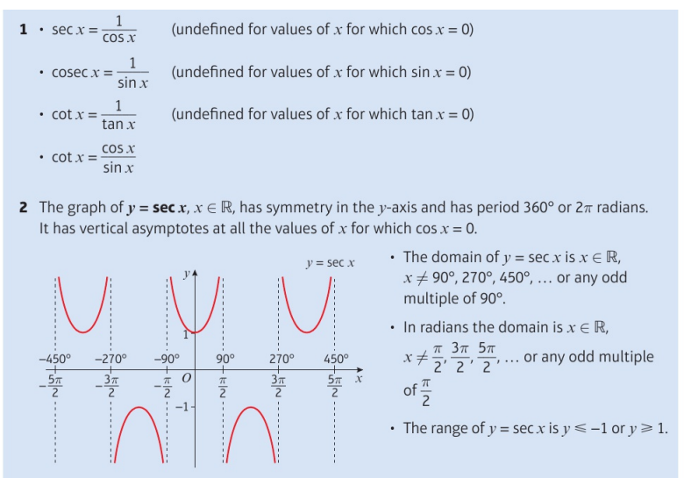
Key Points

Slide 3
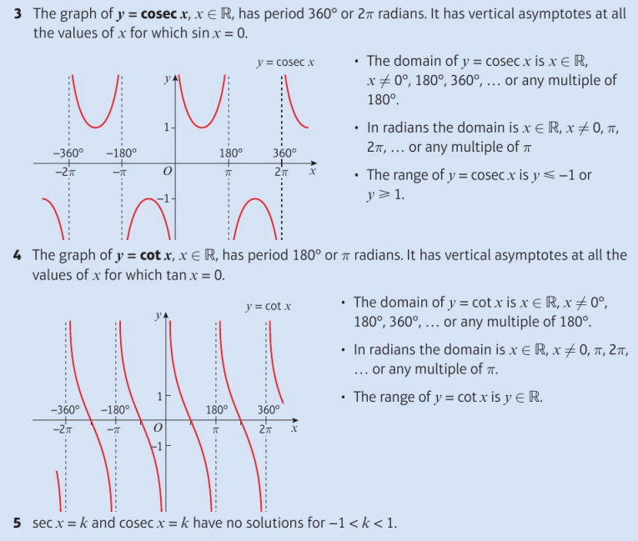
Key Points

Slide 4
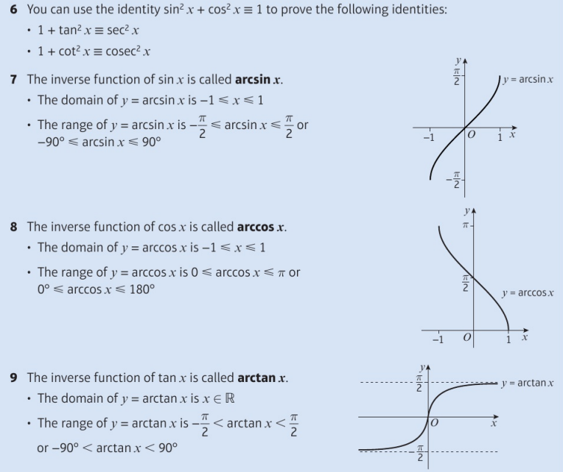
Key Points

Slide 5
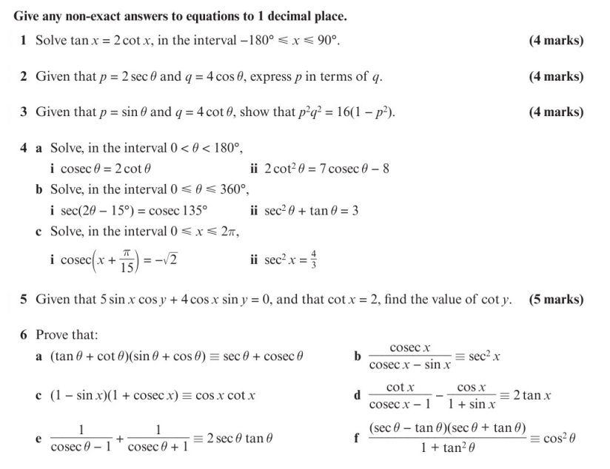
Chapter Exercises

Slide 6
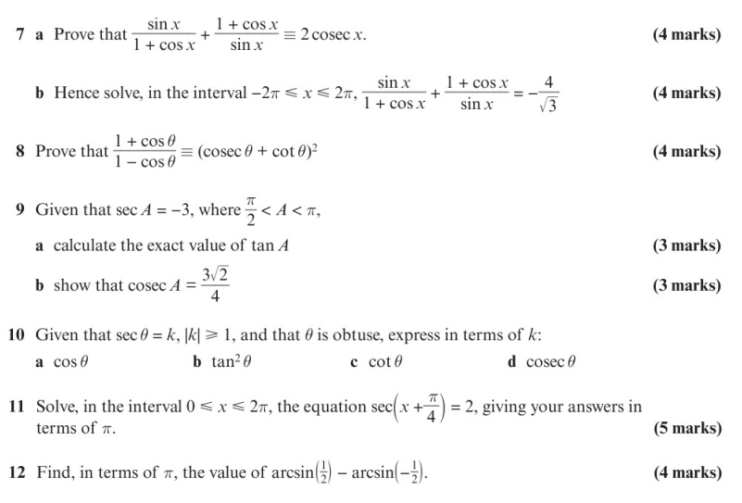
Chapter Exercises

Slide 7
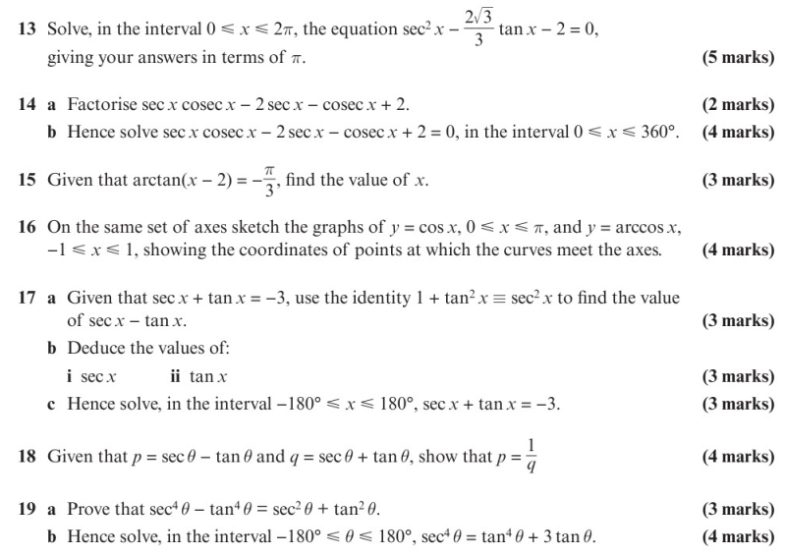
Chapter Exercises

Slide 8
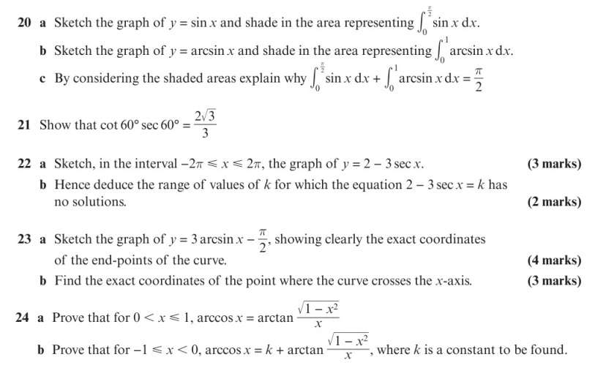
Chapter Exercises

Slide 9
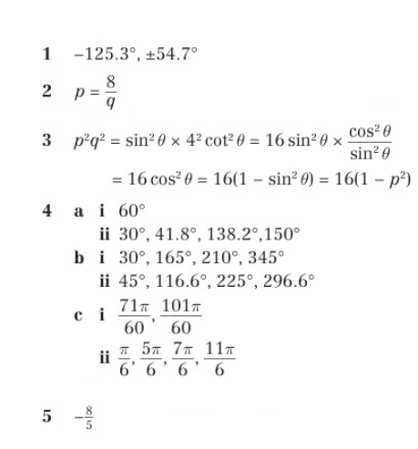
Chapter Answers

Slide 10
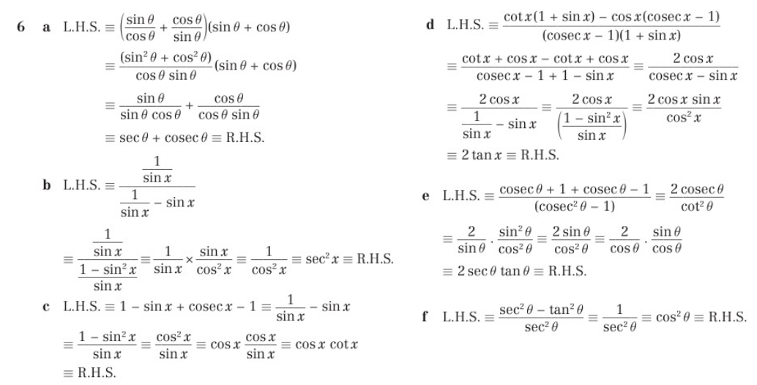
Chapter Answers

Slide 11
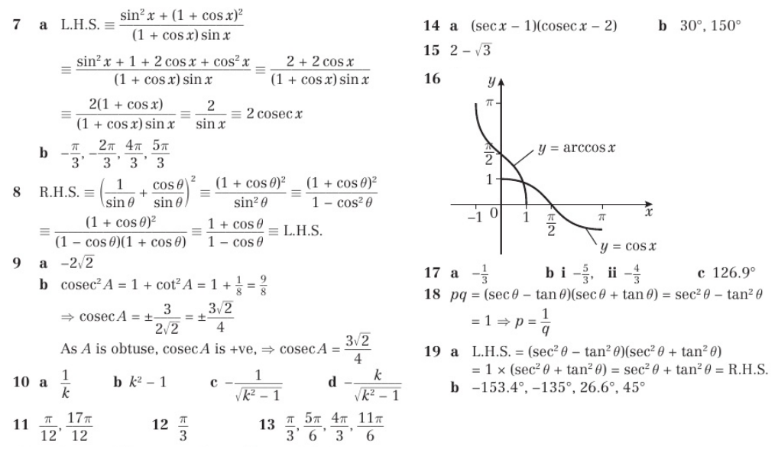
Chapter Answers

Slide 12
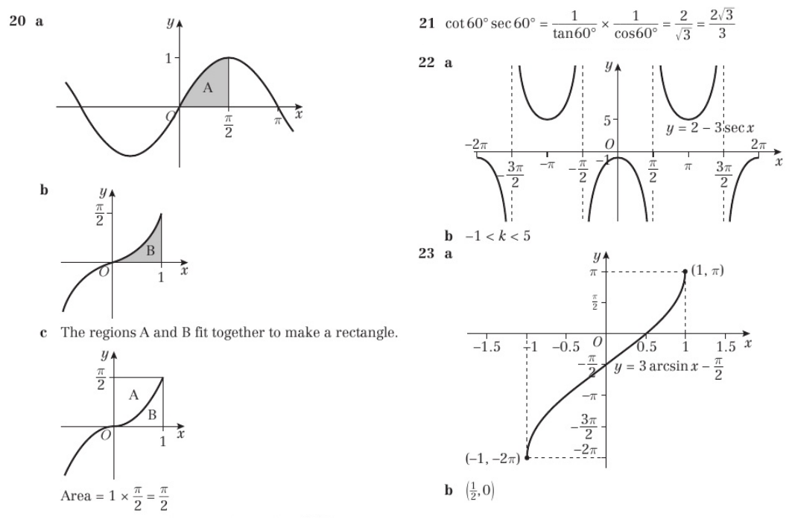
Chapter Answers

Slide 13
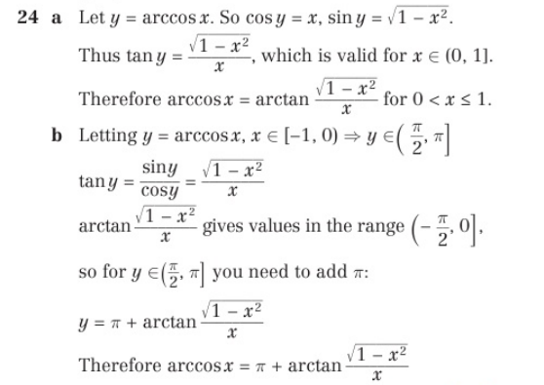
Chapter Answers

