Slide 1
P1 Chapter 13: Integration
Definite Integrals

Slide 2





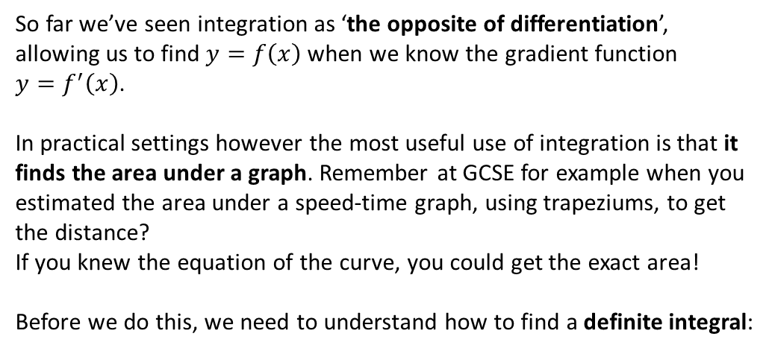




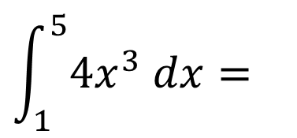

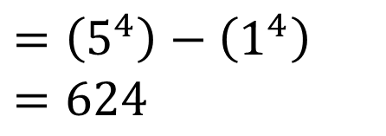
Definite Integration
So far we’ve seen integration as ‘the opposite of differentiation’, allowing us to find $y=f\left(x\right)$ when we know the gradient function
$y=f^{′}\left(x\right)$.
In practical settings however the most useful use of integration is that it finds the area under a graph. Remember at GCSE for example when you estimated the area under a speed-time graph, using trapeziums, to get the distance?
If you knew the equation of the curve, you could get the exact area!
Before we do this, we need to understand how to find a definite integral:
speed
$$Area=distance$$
time
These are known as limits, which give the values of $x$ we’re finding the area between.
We integrate as normal, but put expression in square brackets, meaning we still need to evaluate the integrated expression using the limits.
$$y$$
$$y=4x^{3}$$
$$\int_{1}^{5}{4x^{3} dx}=$$
$${\left[x^{4}\right]}_{1}^{5}$$
$$=\left(5^{4}\right)−\left(1^{4}\right) \\ =624$$
$$?$$
$$Area=distance$$
$$x$$
$$1$$
$$5$$
Write $\left(…\right)−(…)$ and evaluate the expression for each of the limits, top one first.

Slide 3
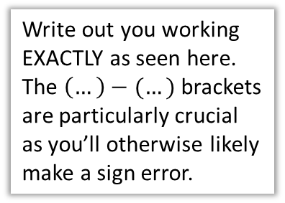

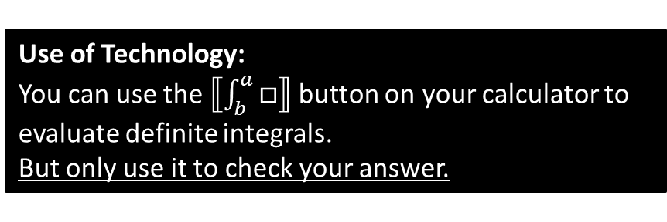
Another Example
?
$$\int_{−3}^{3}{x^{2}+1 dx}={\left[\frac{1}{3}x^{3}+x\right]}_{−3}^{3} \\ =\left(\frac{1}{3}{\left(3\right)}^{3}+3\right)−\left(\frac{1}{3}{\left(−3\right)}^{3}−3\right) \\ =12−−12 \\ =24$$
We DON’T have a constant of integration when doing definite integration. I’ll explain why later.
?
?
Write out you working EXACTLY as seen here. The $\left(…\right)−(…)$ brackets are particularly crucial as you’ll otherwise likely make a sign error.
Use of Technology:
You can use the $⟦\int_{b}^{a}{□}⟧$ button on your calculator to evaluate definite integrals.
But only use it to check your answer.

Slide 4

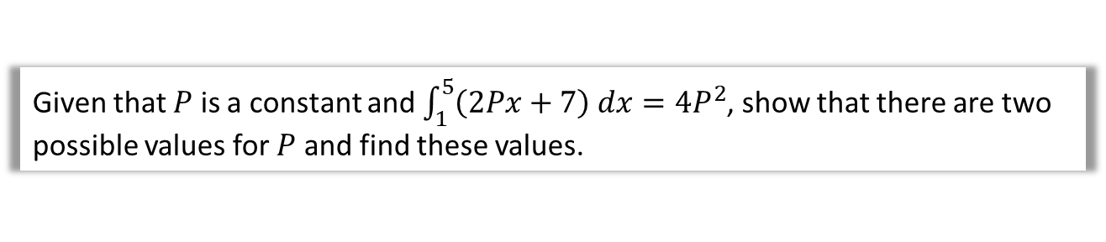
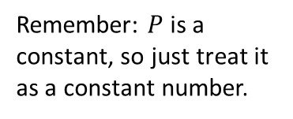
Problem Solving
Given that $P$ is a constant and $\int_{1}^{5}{\left(2Px+7\right) dx}=4P^{2}$, show that there are two possible values for $P$ and find these values.
?
Remember: $P$ is a constant, so just treat it as a constant number.
$$\int_{1}^{5}{\left(2Px+7\right) dx}={\left[Px^{2}+7x\right]}_{1}^{5} \\ =\left(25P+35\right)−\left(P+7\right) \\ =24P+28$$
$$∴24P+28=4P^{2} \\ P^{2}−6P−7=0 \\ \left(P+1\right)\left(P−7\right)=0 \\ P=−1 or 7$$

Slide 5
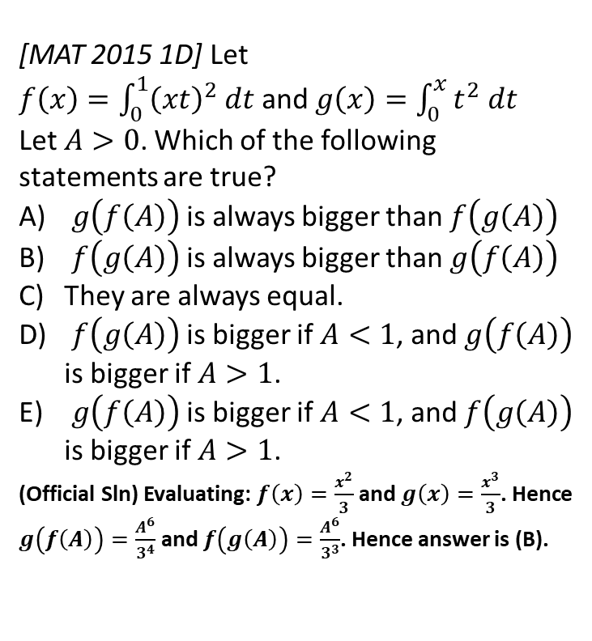

Exercise 13.4
Pearson Pure Mathematics Year 1/AS
Page 106
(Classes in a rush may want to skip this exercise and go to the next section, which continues definite integration, but in the context of areas under graphs).
Extension
2
[MAT 2015 1D] Let
$f\left(x\right)=\int_{0}^{1}{{\left(xt\right)}^{2} dt}$ and $g\left(x\right)=\int_{0}^{x}{t^{2} dt}$
Let $A>0$. Which of the following statements are true?
$g\left(f\left(A\right)\right)$ is always bigger than $f\left(g\left(A\right)\right)$
$f\left(g\left(A\right)\right)$ is always bigger than $g\left(f\left(A\right)\right)$
They are always equal.
$f\left(g\left(A\right)\right)$ is bigger if $A<1$, and $g\left(f\left(A\right)\right)$ is bigger if $A>1$.
$g\left(f\left(A\right)\right)$ is bigger if $A<1$, and $f\left(g\left(A\right)\right)$ is bigger if $A>1$.
(Official Sln) Evaluating: $f\left(x\right)=\frac{x^{2}}{3}$ and $g\left(x\right)=\frac{x^{3}}{3}$. Hence $g\left(f\left(A\right)\right)=\frac{A^{6}}{3^{4}}$ and $f\left(g\left(A\right)\right)=\frac{A^{6}}{3^{3}}$. Hence answer is (B).
1
[MAT 2009 1A] The smallest value of
$$I\left(a\right)=\int_{0}^{1}{{\left(x^{2}−a\right)}^{2} dx}$$
as $a$ varies, is what?
$$I\left(a\right)=\int_{0}^{1}{x^{4}−2ax^{2}+a^{2}} dx \\ ={\left[\frac{1}{5}x^{5}−\frac{2}{3}ax^{3}+a^{2}x\right]}_{0}^{1} \\ =\frac{1}{5}−\frac{2}{3}a+a^{2}$$
We then use differentiation or completing the square to find that the minimum value of $\frac{1}{5}−\frac{2}{3}a+a^{2}$ is $\frac{4}{45}$.
?
?

Slide 6
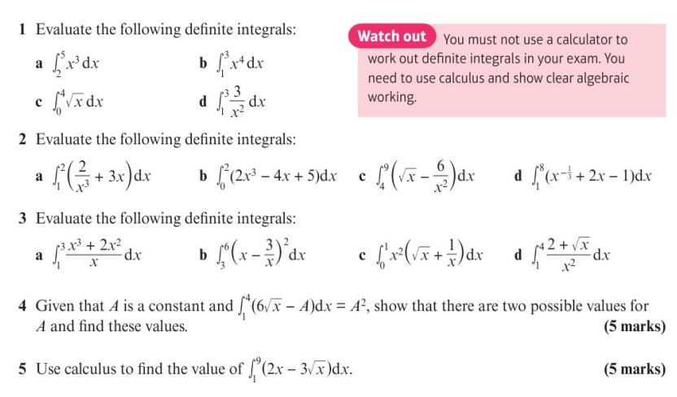
Homework Exercise

Slide 7
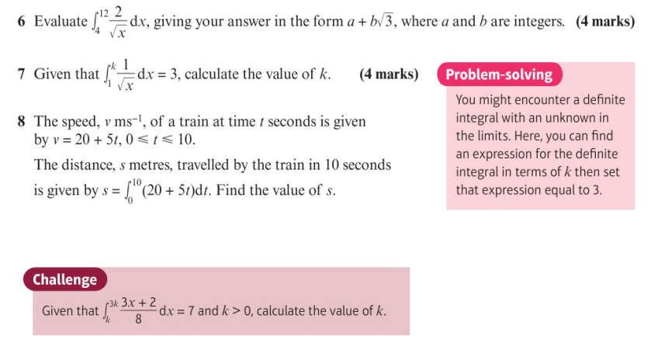
Homework Exercise

Slide 8
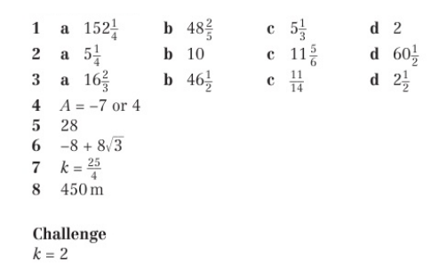
Homework Answers

