Slide 1
P2 Chapter 9: Differentiation Rates of Change

Slide 2



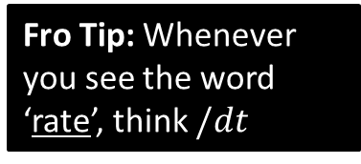

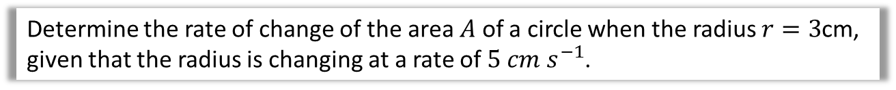








Relating Rates of Change
Q
Determine the rate of change of the area $A$ of a circle when the radius $r=3$cm, given that the radius is changing at a rate of $5 cm s^{−1}$.
Firstly, how would we represent…
Fro Tip: Whenever you see the word ‘rate’, think $/dt$
$$\frac{dA}{dt}$$
?
“the rate of change of the area $A$”
$$\frac{dr}{dt}=5$$
“the rate of change of the radius $r$ is 5”
?
?
“the area $A$ of a circle”
$$A=πr^{2}$$
Then by Chain Rule:
$$dr$$
$$\frac{dA}{dt}= ×$$
First copy top and bottom into the diagonals…
$$dA$$
Click for Fromanimation
$$dt$$
$$dr$$
$$=2πr×5 \\ =2π\left(3\right)×5 \\ =30π$$
…Then fill in the gaps with whatever variable you didn’t use.
?

Slide 3
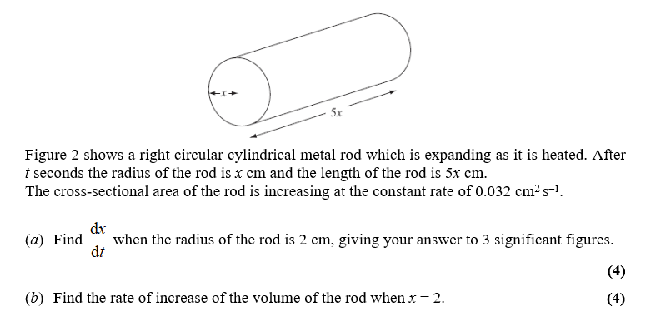
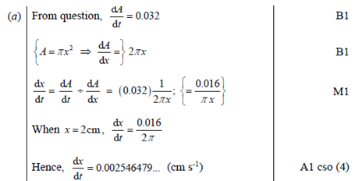
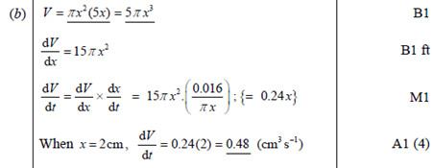
Further Example
Edexcel C4 June 2008 Q3
It’s common to have a second part of the question where you have to connect further rates.
?
?

Slide 4
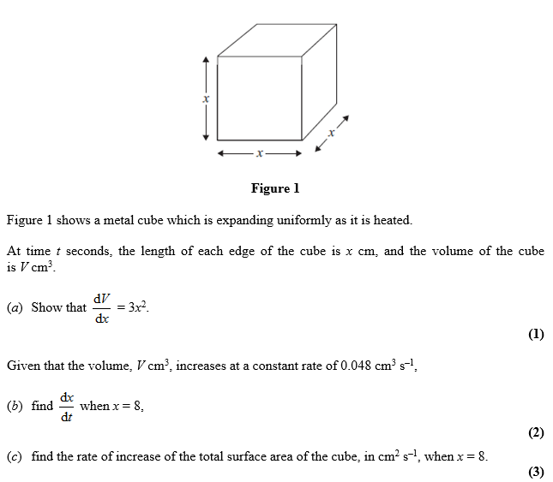
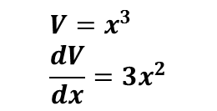
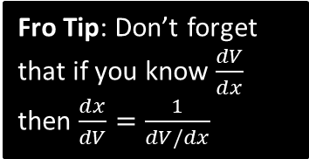

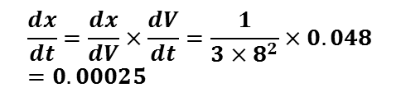
Test Your Understanding
June 2012 Q2
Fro Tip: Don’t forget that if you know $\frac{dV}{dx}$ then $\frac{dx}{dV}=\frac{1}{dV/dx}$
$$V=x^{3} \\ \frac{dV}{dx}=3x^{2}$$
?
?
$$\frac{dx}{dt}=\frac{dx}{dV}×\frac{dV}{dt}=\frac{1}{3×8^{2}}×0.048=0.00025$$
?
$$A=6x^{2} \\ \frac{dA}{dx}=12x \\ \frac{dA}{dt}=\frac{dA}{dx}×\frac{dx}{dt}=\left(12×8\right)×0.00025=0.024$$

Slide 5
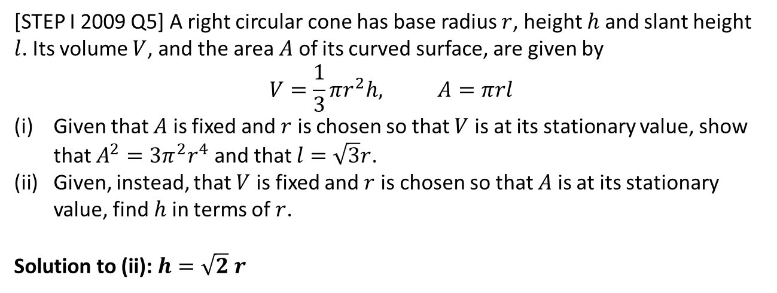
Exercise 9.10
Pearson Pure Year 2
Page 77
Note: I have skipped out the content on ‘setting up differential equations’ as I think it’s better to do this in the Integration chapter. You therefore won’t be able to yet do Q5, Q6.
Extension:
[STEP I 2009 Q5] A right circular cone has base radius $r$, height $h$ and slant height $l$. Its volume $V$, and the area $A$ of its curved surface, are given by
$$V=\frac{1}{3}πr^{2}h, A=πrl$$
Given that $A$ is fixed and $r$ is chosen so that $V$ is at its stationary value, show that $A^{2}=3π^{2}r^{4}$ and that $l=\sqrt{3}r$.
Given, instead, that $V$ is fixed and $r$ is chosen so that $A$ is at its stationary value, find $h$ in terms of $r$.
Solution to (ii): $h=\sqrt{2} r$
?

Slide 6
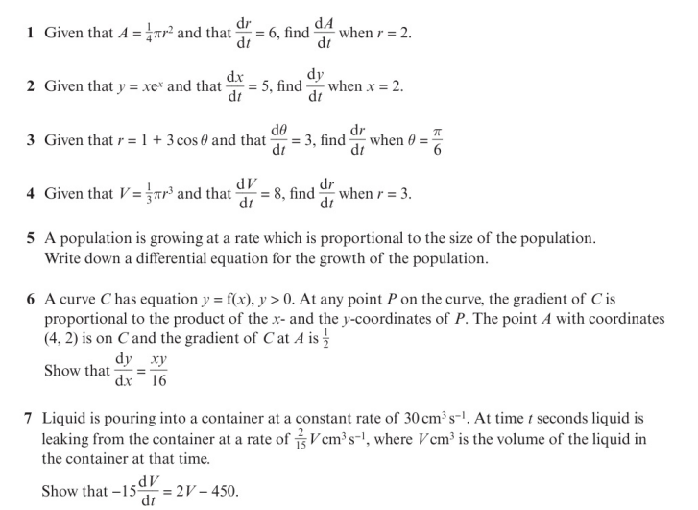
Homework Exercise

Slide 7
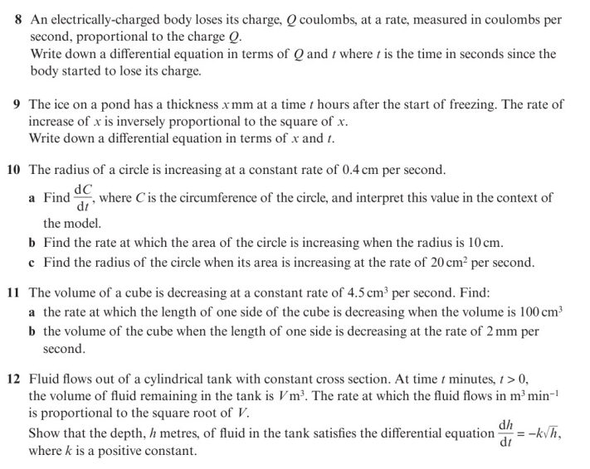
Homework Exercise

Slide 8
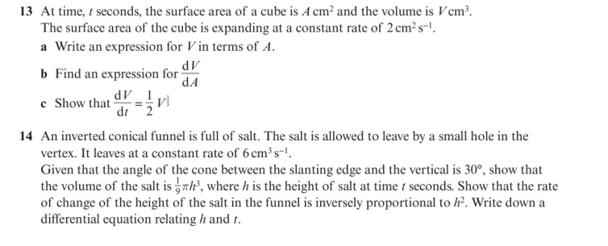
Homework Exercise

Slide 9
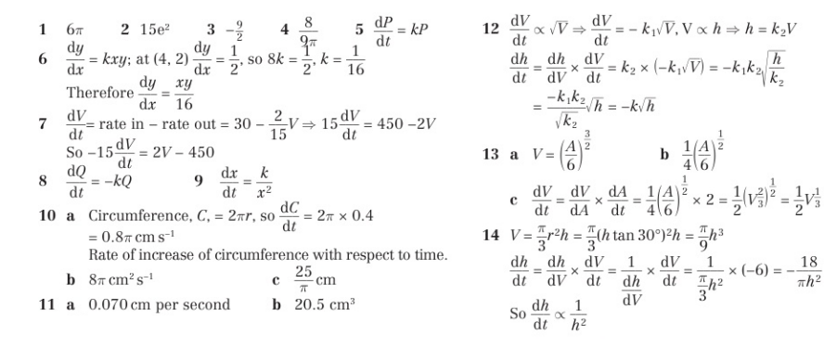
Homework Answers

