Slide 1
P2 Chapter 7: Trigonometric Equations
Chapter Practice

Slide 2
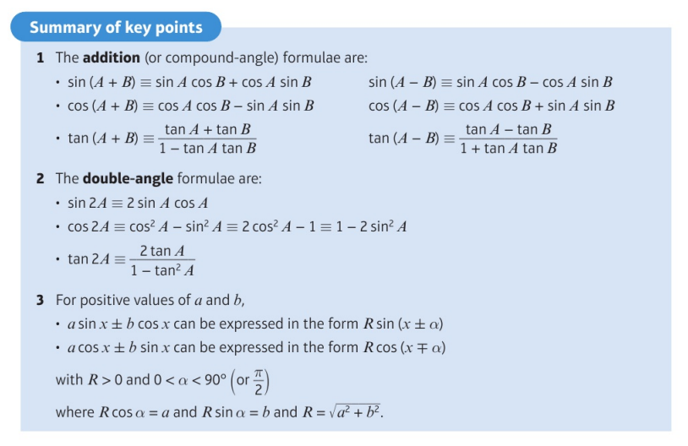
Key Points

Slide 3
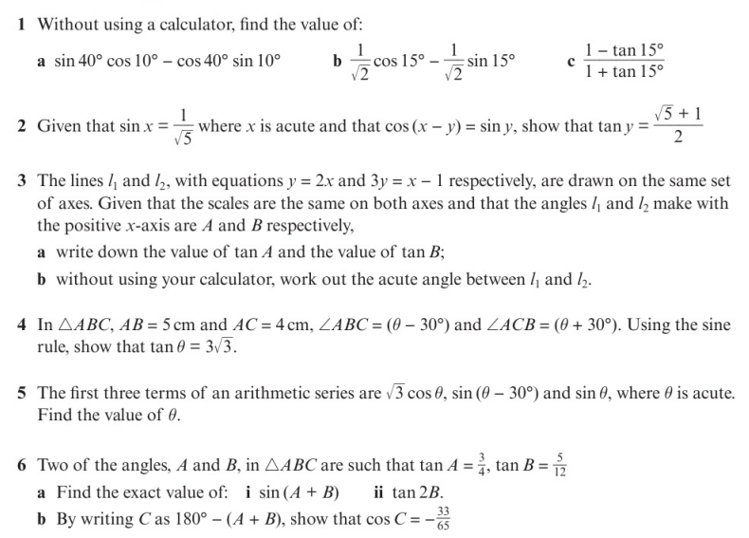
Chapter Exercises

Slide 4
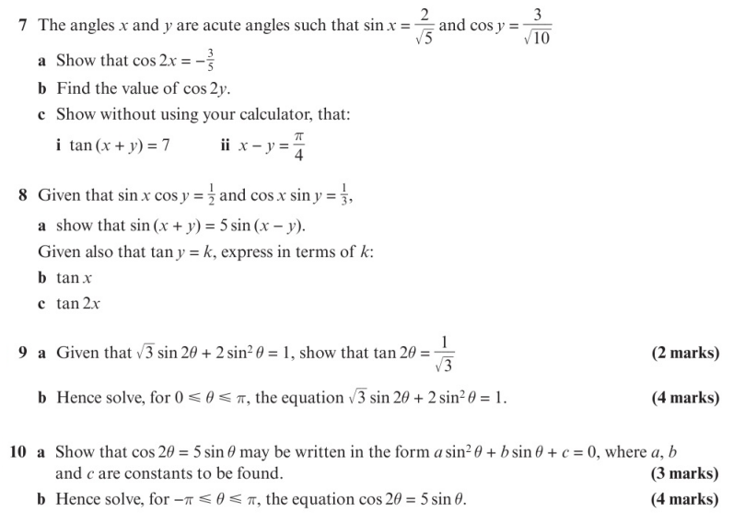
Chapter Exercises

Slide 5
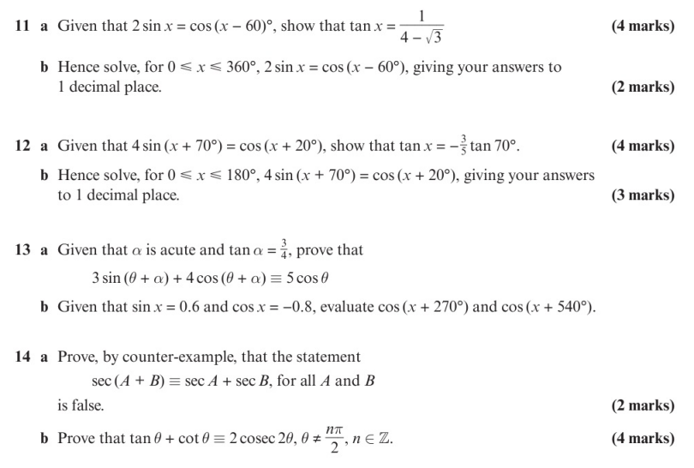
Chapter Exercises

Slide 6
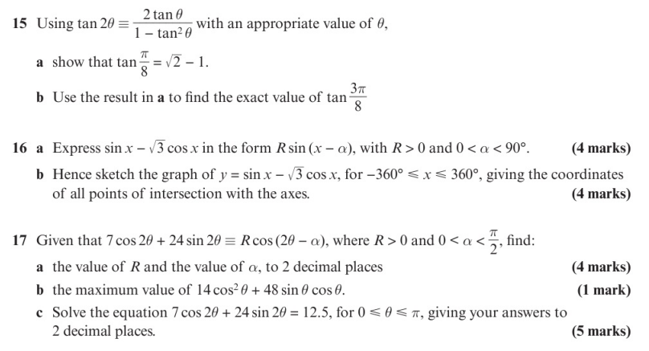
Chapter Exercises

Slide 7
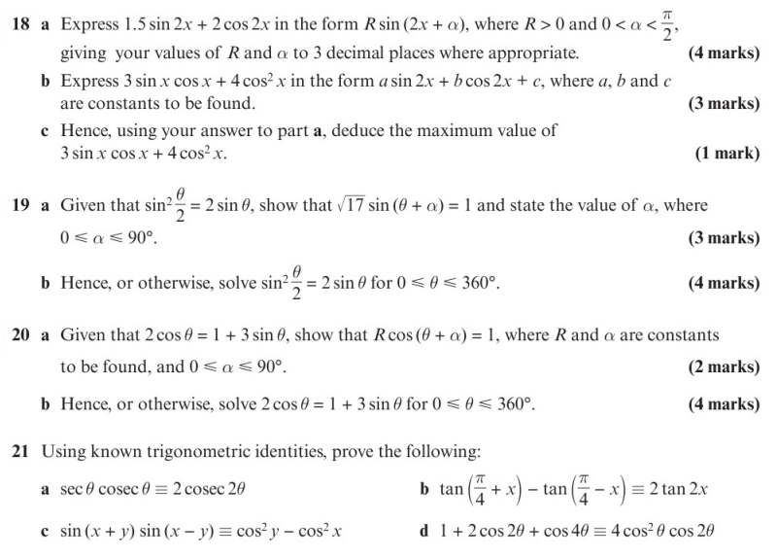
Chapter Exercises

Slide 8
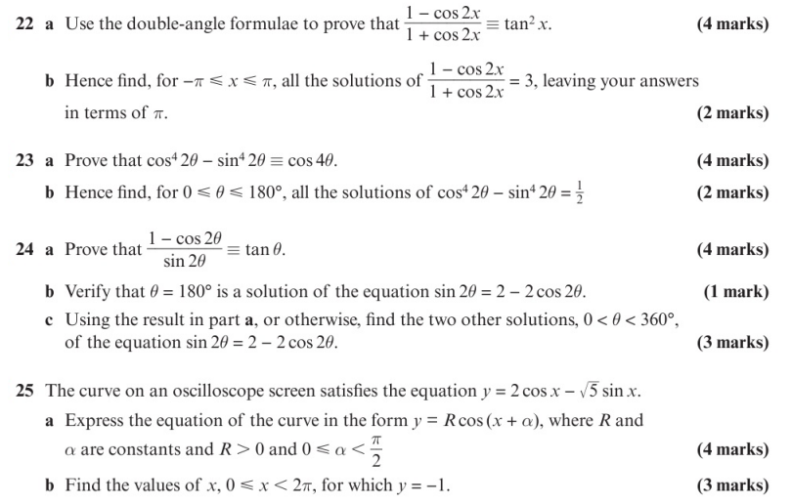
Chapter Exercises

Slide 9
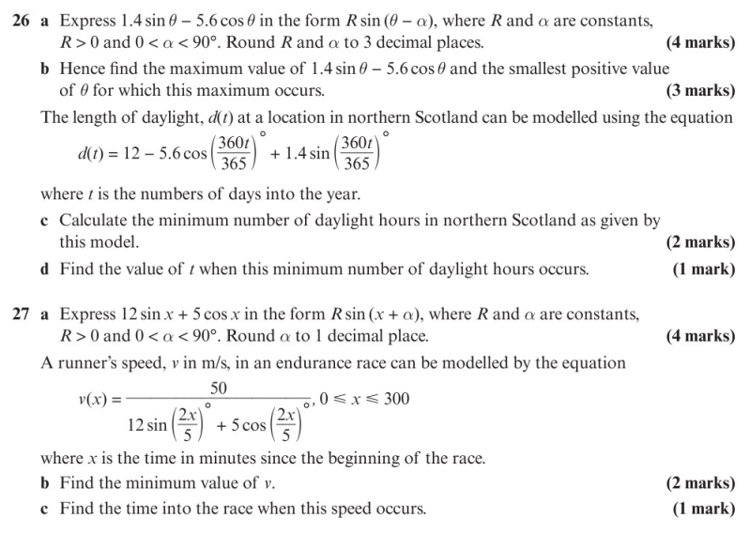
Chapter Exercises

Slide 10
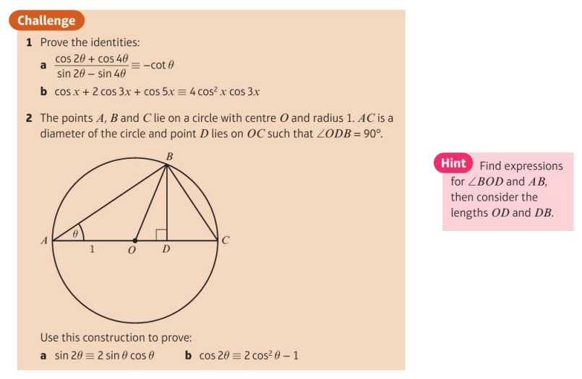
Chapter Exercises

Slide 11
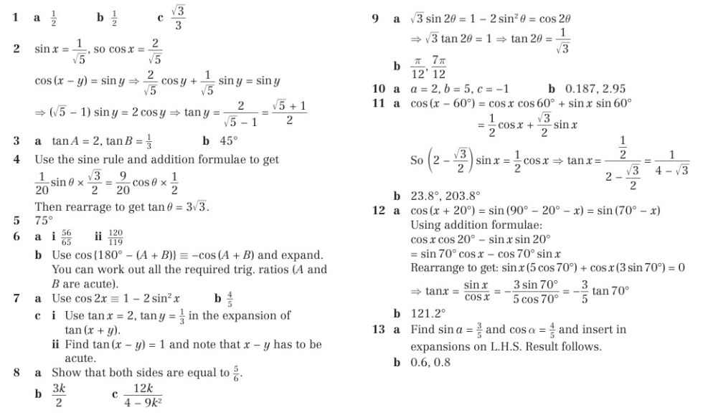
Chapter Answers

Slide 12
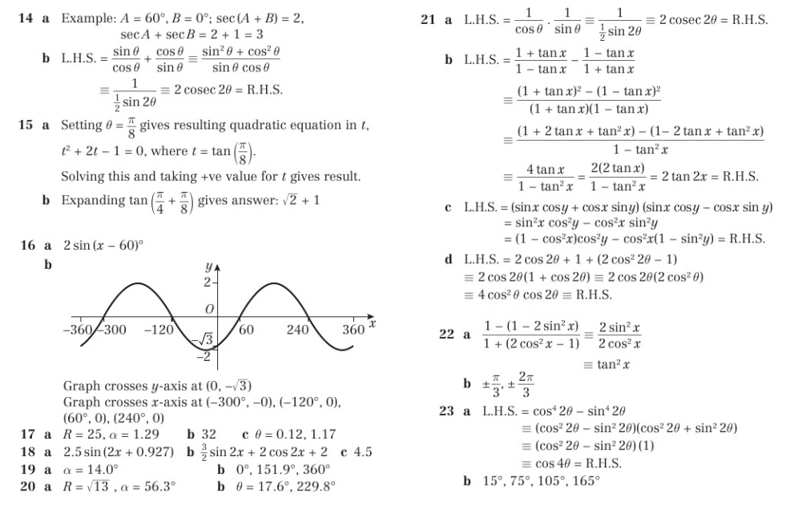
Chapter Answers

Slide 13
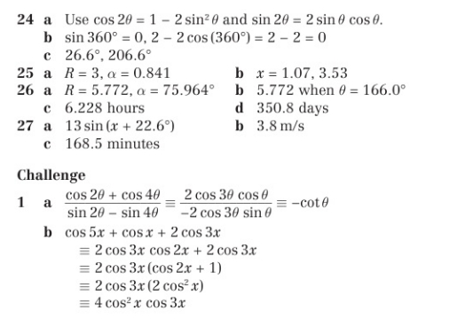
Chapter Answers

