Slide 1
P1 Chapter 12: Differentiation
Gradient Functions

Slide 2
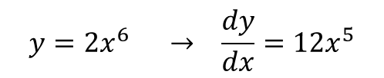
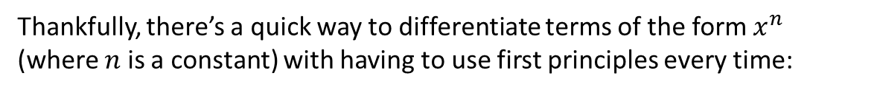
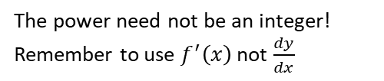
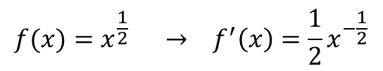
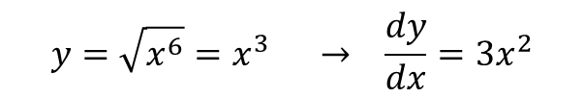
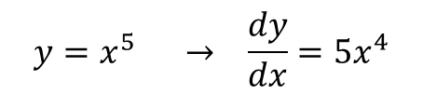

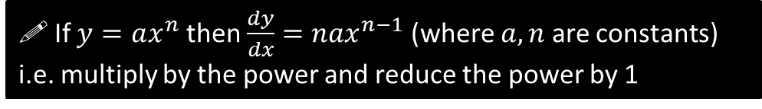

Differentiating $x^{n}$
Thankfully, there’s a quick way to differentiate terms of the form $x^{n}$ (where $n$ is a constant) with having to use first principles every time:
If $y=ax^{n}$ then $\frac{dy}{dx}=nax^{n−1}$ (where $a,n$ are constants)
i.e. multiply by the power and reduce the power by 1
Examples:
?
$$y=x^{5} → \frac{dy}{dx}=5x^{4}$$
Power is 5, so multiply by 5 then reduce power by 5.
$$f(x)=x^{\frac{1}{2}} → f^{′}\left(x\right)=\frac{1}{2}x^{−\frac{1}{2}}$$
The power need not be an integer!
Remember to use $f^{′}\left(x\right)$ not $\frac{dy}{dx}$
?
Why would it be incorrect to say that $y=2^{x}$ differentiates to $\frac{dy}{dx}=x 2^{x−1}$?
The rule only works when the base is $x$ and the power is a constant. Neither is true here! Note that $x^{n}$ is “a power of $x$” whereas $2^{x}$ is an exponential term (which you will encounter more in Chp14), and therefore differentiate differently. You will learn how to differentiate exponential terms in Year 2.
$$y={2x}^{6} → \frac{dy}{dx}=12x^{5}$$
?
?
?
?
$$f\left(x\right)=\frac{x}{x^{4}}=x^{−3} → f^{′}\left(x\right)=−3x^{−4}$$
$$y=\sqrt{x^{6}}=x^{3} → \frac{dy}{dx}=3x^{2}$$
?
?

Slide 3
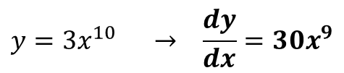
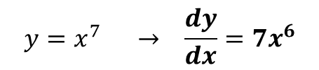
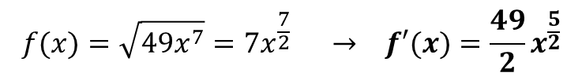
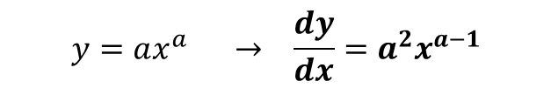
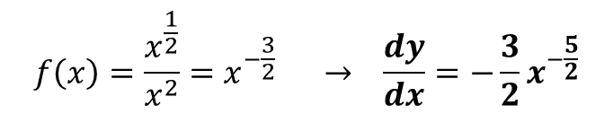
Test Your Understanding
?
$$y=x^{7} → \frac{dy}{dx}=7x^{6}$$
1
$$y=3x^{10} → \frac{dy}{dx}=30x^{9}$$
?
2
$$f\left(x\right)=\frac{x^{\frac{1}{2}}}{x^{2}}=x^{−\frac{3}{2}} → \frac{dy}{dx}=−\frac{3}{2}x^{−\frac{5}{2}}$$
?
?
3
$$y=ax^{a} → \frac{dy}{dx}=a^{2}x^{a−1}$$
?
4
?
?
$$f(x)=\sqrt{49x^{7}}=7x^{\frac{7}{2}} → f′(x)=\frac{49}{2}x^{\frac{5}{2}}$$
5

Slide 4
Exercise 12.3
Pearson Pure Mathematics Year 1/AS
Page 94

Slide 5
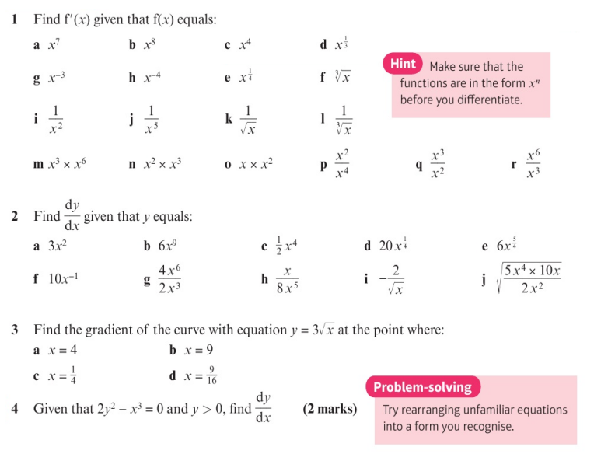
Homework Exercise

Slide 6
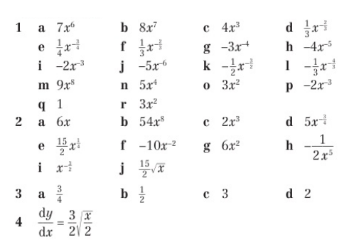
Homework Answers

