Slide 1
P1 Chapter 11: Vectors Representing Vectors

Slide 2


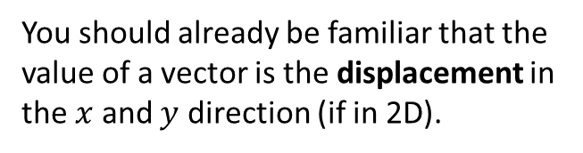

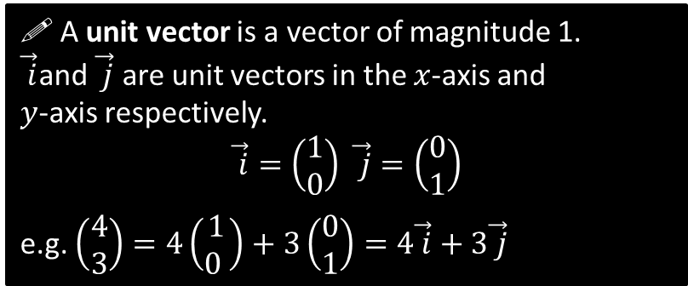




Representing Vectors
You should already be familiar that the value of a vector is the displacement in the $x$ and $y$ direction (if in 2D).
$$\left(\begin{matrix}3 \\ −2 \end{matrix}\right)$$
$$\vec{a}=\left(\begin{matrix}3 \\ −2 \end{matrix}\right), \vec{b}=\left(\begin{matrix}0 \\ −1\end{matrix}\right)$$
$$\vec{a}+\vec{b}=\left(\begin{matrix}3 \\ −3\end{matrix}\right) \\ 2\vec{a} =\left(\begin{matrix}6 \\ −4\end{matrix}\right)$$
?
?
$$j$$
$$\vec{ j}$$
$$i$$
$$\vec{ i}$$
! A unit vector is a vector of magnitude 1.
$\vec{ i}$and $\vec{ j}$ are unit vectors in the $x$-axis and $y$-axis respectively.
$$\vec{ i}=\left(\begin{matrix}1 \\ 0\end{matrix}\right) \vec{ j}=\left(\begin{matrix}0 \\ 1\end{matrix}\right)$$
e.g. $\left(\begin{matrix}4 \\ 3\end{matrix}\right)=4\left(\begin{matrix}1 \\ 0 \end{matrix}\right)+3\left(\begin{matrix}0 \\ 1\end{matrix}\right)=4\vec{ i}+3\vec{ j}$
! Bold notation is used in textbooks and exam papers but is awkward for handwriting.

Slide 3

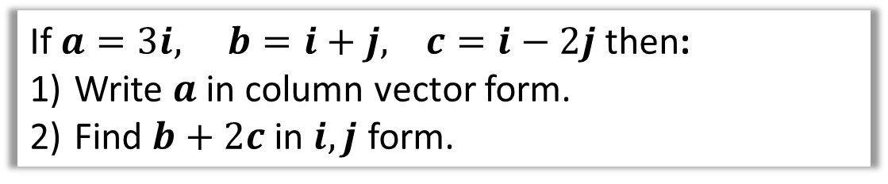
Examples
If $a=3i, b=i+j, c=i−2j$ then:
Write $a$ in column vector form.
Find $b+2c$ in $i,j$ form.
$$a=\left(\begin{matrix}3 \\ 0\end{matrix}\right)$$
$$b+2c=i+j+2\left(i−2j\right) \\ =i+j+2i−4j \\ =3i−3j$$
1
?
2
?

Slide 4
Exercise 11.2
Pearson Pure Mathematics Year 1/AS
Pages 87

Slide 5
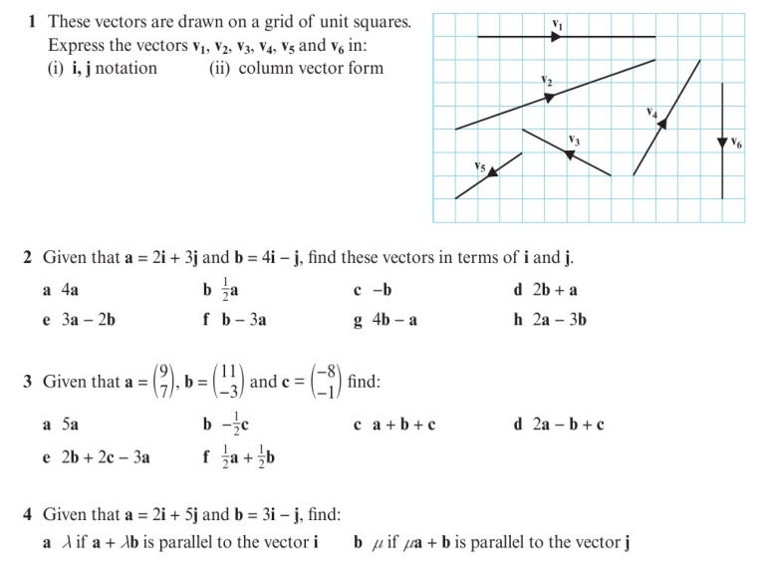
Homework Exercise

Slide 6
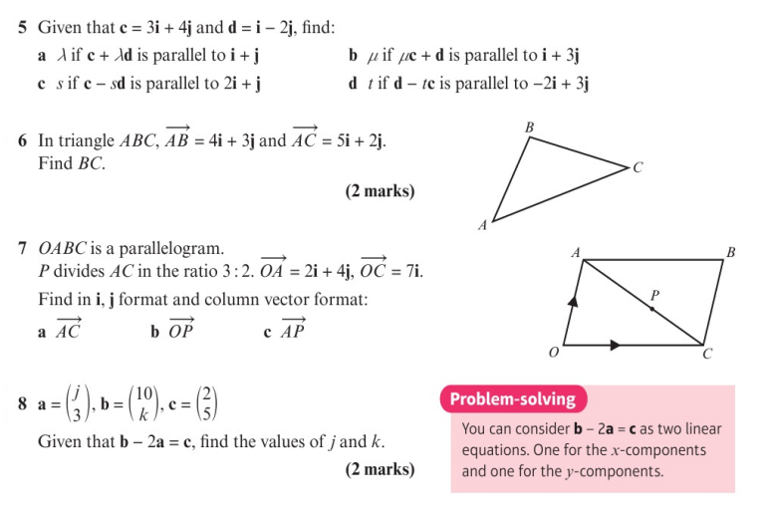
Homework Exercise

Slide 7
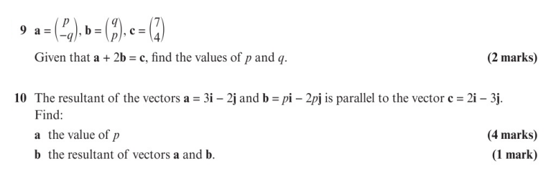
Homework Exercise

Slide 8
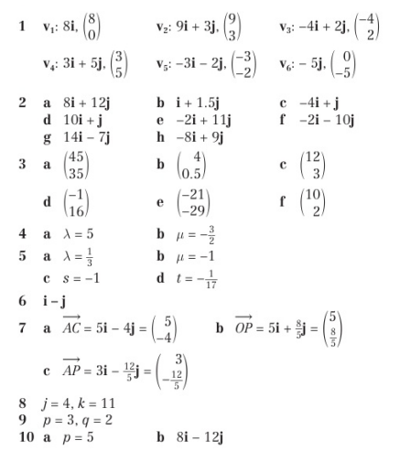
Homework Answers

