Slide 1
P1 Chapter 7: Algebraic Methods Mathematical Proof

Slide 2
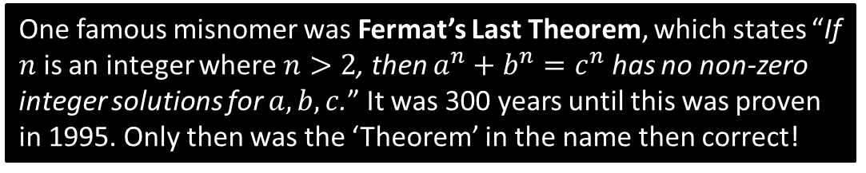
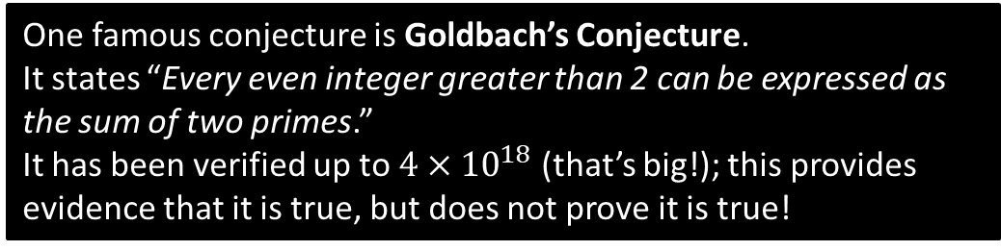
Proof
Terminology
A conjecture is a mathematical statement that has yet to be proven.
One famous conjecture is Goldbach’s Conjecture.
It states “Every even integer greater than 2 can be expressed as the sum of two primes.”
It has been verified up to $4×{10}^{18}$ (that’s big!); this provides evidence that it is true, but does not prove it is true!
A theorem is a mathematical statement that has been proven.
One famous misnomer was Fermat’s Last Theorem, which states “If $n$ is an integer where $n>2$, then $a^{n}+b^{n}=c^{n}$ has no non-zero integer solutions for $a,b,c$.” It was 300 years until this was proven in 1995. Only then was the ‘Theorem’ in the name then correct!

Slide 3

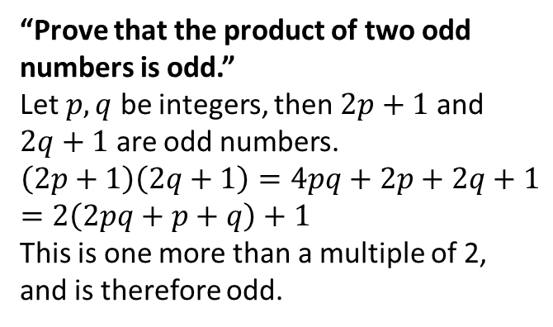
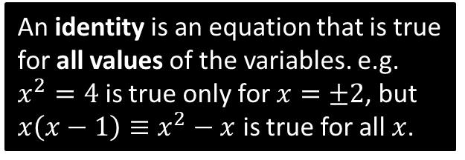
Types of Proof
A proof must show all assumptions you are using, have a clear sequential list of steps that logically follow, and must cover all possible cases.
You should usually make a concluding statement, e.g. restating the original conjecture that you have proven.
a. Proof by Deduction
An identity is an equation that is true for all values of the variables. e.g. $x^{2}=4$ is true only for $x=±2$, but $x\left(x−1\right)≡x^{2}−x$ is true for all $x$.
This is the simplest type, where you start from known facts and reach the desired conclusion via deductive steps.
“Prove that $\left(3x+2\right)\left(x−5\right)\left(x+7\right)≡3x^{3}+8x^{2}−101x−70$”
$$\left(3x+2\right)\left(x−5\right)\left(x+7\right) \\ =\left(3x+2\right)\left(x^{2}+2x−35\right) \\ =3x^{3}+6x^{2}−105x+2x^{2}+4x−70 \\ =3x^{2}+8x^{2}−101x−70$$
$$∴\left(3x+2\right)\left(x−5\right)\left(x+7\right)≡3x^{3}+8x^{2}−101x−70$$
“Prove that the product of two odd numbers is odd.”
Let $p,q$ be integers, then $2p+1$ and $2q+1$ are odd numbers.
$$\left(2p+1\right)\left(2q+1\right)=4pq+2p+2q+1 \\ =2\left(2pq+p+q\right)+1$$
This is one more than a multiple of 2, and is therefore odd.
?
?

Slide 4


Be Warned…
Proof by Deduction requires you to start from known facts and end up at the conclusion. It is not acceptable to start with to the conclusion, and verify it works, because you are assuming the thing you are trying to prove.
Example: Prove that if three consecutive integers are the sides of a right-angled triangle, they must be 3, 4 and 5.
Incorrect Proof:
Let the lengths be 3,4,5.
Therefore:
$$3^{2}+4^{2}=5^{2} \\ 25=25$$
This satisfies Pythagoras’ Theorem, and the numbers are consecutive.
Correct Proof:
If the sides are consecutive, then let the sides be:
$$x,x+1,x+2$$
Then by Pythagoras’ Theorem:
$$x^{2}+{\left(x+1\right)}^{2}={\left(x+2\right)}^{2} \\ … \\ x^{2}−2x−3=0 \\ \left(x+1\right)\left(x−3\right)=0$$ $x=3$ (as $x$ can’t be negative)
Thus the sides are 3, 4, 5.
?
We are assuming the thing we are trying to prove!
?
We are only assuming things in the ‘if’ bit. This is fine!
The underlying problem is that this technique doesn’t prove there can’t be other consecutive integers that work – we have only verified 3,4,5 is one such solution.

Slide 5
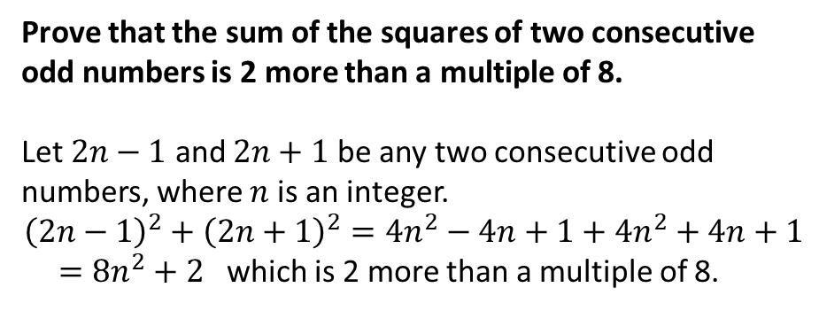
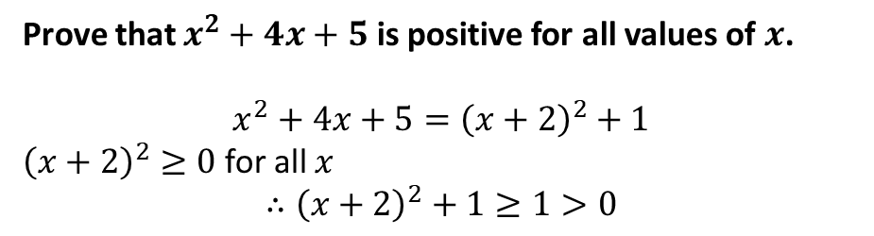
Types of Proof
a. Proof by Deduction
Exam Tip: This is quite a common last parter.
Prove that $x^{2}+4x+5$ is positive for all values of $x$.
$$x^{2}+4x+5={\left(x+2\right)}^{2}+1$$
${\left(x+2\right)}^{2}≥0$ for all $x$
$$∴{\left(x+2\right)}^{2}+1≥1>0$$
?
Anything squared is at least 0. This is formally known as the ‘trivial inequality’.
Test Your Understanding
Prove that the sum of the squares of two consecutive odd numbers is 2 more than a multiple of 8.
Let $2n−1$ and $2n+1$ be any two consecutive odd numbers, where $n$ is an integer.
$${\left(2n−1\right)}^{2}+{\left(2n+1\right)}^{2}=4n^{2}−4n+1+4n^{2}+4n+1$$ $=8n^{2}+2$ which is 2 more than a multiple of 8.
?

Slide 6
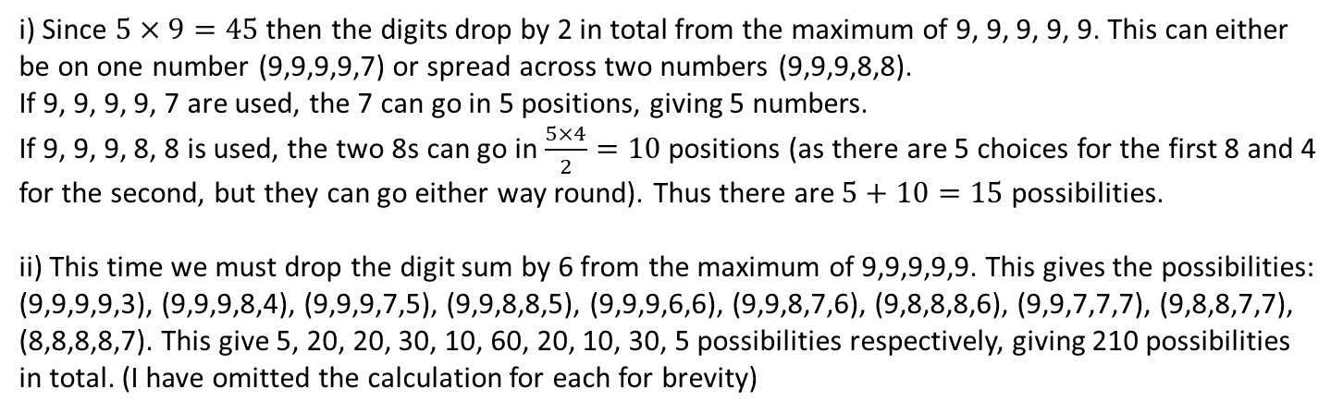
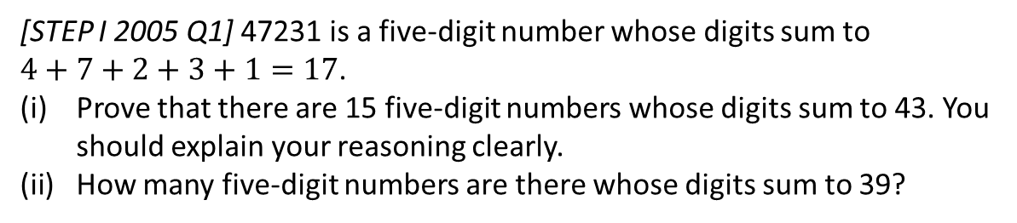
Exercise 7.4
Pearson Pure Mathematics Year 1/AS
Page 58
Extension
[STEP I 2005 Q1] 47231 is a five-digit number whose digits sum to
$4+7+2+3+1=17$.
Prove that there are 15 five-digit numbers whose digits sum to 43. You should explain your reasoning clearly.
How many five-digit numbers are there whose digits sum to 39?
i) Since $5×9=45$ then the digits drop by 2 in total from the maximum of 9, 9, 9, 9, 9. This can either be on one number (9,9,9,9,7) or spread across two numbers (9,9,9,8,8).
If 9, 9, 9, 9, 7 are used, the 7 can go in 5 positions, giving 5 numbers. If 9, 9, 9, 8, 8 is used, the two 8s can go in $\frac{5×4}{2}=10$ positions (as there are 5 choices for the first 8 and 4 for the second, but they can go either way round). Thus there are $5+10=15$ possibilities.
ii) This time we must drop the digit sum by 6 from the maximum of 9,9,9,9,9. This gives the possibilities: (9,9,9,9,3), (9,9,9,8,4), (9,9,9,7,5), (9,9,8,8,5), (9,9,9,6,6), (9,9,8,7,6), (9,8,8,8,6), (9,9,7,7,7), (9,8,8,7,7), (8,8,8,8,7). This give 5, 20, 20, 30, 10, 60, 20, 10, 30, 5 possibilities respectively, giving 210 possibilities in total. (I have omitted the calculation for each for brevity)
? i
? ii

Slide 7
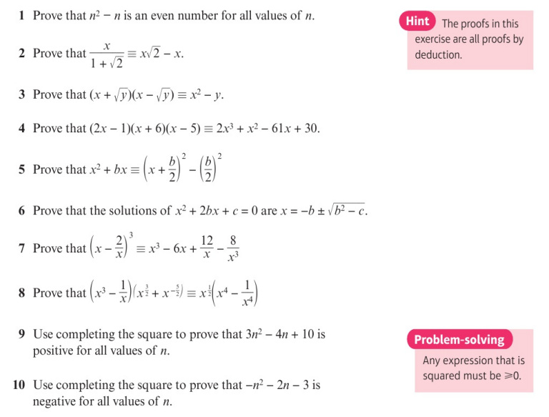
Homework Exercise

Slide 8
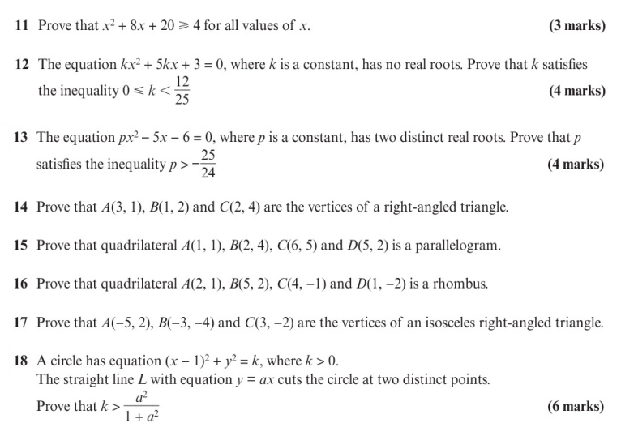
Homework Exercise

Slide 9
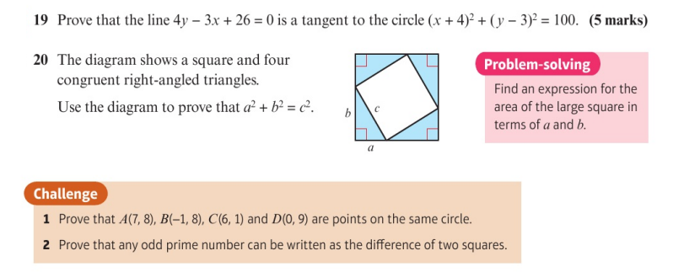
Homework Exercise

Slide 10
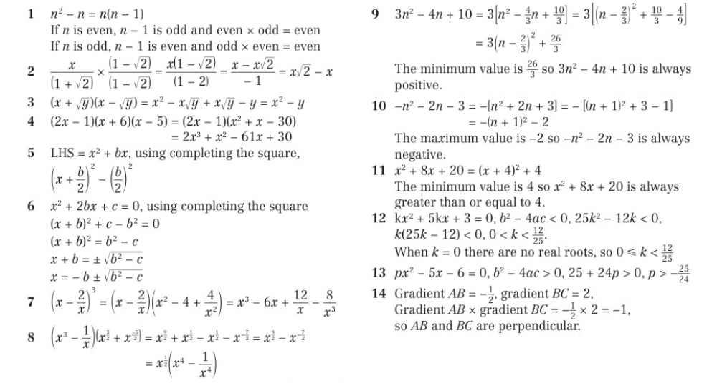
Homework Answers

Slide 11
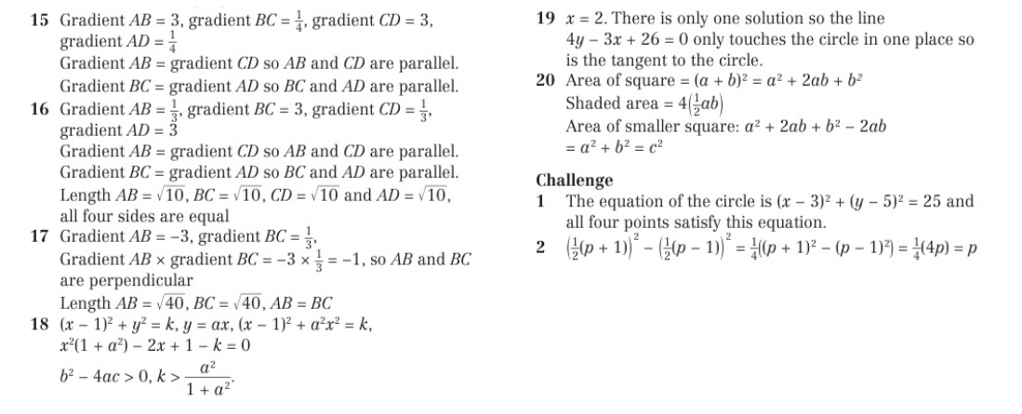
Homework Answers

