Slide 1
Stats Yr2 Chapter 2: Probability Theory Set Notation

Slide 2

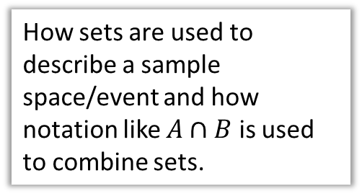
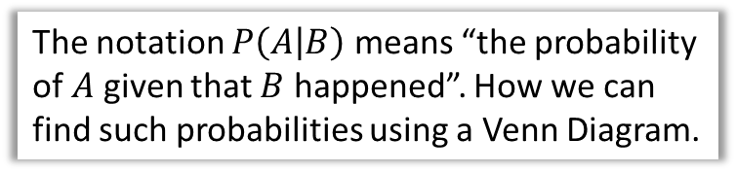
Chapter Overview
1:: Set Notation
2:: Conditional Probability in Venn Diagrams
How sets are used to describe a sample space/event and how notation like $A∩B$ is used to combine sets.
The notation $P\left(A | B\right)$ means “the probability of $A$ given that $B$ happened”. How we can find such probabilities using a Venn Diagram.
4:: Tree Diagrams
3:: Formula for Conditional Probability
“I have 3 red and 4 green balls in a bag. I take one ball out the bag, keep it, then take another. Given that the second ball was green, determine the probability the first was red.”
$$P\left(A | B\right)=\frac{P\left(A∩B\right)}{P\left(B\right)}$$
Teacher Notes: All of this is from the old S1. The chapter was effectively split into two: all the non-conditional probability content in Year 1 and the rest in Year 2. Set notation was not used in Year 1.

Slide 3


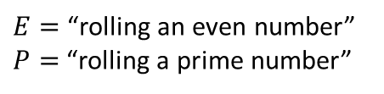
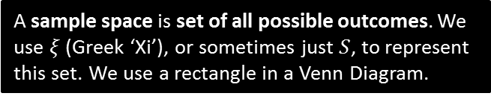

RECAP :: Using sets for sample spaces and events
In general, sets are used to represent collections of items.
In probability, an event is a set of one or more outcomes. These are the circles in the Venn Diagram.
We use capital letters for the variables representing sets.
A sample space is set of all possible outcomes. We use $ξ$ (Greek ‘Xi’), or sometimes just $S$, to represent this set. We use a rectangle in a Venn Diagram.
Each number represents an outcome.
$$ξ$$
$E=$“rolling an even number”
$P=$“rolling a prime number”
$$P$$
$$E$$
3
6
2
5
4
1

Slide 4



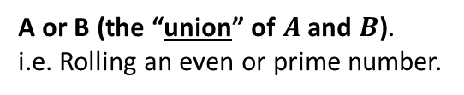




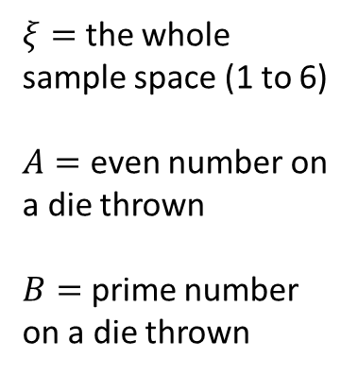
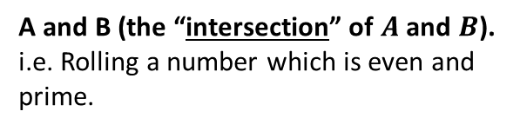
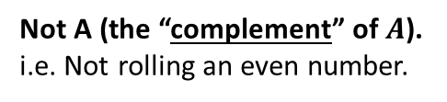


Combining events/sets
$$ξ$$
$$A$$
$$B$$
$ξ=$ the whole sample space (1 to 6)
$A=$ even number on a die thrown
$B=$ prime number on a die thrown
3
4
1
2
6
5
What does it mean in this context?
What is the resulting set of outcomes?
$$A′$$
?
?
Not A (the “complement” of $A$).
i.e. Not rolling an even number.
$$\{1, 3, 5\}$$
$$A∪B$$
A or B (the “union” of $A$ and $B$). i.e. Rolling an even or prime number.
?
?
$$\{2,3,4,5,6\}$$
$$A∩B$$
A and B (the “intersection” of $A$ and $B$).
i.e. Rolling a number which is even and prime.
?
?
$$\{2\}$$

Slide 5



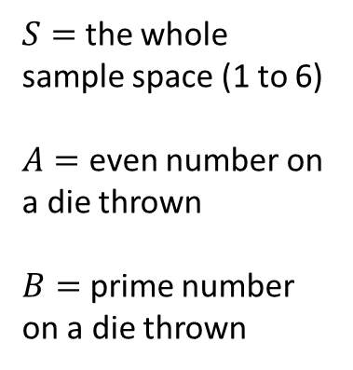



Some fundamentals
$$ξ$$
$$A$$
$$B$$
$S=$ the whole sample space (1 to 6)
$A=$ even number on a die thrown
$B=$ prime number on a die thrown
3
4
1
2
6
5
What does it mean in this context?
What is the resulting set of outcomes?
$$A∩B′$$
?
?
“A and not B”. Rolling a number which is even and not prime.
$$\{4,6\}$$
$$(A∪B)′$$
?
?
Rolling a number which is not [even or prime].
$$\{1\}$$
$${\left(A∩B\right)}^{′}$$
Rolling a number which is not [even and prime].
?
?
$$\{1,3,4,5,6\}$$

Slide 6
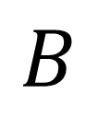
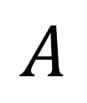


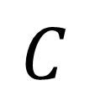
What area is indicated?
$$A$$
$$B$$
$$C$$
$$ξ$$
$$A∩B$$
?

Slide 7

What area is indicated?
$$A$$
$$B$$
$$C$$
$$ξ$$
$$A∪B$$
?

Slide 8

What area is indicated?
$$A$$
$$B$$
$$C$$
$$ξ$$
$$A∩B∩C$$
?

Slide 9

What area is indicated?
$$A$$
$$B$$
$$C$$
$$ξ$$
$$A∩C^{′}$$
?

Slide 10

What area is indicated?
$$A$$
$$B$$
$$C$$
$$ξ$$
$$A∩B∩C^{′}$$
?

Slide 11



What area is indicated?
$$ξ$$
$$A$$
$$B$$
$$C$$
?
?
$$A^{′}∩B^{′}∩C^{′}$$
or
alternatively…
$${\left(A∪B∪C\right)}^{′}$$

Slide 12


What area is indicated?
$$ξ$$
$$A$$
$$B$$
$$C$$
$$A^{′}$$
?

Slide 13


What area is indicated?
$$ξ$$
$$A$$
$$B$$
$$C$$
$$A∩{\left(B∩C\right)}^{′}$$
?

Slide 14


What area is indicated?
$$ξ$$
$$A$$
$$B$$
$$C$$
$$A∩B^{′}∩C′$$
?

Slide 15

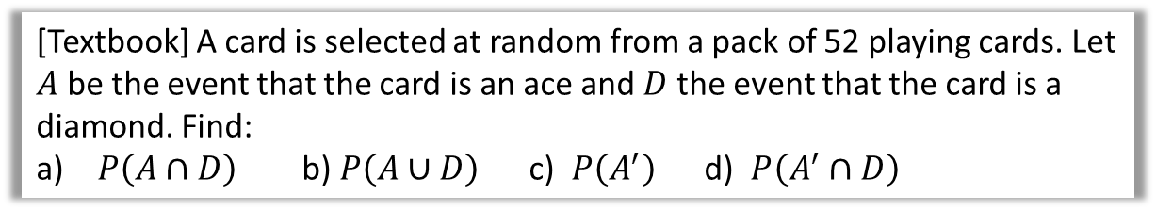


Examples
Venn Diagram can either contain:
The specific outcomes in each set
The number of items in the set (i.e. frequencies)
The probability of being in that set.
This will usually be stated or made obvious from the context.
[Textbook] A card is selected at random from a pack of 52 playing cards. Let $A$ be the event that the card is an ace and $D$ the event that the card is a diamond. Find:
$P\left(A∩D\right)$ b) $P\left(A∪D\right)$ c) $P\left(A^{′}\right)$ d) $P\left(A^{′}∩D\right)$
? Venn Diagram
? a
Think “A and D”.
$$P\left(A∩D\right)=\frac{1}{52} \\ P\left(A∪D\right)=\frac{16}{52} \\ P\left(A^{′}\right)=\frac{48}{52} \\ P\left(A^{′}∩D\right)=\frac{12}{52}$$
$$A$$
$$D$$
For union, I visualise this ‘figure-of-8’ shape:
1
? b
3
12
36
? c
? d

Slide 16

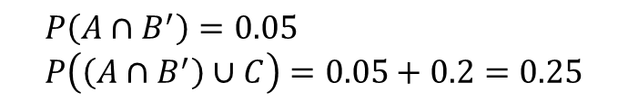
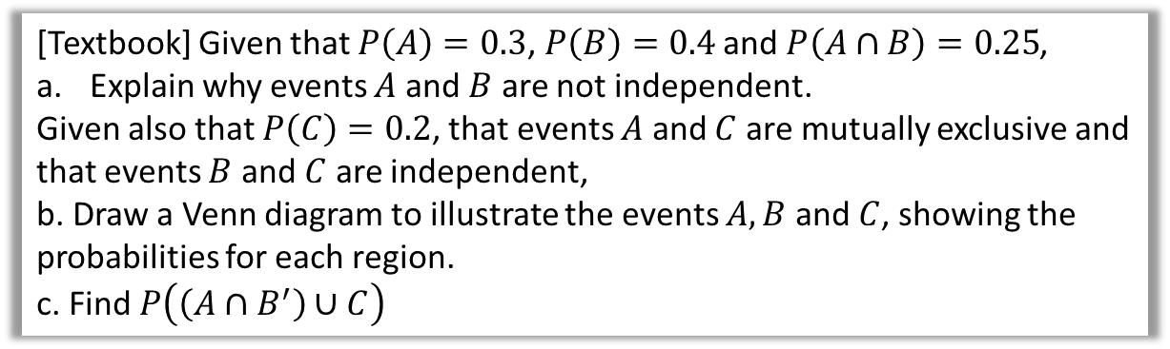



Examples
[Textbook] Given that $P\left(A\right)=0.3$, $P\left(B\right)=0.4$ and $P\left(A∩B\right)=0.25$,
Explain why events $A$ and $B$ are not independent.
Given also that $P\left(C\right)=0.2$, that events $A$ and $C$ are mutually exclusive and that events $B$ and $C$ are independent,
b. Draw a Venn diagram to illustrate the events $A, B$ and $C$, showing the probabilities for each region.
c. Find $P\left(\left(A∩B^{′}\right)∪C\right)$
a
$$P\left(A\right)×P\left(B\right)=0.3×0.4=0.12$$
$$P\left(A∩B^{′}\right)=0.05 \\ P\left(\left(A∩B^{′}\right)∪C\right)=0.05+0.2=0.25$$
?
c
?
b
?
$$A$$
$$B$$
$$C$$
0.07
0.05
0.25
0.08
0.12
0.43

Slide 17

Test Your Understanding
May 2013 (R) Q6
Using the above: $0.1=\left(p+0.1\right)×0.4$ $p+0.1=0.25$ $p=0.15$
?
The Venn diagram in Figure 1 shows three events A, B and C and the probabilities associated with each region of B. The constants p, q and r each represent probabilities associated with the three separate regions outside B.
The events A and B are independent.
Find the value of p. (3)

Slide 18
Exercise 2.1
Pearson Stats/Mechanics Year 2
Pages 9-11

Slide 19
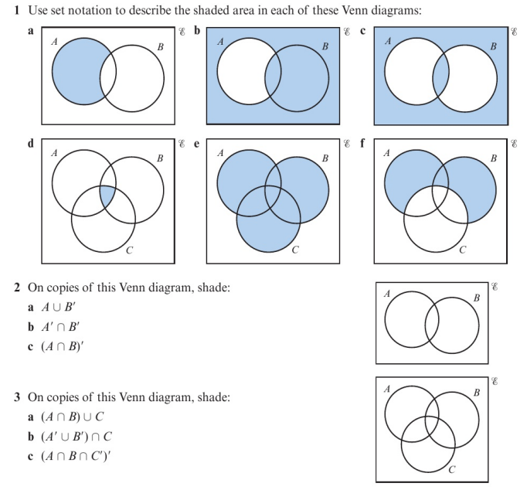
Homework Exercise

Slide 20
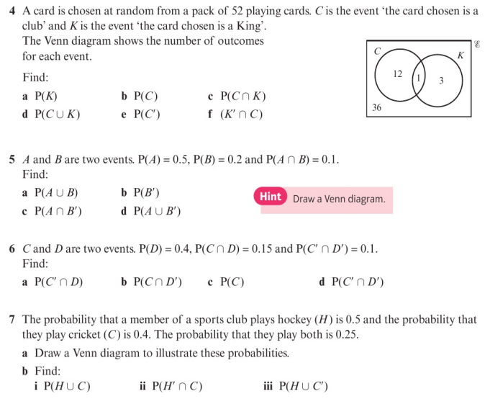
Homework Exercise

Slide 21
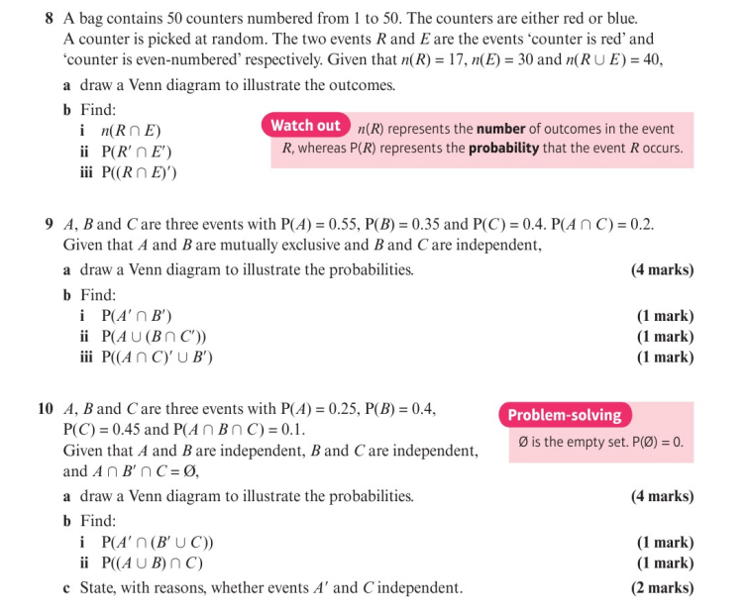
Homework Exercise

Slide 22
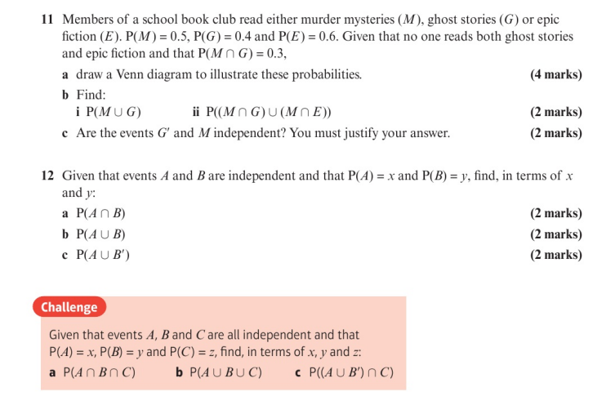
Homework Exercise

Slide 23
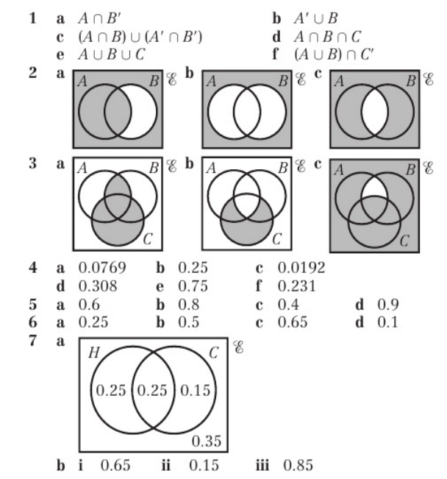
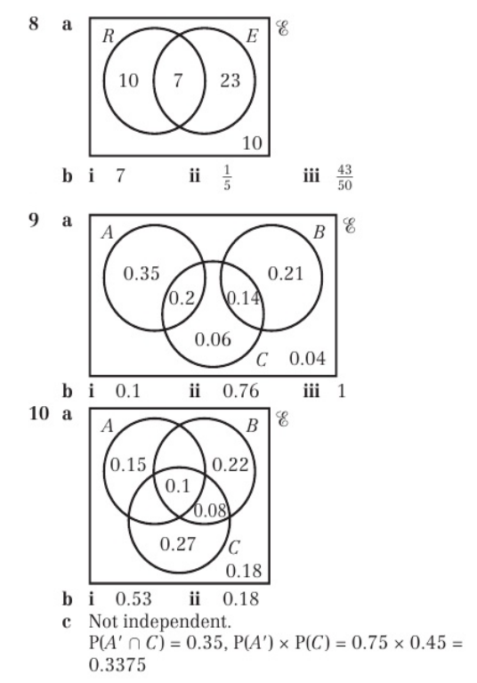
Homework Answers

Slide 24
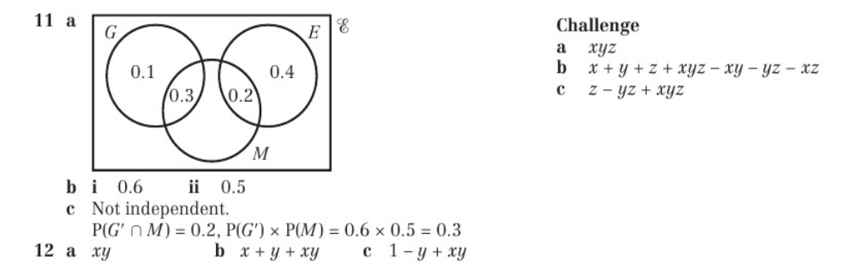
Homework Answers

