Slide 1
P2 Chapter 4: Binomial Terms
Basic Binomials

Slide 2
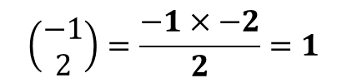
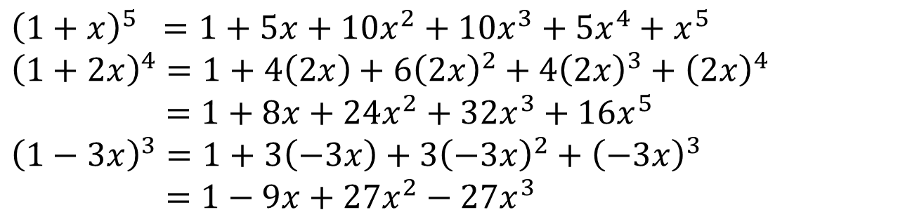
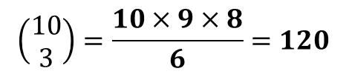
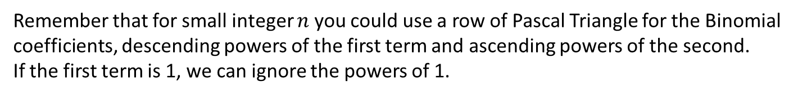

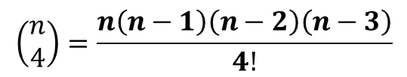
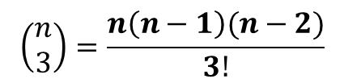
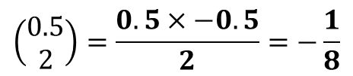
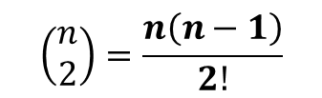
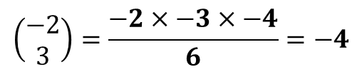
Pure Year 1 Recap
Remember that for small integer $n$ you could use a row of Pascal Triangle for the Binomial coefficients, descending powers of the first term and ascending powers of the second.
If the first term is 1, we can ignore the powers of 1.
$${\left(1+x\right)}^{5} =1+5x+10x^{2}+10x^{3}+5x^{4}+x^{5} \\ {\left(1+2x\right)}^{4}=1+4\left(2x\right)+6{\left(2x\right)}^{2}+4{\left(2x\right)}^{3}+{\left(2x\right)}^{4} \\ =1+8x+24x^{2}+32x^{3}+16x^{5} \\ {\left(1−3x\right)}^{3}=1+3\left(−3x\right)+3{\left(−3x\right)}^{2}+{\left(−3x\right)}^{3} \\ =1−9x+27x^{2}−27x^{3}$$
?
?
?
Do you remember the simple way to find your Binomial coefficients?
Hopefully you can see the pattern by this point.
?
?
?
?
$$\left(\begin{matrix}n \\ 1\end{matrix}\right)=n$$
$$\left(\begin{matrix}n \\ 2\end{matrix}\right)=\frac{n\left(n−1\right)}{2!}$$
$$\left(\begin{matrix}n \\ 3\end{matrix}\right)=\frac{n\left(n−1\right)(n−2)}{3!}$$
$$\left(\begin{matrix}n \\ 4\end{matrix}\right)=\frac{n\left(n−1\right)\left(n−2\right)\left(n−3\right)}{4!}$$
?
?
?
$$\left(\begin{matrix}10 \\ 3\end{matrix}\right)=\frac{10×9×8}{6}=120$$
$$\left(\begin{matrix}−1 \\ 2\end{matrix}\right)=\frac{−1×−2}{2}=1$$
$$\left(\begin{matrix}−2 \\ 3\end{matrix}\right)=\frac{−2×−3×−4}{6}=−4$$
?
Note: You can work out a ‘choose’ value, in the same way, when the top number is negative or fractional, but your calculator can not do this directly.
$$\left(\begin{matrix}0.5 \\ 2\end{matrix}\right)=\frac{0.5×−0.5}{2}=−\frac{1}{8}$$

Slide 3
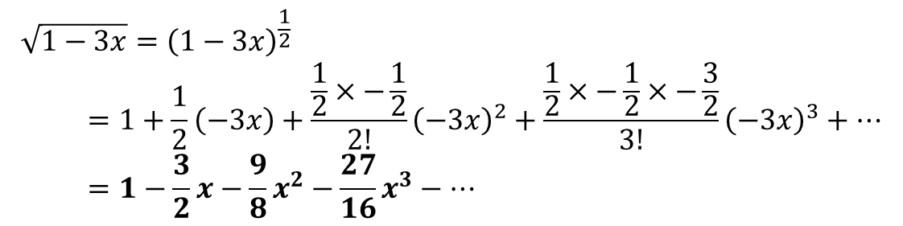
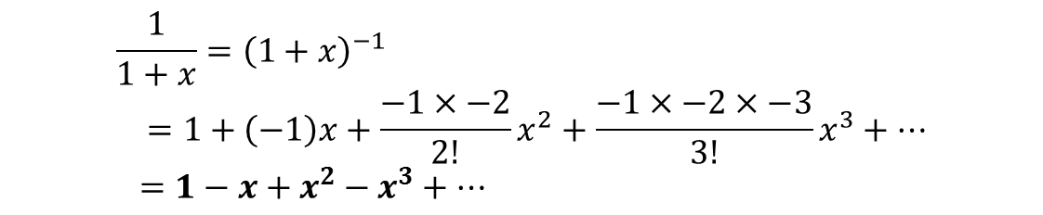
Binomial Expansion
! ${\left(1+x\right)}^{n}=1+nx+\frac{n\left(n−1\right)}{2!}x^{2}+\frac{n\left(n−1\right)\left(n−2\right)}{3!}x^{3}+…+nCr x^{n}$
Binomial expansions, when $n$ is either negative or fractions, are infinitely long.
Use the binomial expansion to find the first four terms of $\frac{1}{1+x}$
?
$$\frac{1}{1+x}={\left(1+x\right)}^{−1} \\ =1+\left(−1\right)x+\frac{−1×−2}{2!}x^{2}+\frac{−1×−2×−3}{3!}x^{3}+… \\ =1−x+x^{2}−x^{3}+…$$
And the first four terms of $\sqrt{1−3x}$
?
$$\sqrt{1−3x}={\left(1−3x\right)}^{\frac{1}{2}} \\ =1+\frac{1}{2}\left(−3x\right)+\frac{\frac{1}{2}×−\frac{1}{2}}{2!}{\left(−3x\right)}^{2}+\frac{\frac{1}{2}×−\frac{1}{2}×−\frac{3}{2}}{3!}{\left(−3x\right)}^{3}+… \\ =1−\frac{3}{2}x−\frac{9}{8}x^{2}−\frac{27}{16}x^{3}−…$$

Slide 4

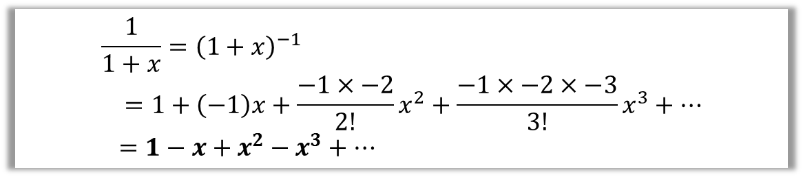
When are infinite expansions valid?
Our expansion might be an infinite number of terms. If so, the result must converge
$$\frac{1}{1+x}={\left(1+x\right)}^{−1} \\ =1+\left(−1\right)x+\frac{−1×−2}{2!}x^{2}+\frac{−1×−2×−3}{3!}x^{3}+… \\ =1−x+x^{2}−x^{3}+…$$
What would happen in the expansion if:
a) $x>1$ : e.g. $1−2+2^{2}−2^{4}+…$ This diverges, so expansion is not valid.
b) $0<x<1$: e.g $1−0.5+{0.5}^{2}−{0.5}^{3}+…$ This converges, as the terms
become smaller each time.
c) $−1<x<0$: Again, this converges.
d) $x=1$ : This would suggest $1−1+1−1+1−…=\frac{1}{2}$ ! Indeed in
some branches of mathematics this result is valid, but for the purposes
of A Level this expansion is not valid.
Therefore requirement on $x$:
$$−1<x<1$$
which we’d typically write as $\left|x\right|<1$
?
?
?
?
?

Slide 5

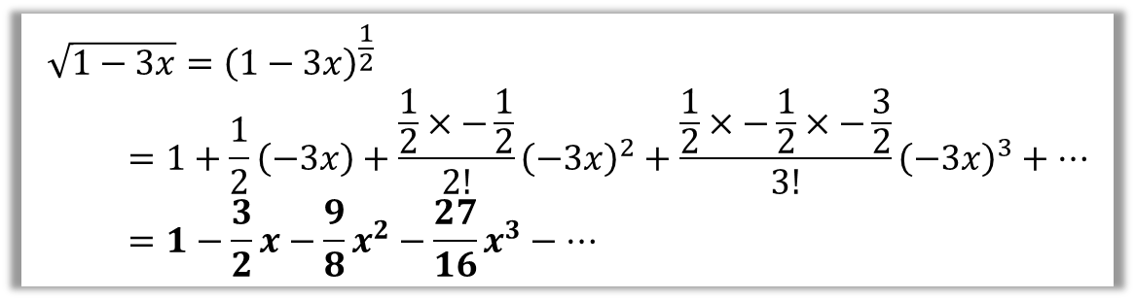
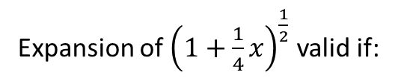

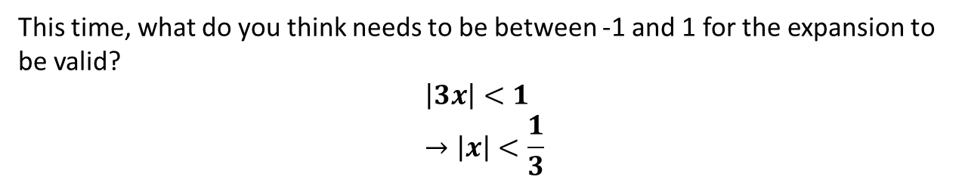

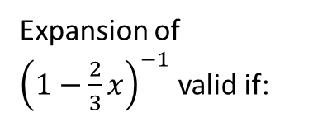



When are infinite expansions valid?
Expansions are allowed to infinite. However, the result must converge
$$\sqrt{1−3x}={\left(1−3x\right)}^{\frac{1}{2}} \\ =1+\frac{1}{2}\left(−3x\right)+\frac{\frac{1}{2}×−\frac{1}{2}}{2!}{\left(−3x\right)}^{2}+\frac{\frac{1}{2}×−\frac{1}{2}×−\frac{3}{2}}{3!}{\left(−3x\right)}^{3}+… \\ =1−\frac{3}{2}x−\frac{9}{8}x^{2}−\frac{27}{16}x^{3}−…$$
This time, what do you think needs to be between -1 and 1 for the expansion to be valid?
$$\left|3x\right|<1 \\ →\left|x\right|<\frac{1}{3}$$
?
! An infinite expansion ${\left(1+x\right)}^{n}$ is valid if $\left|x\right|<1$
Quickfire Examples:
Expansion of ${\left(1−\frac{2}{3}x\right)}^{−1}$ valid if:
?
Expansion of ${\left(1+2x\right)}^{−1}$ valid if:
$$\left|2x\right|<1 → \left|x\right|<\frac{1}{2}$$
$$|x|<1$$
Expansion of ${\left(1−x\right)}^{−2}$ valid if:
?
?
Expansion of ${\left(1+\frac{1}{4}x\right)}^{\frac{1}{2}}$ valid if:
$$\left|\frac{2}{3}x\right|<1 → \left|x\right|<\frac{3}{2}$$
?
$$\left|\frac{1}{4}x\right|<1 → \left|x\right|<4$$

Slide 6
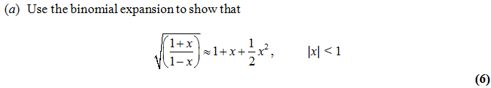


Combining Expansions
Edexcel C4 June 2013 Q2
?
Firstly express as a product:
$$\sqrt{\frac{1+x}{1−x}}={\left(1+x\right)}^{\frac{1}{2}}{\left(1−x\right)}^{−\frac{1}{2}}$$
How many terms do we need in each expansion?
We don’t need beyond $x^{2}$ in each, because in the product other terms would have a power higher than 2.
Completing:
$${\left(1+x\right)}^{\frac{1}{2}}=1+\frac{1}{2}x+\frac{\frac{1}{2}×−\frac{1}{2}}{2!}x^{2} =1+\frac{1}{2}x−\frac{1}{8}x^{2}+… \\ {\left(1−x\right)}^{−\frac{1}{2}}=1+\left(−\frac{1}{2}\right)\left(−x\right)+\frac{−\frac{1}{2}×−\frac{3}{2}}{2!}{\left(−x\right)}^{2}=1+\frac{1}{2}x+\frac{3}{8}x^{2}−… \\ \left(1+\frac{1}{2}x−\frac{1}{8}x^{2}\right)\left(1+\frac{1}{2}x+\frac{3}{8}x^{2}\right)=1+\frac{1}{2}x+\frac{1}{2}x+\frac{1}{4}x−\frac{1}{8}x^{2}+\frac{3}{8}x^{2}+… \\ =1+x+\frac{1}{2}x^{2}$$
?
?

Slide 7
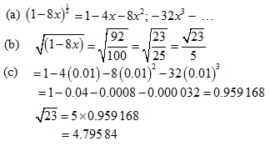
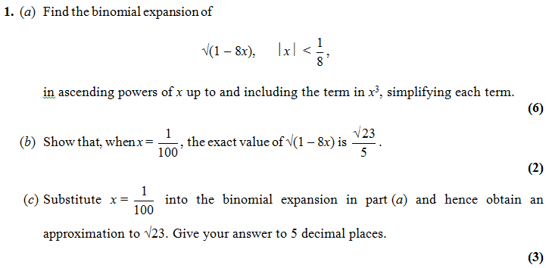
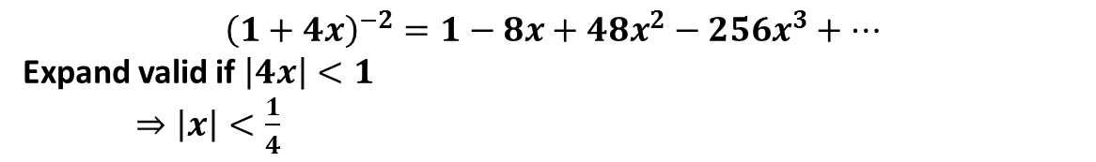
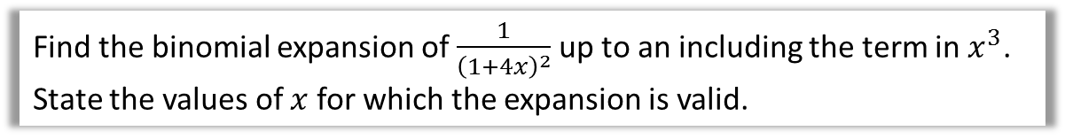
Test Your Understanding
Find the binomial expansion of $\frac{1}{{\left(1+4x\right)}^{2}}$ up to an including the term in $x^{3}$. State the values of $x$ for which the expansion is valid.
?
$${\left(1+4x\right)}^{−2}=1−8x+48x^{2}−256x^{3}+…$$
Expand valid if $\left|4x\right|<1$
$⇒\left|x\right|<\frac{1}{4}$
?
C4 Edexcel Jan 2010

Slide 8
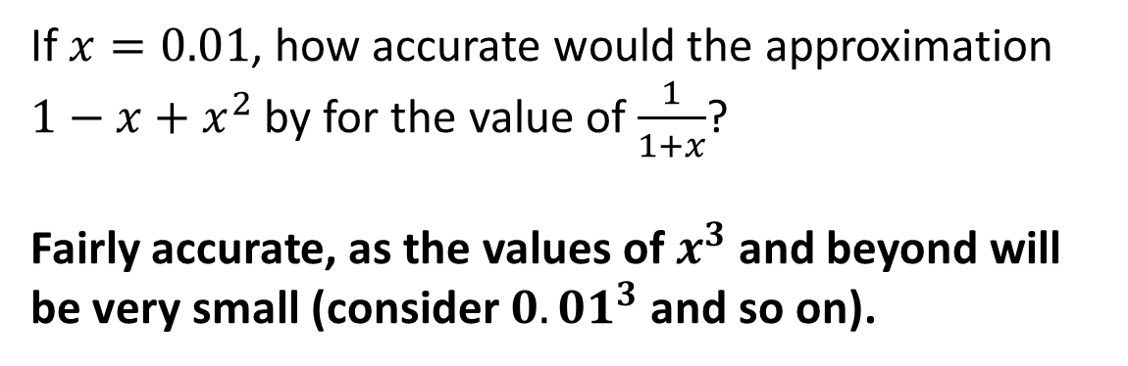
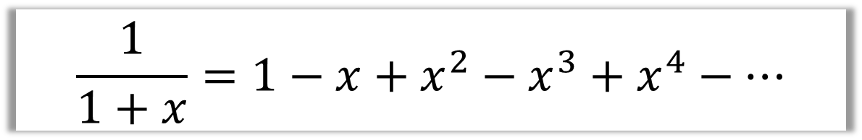
Accuracy of an approximation
$$\frac{1}{1+x}=1−x+x^{2}−x^{3}+x^{4}−…$$
If $x=0.01$, how accurate would the approximation $1−x+x^{2}$ by for the value of $\frac{1}{1+x}$?
Fairly accurate, as the values of $x^{3}$ and beyond will be very small (consider ${0.01}^{3}$ and so on).
?

Slide 9
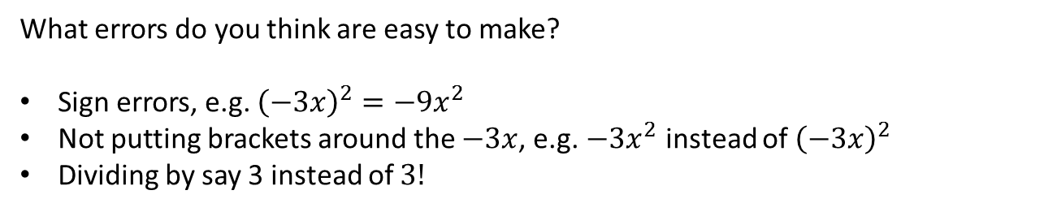

Common Errors
$$\sqrt{1−3x}={\left(1−3x\right)}^{\frac{1}{2}} \\ =1+\frac{1}{2}\left(−3x\right)+\frac{\frac{1}{2}×−\frac{1}{2}}{2!}{\left(−3x\right)}^{2}+\frac{\frac{1}{2}×−\frac{1}{2}×−\frac{3}{2}}{3!}{\left(−3x\right)}^{3}+… \\ =1−\frac{3}{2}x−\frac{9}{8}x^{2}−\frac{27}{16}x^{3}−…$$
What errors do you think are easy to make?
Sign errors, e.g. ${\left(−3x\right)}^{2}=−9x^{2}$
Not putting brackets around the $−3x$, e.g. $−3x^{2}$ instead of ${\left(−3x\right)}^{2}$
Dividing by say 3 instead of $3!$

Slide 10
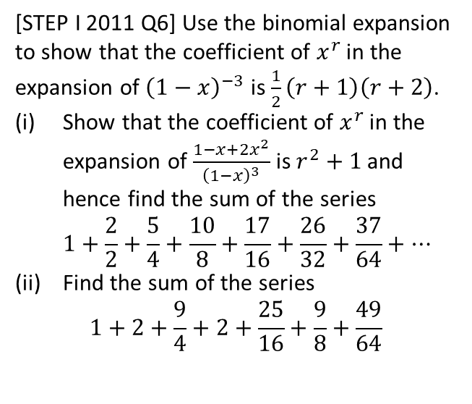
Exercise 4.1
Pearson Pure Mathematics Year 2/AS
Page 29
Extension
1
[STEP I 2011 Q6] Use the binomial expansion to show that the coefficient of $x^{r}$ in the expansion of ${\left(1−x\right)}^{−3}$ is $\frac{1}{2}\left(r+1\right)\left(r+2\right)$.
Show that the coefficient of $x^{r}$ in the expansion of $\frac{1−x+2x^{2}}{{\left(1−x\right)}^{3}}$ is $r^{2}+1$ and hence find the sum of the series
$1+\frac{2}{2}+\frac{5}{4}+\frac{10}{8}+\frac{17}{16}+\frac{26}{32}+\frac{37}{64}+…$
Find the sum of the series
$1+2+\frac{9}{4}+2+\frac{25}{16}+\frac{9}{8}+\frac{49}{64}$

Slide 11
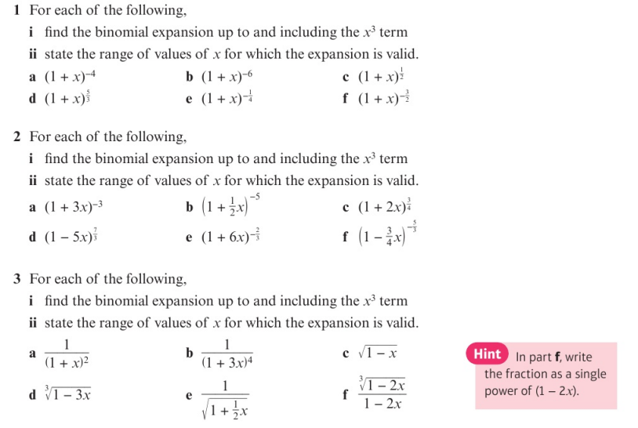
Homework Exercise

Slide 12
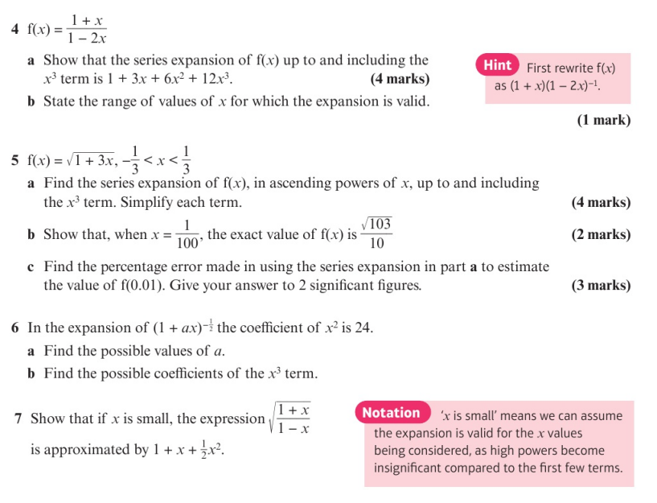
Homework Exercise

Slide 13
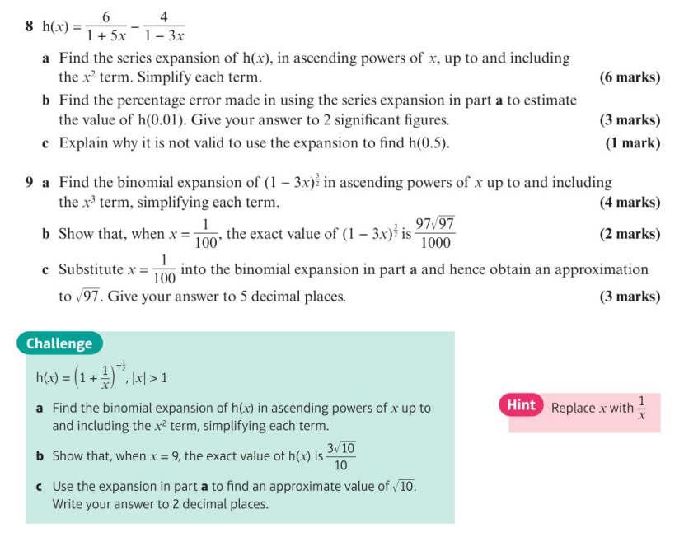
Homework Exercise

Slide 14
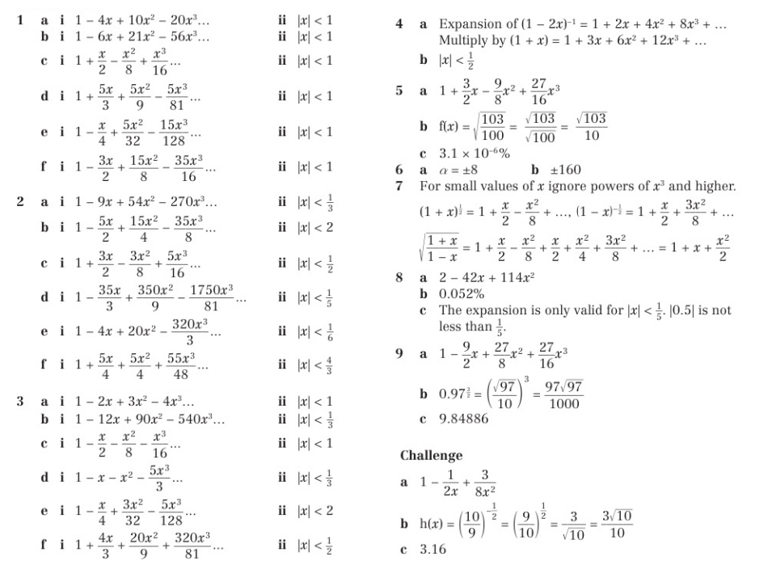
Homework Answers

