Slide 1
P1 Chapter 12: Differentiation
Second Order Derivatives

Slide 2

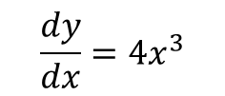



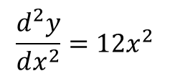





Second Order Derivatives
When you differentiate once, the expression you get is known as the first derivative.
Unsurprisingly, when we differentiate a second time, the resulting expression is known as the second derivative. And so on…
Original Function
First Derivative
Second Derivative
$$\frac{dy}{dx}=4x^{3}$$
$$\frac{d^{2}y}{dx^{2}}=12x^{2}$$
Leibniz’s
$$y=x^{4}$$
$$y′=4x^{3}$$
$$y′′=12x^{2}$$
Newton’s
$$\dot{y}=4x^{3}$$
$$\ddot{y}=12x^{2}$$
Lagrange’s
$$f\left(x\right)=x^{4}$$
$$f′\left(x\right)=4x^{3}$$
$$f′′\left(x\right)=12x^{2}$$
You can similarly have the third derivative ($\frac{d^{3}y}{dx^{3}}$), although this is no longer in the A Level syllabus. We’ll see why might use the second derivative soon…

Slide 3
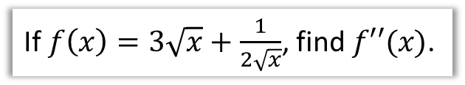
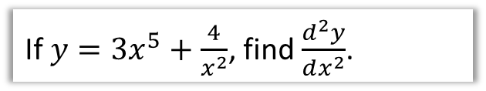


Examples
If $y=3x^{5}+\frac{4}{x^{2}}$, find $\frac{d^{2}y}{dx^{2}}$.
If $f\left(x\right)=3\sqrt{x}+\frac{1}{2\sqrt{x}}$, find $f′′(x)$.
?
?
$$y=3x^{5}+4x^{−2} \\ \frac{dy}{dx}=15x^{4}−8x^{−3} \\ \frac{d^{2}y}{dx^{2}}=60x^{3}+24x^{−4}$$
This could also be written as:
$$60x^{3}+\frac{24}{x^{4}}$$
$$f\left(x\right)=3x^{\frac{1}{2}}+\frac{1}{2}x^{−\frac{1}{2}} \\ f^{′}\left(x\right)=\frac{3}{2}x^{−\frac{1}{2}}−\frac{1}{4}x^{−\frac{3}{2}} \\ f^{′′}\left(x\right)=−\frac{3}{4}x^{−\frac{3}{2}}+\frac{3}{8}x^{−\frac{5}{2}}$$

Slide 4

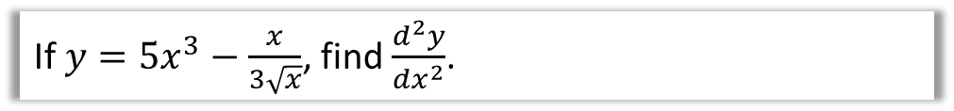
Test Your Understanding
If $y=5x^{3}−\frac{x}{3\sqrt{x}}$, find $\frac{d^{2}y}{dx^{2}}$.
?
$$y=5x^{3}−\frac{1}{3}x^{\frac{1}{2}} \\ \frac{dy}{dx}=15x^{2}−\frac{1}{6}x^{−\frac{1}{2}} \\ \frac{d^{2}y}{dx^{2}}=30x+\frac{1}{12}x^{−\frac{3}{2}}$$

Slide 5
Exercise 12.8
Pearson Pure Mathematics Year 1/AS
Page 97

Slide 6

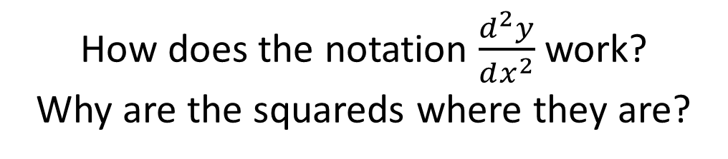
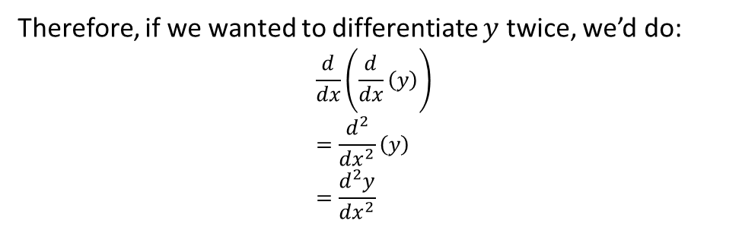
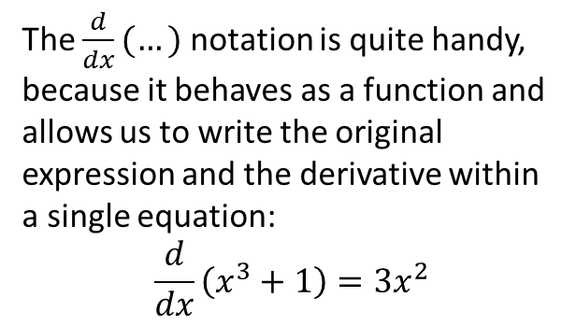
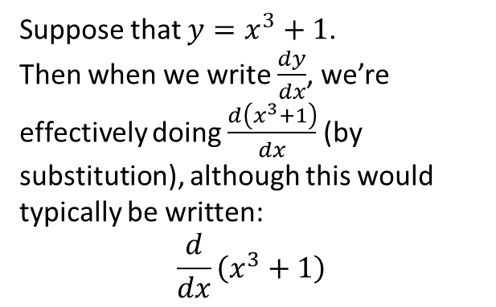
Just for your interest…
How does the notation $\frac{d^{2}y}{dx^{2}}$ work?
Why are the squareds where they are?
Suppose that $y=x^{3}+1$.
Then when we write $\frac{dy}{dx}$, we’re effectively doing $\frac{d\left(x^{3}+1\right)}{dx}$ (by substitution), although this would typically be written:
$$\frac{d}{dx}\left(x^{3}+1\right)$$
The $\frac{d}{dx}(…)$ notation is quite handy, because it behaves as a function and allows us to write the original expression and the derivative within a single equation:
$$\frac{d}{dx}\left(x^{3}+1\right)=3x^{2}$$
Therefore, if we wanted to differentiate $y$ twice, we’d do:
$$\frac{d}{dx}\left(\frac{d}{dx}\left(y\right)\right) \\ =\frac{d^{2}}{dx^{2}}\left(y\right) \\ =\frac{d^{2}y}{dx^{2}}$$

Slide 7
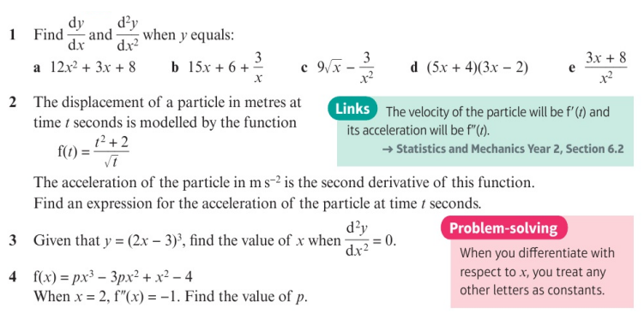
Homework Exercise

Slide 8
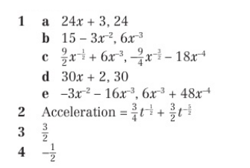
Homework Answers

