Slide 1
P1 Chapter 6: Circles Perpendicular Bisectors

Slide 2


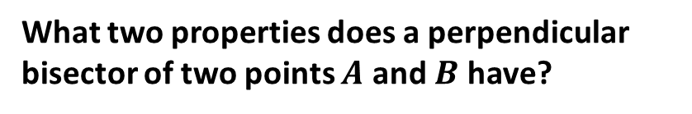



Midpoints and Perpendicular Bisectors
Later in the chapter you will need to find the perpendicular bisector of a chord of a circle.
What two properties does a perpendicular bisector of two points $A$ and $B$ have?
chord
perpendicular bisector
$$B\left(6,7\right)$$
$$A\left(2,5\right)$$
$$M\left(4,6\right)$$
Just find the mean of the $x$ values and the mean of the $y$ values.
?
1. It passes through the midpoint of $AB$.
2. It is perpendicular to $AB$.
Equation?
$$m_{AB}=\frac{2}{4}=\frac{1}{2} \\ m_{⊥}=−2$$
$$y−6=−2\left(x−4\right)$$
?

Slide 3



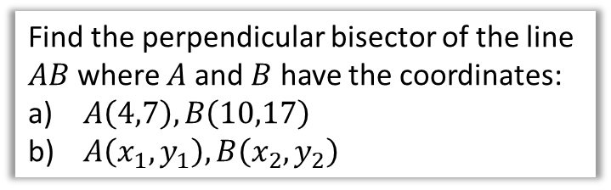


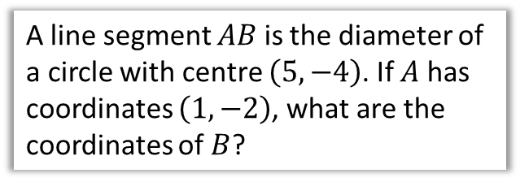
Test Your Understanding
Find the perpendicular bisector of the line $AB$ where $A$ and $B$ have the coordinates:
$A\left(4,7\right), B\left(10,17\right)$
$A\left(x_{1},y_{1}\right), B\left(x_{2},y_{2}\right)$
A line segment $AB$ is the diameter of a circle with centre $\left(5,−4\right)$. If $A$ has coordinates $\left(1,−2\right)$, what are the coordinates of $B$?
a
$$M\left(7,12\right) \\ m_{AB}=\frac{10}{6}=\frac{5}{3} ∴m_{⊥}=−\frac{3}{5} \\ y−12=−\frac{3}{5}\left(x−7\right)$$
$$M\left(\frac{x_{1}+x_{2}}{2},\frac{y_{1}+y_{2}}{2}\right) \\ m_{AB}=\frac{y_{2}−y_{1}}{x_{2}−x_{1}} m_{⊥}=\frac{x_{1}−x_{2}}{y_{2}−y_{1}} \\ y−\frac{y_{1}+y_{2}}{2}=\frac{x_{1}−x_{2}}{y_{2}−y_{1}}\left(x−\frac{x_{1}+x_{2}}{2}\right)$$
?
$$A\left(1,−2\right)$$
$$M\left(5,−4\right)$$
$$B$$
b
?
We could use the formula $\left(\frac{x_{1}+x_{2}}{2},\frac{y_{1}+y_{2}}{2}\right)$, but it is easy to see from the diagram that whatever movement there is from $A$ to $M$, we can continue to get to $B$.
$$5+4=9 \\ −4−2=−6 \\ B\left(9,−6\right)$$
?
Note: No need to memorise!

Slide 4
Exercise 6.1
Pearson Pure Mathematics Year 2/AS
Page 46

Slide 5
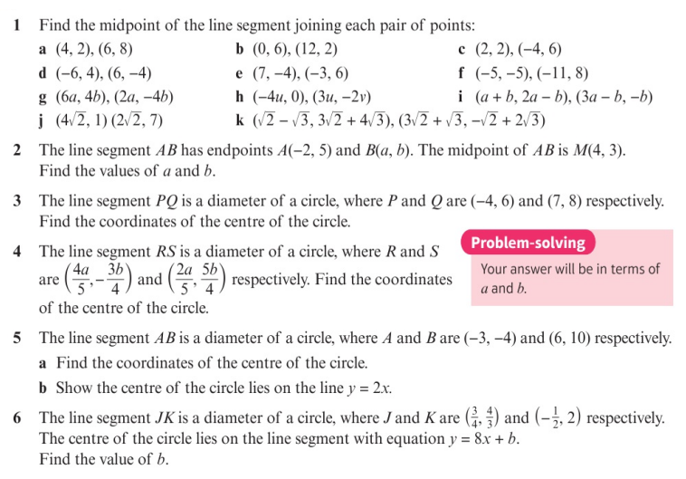
Homework Exercise

Slide 6
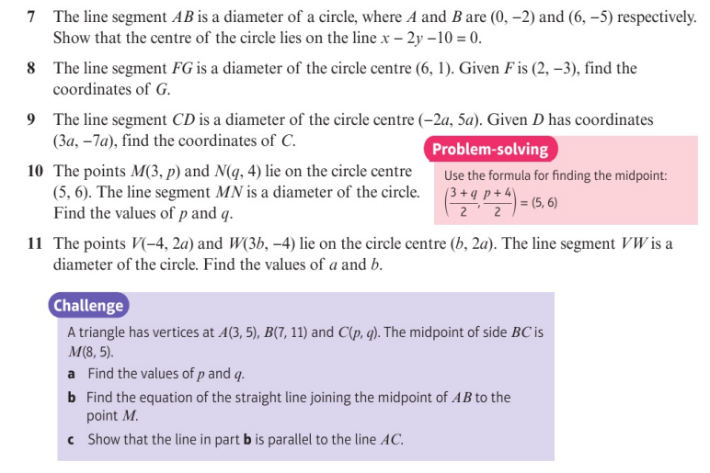
Homework Exercise

Slide 7
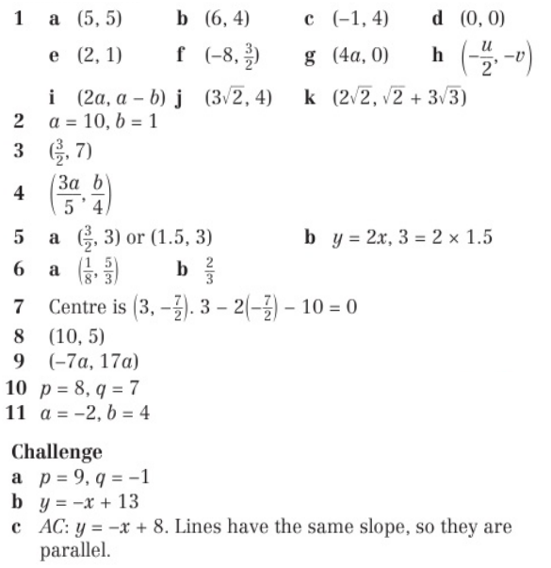
Homework Answers

Slide 8
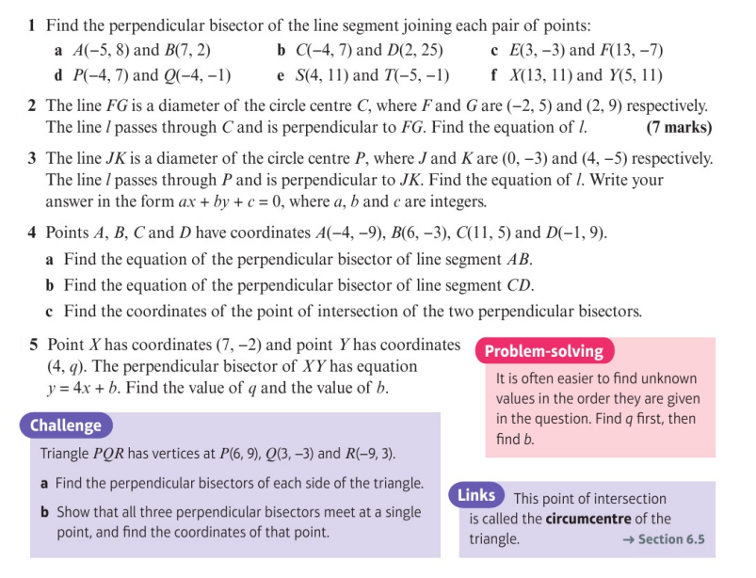
Homework Exercise

Slide 9
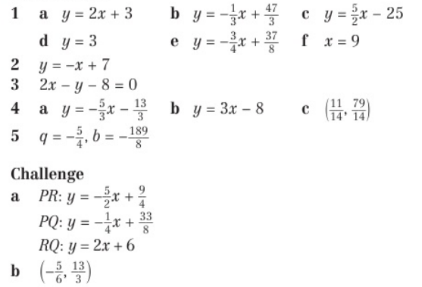
Homework Answers

