Slide 1
P2 Chapter 2: Graphing Functions
Composite Functions

Slide 2






Composite Functions
Sometimes we may apply multiple functions in succession to an input.
These combined functions are known as a composite function.
$$f$$
$$g$$
$$x$$
$$f\left(x\right)$$
$$gf\left(x\right)$$
$$gf$$
! $gf(x)$ means $g(f\left(x\right))$, i.e. $f$ is applied first, then $g$.

Slide 3
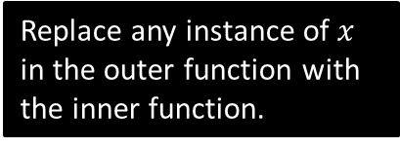


Examples
Let $f\left(x\right)=x^{2}+1$, and $g\left(x\right)=4x−2$.
What is…
$fg(2)$? $=f\left(g\left(2\right)\right)=f\left(6\right)=37$
$fg(x)$? $f\left(g\left(x\right)\right)=f\left(4x−2\right)$
$$={\left(4x−2\right)}^{2}+1 \\ =16x^{2}−16x+5$$
$gf(x)$? $g\left(f\left(x\right)\right)=g\left(x^{2}+1\right)$
$$=4\left(x^{2}+1\right)−2 \\ =4x^{2}+2$$
$f^{2}\left(x\right)$? $=f\left(f\left(x\right)\right)={\left(x^{2}+1\right)}^{2}+1$
Solve $gf\left(x\right)=38$ $4x^{2}+2=38$
$$x=±3$$
?
?
Replace any instance of $x$ in the outer function with the inner function.
?
?
$f^{2}\left(x\right)$ means $ff(x)$
?

Slide 4



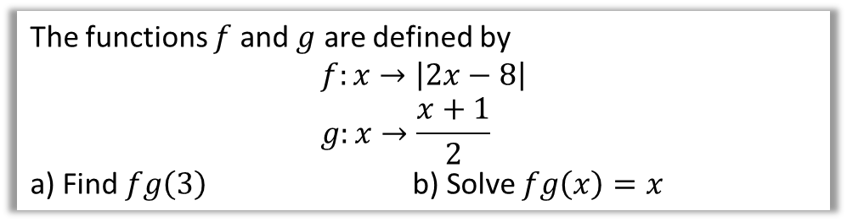

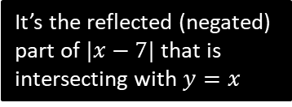




Further Examples
The functions $f$ and $g$ are defined by
$$f:x→\left|2x−8\right| \\ g:x→\frac{x+1}{2}$$
a) Find $fg\left(3\right)$ b) Solve $fg\left(x\right)=x$
a
?
$$fg\left(3\right)=f\left(g\left(3\right)\right)=f\left(2\right) \\ =\left|4−8\right|=\left|−4\right|=4$$
$$fg\left(x\right)=f\left(\frac{x+1}{2}\right)=\left|2\left(\frac{x+1}{2}\right)−8\right| \\ =\left|x−7\right|$$
$$\left|x−7\right|=x$$
b
?
$$y$$
$$y=x$$
$$y=|x−7|$$
$$−x+7=x \\ x=3.5$$
It’s the reflected (negated) part of $|x−7|$ that is intersecting with $y=x$
$$7$$
$$7$$
$$x$$

Slide 5

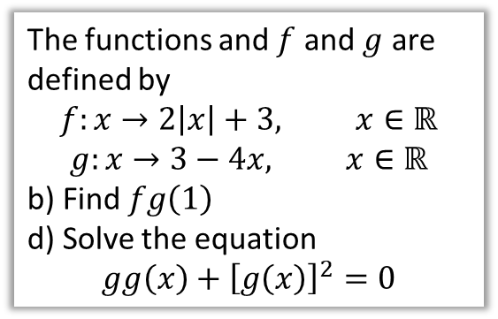
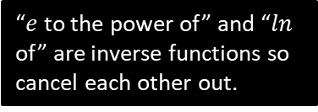
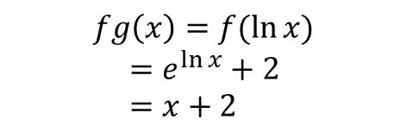
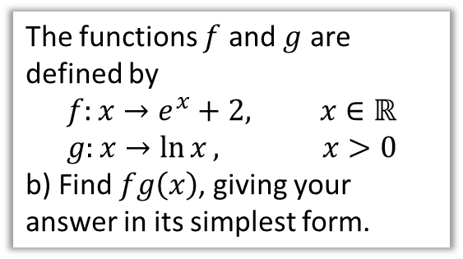
Test Your Understanding
Edexcel C4 June 2013(R) Q4
Edexcel C4 June 2012 Q6
The functions and $f$ and $g$ are defined by
$$f:x→2\left|x\right|+3, x∈ℝ$$
$$g:x→3−4x, x∈ℝ$$
b) Find $fg\left(1\right)$
d) Solve the equation
$$gg\left(x\right)+{\left[g\left(x\right)\right]}^{2}=0$$
The functions $f$ and $g$ are defined by
$$f:x→e^{x}+2, x∈ℝ \\ g:x→\ln{x}, x>0$$
b) Find $fg\left(x\right)$, giving your answer in its simplest form.
? b
?
$$fg\left(1\right)=f\left(−1\right) \\ =2\left|−1\right|+3=5$$
$$3−4\left(3−4x\right)+{\left(3−4x\right)}^{2}=0 \\ 3−12+16x+9−24x+16x^{2}=0 \\ 16x^{2}−8x=0 \\ 2x^{2}−x=0 \\ x\left(2x−1\right)=0 \\ x=0, 0.5$$
$$fg\left(x\right)=f(\ln{x)} \\ =e^{\ln{x}}+2 \\ =x+2$$
? d
“$e$ to the power of” and “$ln$ of” are inverse functions so cancel each other out.

Slide 6


Exercise 2.3
Pearson Pure Mathematics Year 2/AS
Pages 8
2
[MAT 2012 Q2]
Let $f\left(x\right)=x+1$ and $g\left(x\right)=2x$.
i) Show that $f^{2}g\left(x\right)=gf\left(x\right)$
ii) Note that $gf^{2}g\left(x\right)=4x+4$
Find all the other ways of combining $f$ and $g$ that result in the function $4x+4$.
iii) Let $i,j,k≥0$ be integers. Determine the function
$$f^{i}gf^{j}gf^{k}(x)$$
iv) Let $m≥0$ be an integer. How many different ways of combining the functions $f$ and $g$ are there that result in the function $4x+4m$?
$f^{2}g\left(x\right)=2x+1+1=2x+2$
$gf\left(x\right)=2\left(x+1\right)=2x+2$
$f^{4}g^{2}, f^{2}gfg, gf^{2}g, g^{2}f$
$=4x+4k+2j+i$
$4x+4k+2j+i=4x+4m$
$∴4k+2j+i=4m$
If $k=0$, $j$ can vary between 0 and $2m$, which is $2m+1$ possibilities. If $k=1$, $j$ can vary between 0 and $2m−2$ which is $2m+1$ possibilities. Continuing in this way we get $1+3+5+…+\left(2m+1\right)$. This can be simplified to ${\left(m+1\right)}^{2}$ (see Arithmetic Series).
Extension
1
[MAT 2014 1F]
The functions $S$ and $T$ are defined for real numbers by $S\left(x\right)=x+1$ and $T\left(x\right)=−x$.
The function $S$ is applied $s$ times and the function $T$ is applied $t$ times, in some order, to produce the function
$$F\left(x\right)=8−x$$
It is possible to deduce that:
$s=8$ and $t=1$
$s$ is odd and $t$ is even.
$s$ is even and $t$ is odd.
$s$ and $t$ are powers of 2.
none of the above.
Each application of $T$ will oscillate the sign of $x$, so clearly $t$ is odd, eliminating (ii) and (iv). Each application of $T$ doesn’t change the magnitude of the constant term.
If $t=0$ we’d need 8 applications of $S$ to get to 8. An application of $T$ might get us from say 3 to -3. We’d then require and even number of applications of $S$ to get back up to 3 (in this case 6). So $s$ must be even. This leaves (i) and (iii), but there is more than one way, so the answer is (iii).
?
?

Slide 7
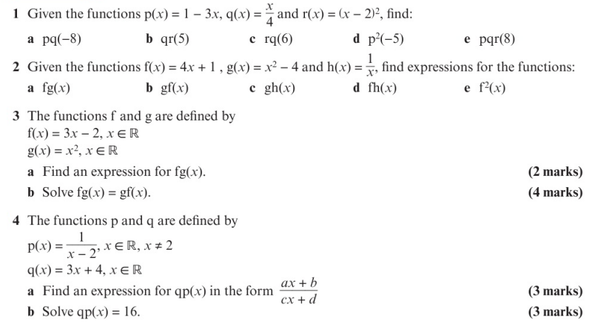
Homework Exercise

Slide 8
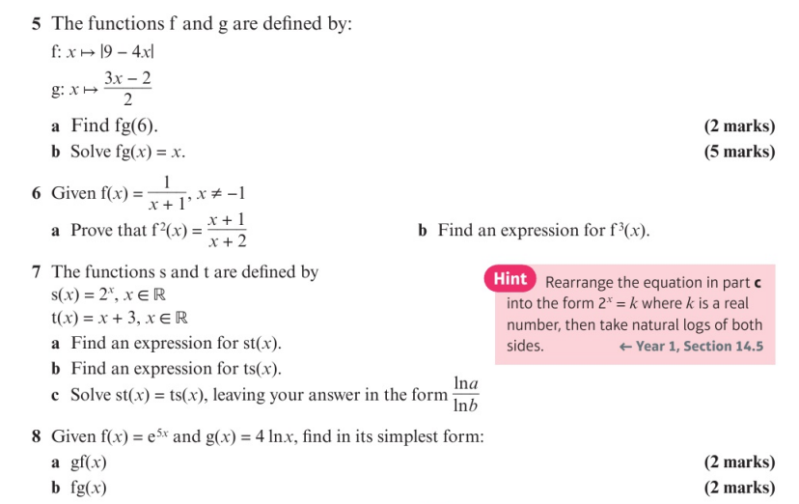
Homework Exercise

Slide 9
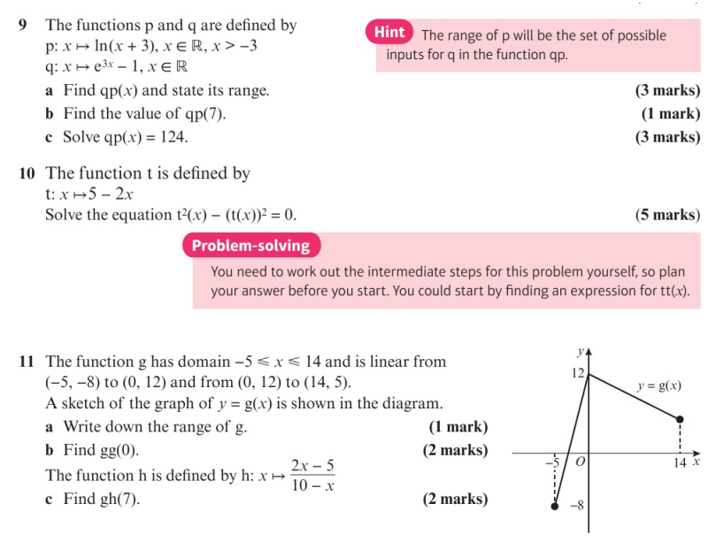
Homework Exercise

Slide 10
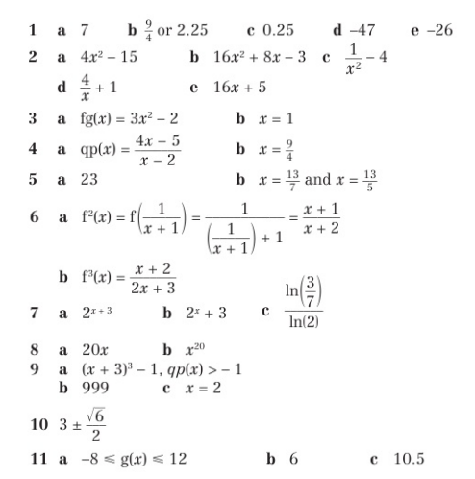
Homework Answers

