Slide 1
M1 Chapter 9: Constant Acceleration Motion Graphs

Slide 2








RECAP :: Displacement-Time Graphs
Describe the motion of each object:
$$s (m)$$
$$s (m)$$
$$s (m)$$
$$t (s)$$
$$t (s)$$
$$t (s)$$
?
?
?
Object is stationary.
Object is moving with constant velocity.
Object is accelerating.
Velocity is the rate of change of displacement
(i.e. gradient of displacement-time graph)
?
Displacement from starting point
Time taken
?
Average Velocity $=$
The distinction is important. If you went out then some time later travelled back home, your average velocity is 0 because your eventual displacement is 0!
Total distance travelled
Time taken
Average Speed $=$
?

Slide 3







Example
[Textbook] A cyclist rides in a straight line for 20 minutes. She waits for half an hour, then returns in a straight line to her starting point in 15 minutes. This is a displacement-time graph for her journey.
Work out the average velocity for each stage of the journey in km h⁻¹.
Write down the average velocity for the whole journey.
Work out average speed for the whole journey.
$$d (km)$$
$$A$$
$$B$$
5
$$O$$
$$C$$
20
50
65
$$t (mins)$$
$$OA: \frac{5}{20}=0.25 km \min^{−1}=15km h^{−1} \\ AB:0 km h^{−1} \\ BC:−\frac{5}{15}=−\frac{1}{3} km \min^{−1}=20 km h^{−1}$$
0 (as displacement is 0)
Total distance: 10km. Total time: 65 mins
$$Avg speed=\frac{10}{65}=\frac{2}{13} km \min^{−1}=9.23 km h^{−1} (3sf)$$
a
?
b
?
c
?

Slide 4
Exercise 9.1 Displacement-time graphs.
Pearson Stats/Mechanics Year 1
Pages 58-59

Slide 5



RECAP :: Velocity-Time Graphs
Describe the motion of each object:
$$v (ms^{−1})$$
$$v (ms^{−1})$$
$$v (ms^{−1})$$
$$t (s)$$
$$t (s)$$
$$t (s)$$
?
Object has constant acceleration (as velocity is increasing at constant rate).
?
Object is moving with constant velocity (as change in velocity is 0).
?
Object is stationary.
Acceleration is the rate of change of velocity
(i.e. gradient of velocity-time graph)
?
?
The area under a velocity-time graph gives the distance travelled.
Fro Note: We’ll see later in Chapter 11 that when we differentiate displacement we get velocity, and therefore integrating velocity gives displacement. But we know that integrating finds the area under the graph.

Slide 6


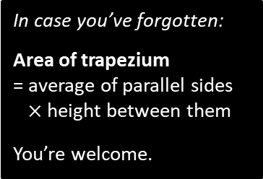

Examples
[Textbook] The figure shows a velocity-time graph illustrating the motion of a cyclist moving along a straight road for a period of 12 seconds. For the first 8 seconds, she moves at a constant speed of 6 m s⁻¹. She then decelerates at a constant rate, stopping after a further 4 seconds.
Find the displacement from the starting point of the cyclist after this 12 second period.
Work out the rate at which the cyclist decelerates.
$$v (ms^{−1})$$
6
$$t (s)$$
8
12
a
?
In case you’ve forgotten:
Area of trapezium
= average of parallel sides
$×$ height between them
You’re welcome.
Area of trapezium:
$$\frac{8+12}{2}×6=60 m$$
Using the gradient:
$$−\frac{6}{4}=−1.5 ms^{−2}$$
b
?

Slide 7




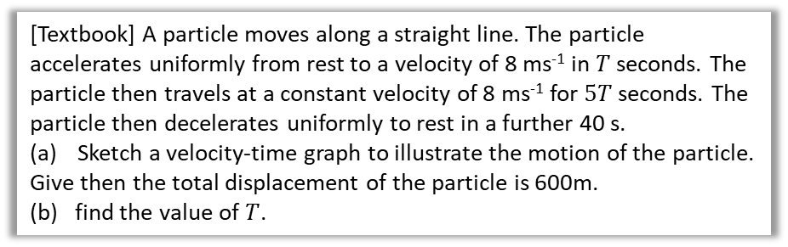






Algebraic Example
[Textbook] A particle moves along a straight line. The particle accelerates uniformly from rest to a velocity of 8 ms⁻¹ in $T$ seconds. The particle then travels at a constant velocity of 8 ms⁻¹ for $5T$ seconds. The particle then decelerates uniformly to rest in a further 40 s.
Sketch a velocity-time graph to illustrate the motion of the particle.
Give then the total displacement of the particle is 600m.
(b) find the value of $T$.
b
Using area:
$$\frac{5T+\left(6T+40\right)}{2}×8=600 \\ 44T+160=600 \\ T=10$$
a
?
?
$$v (ms^{−1})$$
$$A$$
$$B$$
8
$$O$$
$$C$$
$$t (s)$$
$$T$$
$$5T$$
$$40$$
Fro Tip: Sometimes it’s easier to indicate the period of time that has passed (using arrows) rather than the time at the end of the interval.

Slide 8
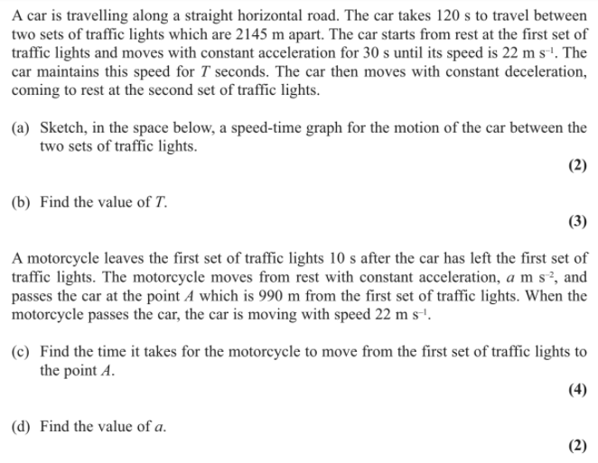
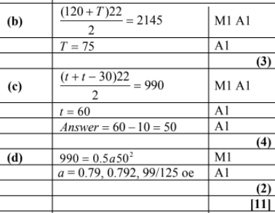
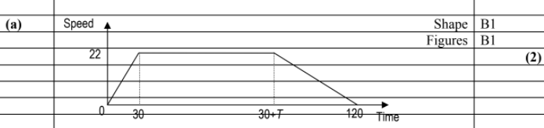
Test Your Understanding
Edexcel M1 May 2013
?
?
?
You won’t likely have the knowledge for (d) yet…
?

Slide 9
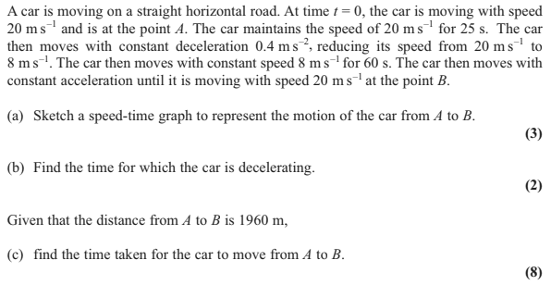
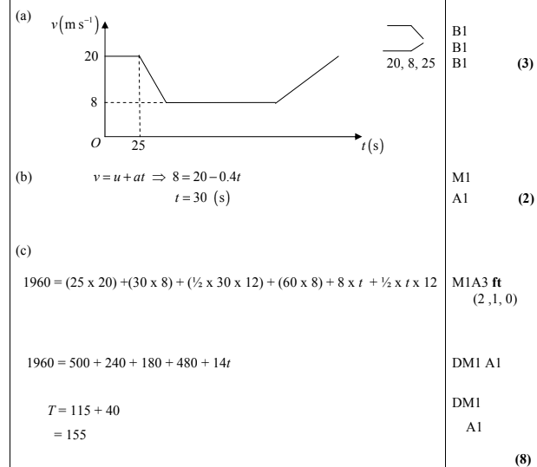
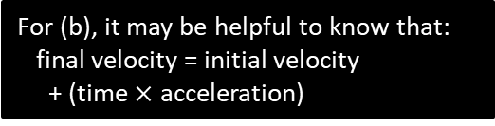
Exercise 9B
Pearson Stats/Mechanics Year 1
Pages 135-136
Edexcel M1 May 2012 Q4
?
?
?
For (b), it may be helpful to know that:
final velocity = initial velocity
+ (time $×$ acceleration)

Slide 10
Exercise 9.2
Pearson Stats/Mechanics Year 1
Pages 59-60

Slide 11
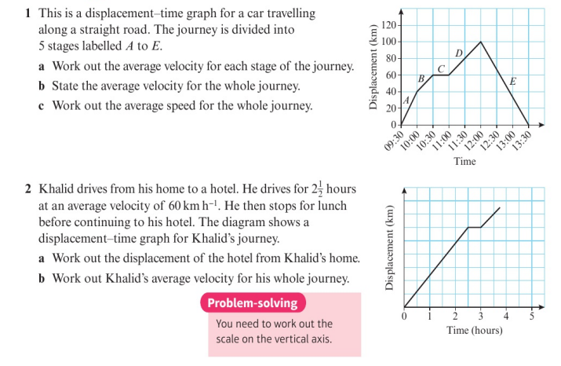
Homework Exercise

Slide 12
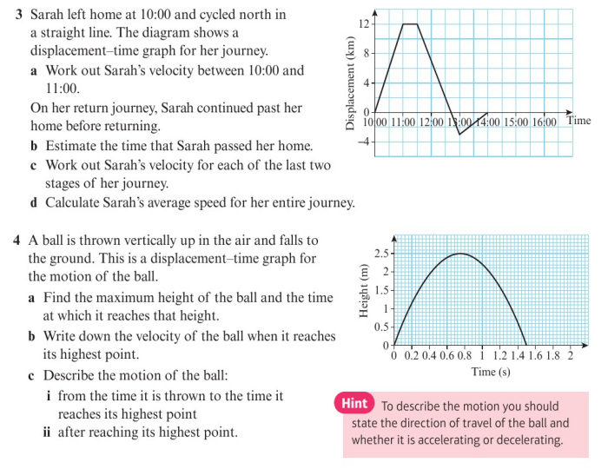
Homework Exercise

Slide 13
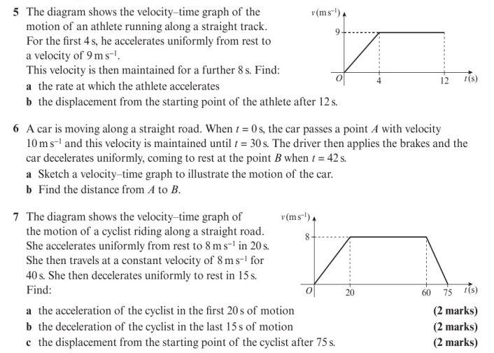
Homework Exercise

Slide 14
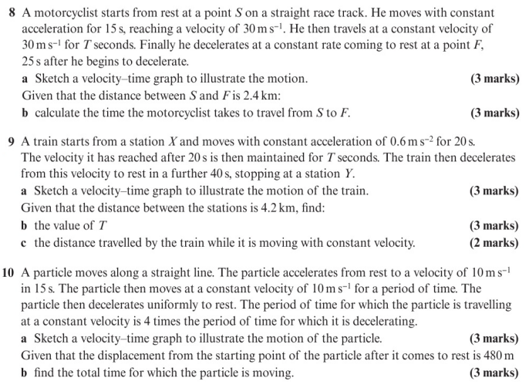
Homework Exercise

Slide 15
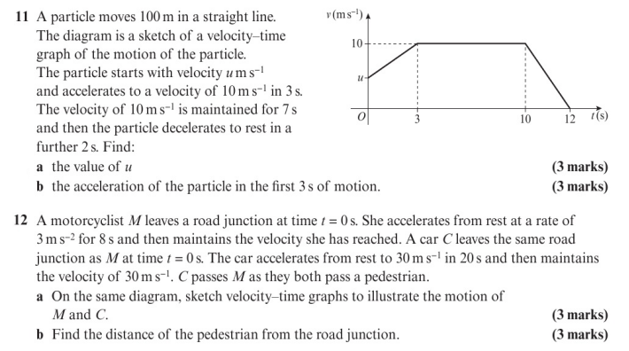
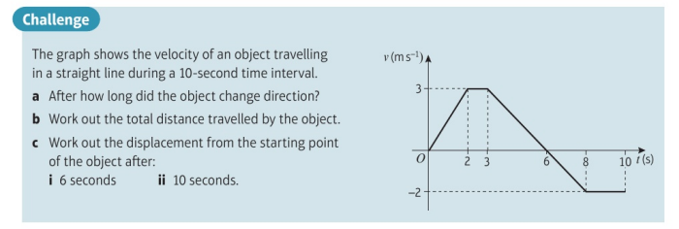
Homework Exercise

Slide 16
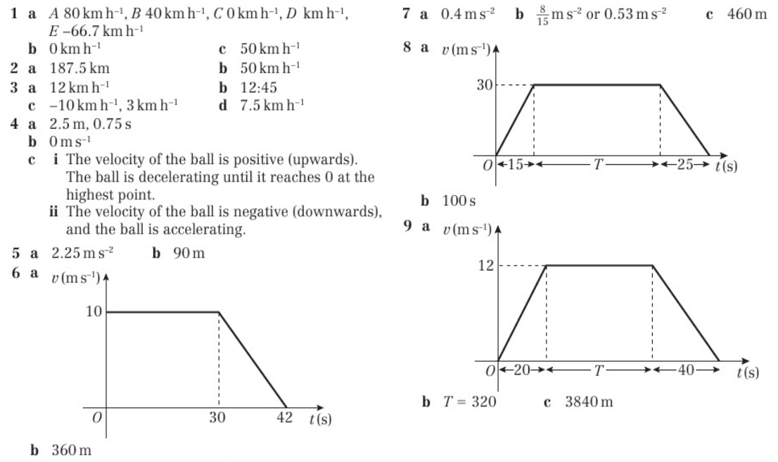
Homework Answers

Slide 17
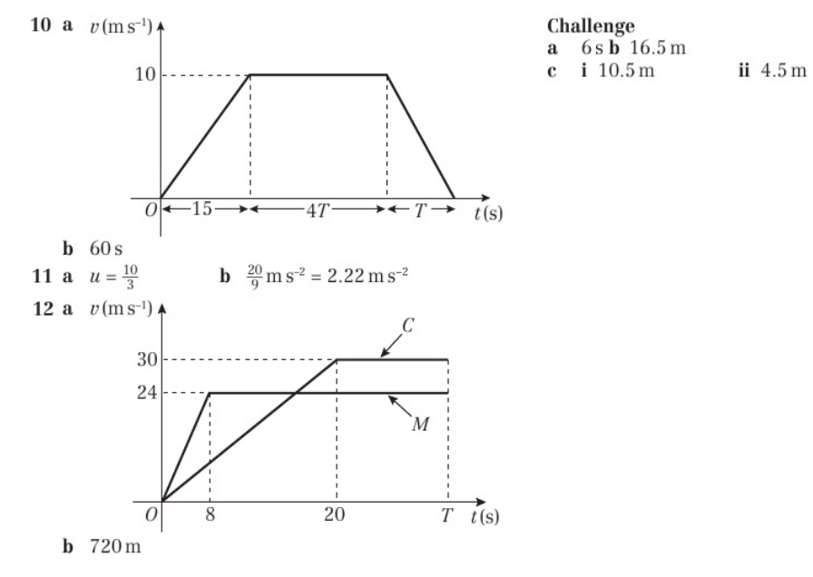
Homework Answers

