Slide 1
P1 Chapter 1: Algebra Surds

Slide 2
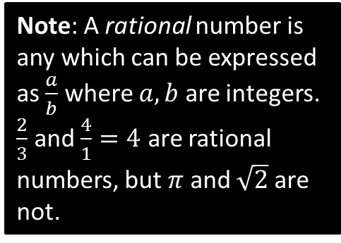
Surds
Recap:
Note: A rational number is any which can be expressed as $\frac{a}{b}$ where $a,b$ are integers. $\frac{2}{3}$ and $\frac{4}{1}=4$ are rational numbers, but $π$ and $\sqrt{2}$ are not.
A surd is a root of a number that does not simplify to a rational number.
Laws:
$$\sqrt{a}×\sqrt{b}=\sqrt{ab} \\ \frac{\sqrt{a}}{\sqrt{b}}=\sqrt{\frac{a}{b}}$$
?
$$\sqrt{3}×2 =2\sqrt{3} \\ 3\sqrt{5}×2\sqrt{5} =30 \\ \sqrt{8}=\sqrt{4}\sqrt{2} =2\sqrt{2} \\ \sqrt{12}+\sqrt{27} =2\sqrt{3}+3\sqrt{3}=5\sqrt{3} \\ \left(\sqrt{8}+1\right)\left(\sqrt{2}−3\right) =\sqrt{16}−3\sqrt{8}+\sqrt{2}−3 \\ =4−6\sqrt{2}+\sqrt{2}−3 \\ =1−5\sqrt{2}$$
?
?
?
?
?
?

Slide 3
Exercise 1.5
Pearson Pure Mathematics Year 1/AS
Page 4

Slide 4
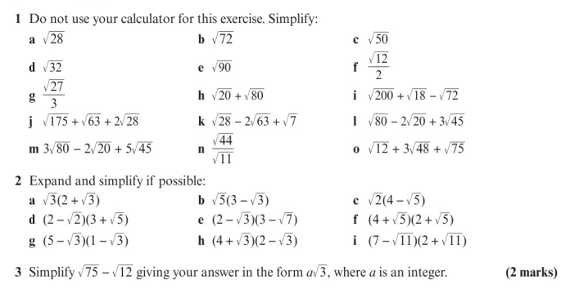
Homework Exercise

Slide 5
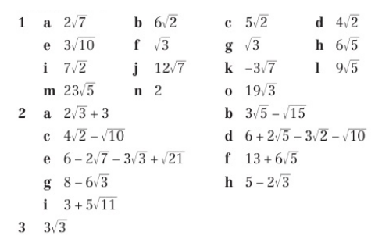
Homework Answers

