Slide 1
P2 Chapter 4: Binomial Terms
General Binomials

Slide 2

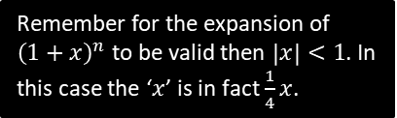
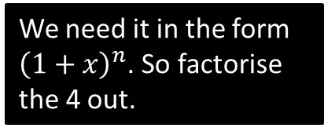

Dealing with ${\left(a+bx\right)}^{n}$
Find first four terms in the binomial expansion of $\sqrt{4+x}$
State the values of $x$ for which the expansion is valid.
?
We need it in the form ${\left(1+x\right)}^{n}$. So factorise the 4 out.
$${\left(4+x\right)}^{\frac{1}{2}}={\left[4\left(1+\frac{1}{4}x\right)\right]}^{\frac{1}{2}} \\ =4^{\frac{1}{2}}{\left(1+\frac{1}{4}x\right)}^{\frac{1}{2}} \\ =2(1+\left(\frac{1}{2}\right)\left(\frac{1}{4}x\right)+\frac{\frac{1}{2}×−\frac{1}{2}}{2!}{\left(\frac{1}{4}x\right)}^{2}+\frac{\left(\frac{1}{2}×−\frac{1}{2}×−\frac{3}{2}\right)}{3!}{\left(\frac{1}{4}x\right)}^{3} \\ =2\left(1+\frac{1}{8}x−\frac{1}{128}x^{2}+\frac{1}{1024}x^{3}−…\right) \\ =2+\frac{1}{4}x−\frac{1}{64}x^{2}+\frac{1}{512}x^{3}−…$$
Valid if $\left|\frac{1}{4}x\right|<1 ⇒ \left|x\right|<4$
?
?
?
?
?
Remember for the expansion of ${\left(1+x\right)}^{n}$ to be valid then $\left|x\right|<1$. In this case the ‘$x$’ is in fact $\frac{1}{4}x$.

Slide 3
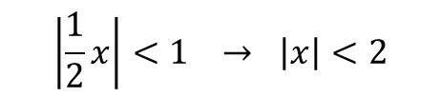
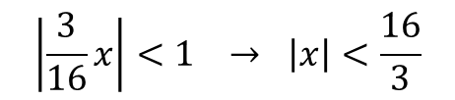

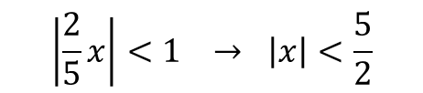
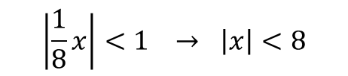
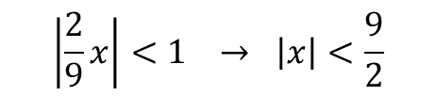
Quickfire First Step
What would be the first step in finding the Binomial expansion of each of these?
Binomial expansion valid if:
?
?
$${\left(2+x\right)}^{−3} ⇒ \frac{1}{8}{\left(1+\frac{1}{2}x\right)}^{−3} \\ {\left(9+2x\right)}^{\frac{1}{2}} ⇒ 3{\left(1+\frac{2}{9}x\right)}^{\frac{1}{2}} \\ {\left(8−x\right)}^{\frac{1}{3}} ⇒ 2{\left(1−\frac{1}{8}x\right)}^{\frac{1}{3}} \\ {\left(5−2x\right)}^{−3}⇒ \frac{1}{25}{\left(1−\frac{2}{5}x\right)}^{−3} \\ {\left(16+3x\right)}^{−\frac{1}{2}} ⇒ \frac{1}{4}{\left(1+\frac{3}{16}x\right)}^{−\frac{1}{2}}$$
$$\left|\frac{1}{2}x\right|<1 → \left|x\right|<2$$
?
?
$$\left|\frac{2}{9}x\right|<1 → \left|x\right|<\frac{9}{2}$$
?
?
$$\left|\frac{1}{8}x\right|<1 → \left|x\right|<8$$
?
?
$$\left|\frac{2}{5}x\right|<1 → \left|x\right|<\frac{5}{2}$$
?
?
$$\left|\frac{3}{16}x\right|<1 → \left|x\right|<\frac{16}{3}$$

Slide 4
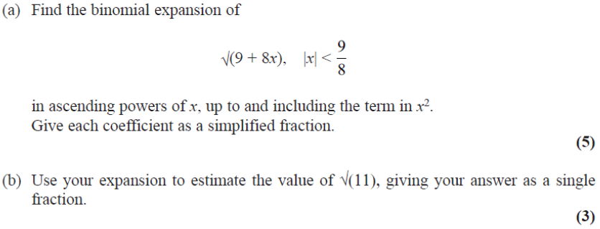
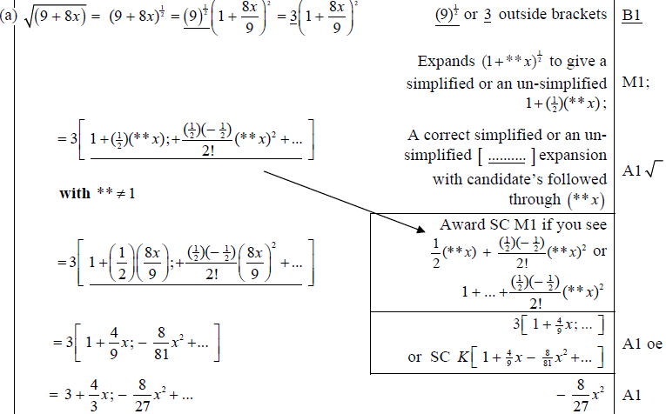
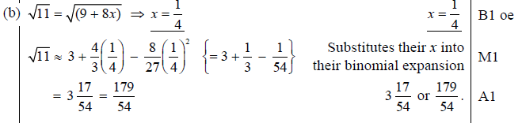
Test Your Understanding
Edexcel C4 June 2013 (Withdrawn) Q1
?
?

Slide 5
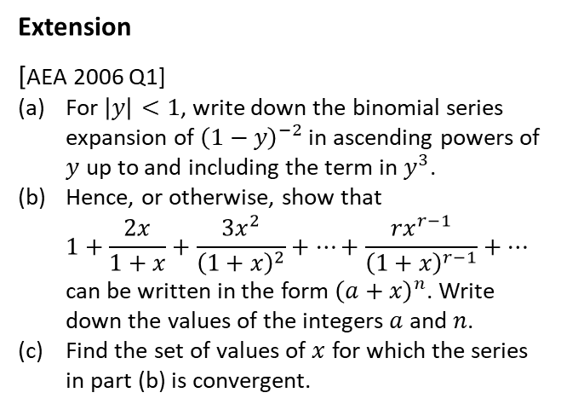
Exercise 4B
Pearson Pure Mathematics Year 2/AS
Pages 99-100
Extension
[AEA 2006 Q1]
For $\left|y\right|<1$, write down the binomial series expansion of ${\left(1−y\right)}^{−2}$ in ascending powers of $y$ up to and including the term in $y^{3}$.
Hence, or otherwise, show that
$1+\frac{2x}{1+x}+\frac{3x^{2}}{{\left(1+x\right)}^{2}}+…+\frac{rx^{r−1}}{{\left(1+x\right)}^{r−1}}+…$
can be written in the form ${\left(a+x\right)}^{n}$. Write down the values of the integers $a$ and $n$.
Find the set of values of $x$ for which the series in part (b) is convergent.
? a
? b
? c

Slide 6
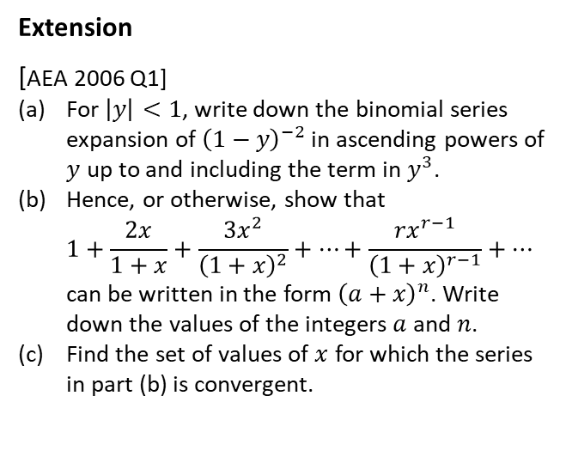
Exercise 4.2
Pearson Pure Mathematics Year 2/AS
Page 30
Extension
[AEA 2006 Q1]
For $\left|y\right|<1$, write down the binomial series expansion of ${\left(1−y\right)}^{−2}$ in ascending powers of $y$ up to and including the term in $y^{3}$.
Hence, or otherwise, show that
$1+\frac{2x}{1+x}+\frac{3x^{2}}{{\left(1+x\right)}^{2}}+…+\frac{rx^{r−1}}{{\left(1+x\right)}^{r−1}}+…$
can be written in the form ${\left(a+x\right)}^{n}$. Write down the values of the integers $a$ and $n$.
Find the set of values of $x$ for which the series in part (b) is convergent.
? a
? b
? c

Slide 7
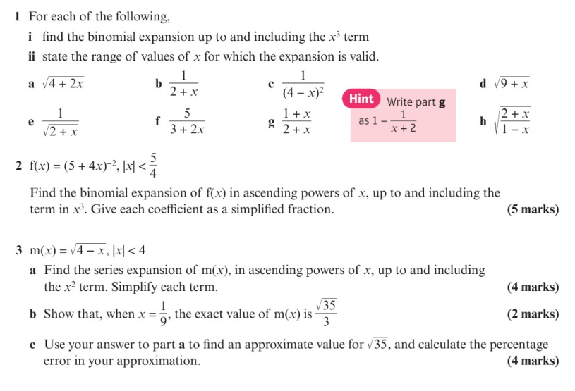
Homework Exercise

Slide 8
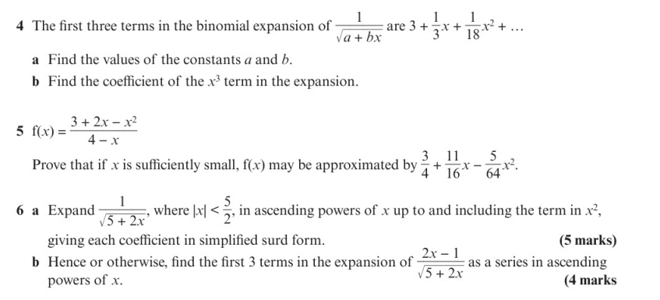
Homework Exercise

Slide 9
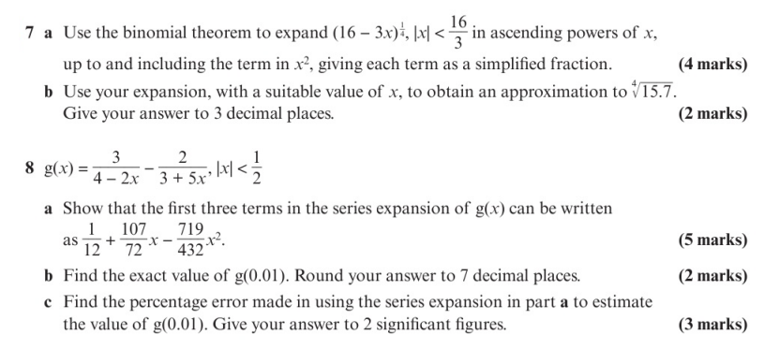
Homework Exercise

Slide 10
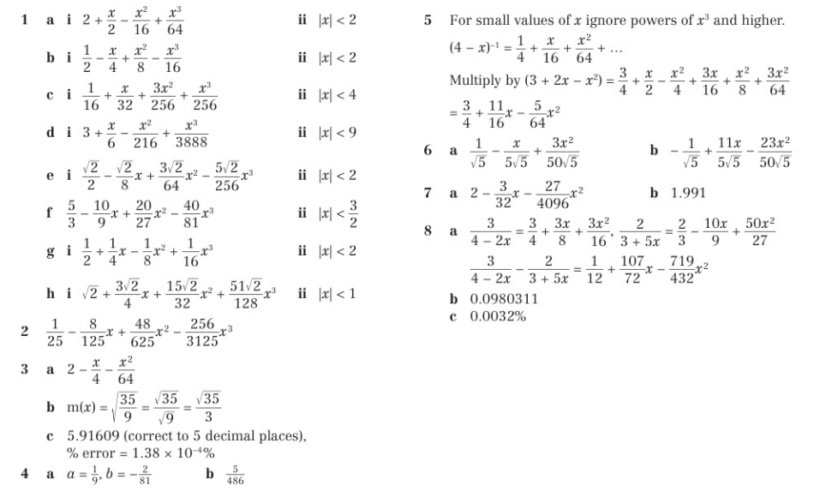
Homework Answers

