Slide 1
P2 Chapter 9: Differentiation Implicit Differentiation

Slide 2

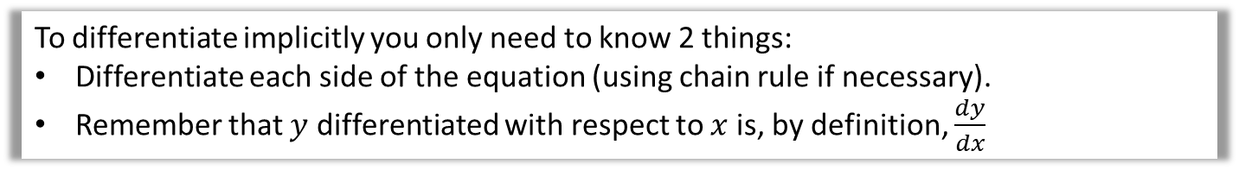
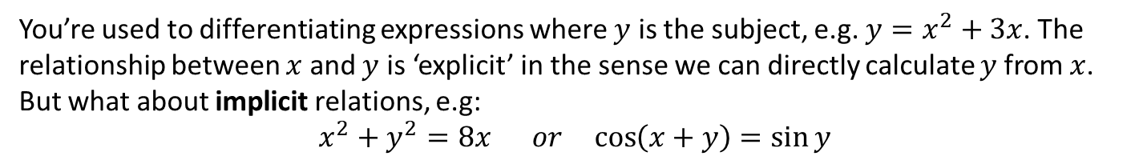
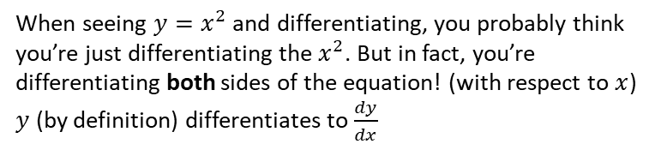


Implicit Differentiation
You’re used to differentiating expressions where $y$ is the subject, e.g. $y=x^{2}+3x$. The relationship between $x$ and $y$ is ‘explicit’ in the sense we can directly calculate $y$from $x$.
But what about implicit relations, e.g:
$$x^{2}+y^{2}=8x or \cos\left(x+y\right)=\sin{y}$$
MIND-BLOWING MOMENT
$$y=x^{2} \\ \frac{dy}{dx}=2x$$
$$\frac{d}{dx}$$
$$\frac{d}{dx}$$
When seeing $y=x^{2}$ and differentiating, you probably think you’re just differentiating the $x^{2}$. But in fact, you’re differentiating both sides of the equation! (with respect to $x$)
$y$ (by definition) differentiates to $\frac{dy}{dx}$
To differentiate implicitly you only need to know 2 things:
Differentiate each side of the equation (using chain rule if necessary).
Remember that $y$ differentiated with respect to $x$ is, by definition, $\frac{dy}{dx}$

Slide 3
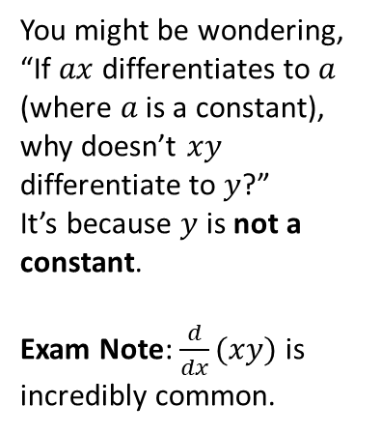
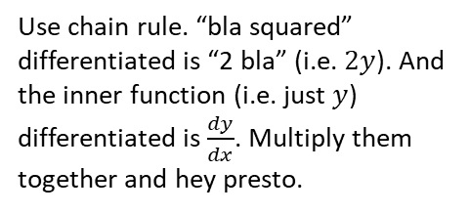
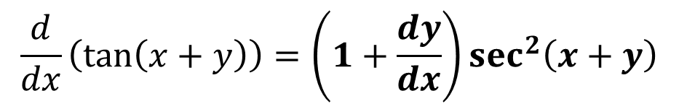
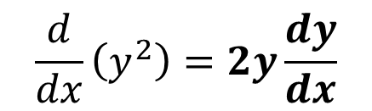
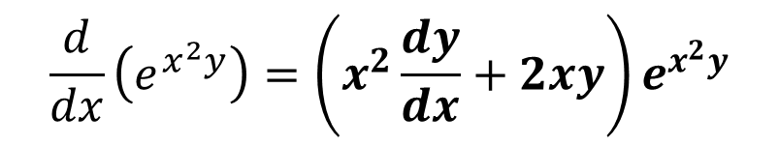
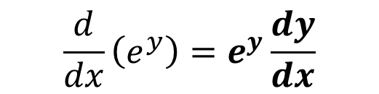
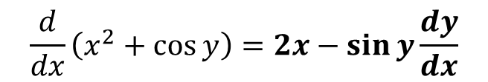
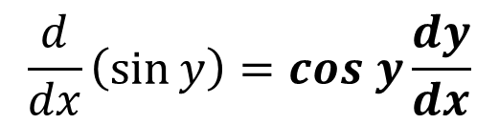
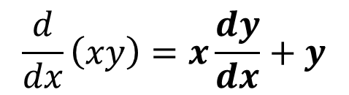
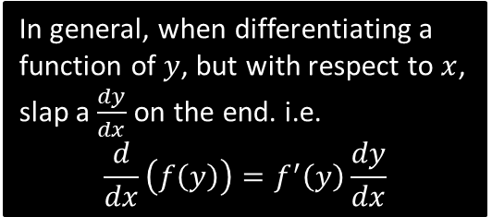
Examples
Use chain rule. “bla squared” differentiated is “2 bla” (i.e. $2y$). And the inner function (i.e. just $y$) differentiated is $\frac{dy}{dx}$. Multiply them together and hey presto.
In general, when differentiating a function of $y$, but with respect to $x$, slap a $\frac{dy}{dx}$ on the end. i.e.
$$\frac{d}{dx}\left(f\left(y\right)\right)=f^{′}\left(y\right)\frac{dy}{dx}$$
?
$$\frac{d}{dx}\left(y^{2}\right)=2y\frac{dy}{dx}$$
?
?
?
$$\frac{d}{dx}\left(xy\right)=x\frac{dy}{dx}+y$$
$$\frac{d}{dx}\left(\sin{y}\right)=cos y\frac{dy}{dx}$$
$$\frac{d}{dx}\left(e^{y}\right)=e^{y}\frac{dy}{dx}$$
?
$$\frac{d}{dx}\left(e^{x^{2}y}\right)=\left(x^{2}\frac{dy}{dx}+2xy\right)e^{x^{2}y}$$
You might be wondering, “If $ax$ differentiates to $a$ (where $a$ is a constant), why doesn’t $xy$ differentiate to $y$?”
It’s because $y$ is not a constant.
Exam Note: $\frac{d}{dx}(xy)$ is incredibly common.
?
$$\frac{d}{dx}\left(\tan\left(x+y\right)\right)=\left(1+\frac{dy}{dx}\right)\sec^{2}\left(x+y\right)$$
?
$$\frac{d}{dx}\left(x^{2}+\cos{y}\right)=2x−\sin{y}\frac{dy}{dx}$$

Slide 4
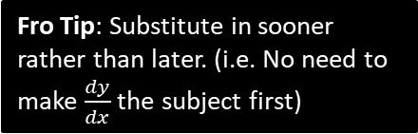


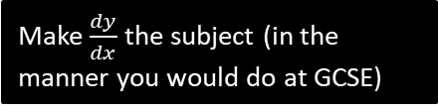


Meatier Examples
[Textbook] Find $\frac{dy}{dx}$ in terms of $x$ and $y$ where $x^{3}+x+y^{3}+3y=6$
?
$$3x^{2}+1+3y^{2}\frac{dy}{dx}+3\frac{dy}{dx}=0 \\ 3y^{2}\frac{dy}{dx}+3\frac{dy}{dx}=−3x^{2}−1 \\ \frac{dy}{dx}\left(3y^{2}+3\right)=−3x^{2}−1 \\ \frac{dy}{dx}=\frac{−3x^{2}−1}{3y^{2}+3}$$
Differentiate both sides of the equation with respect to $x$ (Common error: Forgetting the 6 becomes 0)
Make $\frac{dy}{dx}$ the subject (in the manner you would do at GCSE)
[Textbook] Find the value of $\frac{dy}{dx}$ at the point $(1,1)$, where $e^{2x}\ln{y}=x+y−2$
?
$$2e^{2x}\ln{y}+e^{2x}\left(\ln{y}\frac{dy}{dx}\right)=1+\frac{dy}{dx}$$
When $x=1, y=1$,
$$e^{2}\frac{dy}{dx}=1+\frac{dy}{dx} \\ \left(e^{2}−1\right)\frac{dy}{dx}=1 \\ \frac{dy}{dx}=\frac{1}{e^{2}−1}$$
Fro Tip: Substitute in sooner rather than later. (i.e. No need to make $\frac{dy}{dx}$ the subject first)
Frobservation: In Year 1 differentiation, you only ever needed the $x$ value to calculate the gradient a particular point. In Year 2 the gradient can depend on $x$ and $y$.

Slide 5
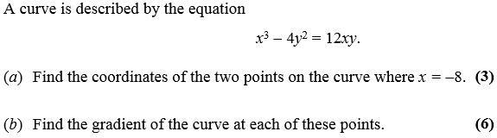
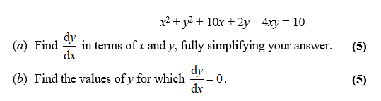
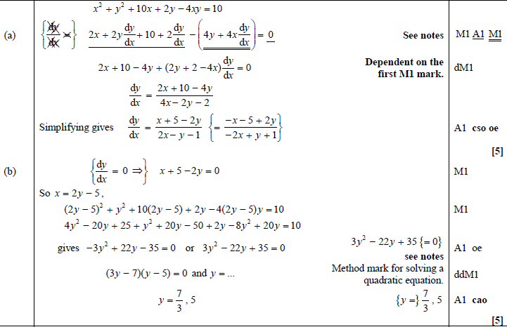

Test Your Understanding
C4 Jan 2008 Q5
Hint for (b): Solve simultaneously with original equation.
C4 June 2014(R) Q3
$−512−4y^{2}=−96y$ $y^{2}−24y+128=0$ $\left(y−16\right)\left(y−8\right)=0$ Gives point $\left(−8,16\right), \left(−8,8\right)$
Implicitly differentiating: $3x^{2}−8y\frac{dy}{dx}=12x\frac{dy}{dx}+12y$ $\frac{dy}{dx}$ not needed, but it’s $\frac{3x^{2}−12y}{12x+8y}$
If $x=−8, y=16,\frac{dy}{dx}=0$
If $x=−8, y=8,\frac{dy}{dx}=−3$
?
?
?
?
Exam Note: This type of question was quite common.

Slide 6
Exercise 9.3
Pearson Pure Year 2
Page 71

Slide 7
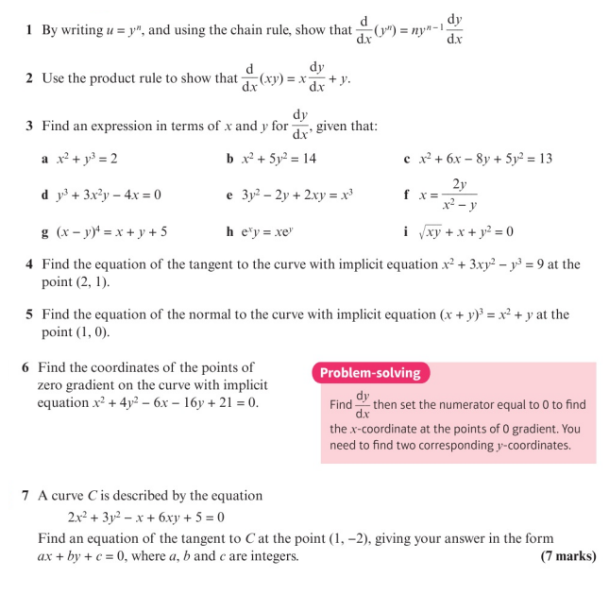
Homework Exercise

Slide 8
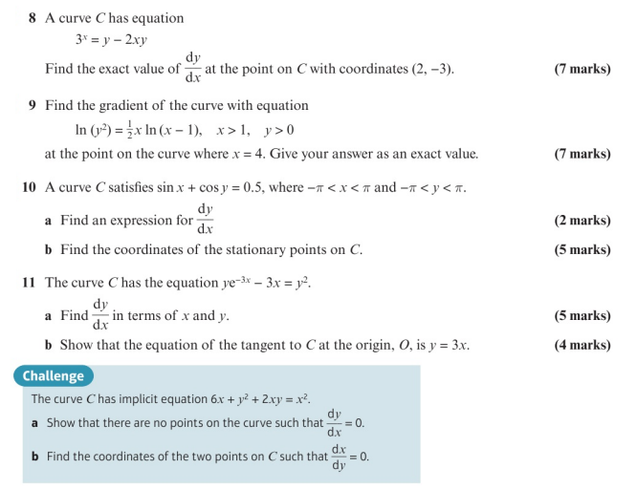
Homework Exercise

Slide 9
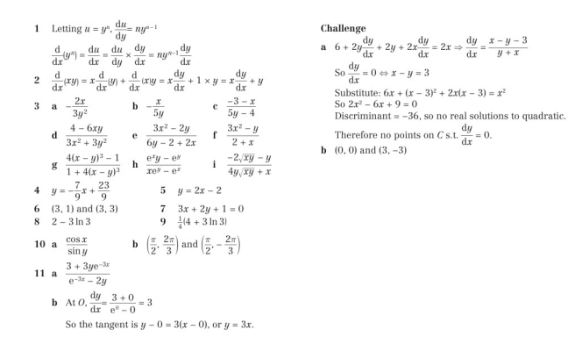
Homework Answers

