Slide 1
M2 Chapter 6: Projectiles Horizontal Projection

Slide 2

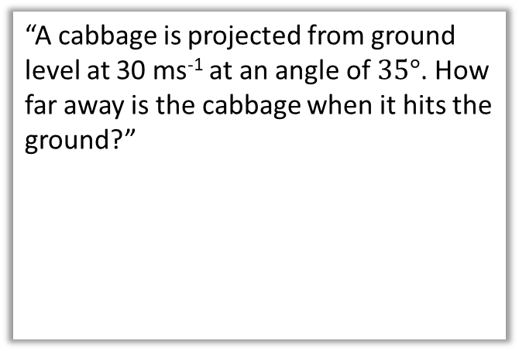





Overview
In Mechanics 1 we already encountered problems of vertical motion of objects when projected upwards. We used “suvat” equations where the acceleration was $g$ ms⁻².
In this chapter we allow the object to be projected sideways!
1:: Horizontally projected
2:: Projection at any angle
“A particle is projected horizontally at 20 ms⁻¹, at a distance 50m above the ground. How far along the ground does it travel?”
“A cabbage is projected from ground level at 30 ms⁻¹ at an angle of $35°$. How far away is the cabbage when it hits the ground?”
50m
$30$ms⁻¹
$$35°$$
$x$ m
$x$ m

Slide 3



Acceleration in each direction.
The key is separately considering the motion in the vertical and horizontal directions:
! In vertical direction, acceleration downwards is $g$ ms⁻². Use suvat equations as before.
In horizontal direction, acceleration is 0 ms⁻². Constant velocity, so can use bog standard $speed=\frac{distance}{time}$
?
?
[Textbook] A particle is project horizontally at 25 ms⁻¹ from a point 78.4 metres above a horizontal surface. Find:
the time taken by the particle to reach the surface
the horizontal distance travelled in that time.
the distance of the impact point from the original point.
a
?
$$R\left(↓\right): s=78.4, u=0, v= , \\ a=9.8, t=?$$
$$s=ut+\frac{1}{2}at^{2} \\ 78.4=4.9t^{2} \\ t=4 s$$
$$R\left(→\right): x=25×4=100 m$$
$\sqrt{{78.4}^{2}+{100}^{2}}=130$ m (2sf)
$25$ms⁻¹
78.4m
b
?
$x$ m
d
Just using ‘sdt triangle’:
s
t
c
?

Slide 4

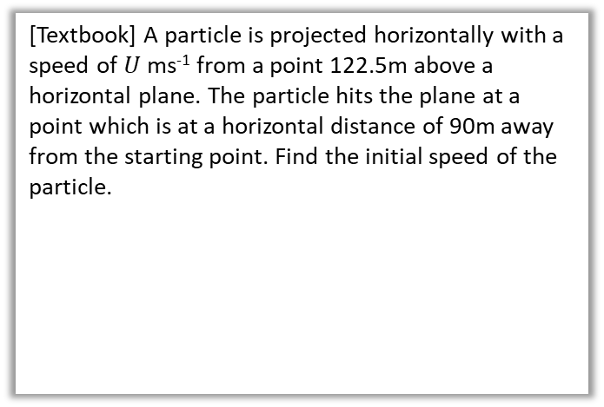

Further Example
?
[Textbook] A particle is projected horizontally with a speed of $U$ ms⁻¹ from a point 122.5m above a horizontal plane. The particle hits the plane at a point which is at a horizontal distance of 90m away from the starting point. Find the initial speed of the particle.
$$R\left(↓\right): s=122.5, u=0, v= , \\ a=9.8, t=?$$
$$s=ut+\frac{1}{2}at^{2} \\ 122.5=4.9t^{2} \\ t=5 s$$
$$R\left(→\right): 90=U×5 \\ U=18 ms^{−1}$$
$U$ ms⁻¹
122.5m
90 m

Slide 5

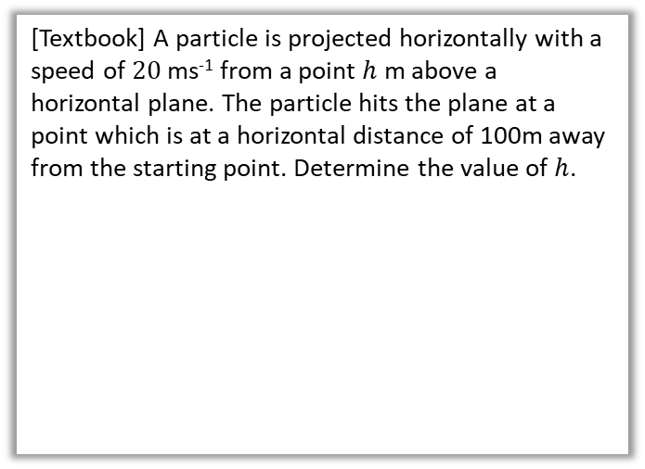


Test Your Understanding
[Textbook] A particle is projected horizontally with a speed of $20$ ms⁻¹ from a point $h$ m above a horizontal plane. The particle hits the plane at a point which is at a horizontal distance of 100m away from the starting point. Determine the value of $h$.
$$R\left(→\right): t=\frac{100}{20}=5 s$$
$$R\left(↓\right): s=h, u=0, v= , \\ a=9.8, t=5$$
$$s=ut+\frac{1}{2}at^{2} \\ h=\frac{1}{2}×9.8×5^{2} \\ =122.5 m$$
?
$20$ ms⁻¹
$$h$$
100 m

Slide 6
Exercise 6.1
Pearson Stats/Mechanics Year 2
Pages 49-50

Slide 7
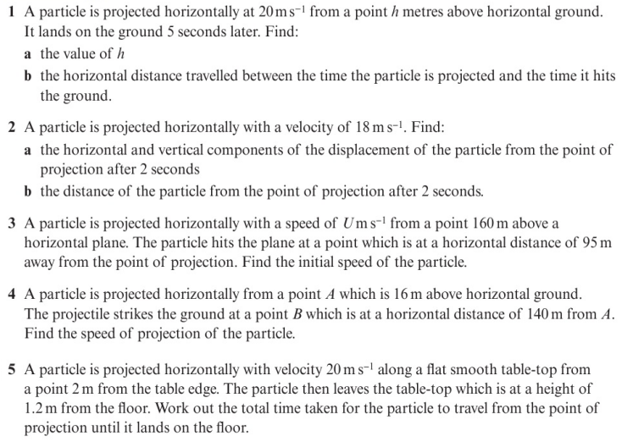
Homework Exercise

Slide 8
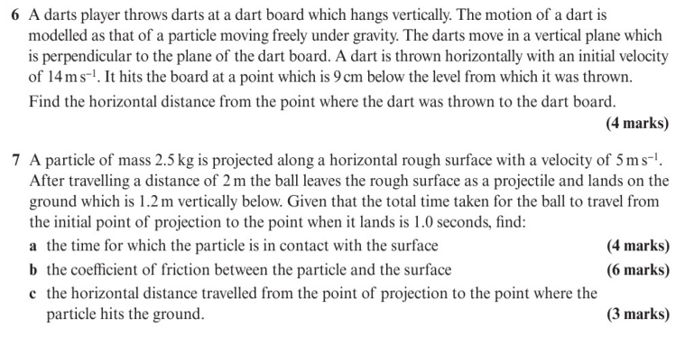
Homework Exercise

Slide 9
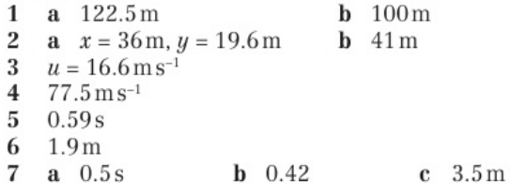
Homework Answers

