Slide 1
P1 Chapter 4: Transforming Graphs Quartic Graphs

Slide 2







Recap
If we sketched $y=\left(x−a\right){\left(x−b\right)}^{2}{\left(x−c\right)}^{3}$ what happens on the $x$-axis at:
$x=a$: The line crosses the axis.
$x=b$: The line touches the axis.
$x=c$: Point of inflection on the axis.
?
$$x$$
$$a$$
?
$$x$$
$$b$$
?
$$x$$
$$c$$

Slide 3
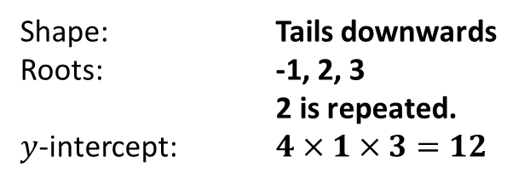
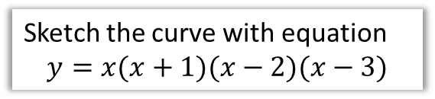
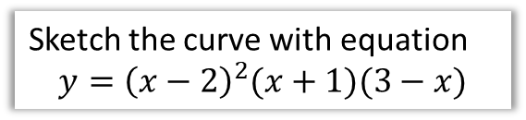
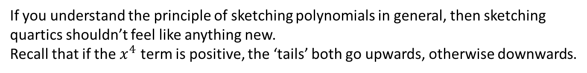


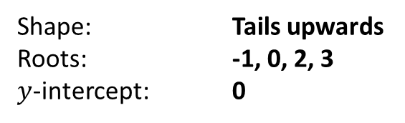
Quartics
If you understand the principle of sketching polynomials in general, then sketching quartics shouldn’t feel like anything new.
Recall that if the $x^{4}$ term is positive, the ‘tails’ both go upwards, otherwise downwards.
Sketch the curve with equation
$$y=x(x+1)(x−2)(x−3)$$
Sketch the curve with equation
$$y={\left(x−2\right)}^{2}(x+1)(3−x)$$
Shape: Tails upwards
Roots: -1, 0, 2, 3
$y$-intercept: 0
Shape: Tails downwards
Roots: -1, 2, 3 2 is repeated.
$y$-intercept: $4×1×3=12$
?
?
?
?
?
?
$$y$$
?
?
$$y$$
12
-1
2
3
$$x$$
-1
2
3
$$x$$

Slide 4


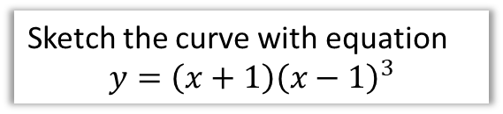
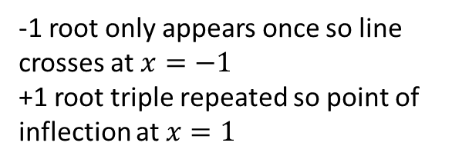
Quartics
Sketch the curve with equation
$$y=\left(x+1\right){\left(x−1\right)}^{3}$$
Sketch the curve with equation
$$y={\left(x−2\right)}^{4}$$
-1 root only appears once so line crosses at $x=−1$
+1 root triple repeated so point of inflection at $x=1$
2 is a quadruple repeated root! Because the line effectively crosses the axis 4 times all at -2, it ends up in the opposite direction, and hence looks like a ‘touch’ point.
?
$$y$$
?
$$y$$
16
2
$$x$$
-1
1
$$x$$
-1

Slide 5
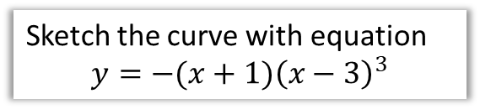
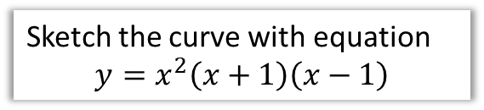

Test Your Understanding
Sketch the curve with equation
$$y=x^{2}\left(x+1\right)\left(x−1\right)$$
Sketch the curve with equation
$$y=−(x+1){\left(x−3\right)}^{3}$$
?
?
$$y$$
$$y$$
27
-1
1
$$x$$
-1
3
$$x$$

Slide 6
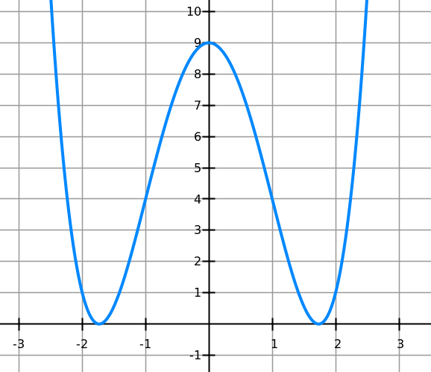
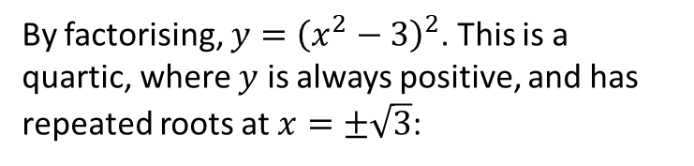
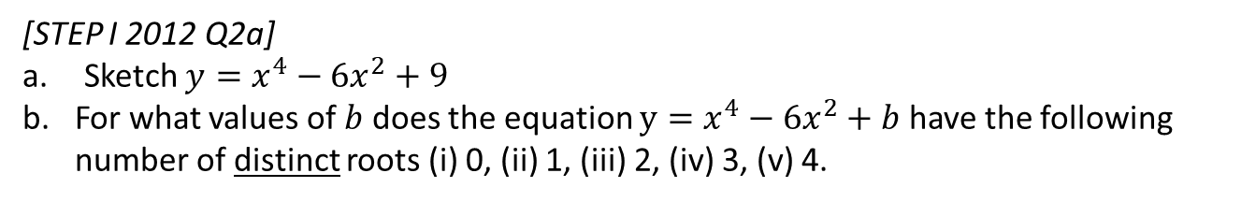

Exercise 4.2
Pearson Pure Mathematics Year 1/AS
Page 27
Extension
[STEP I 2012 Q2a]
Sketch $y=x^{4}−6x^{2}+9$
For what values of $b$ does the equation $y=x^{4}−6x^{2}+b$ have the following number of distinct roots (i) 0, (ii) 1, (iii) 2, (iv) 3, (v) 4.
1
a)
By factorising, $y={\left(x^{2}−3\right)}^{2}$. This is a quartic, where $y$ is always positive, and has repeated roots at $x=±\sqrt{3}$:
b)
By changing $b$, we shift the graph up and down. Then we can see that:
0 roots: When $b>9$
1 root: Not possible.
2 roots: When $b=9 or b<0$
3 roots: $b=0$
4 roots: $0<b<9$
?
?
?
?
?
?

Slide 7
Exercise 1.1
Pearson Pure Mathematics Year 1/AS
Pages 1

Slide 8
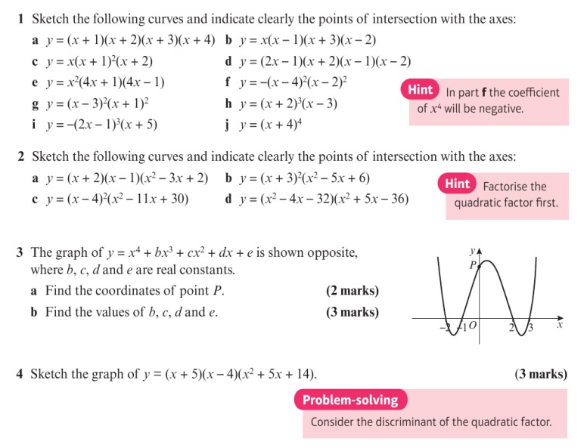
Homework Exercise

Slide 9
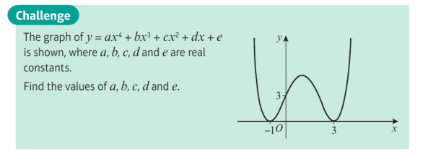
Homework Exercise

Slide 10
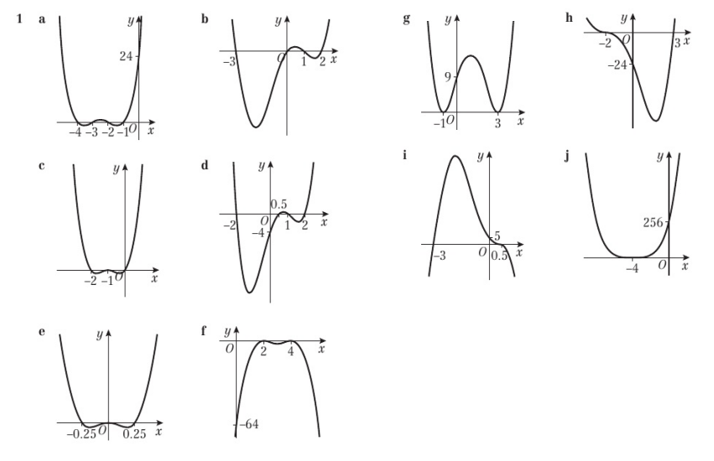
Homework Answers

Slide 11
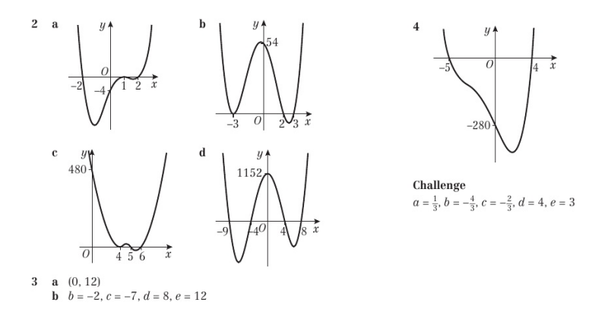
Homework Answers

