Slide 1
Stats Yr2 Chapter 2: Probability Theory Conditional Probability

Slide 2







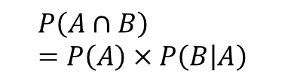


Conditional Probability
Think about how we formed a probability tree at GCSE:
?
$$P\left(A∩B\right) \\ =P\left(A\right)×P\left(B | A\right)$$
P$\left(B|A\right)$
$$B$$
?
$$P\left(A\right)$$
$$A$$
Read the ‘|’ symbol as “given that”. i.e. “B occurred given that A occurred”.
$$B′$$
$$B$$
$$A′$$
$$B′$$
Alternatively (and more commonly):
Memory Tip: You’re dividing by the event you’re conditioning on.
?
! $P\left(B | A\right)=\frac{P\left(A∩B\right)}{P\left(A\right)}$

Slide 3
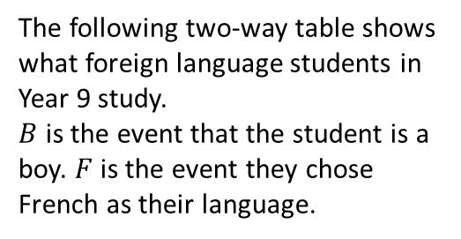
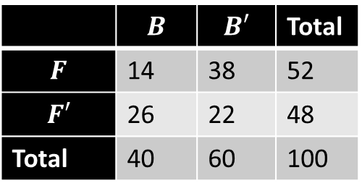

Examples
a
Determine the probability of:
$P\left(F | B^{′}\right)$
Method 1: Using the formula:
$$P\left(F | B^{′}\right)=\frac{P\left(F∩B^{′}\right)}{P\left(B^{′}\right)}=\frac{\frac{38}{100}}{\frac{60}{100}}=\frac{38}{60}$$ Method 2: Restricted sample space.
We’re finding the “probability they study French given they’re not a boy”, i.e. we’re choosing only from the non-boys:
$$P\left(F | B^{′}\right)=\frac{38}{60}$$
$P\left(B | F^{′}\right)=\frac{26}{48}$
1
The following two-way table shows what foreign language students in Year 9 study.
$B$ is the event that the student is a boy. $F$ is the event they chose French as their language.
?
?
 | $$B$$ | $$B′$$ | Total
$$F$$ | 14 | 38 | 52
$$F′$$ | 26 | 22 | 48
Total | 40 | 60 | 100
?
b

Slide 4

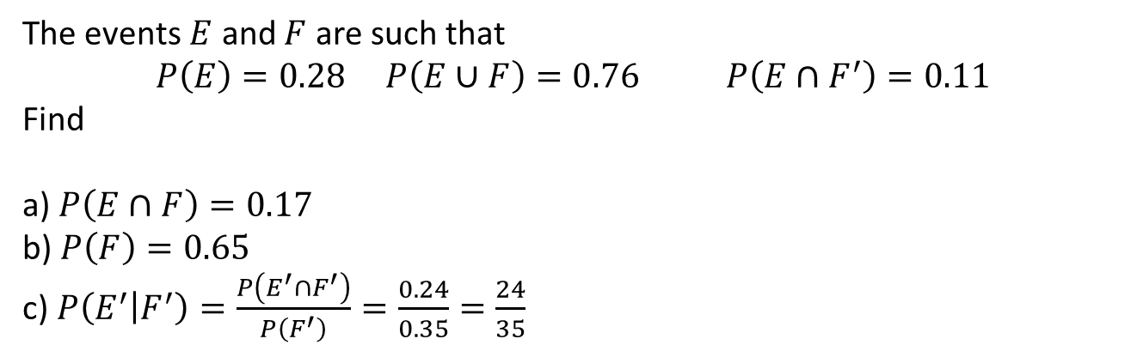


Check your understanding
The events $E$ and $F$ are such that
$$P\left(E\right)=0.28 P\left(E∪F\right)=0.76 P\left(E∩F^{′}\right)=0.11$$
Find
a) $P\left(E∩F\right)=0.17$
b) $P\left(F\right)=0.65$
c) $P\left(E^{′} | F^{′}\right)=\frac{P\left(E^{′}∩F^{′}\right)}{P\left(F^{′}\right)}=\frac{0.24}{0.35}=\frac{24}{35}$
?
?
?
Click to reveal Venn Diagram
$$ξ$$
$$E$$
$$F$$
0.11
0.17
0.48
0.24

Slide 5
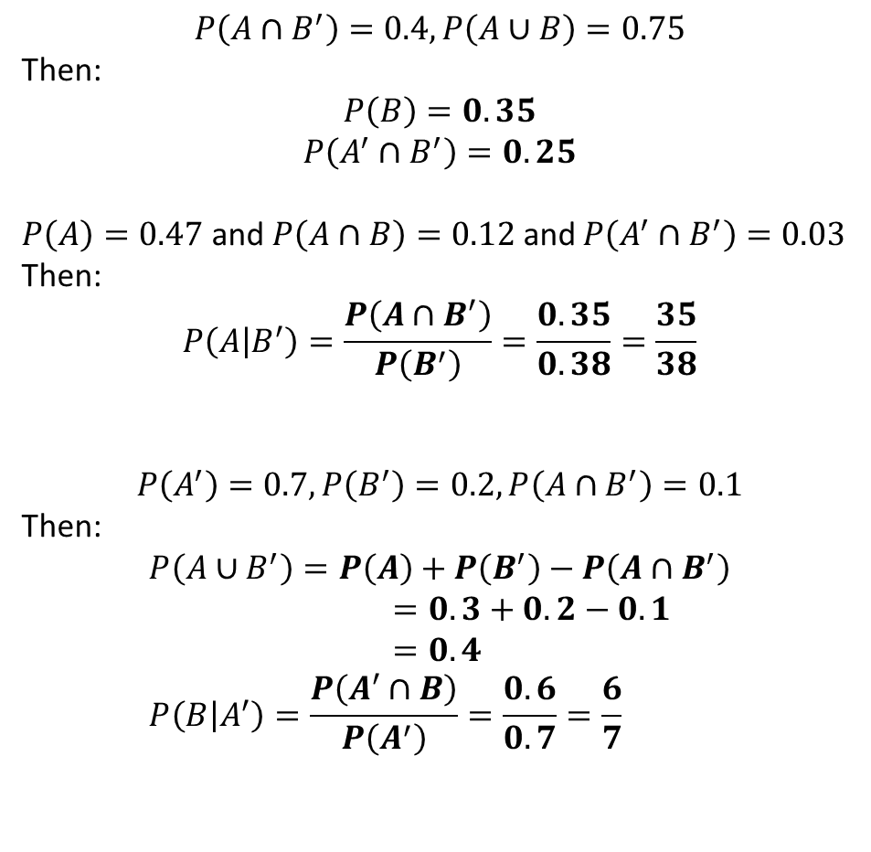
Further Practice
1
$$P\left(A∩B^{′}\right)=0.4, P\left(A∪B\right)=0.75$$
Then:
$$P\left(B\right)=0.35$$
$$P\left(A^{′}∩B^{′}\right)=0.25$$
$P\left(A\right)=0.47$ and $P\left(A∩B\right)=0.12$ and $P\left(A^{′}∩B^{′}\right)=0.03$
Then:
$$P\left(A | B^{′}\right)=\frac{P\left(A∩B^{′}\right)}{P\left(B^{′}\right)}=\frac{0.35}{0.38}=\frac{35}{38}$$
$$P\left(A^{′}\right)=0.7, P\left(B^{′}\right)=0.2, P\left(A∩B^{′}\right)=0.1$$
Then:
$$P\left(A∪B^{′}\right)=P\left(A\right)+P\left(B^{′}\right)−P\left(A∩B^{′}\right) \\ =0.3+0.2−0.1 \\ =0.4 \\ P\left(B | A^{′}\right)=\frac{P\left(A^{′}∩B\right)}{P\left(A^{′}\right)}=\frac{0.6}{0.7}=\frac{6}{7}$$
?
?
2
?
3
?
?

Slide 6
Exercise 2.2
Pearson Stats/Mechanics Year 2
Pages 11-13

Slide 7
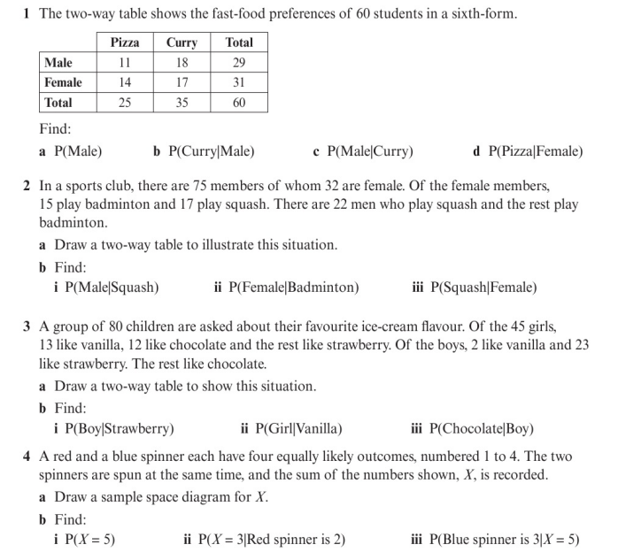
Homework Exercise

Slide 8
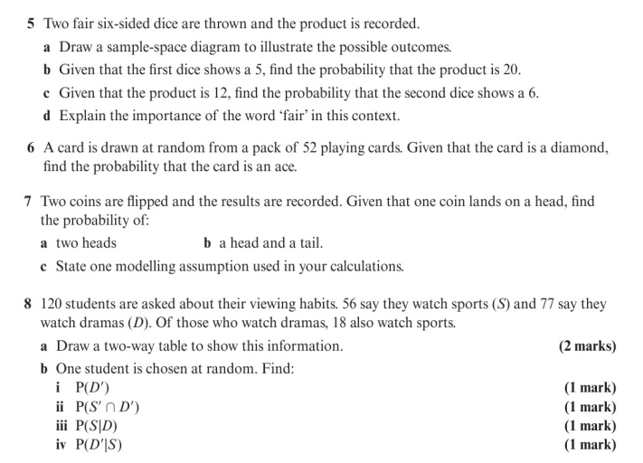
Homework Exercise

Slide 9
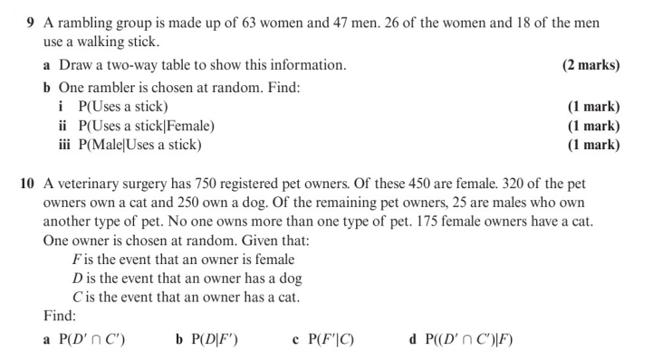
Homework Exercise

Slide 10
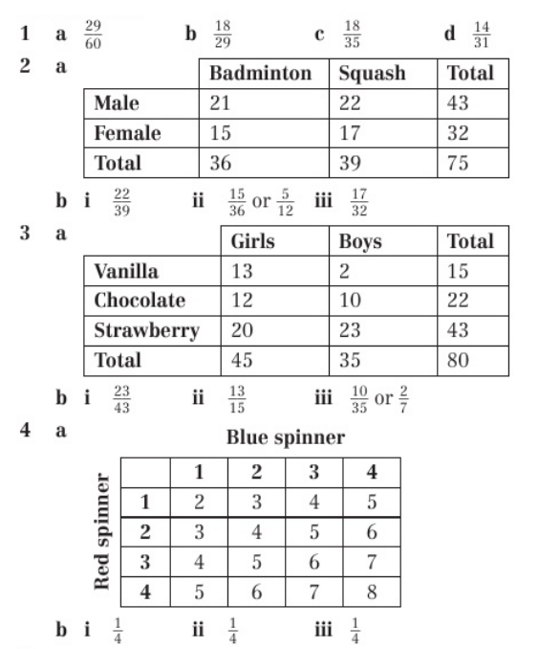
Homework Answers

Slide 11
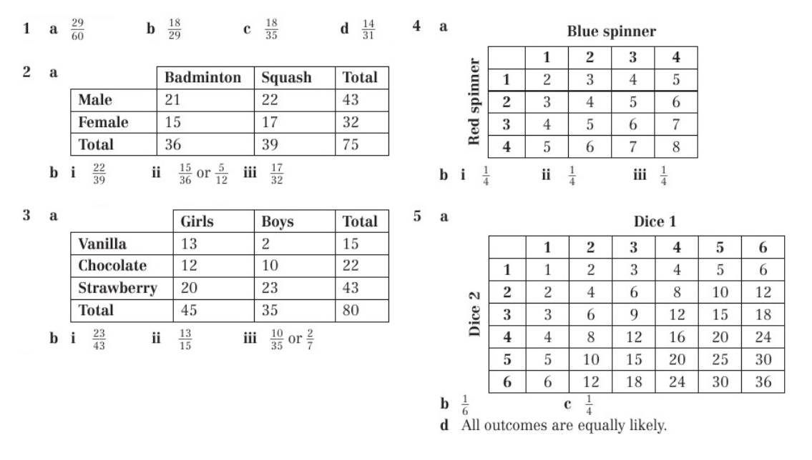
Homework Answers

Slide 12
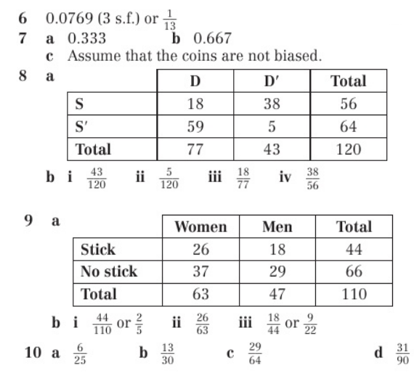
Homework Answers

