Slide 1
P1 Chapter 3: Inequalities Quadratic Inequalities

Slide 2

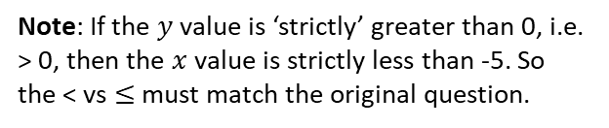



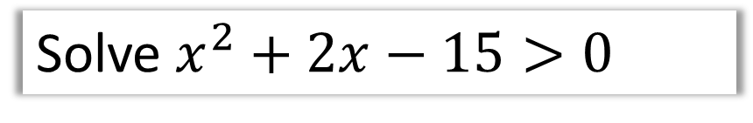

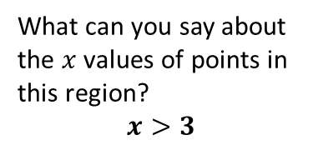

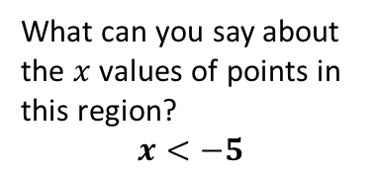

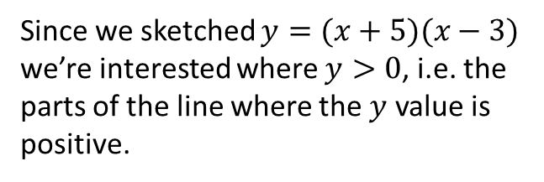
Solving Quadratic Inequalities
Solve $x^{2}+2x−15>0$
Step 1: Get 0 on one side
(already done!)
?
$$\left(x+5\right)\left(x−3\right)>0$$
Step 2: Factorise
Step 3: Sketch and reason
$$y$$
$$y=(x+5)(x−3)$$
Since we sketched $y=(x+5)(x−3)$
we’re interested where $y>0$, i.e. the parts of the line where the $y$ value is positive.
$$x$$
$$−5$$
$$3$$
Click to Fro-Bolden >
What can you say about the $x$ values of points in this region?
$$x<−5$$
What can you say about the $x$ values of points in this region?
$$x>3$$
?
$$\left\{x:x<−5\right\}∪\{x:x>3\}$$
Note: If the $y$ value is ‘strictly’ greater than 0, i.e. > 0, then the $x$ value is strictly less than -5. So the < vs $≤$ must match the original question.
?
?

Slide 3


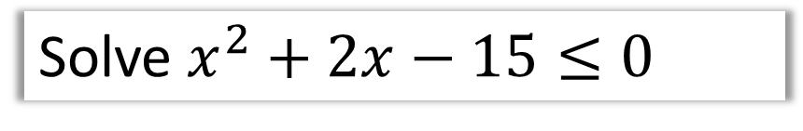
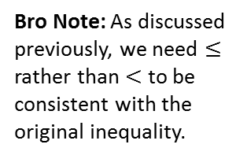

Solving Quadratic Inequalities
Solve $x^{2}+2x−15≤0$
Step 1: Get 0 on one side
(already done!)
$$\left(x+5\right)\left(x−3\right)≤0$$
Step 2: Factorise
Step 3: Sketch and reason
$$y$$
? Sketch with highlighted region
$$y=(x+5)(x−3)$$
? Final solution
$$x$$
$$\{x : −5≤x≤3\}$$
$$−5$$
$$3$$
Again, what can we say about the $x$ value of any point in this region?
Bro Note: As discussed previously, we need $≤$ rather than $<$ to be consistent with the original inequality.

Slide 4
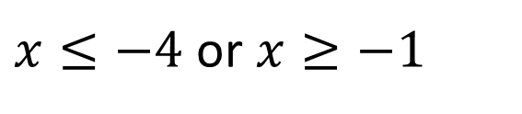














Further Examples
Solve $x^{2}+5x≥−4$
$$x^{2}+5x+4≥0 \\ \left(x+4\right)\left(x+1\right)≥0$$
Solve $x^{2}<9$ $$x^{2}−9<0 \\ \left(x+3\right)\left(x−3\right)<0$$
?
?
$$y$$
$$y$$
$$y=(x+4)(x+1)$$
$$y=(x+3)(x−3)$$
$$x$$
$$3$$
$$x$$
$$−4$$
$$−1$$
$$−3$$
$x≤−4$ or $x≥−1$
$$−3<x<3$$
Note: The most common error students make with quadratic inequalities is to skip the ‘sketch step’. Sod’s Law states that even though you have a 50% chance of getting it right without a sketch (presuming you’ve factorised correctly).
Use of Technology:
Use the quadratic inequality solver on my ClassWiz. Just go to Menu $→$ Inequalities, then choose ‘order 2’ (i.e. quadratic)

Slide 5
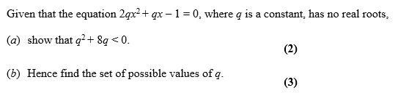
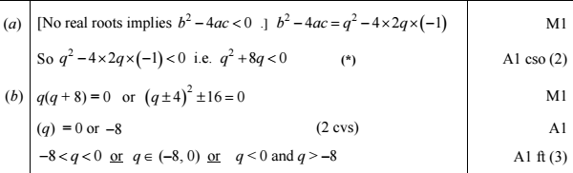
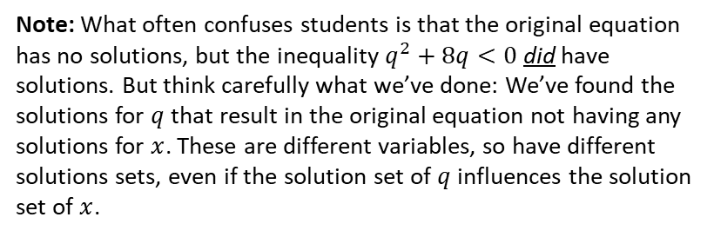
Test Your Understanding
Edexcel C1 June 2008 Q8
?
?
Note: What often confuses students is that the original equation has no solutions, but the inequality $q^{2}+8q<0$ did have solutions. But think carefully what we’ve done: We’ve found the solutions for $q$ that result in the original equation not having any solutions for $x$. These are different variables, so have different solutions sets, even if the solution set of $q$ influences the solution set of $x$.

Slide 6
Exercise 3.5
Pearson Pure Mathematics Year 1/AS
Page 20

Slide 7
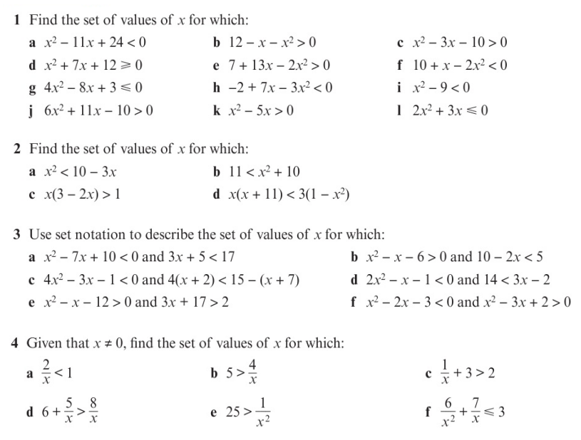
Homework Exercise

Slide 8
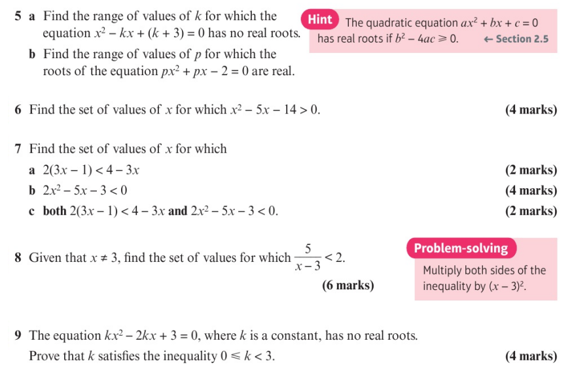
Homework Exercise

Slide 9
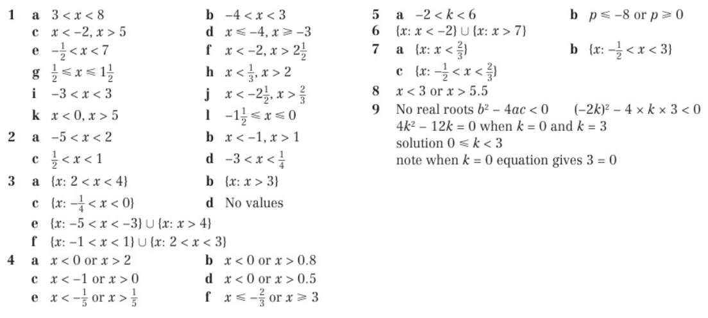
Homework Answers

