Slide 1
Stats1 Chapter 7: Hypothesis Testing One Tailed Tests

Slide 2
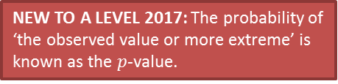
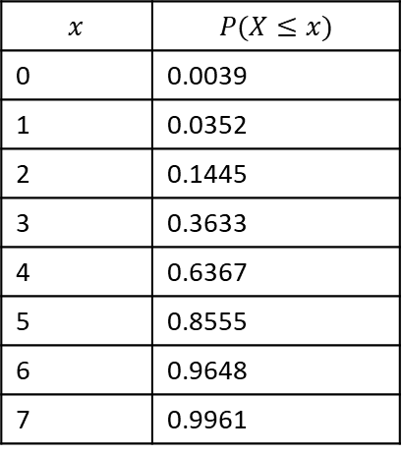
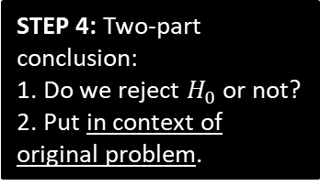

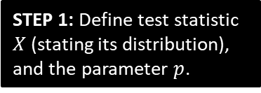


Doing a full one-tailed hypothesis test
We’ve done various bits of a hypothesis test, and haven’t actually properly conducted one yet. Let’s do an example!
John tosses a coin 8 times and it comes up heads 6 times. He claims the coin is biased towards heads. With a significance level of 5%, test his claim.
?
$X$ is number of heads.
$p$ is probability of heads.
$$X\sim B\left(8,p\right)$$
$$H_{0}:p=0.5 \\ H_{1}:p>0.5$$
STEP 1: Define test statistic $X$ (stating its distribution), and the parameter $p$.
C.D.F. Binomial table:
$$p=0.5, n=8$$
STEP 2: Write null and alternative hypotheses.
$$x$$ | $$P(X≤x)$$
0 | 0.0039
1 | 0.0352
2 | 0.1445
3 | 0.3633
4 | 0.6367
5 | 0.8555
6 | 0.9648
7 | 0.9961
?
Assume $H_{0}$ is true, $X\sim B\left(8,0.5\right)$
$$P\left(X≥6\right)=1−P\left(X≤5\right) \\ =1−0.8555 \\ =0.1445$$
14.45% > 5%, so insufficient evidence to reject $H_{0}$.
Coin is not biased.
STEP 3: Determine probability of observed test statistic (or ‘more extreme’), assuming null hypothesis.
i.e. Determine probability we’d see this outcome just by chance.
?
?
STEP 4: Two-part conclusion:
1. Do we reject $H_{0}$ or not?
2. Put in context of original problem.
NEW TO A LEVEL 2017: The probability of ‘the observed value or more extreme’ is known as the $p$-value.

Slide 3
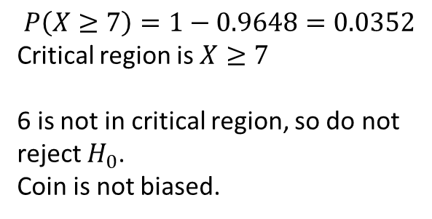
Alternative method using critical regions
We can also find the critical region and see if the test statistic lies within it.
John tosses a coin 8 times and it comes up heads 6 times. He claims the coin is biased towards heads. With a significance level of 5%, test his claim.
$X$ is number of heads.
$p$ is probability of heads.
$$X\sim B\left(8,p\right)$$
$$H_{0}:p=0.5 \\ H_{1}:p>0.5$$
STEP 1: Define test statistic $X$ (stating its distribution), and the parameter $p$.
C.D.F. Binomial table:
$$p=0.5, n=8$$
STEP 2: Write null and alternative hypotheses.
$$x$$ | $$P(X≤x)$$
0 | 0.0039
1 | 0.0352
2 | 0.1445
3 | 0.3633
4 | 0.6367
5 | 0.8555
6 | 0.9648
7 | 0.9961
$$P\left(X≥7\right)=1−0.9648=0.0352$$
Critical region is $X≥7$
6 is not in critical region, so do not reject $H_{0}$.
Coin is not biased.
?
STEP 3 (Alternative): Determine critical region.
?
STEP 4: Two-part conclusion:
1. Do we reject $H_{0}$ or not?
2. Put in context of original problem.

Slide 4
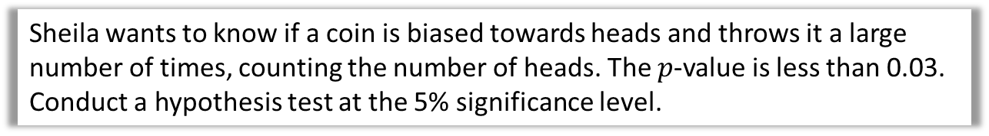
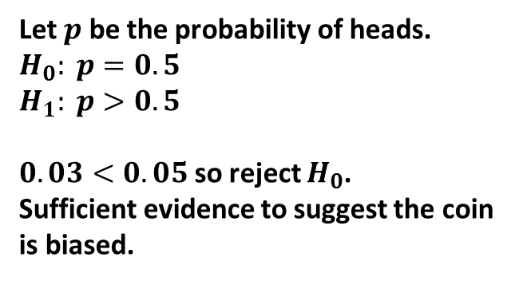
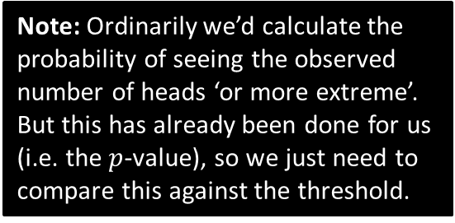
More on $p$-values
(Note that this is not covered in the Pearson textbook, but is in the specification)
Sheila wants to know if a coin is biased towards heads and throws it a large number of times, counting the number of heads. The $p$-value is less than 0.03.
Conduct a hypothesis test at the 5% significance level.
?
Note: Ordinarily we’d calculate the probability of seeing the observed number of heads ‘or more extreme’. But this has already been done for us (i.e. the $p$-value), so we just need to compare this against the threshold.
Let $p$ be the probability of heads.
$H_{0}: p=0.5$ $H_{1}: p>0.5$
$0.03<0.05$ so reject $H_{0}$.
Sufficient evidence to suggest the coin is biased.

Slide 5


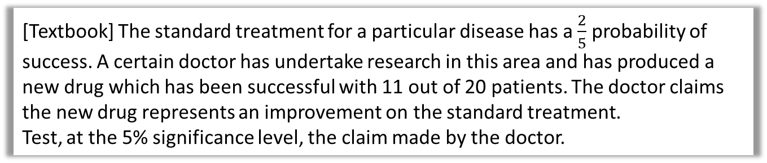


Further Example
[Textbook] The standard treatment for a particular disease has a $\frac{2}{5}$ probability of success. A certain doctor has undertake research in this area and has produced a new drug which has been successful with 11 out of 20 patients. The doctor claims the new drug represents an improvement on the standard treatment.
Test, at the 5% significance level, the claim made by the doctor.
?
$X$ is number of patients for whom trial was successful.
$p$ is probability of success in each patient.
$$X\sim B\left(20,p\right)$$
$$H_{0}:p=0.4 \\ H_{1}:p>0.4$$
Assume $H_{0}$ is true, so $X\sim B(20,0.4)$
$$P\left(X≥11\right)=1−P\left(X≤10\right)=0.1275$$
12.75% > 5% so not enough evidence to reject $H_{0}$.
$∴$ New drug is no better than old one.
STEP 1: Define test statistic $X$ (stating its distribution), and the parameter $p$.
?
STEP 2: Write null and alternative hypotheses.
?
STEP 3: Determine probability of observed test statistic (or ‘more extreme’), assuming null hypothesis.
?
STEP 4: Two-part conclusion:
1. Do we reject $H_{0}$ or not?
2. Put in context of original problem.

Slide 6
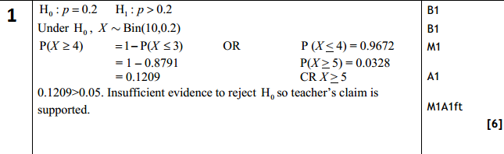

Test Your Understanding
Edexcel S2 Jan 2011 Q2
A student takes a multiple choice test. The test is made up of 10 questions each with 5 possible answers. The student gets 4 questions correct. Her teacher claims she was guessing the answers. Using a one tailed test, at the 5% level of significance, test whether or not there is evidence to reject the teacher’s claim.
State your hypotheses clearly. (6)
?
Note the mark for stating distribution of $X$ under null hypothesis.
Note two-mark conclusion.

Slide 7
Exercise 7.3
Pearson Applied Year 1/AS
Pages 47-48

Slide 8
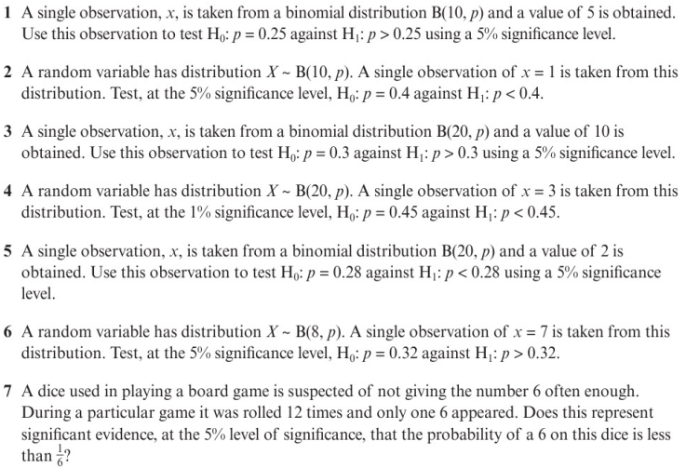
Homework Exercise

Slide 9
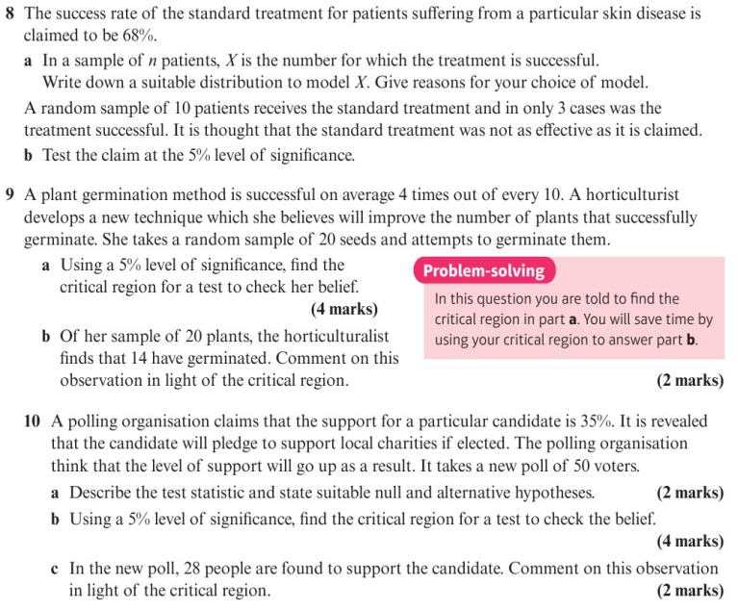
Homework Exercise

Slide 10
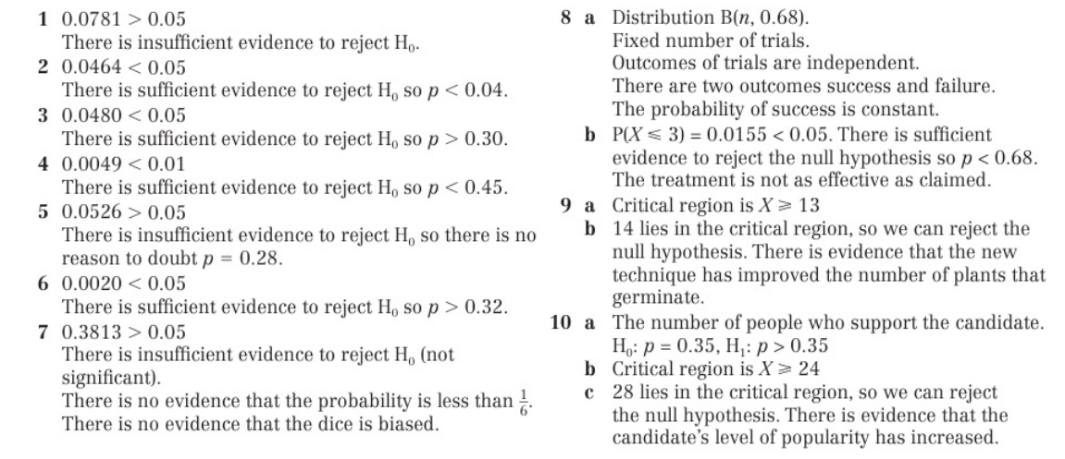
Homework Answers

