Slide 1
Stats2 Chapter 1: Measuring Correlation Exponential Models

Slide 2
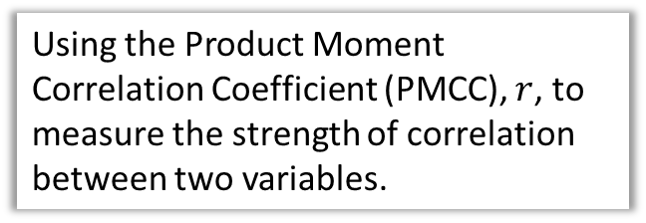
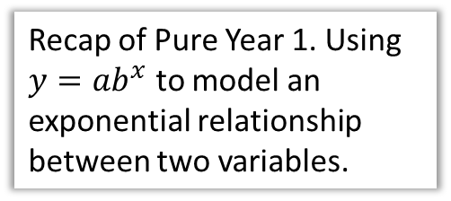
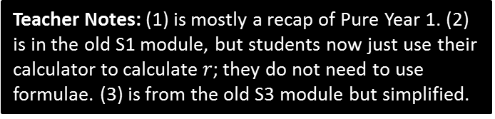
Chapter Overview
1:: Exponential Models
Recap of Pure Year 1. Using $y=ab^{x}$ to model an exponential relationship between two variables.
2:: Measuring Correlation
Using the Product Moment Correlation Coefficient (PMCC), $r$, to measure the strength of correlation between two variables.
3:: Hypothesis Testing for no correlation
Find the first 4 terms in the We want to test whether two variables have some kind of correlation, or whether any correlation observed just happened by chance.
Teacher Notes: (1) is mostly a recap of Pure Year 1. (2) is in the old S1 module, but students now just use their calculator to calculate $r$; they do not need to use formulae. (3) is from the old S3 module but simplified.

Slide 3


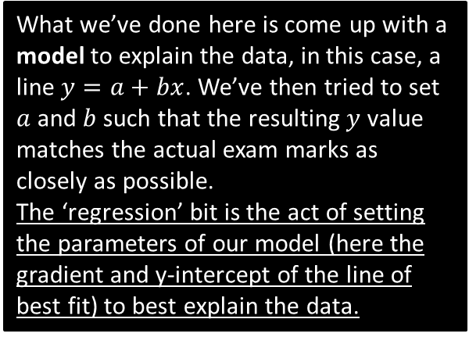

RECAP :: What is regression?
What we’ve done here is come up with a model to explain the data, in this case, a line $y=a+bx$. We’ve then tried to set $a$ and $b$ such that the resulting $y$ value matches the actual exam marks as closely as possible.
The ‘regression’ bit is the act of setting the parameters of our model (here the gradient and y-intercept of the line of best fit) to best explain the data.
Exam mark $(y)$
$$y=20+3x$$
Time spent revising $(x)$
I record people’s exam marks as well as the time they spent revising. I want to predict how well someone will do based on the time they spent revising. How would I do this?

Slide 4
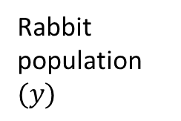
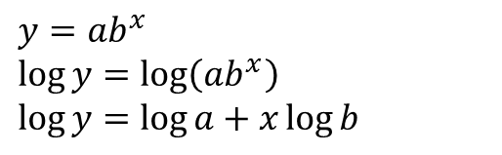


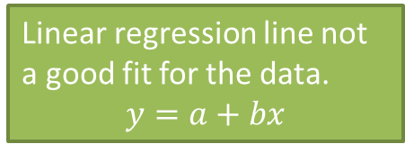
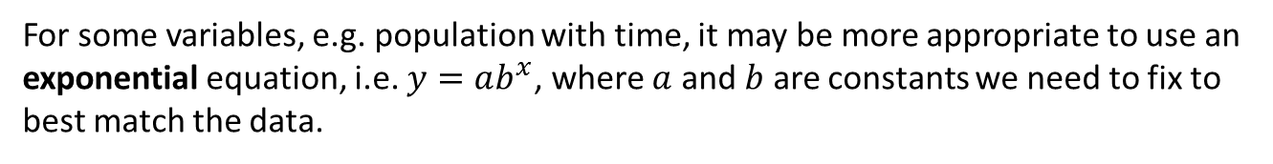
Exponential Regression
Linear regression line not a good fit for the data.
$$y=a+bx$$
Rabbit population $(y)$
Exponential line much better fit.
$$y=ab^{x}$$
Time$(x)$
For some variables, e.g. population with time, it may be more appropriate to use an exponential equation, i.e. $y=ab^{x}$, where $a$ and $b$ are constants we need to fix to best match the data.
$$y=ab^{x} \\ \log{y}=\log\left(ab^{x}\right) \\ \log{y}=\log{a}+x\log{b}$$
In Year 1, what did we do to both sides to end up with a straight line equation?
?
! If $y=kb^{x}$ for constants $k$ and $b$ then $\log{y}=\log{k}+x\log{b}$

Slide 5

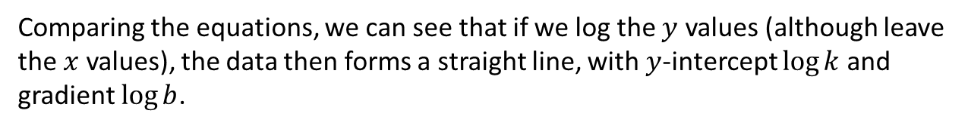
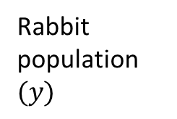


Exponential Regression
If $y=kb^{x}$ for constants $k$ and $b$ then $\log{y}=\log{k}+x\log{b}$
$$\log{y}$$
Rabbit population $(y)$
Time ($x$)
Time ($x$)
Comparing the equations, we can see that if we log the $y$ values (although leave the $x$ values), the data then forms a straight line, with $y$-intercept $\log{k}$ and gradient $\log{b}$.

Slide 6
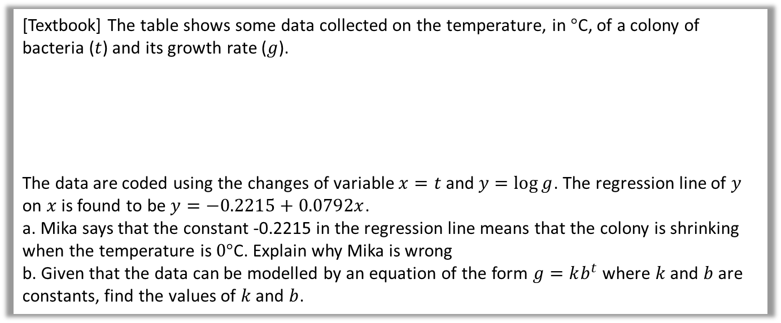
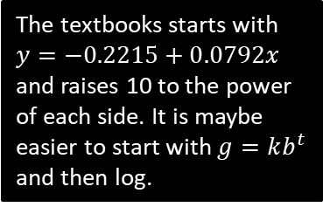

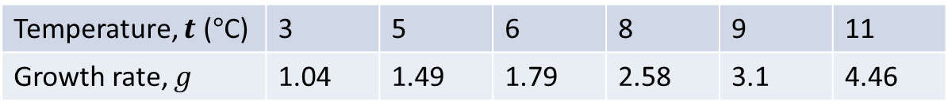
Example
[Textbook] The table shows some data collected on the temperature, in $°$C, of a colony of bacteria ($t$) and its growth rate ($g$).
The data are coded using the changes of variable $x=t$ and $y=\log{g}$. The regression line of $y$ on $x$ is found to be $y=−0.2215+0.0792x$.
a. Mika says that the constant -0.2215 in the regression line means that the colony is shrinking when the temperature is $0°$C. Explain why Mika is wrong
b. Given that the data can be modelled by an equation of the form $g=kb^{t}$ where $k$ and $b$ are constants, find the values of $k$ and $b$.
Temperature, $t$ ($°$C) | 3 | 5 | 6 | 8 | 9 | 11
Growth rate, $g$ | 1.04 | 1.49 | 1.79 | 2.58 | 3.1 | 4.46
a
When $t=0,y=−0.2215+\left(0.0792×0\right)=−0.2215$
$$y=\log{g} ∴g={10}^{y}={10}^{−0.2215}=0.600 (3sf)$$
The growth rate is positive.
$$g=kb^{t} \\ \log{g}=\log{k}+t\log{b}$$
Compare to $y=−0.2215+0.0792x → \log{g}=−0.2215+0.0792g$
$$\log{k}=−0.2215 → k={10}^{−0.2215}=0.600 \\ \log{b}=0.0792 → b={10}^{0.0792}=1.20$$
?
?
b
The textbooks starts with $y=−0.2215+0.0792x$ and raises 10 to the power of each side. It is maybe easier to start with $g=kb^{t}$ and then log.

Slide 7
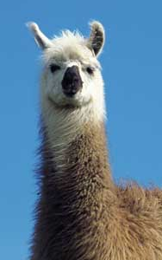

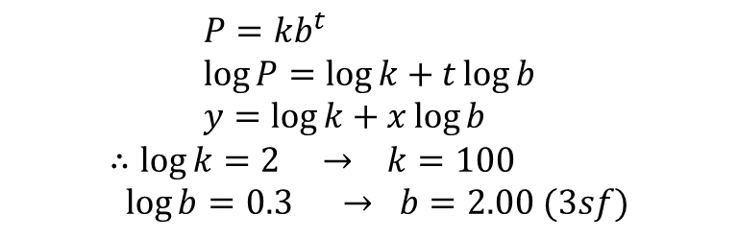
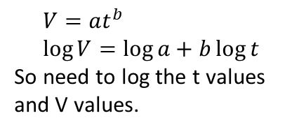
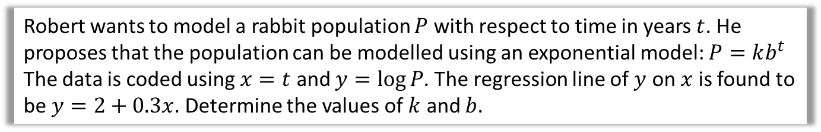
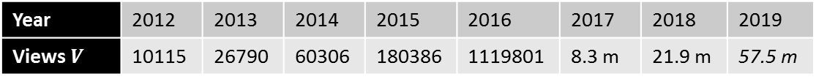
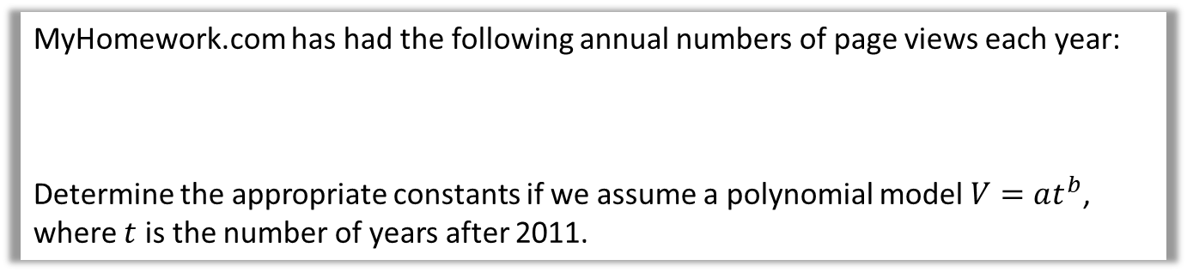
Test Your Understanding
Robert wants to model a rabbit population $P$ with respect to time in years $t$. He proposes that the population can be modelled using an exponential model: $P=kb^{t}$
The data is coded using $x=t$ and $y=\log{P}$. The regression line of $y$ on $x$ is found to be $y=2+0.3x$. Determine the values of $k$ and $b$.
?
$$P=kb^{t} \\ \log{P}=\log{k}+t\log{b} \\ y=\log{k}+x\log{b}$$
$$∴\log{k}=2 → k=100 \\ \log{b}=0.3 → b=2.00 (3sf)$$
Rabbit
MyHomework.com has had the following annual numbers of page views each year:
Determine the appropriate constants if we assume a polynomial model $V=at^{b}$, where $t$ is the number of years after 2011.
Year | 2012 | 2013 | 2014 | 2015 | 2016 | 2017 | 2018 | 2019
Views $V$ | 10115 | 26790 | 60306 | 180386 | 1119801 | 8.3 m | 21.9 m | 57.5 m
projected
$$V=at^{b} \\ \log{V}=\log{a}+b\log{t}$$
So need to log the t values and V values.
?
$$log t$$ | 0 | 0.3010 | 0.4771 | 0.6020 | 0.6989 | 0.7781 | 0.8450 | 0.9030
$$log V$$ | 4.0050 | 4.4280 | 4.7804 | 5.2562 | 6.0491 | 6.9191 | 7.3404 | 7.7597
Using calculator stats mode, y-intercept: $\log{a}=3.3406$, gradient: $b=4.3025$
Therefore $V=2191×t^{4.3025}$

Slide 8

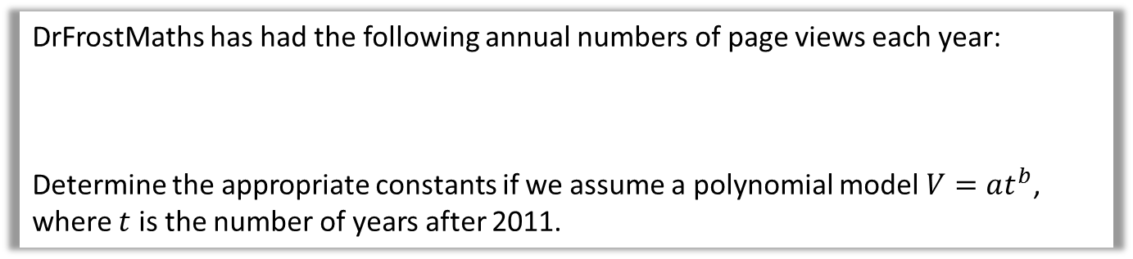
DrFrostMaths has had the following annual numbers of page views each year:
Determine the appropriate constants if we assume a polynomial model $V=at^{b}$, where $t$ is the number of years after 2011.
Year | 2012 | 2013 | 2014 | 2015 | 2016 | 2017 | 2018 | 2019
Views $V$ | 10115 | 26790 | 60306 | 180386 | 1119801 | 8.3 m | 21.9 m | 57.5 m
As you can see below, this polynomial model we found produces a strong fit to the data!
An exponential model would have also produced a good fit.

Slide 9
Exercise 1.1
Pearson Stats/Mechanics Year 2
Pages 1-2

Slide 10
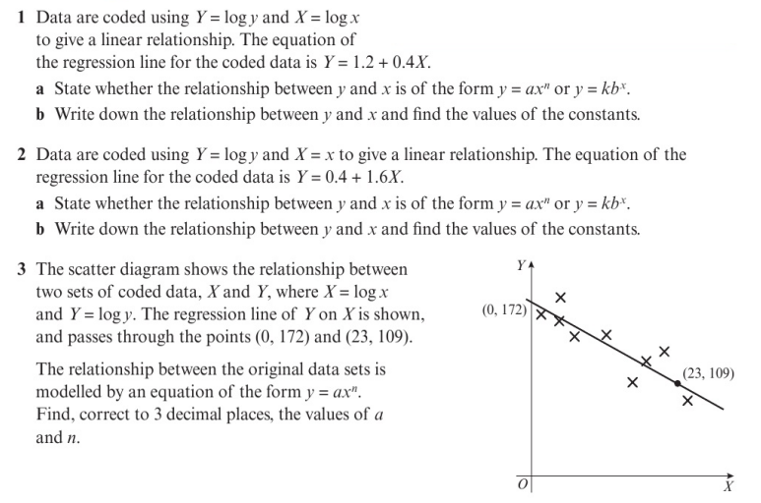
Homework Exercise

Slide 11
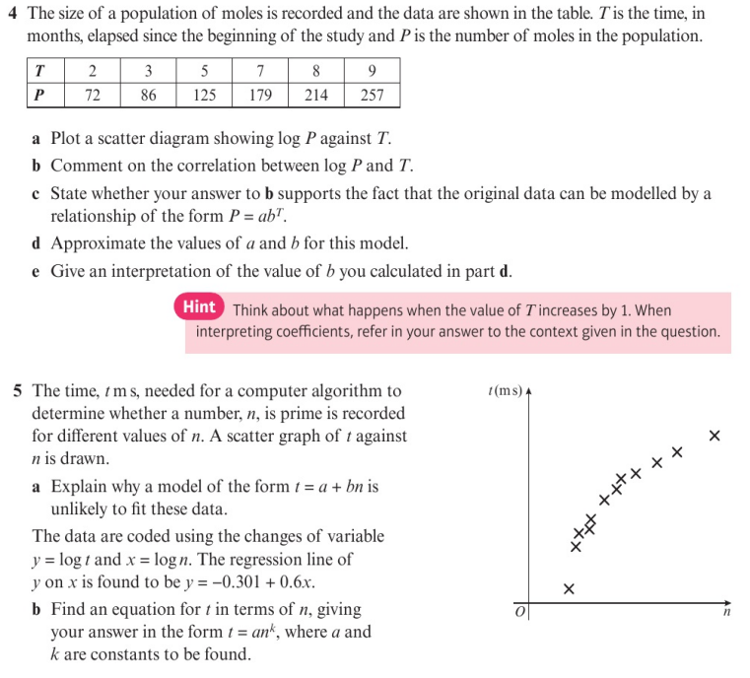
Homework Exercise

Slide 12
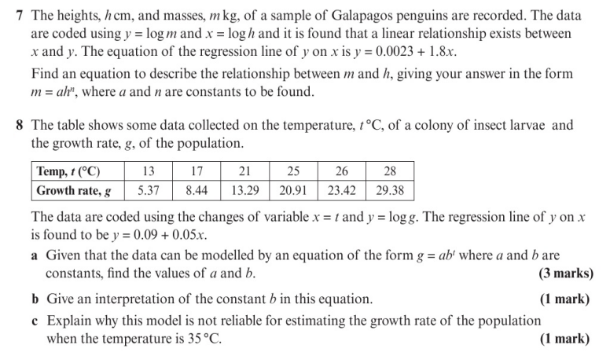
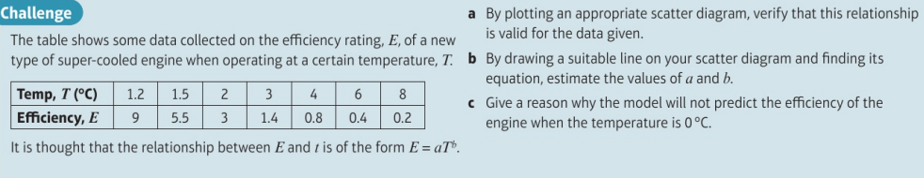
Homework Exercise

Slide 13
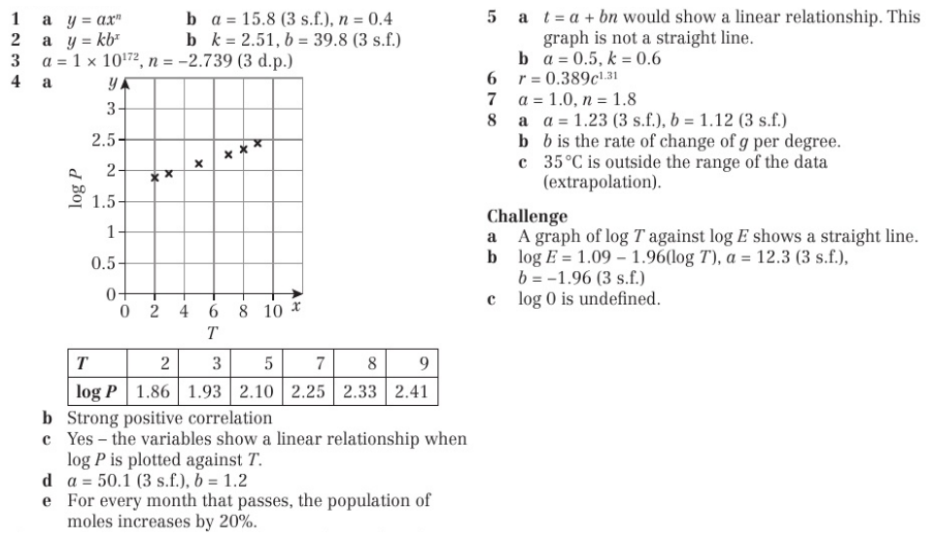
Homework Answers

