Slide 1
M1 Chapter 10: Forces and Motion Connected Particles

Slide 2
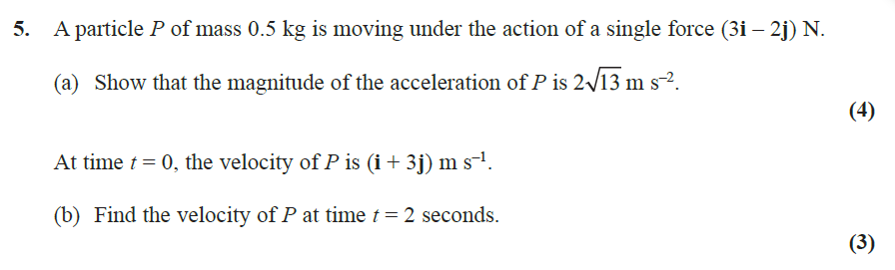
Starter

Slide 3


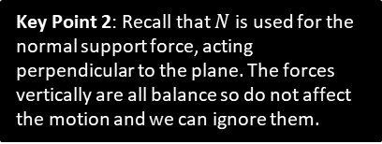

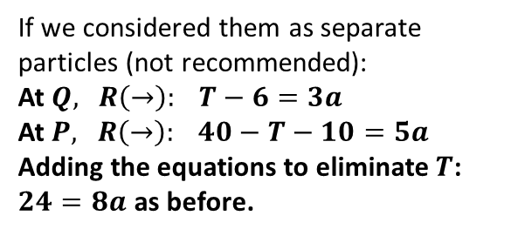
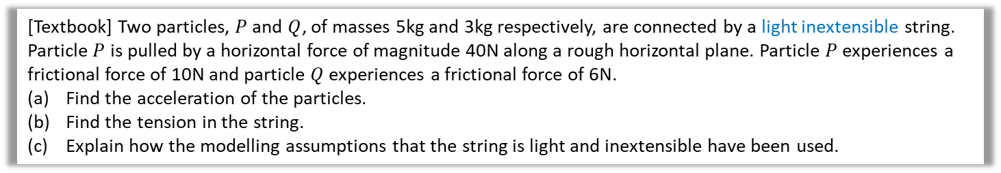
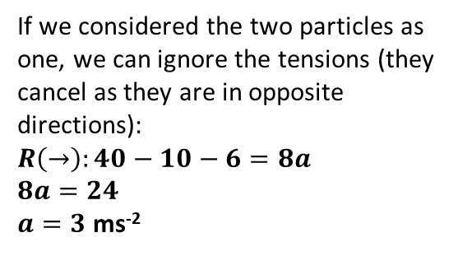





Connected Particles
General approach: create a free body force diagram for each part separately.
If their connection is light and inextensible this means the tension T in the connection is equal everywhere and opposite at the two ends.
If (and only if) the objects move in the same direction, you can treat the connected bodies as a single object to save a little algebra ( what happens to T ? how does this differ from the general approach? ).
[Textbook] Two particles, $P$ and $Q$, of masses 5kg and 3kg respectively, are connected by a light inextensible string. Particle $P$ is pulled by a horizontal force of magnitude 40N along a rough horizontal plane. Particle $P$ experiences a frictional force of 10N and particle $Q$ experiences a frictional force of 6N.
Find the acceleration of the particles.
Find the tension in the string.
Explain how the modelling assumptions that the string is light and inextensible have been used.
a
If we considered the two particles as one, we can ignore the tensions (they cancel as they are in opposite directions):
$$R\left(→\right):40−10−6=8a \\ 8a=24$$ $a=3$ ms⁻²
? Diagram
?
$$a$$
$$Q$$
$$T$$
$$P$$
3kg
$$T$$
5kg
$$40 N$$
$$6 N$$
$$10 N$$
If we considered them as separate particles (not recommended):
At $Q,$ $R\left(→\right): T−6=3a$
At $P,$ $R\left(→\right): 40−T−10=5a$
Adding the equations to eliminate $T$:
$24=8a$ as before.
Key Point 1: The tension in a given piece of string is the same in any part of the string (at a given time). The tension acts away from each particle in the direction of the string.
Key Point 2: Recall that $N$ is used for the normal support force, acting perpendicular to the plane. The forces vertically are all balance so do not affect the motion and we can ignore them.

Slide 4



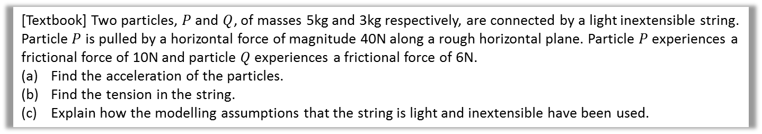
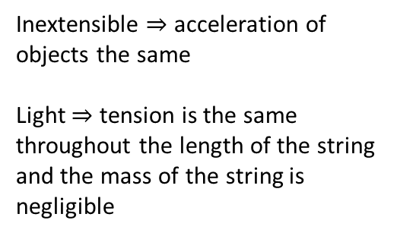


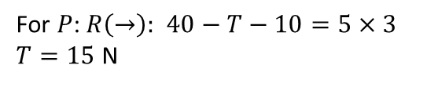



Connected Particles
[Textbook] Two particles, $P$ and $Q$, of masses 5kg and 3kg respectively, are connected by a light inextensible string. Particle $P$ is pulled by a horizontal force of magnitude 40N along a rough horizontal plane. Particle $P$ experiences a frictional force of 10N and particle $Q$ experiences a frictional force of 6N.
Find the acceleration of the particles.
Find the tension in the string.
Explain how the modelling assumptions that the string is light and inextensible have been used.
For $P$: $R\left(→\right):$ $40−T−10=5×3$ $T=15$ N
b
?
$$a$$
Inextensible $⇒$ acceleration of objects the same
Light $⇒$ tension is the same throughout the length of the string and the mass of the string is negligible
c
?
$$Q$$
$$T$$
$$P$$
3kg
$$T$$
5kg
$$40 N$$
$$6 N$$
$$10 N$$

Slide 5
Classwork Exercise 10.6
Pearson Stats/Mechanics Year 1 Exercise Book
Pages 72-73
Questions 1-3 (not 4) 5-9

Slide 6
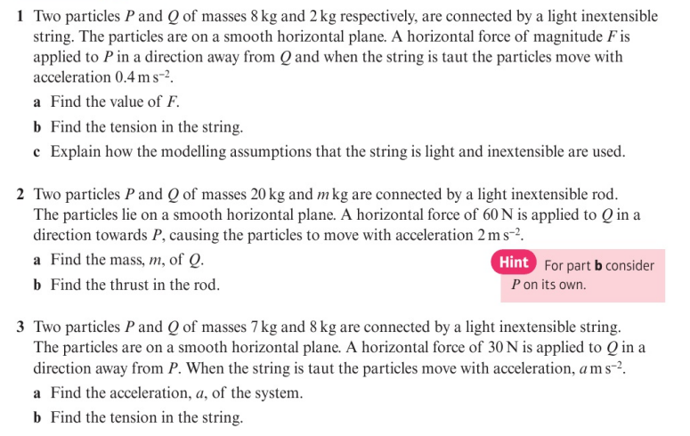
Homework Exercise

Slide 7
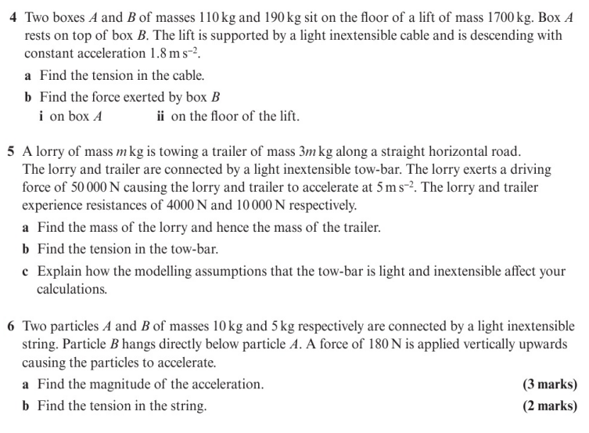
Homework Exercise

Slide 8
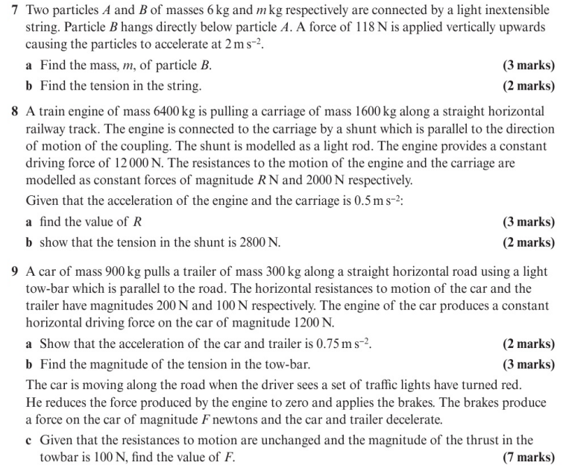
Homework Exercise

Slide 9
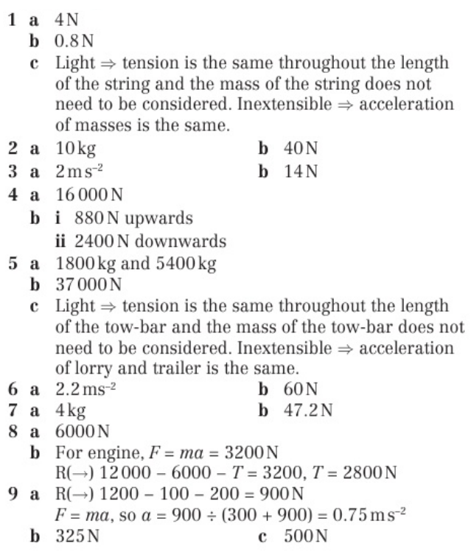
Homework Answers

