Slide 1
P2 Chapter 1: Algebra Techniques
Algebraic Fractions

Slide 2
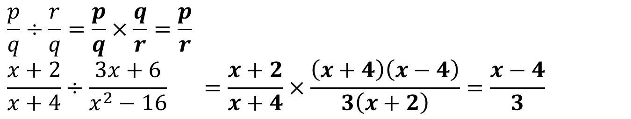
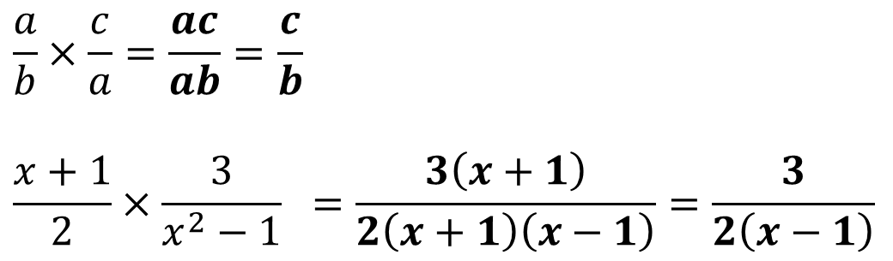
Multiplying/Dividing Algebraic Fractions
As your saw at GCSE level, multiplying algebraic fractions is no different to multiply numeric fractions.
You may however need to cancel common factors, by factorising where possible.
?
$$\frac{a}{b}×\frac{c}{a}=\frac{ac}{ab}=\frac{c}{b}$$
$$\frac{x+1}{2}×\frac{3}{x^{2}−1} =\frac{3\left(x+1\right)}{2\left(x+1\right)\left(x−1\right)}=\frac{3}{2\left(x−1\right)}$$
?
To divide by a fraction, multiply by the reciprocal of the second fraction.
?
$$\frac{p}{q}÷\frac{r}{q}=\frac{p}{q}×\frac{q}{r}=\frac{p}{r} \\ \frac{x+2}{x+4}÷\frac{3x+6}{x^{2}−16} =\frac{x+2}{x+4}×\frac{\left(x+4\right)\left(x−4\right)}{3\left(x+2\right)}=\frac{x−4}{3}$$
?

Slide 3
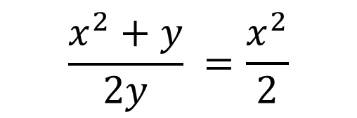
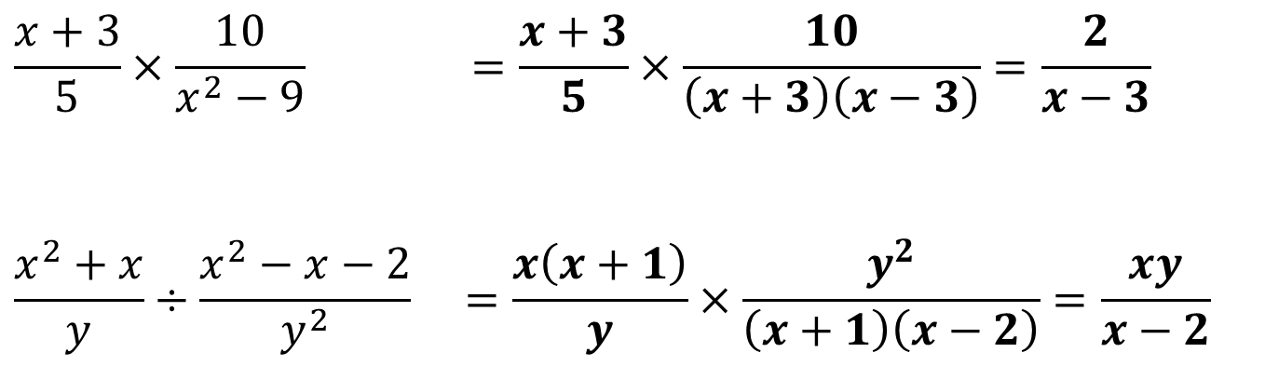

Test Your Understanding
?
$$\frac{x+3}{5}×\frac{10}{x^{2}−9} =\frac{x+3}{5}×\frac{10}{\left(x+3\right)\left(x−3\right)}=\frac{2}{x−3}$$
$$\frac{x^{2}+x}{y}÷\frac{x^{2}−x−2}{y^{2}} =\frac{x\left(x+1\right)}{y}×\frac{y^{2}}{\left(x+1\right)\left(x−2\right)}=\frac{xy}{x−2}$$
?
“Crimes against Mathematics”:
Cancelling in fractions only occurs by dividing. But the student has subtracted $y$ in the numerator.
$$\frac{x^{2}+y}{2y} =\frac{x^{2}}{2}$$
?

Slide 4
Exercise 1.2
Pearson Pure Mathematics Year 2/AS
Page 1

Slide 5
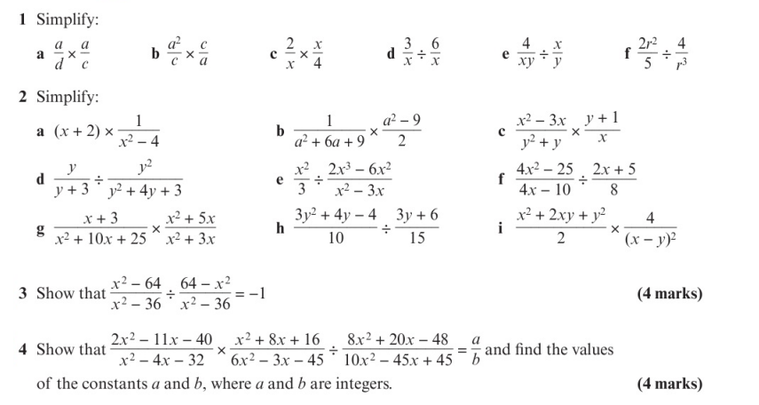
Homework Exercise

Slide 6
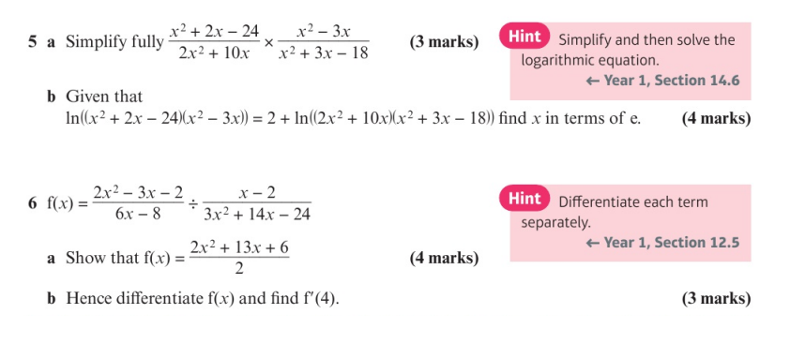
Homework Exercise

Slide 7
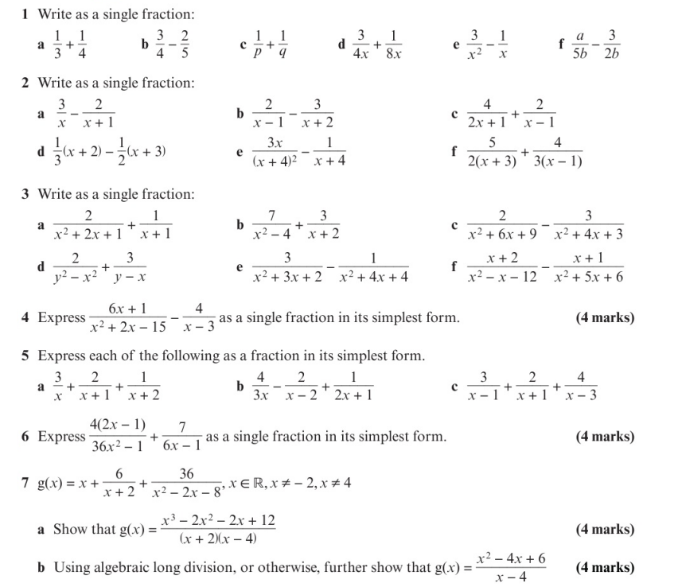
Homework Exercise

Slide 8
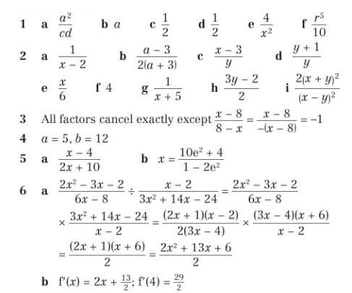
Homework Answers

Slide 9
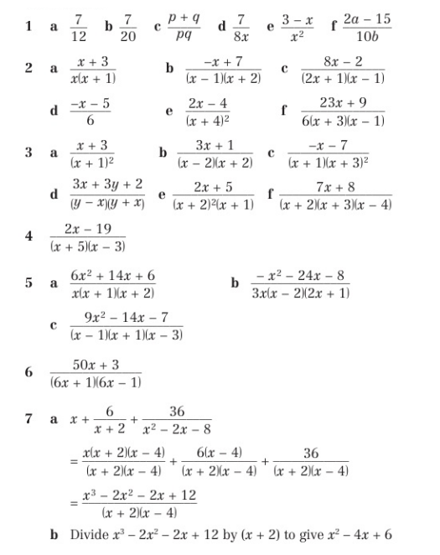
Homework Answers

