Slide 1
M1 Chapter 10: Forces and Motion Lifting

Slide 2
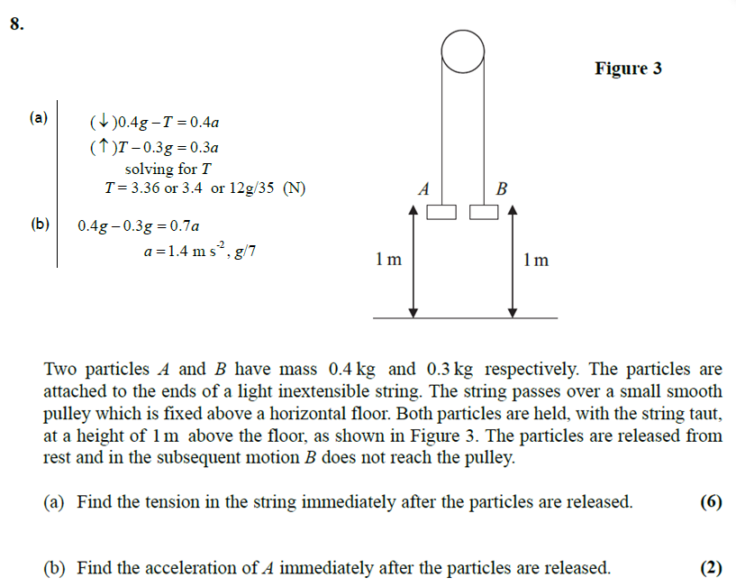
Starter
?
?

Slide 3
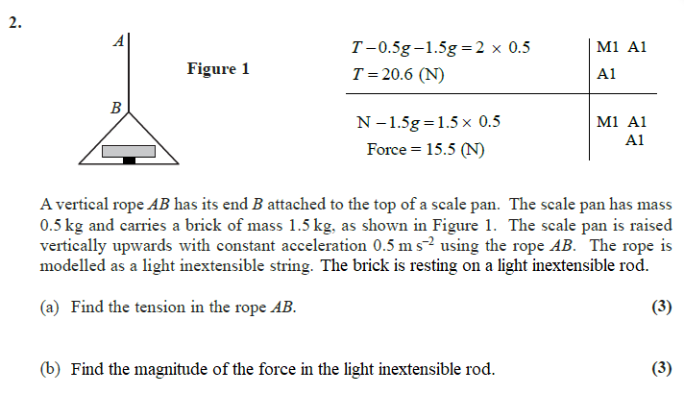
Contact Forces
?
?
(c) How does the acceleration of the brick get affected by the height
of the supporting rod?
(d) What happens to the acceleration of the brick if the supporting
rod has it’s thickness made equal to zero?
(e) What is the normal supporting force during the acceleration when
there is no rod?

Slide 4
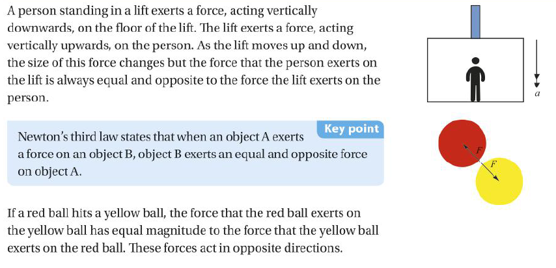
Newton’s 3rd Law
! Newton’s 3rd Law: For every action there is an equal and opposite reaction.
If object A causes an action-force on object B, the object causing the action feels a recoiling force. The recoil is the reaction object A has to causing an action force on B.
Confused.com: “If the reaction is equal but opposite, surely the object can’t move?”
Solution: The action and reaction are acting on different objects!

Slide 5





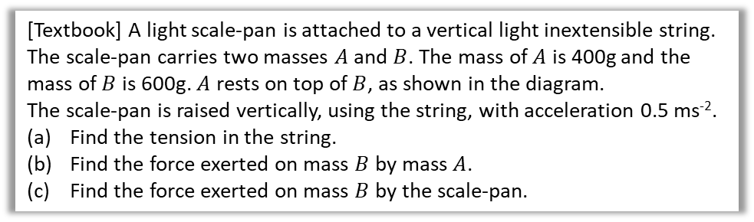


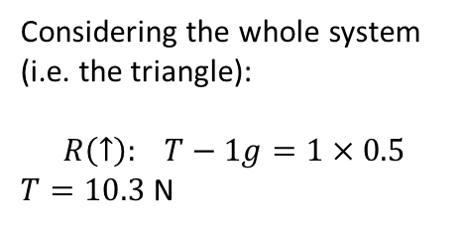



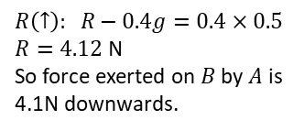
Lifting
[Textbook] A light scale-pan is attached to a vertical light inextensible string. The scale-pan carries two masses $A$ and $B$. The mass of $A$ is 400g and the mass of $B$ is 600g. $A$ rests on top of $B$, as shown in the diagram.
The scale-pan is raised vertically, using the string, with acceleration 0.5 ms⁻².
Find the tension in the string.
Find the force exerted on mass $B$ by mass $A$.
Find the force exerted on mass $B$ by the scale-pan.
Confused.com: “If the reaction is equal but opposite, surely the object can’t move?”
Solution: The action and reaction are acting on different objects!
By Newton’s 3rd Law, we force exerted on $B$ by $A$ is the same as that exerted on $A$ by $B$. So considering forces at $A$:
a
?
b
?
Considering the whole system (i.e. the triangle):
$$R\left(↑\right): T−1g=1×0.5$$ $T=10.3$ N
$$R$$
$$R\left(↑\right): R−0.4g=0.4×0.5$$ $R=4.12$ N
So force exerted on $B$ by $A$ is 4.1N downwards.
$$T$$
$0.5$ms⁻²
$$A$$
$$A$$
0.4 kg
0.4 kg
$$0.4g$$
$1$kg
0.6 kg
$$B$$
$$1g$$

Slide 6
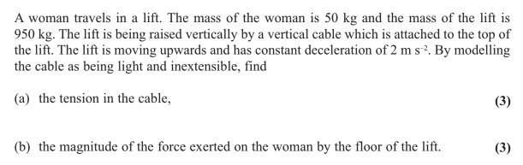
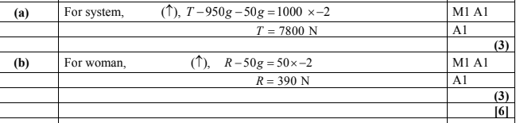
Test Your Understanding
Edexcel M1 May 2013 Q2
?
?

Slide 7
Classwork Exercise 10.5
Pearson Stats/Mechanics Year 1 Exercise Book
Page 72
Question 4

Slide 8
Homework Exercise

Slide 9
Homework Exercise

Slide 10
Homework Exercise

Slide 11
Homework Exercise

Slide 12
Homework Answers

Slide 13
Homework Answers

