Slide 1
M1 Chapter 10: Forces and Motion Pulleys

Slide 2
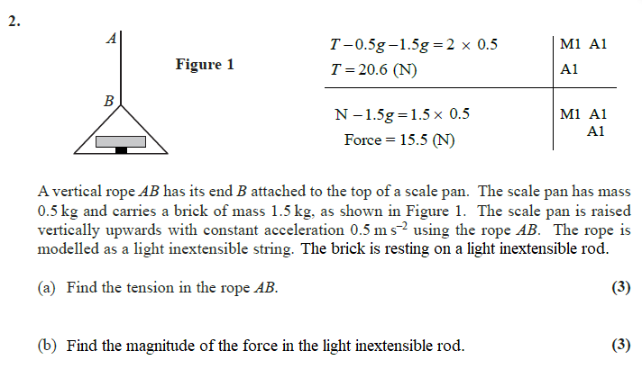
Starter
?
?

Slide 3



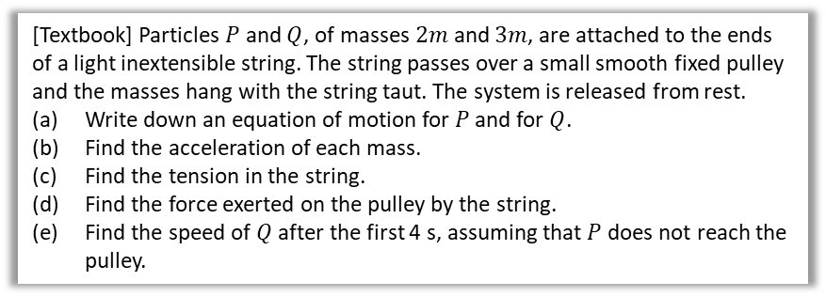






Pulleys
A pulley is a wheel on which a rope/string/cable passes.
For now the two particles hanging either side will either be horizontal or vertical.
Later they could be on a slope which works the same way, but needs more geometry.
[Textbook] Particles $P$ and $Q$, of masses $2m$ and $3m$, are attached to the ends of a light inextensible string. The string passes over a small smooth fixed pulley and the masses hang with the string taut. The system is released from rest.
Write down an equation of motion for $P$ and for $Q$.
Find the acceleration of each mass.
Find the tension in the string.
Find the force exerted on the pulley by the string.
Find the speed of $Q$ after the first 4 s, assuming that $P$ does not reach the pulley.
Why can’t we just model both particles as a single particle as before?
The particles are moving in different directions (it is possible, but now separate just works better).
Under what conditions is the tension in each part of the string the same?
Single piece of string and a smooth pulley.
?
?
Diagram
For $P$, $R\left(↑\right)$: $T−2mg=2ma$ (1)
For $Q$, $R\left(↓\right)$: $3mg−T=3ma$ (2)
Adding equations:
$mg=5ma → a=\frac{1}{5}g$ ms⁻²
Substituting back into (1):
$T=2ma+2mg=\frac{2}{5}mg+2mg=\frac{12}{5}mg$ N
Force exerted on pulley by string:
$=2T=\frac{24}{5}mg$ N
$$v=at$$ $=7.84$ m/s (3sf)
$$F$$
a
?
?
b
?
$$T$$
$$T$$
$$a$$
$$a$$
c
?
Remember that tension acts away from each object in the direction of the string. This includes the pulley!
$$T$$
$$T$$
$$3m$$
d
?
$$2m$$
$$3mg$$
$$2mg$$
Ensure that you add the direction of acceleration at each moving particle, and resolve forces in this direction.
e
?

Slide 4









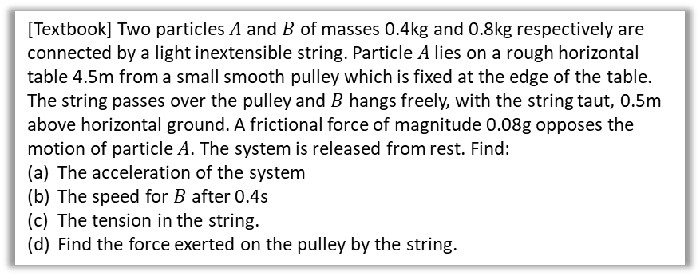




Horizontal and vertical string
?
Diagram
[Textbook] Two particles $A$ and $B$ of masses 0.4kg and 0.8kg respectively are connected by a light inextensible string. Particle $A$ lies on a rough horizontal table 4.5m from a small smooth pulley which is fixed at the edge of the table. The string passes over the pulley and $B$ hangs freely, with the string taut, 0.5m above horizontal ground. A frictional force of magnitude 0.08g opposes the motion of particle $A$. The system is released from rest. Find:
The acceleration of the system
The speed for $B$ after 0.4s
The tension in the string.
Find the force exerted on the pulley by the string.
$$a$$
$$A$$
$$T$$
$$T$$
$$0.08g$$
$$0.4kg$$
$$T$$
$$a$$
$$T$$
$$0.8kg$$
$$B$$
$$0.8g$$
For $A$, $R\left(→\right)$, $T−0.08g=0.4a$ (1)
For $B$, $R\left(↓\right)$, $0.8g−T=0.8a$ (2)
Adding:
$$0.72g=1.2a → a=0.6g$$
$$v=at, a=5.88$$ v =$2.4 m/s (2sf)$
From $A$ (eqn-1), $T=0.4a+0.08g→ T=1.0N$
The resultant force of the two tensions against the pulley:
$R^{2}=T^{2}+T^{2}$
$R= \sqrt{2} T$
$$→ R=1.4N$$
a
?
?
b
?
C
?
d
$A,B$ start moving.
$A$ comes to rest.

Slide 5
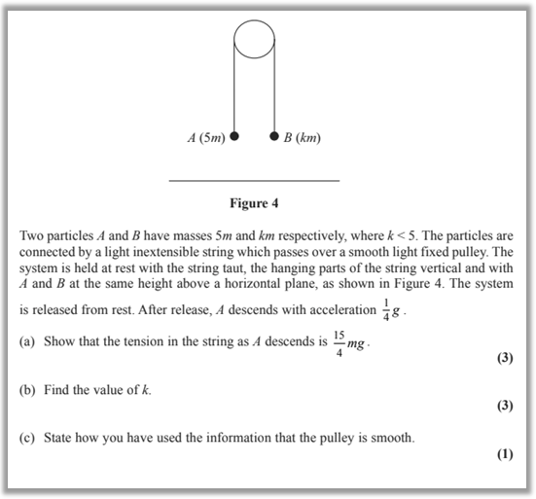
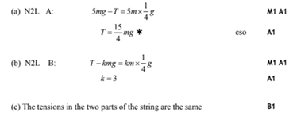
Test Your Understanding
Edexcel M1 Jan 2010 Q6
(“N2L” = Newton’s 2nd Law)
?
?
?

Slide 6
Classwork Exercise 10.6
Pearson Stats/Mechanics Year 1 Exercise Book
Pages 74-75
Questions 1 to 4

Slide 7
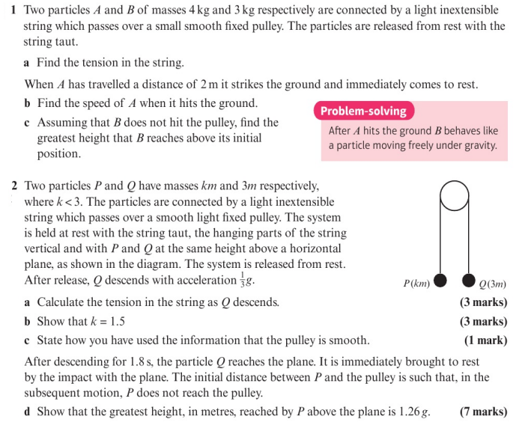
Homework Exercise

Slide 8
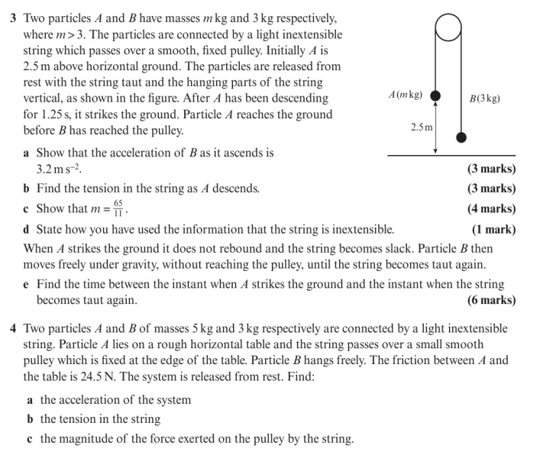
Homework Exercise

Slide 9
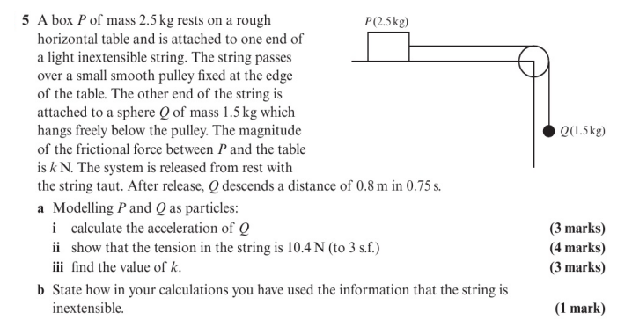
Homework Exercise

Slide 10
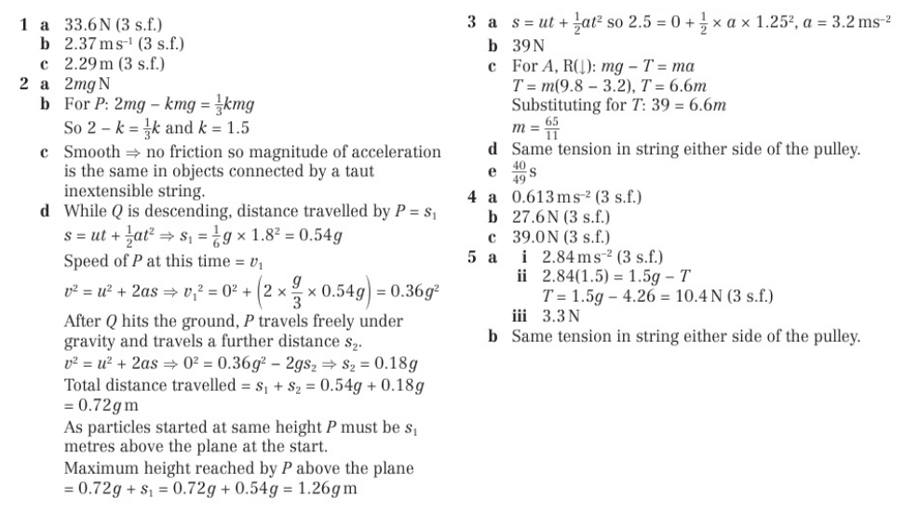
Homework Answers

