Slide 1
P1 Chapter 10: Trigonometry Equations Trigonometric Identities

Slide 2
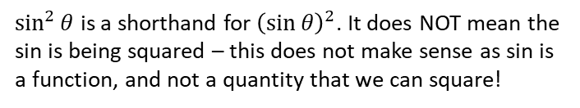








Trigonometric Identities
$$P$$
Returning to our point on the unit circle…
$$1$$
?
$$\sin{θ}$$
$$θ$$
$$O$$
$$cos θ$$
?
?
1
Then $tan θ=\frac{sin θ}{cos θ}$
?
2
Pythagoras gives you...
$$sin^{2}θ+cos^{2}θ=1$$
$\sin^{2}{θ}$ is a shorthand for ${\left(\sin{θ}\right)}^{2}$. It does NOT mean the sin is being squared – this does not make sense as sin is a function, and not a quantity that we can square!

Slide 3
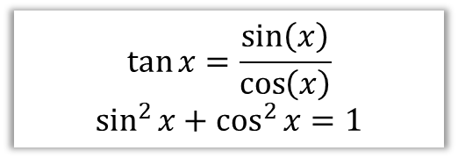

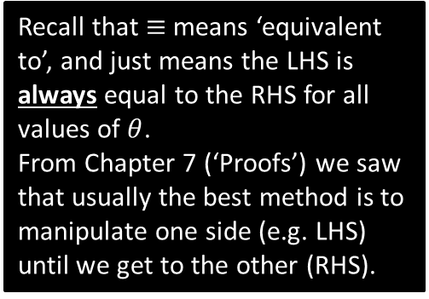
Application of identities #1: Proofs
Prove that $1−\tan{θ}\sin{θ}\cos{θ}≡\cos^{2}{θ}$
$$\tan{x}=\frac{\sin\left(x\right)}{\cos\left(x\right)}$$
$$\sin^{2}{x}+\cos^{2}{x}=1$$
?
Tip #1: Turn any tan’s into sin’s and cos’s.
$$LHS=1−\frac{\sin{θ}}{\cos{θ}}\sin{θ}\cos{θ}$$
$$=1−\frac{\sin^{2}{θ}cosθ}{\cos{θ}} \\ =1−\sin^{2}{θ} \\ =\cos^{2}{θ}=RHS$$
?
Recall that $≡$ means ‘equivalent to’, and just means the LHS is always equal to the RHS for all values of $θ$.
From Chapter 7 (‘Proofs’) we saw that usually the best method is to manipulate one side (e.g. LHS) until we get to the other (RHS).
?
?

Slide 4

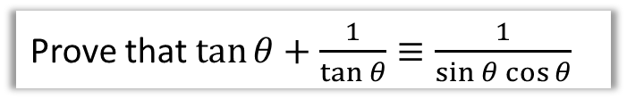
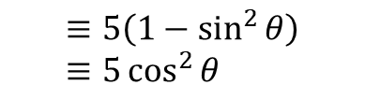


More Examples
Edexcel C2 June 2012 Paper 1 Q16
Prove that $\tan{θ}+\frac{1}{\tan{θ}}≡\frac{1}{\sin{θ}\cos{θ}}$
Simplify $5−5\sin^{2}{θ}$
?
?
$$≡5\left(1−\sin^{2}{θ}\right) \\ ≡5\cos^{2}{θ}$$
$$LHS≡\frac{\sin{θ}}{\cos{θ}}+\frac{\cos{θ}}{\sin{θ}}$$
$$≡\frac{\sin^{2}{θ}}{\sin{θ}\cos{θ}}+\frac{\cos^{2}{θ}}{\sin{θ}\cos{θ}}$$
$$≡\frac{\sin^{2}{θ}+\cos^{2}{θ}}{\sin{θ}\cos{θ}}$$
$$≡\frac{1}{\sin{θ}\cos{θ}}≡RHS$$
?
Tip #3: Look out for $1−\sin^{2}{θ}$ and $1−\cos^{2}{θ}$.
Students often don’t spot that these can be simplified.
?
?
Tip #2: In any addition/subtraction involving at least one fraction (with trig functions), always combine algebraically into one.

Slide 5

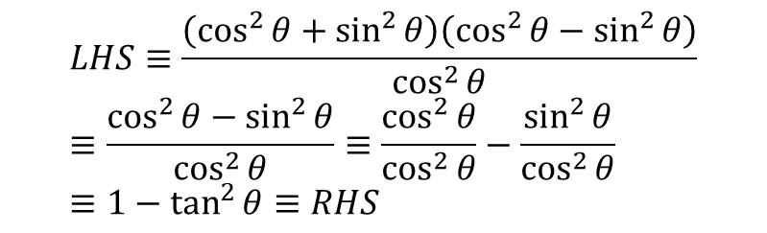

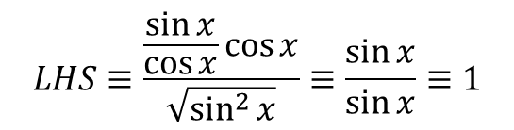

Test Your Understanding
Prove that $\frac{\tan{x}\cos{x}}{\sqrt{1−\cos^{2}{x}}}≡1$
Prove that $\frac{\cos^{4}{θ}−\sin^{4}{θ}}{\cos^{2}{θ}}≡1−\tan^{2}{θ}$
?
?
$$LHS≡\frac{\frac{\sin{x}}{\cos{x}}\cos{x}}{\sqrt{\sin^{2}{x}}}≡\frac{\sin{x}}{\sin{x}}≡1$$
$$LHS≡\frac{\left(\cos^{2}{θ}+\sin^{2}{θ}\right)\left(\cos^{2}{θ}−\sin^{2}{θ}\right)}{\cos^{2}{θ}} \\ ≡\frac{\cos^{2}{θ}−\sin^{2}{θ}}{\cos^{2}{θ}}≡\frac{\cos^{2}{θ}}{\cos^{2}{θ}}−\frac{\sin^{2}{θ}}{\cos^{2}{θ}} \\ ≡1−\tan^{2}{θ}≡RHS$$
AQA IGCSE Further Maths Worksheet
Prove that $\tan^{2}{θ}≡\frac{1}{\cos^{2}{θ}}−1$
?
$$LHS≡\frac{\sin^{2}{θ}}{\cos^{2}{θ}}$$
$$≡\frac{1−\cos^{2}{θ}}{\cos^{2}{θ}}$$
$$≡\frac{1}{\cos^{2}{θ}}−\frac{\cos^{2}{θ}}{\cos^{2}{θ}}≡\frac{1}{\cos^{2}{θ}}−1≡RHS$$

Slide 6

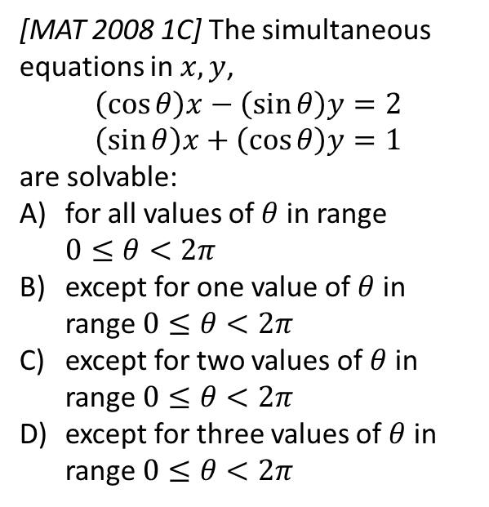
Exercise 10.3
Pearson Pure Mathematics Year 1/AS
Page 79
Extension:
?
For convenience let $s=\sin{θ}$ and $c=\cos{θ}$. As we’d usually do for simultaneous equations, we could make coefficients of $x$ terms the same:
$$scx−s^{2}y=2s \\ scx+c^{2}y=c$$
Then subtracting:
$$\left(s^{2}+c^{2}\right)y=c−2s \\ ∴y=c−2s$$
Similarly making $y$ terms the same, we yield $x=2c+s$
$x,y$ are defined for every value of $θ$, so the answer is (A). Why might it have not been (A)? Suppose $x=\frac{2\cos{θ}+sinθ}{sin θ}$. This would not be defined whenever $sin θ=0$.
[MAT 2008 1C] The simultaneous equations in $x,y$,
$$\left(\cos{θ}\right)x−\left(\sin{θ}\right)y=2 \\ \left(\sin{θ}\right)x+\left(\cos{θ}\right)y=1$$
are solvable:
for all values of $θ$ in range $0≤θ<2π$
except for one value of $θ$ in range $0≤θ<2π$
except for two values of $θ$ in range $0≤θ<2π$
except for three values of $θ$ in range $0≤θ<2π$

Slide 7
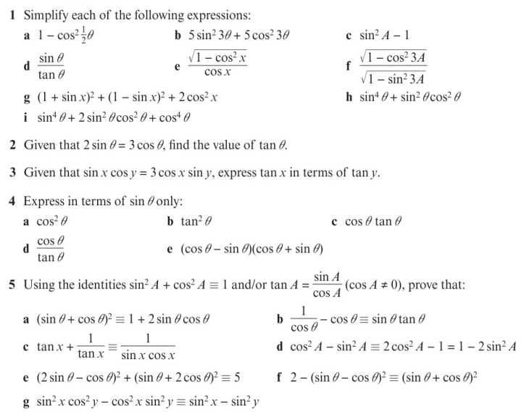
Homework Exercise

Slide 8
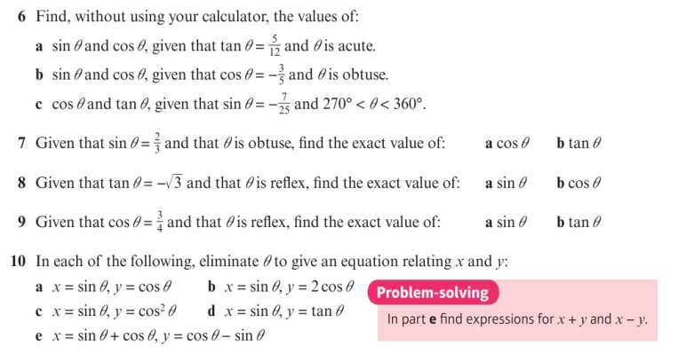
Homework Exercise

Slide 9
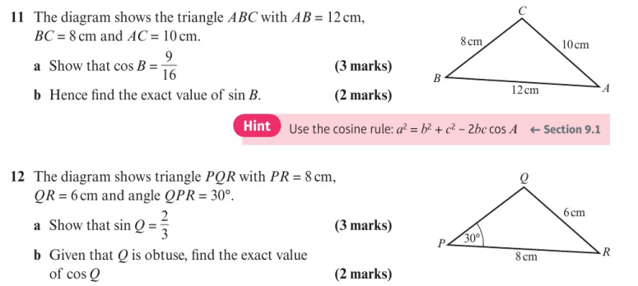
Homework Exercise

Slide 10
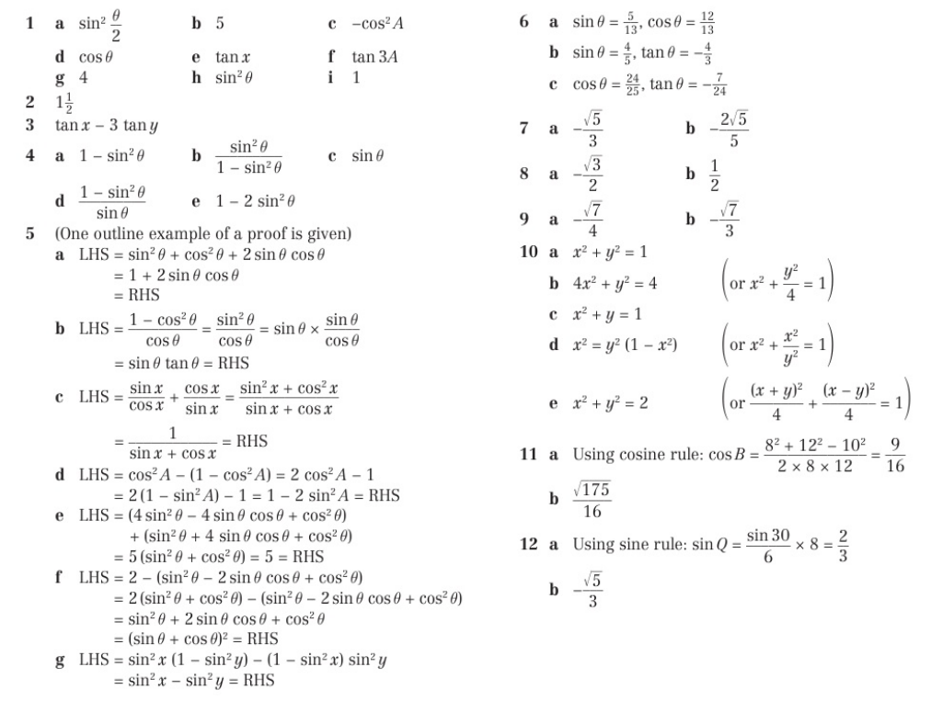
Homework Answers

