Slide 1
P2 Chapter 8: Parametric Equations Using Parameters

Slide 2
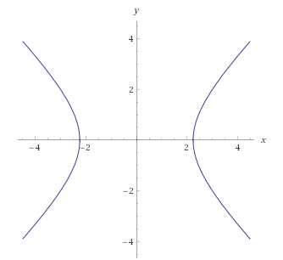
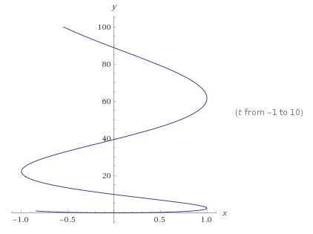


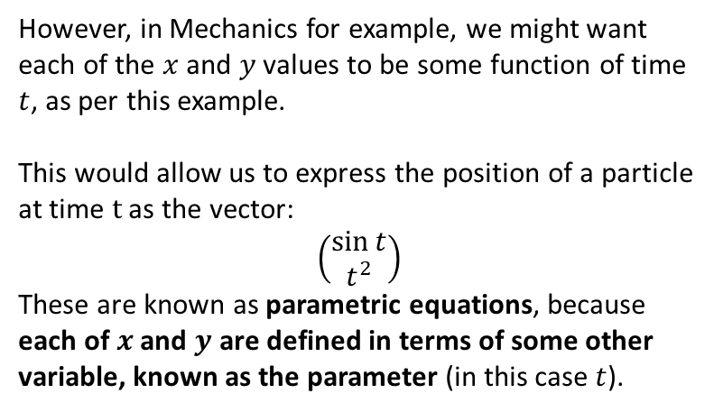

What are they and what is the point?
$$x^{2}−y^{2}=5$$
Typically, with two variables $x$ and $y$, we can relate the two by a single equation involving just $x$ and $y$.
This is known as a Cartesian equation.
The line shows all points $\left(x,y\right)$ which satisfy the Cartesian equation.
$$x=\sin\left(t\right) \\ y=t^{2}$$
However, in Mechanics for example, we might want each of the $x$ and $y$ values to be some function of time $t$, as per this example.
This would allow us to express the position of a particle at time $t$ as the vector:
$$\left(\begin{matrix}\sin{t} \\ t^{2}\end{matrix}\right)$$
These are known as parametric equations, because each of $x$ and $y$ are defined in terms of some other variable, known as the parameter (in this case $t$).

Slide 3

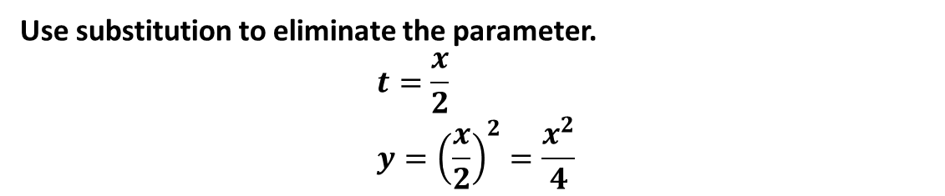




Converting parametric to Cartesian
How could we convert these parametric equations into a single Cartesian one?
$$x=2t, y=t^{2}, −3<t<3$$
?
Use substitution to eliminate the parameter.
$$t=\frac{x}{2} \\ y={\left(\frac{x}{2}\right)}^{2}=\frac{x^{2}}{4}$$
What is the domain of the function?
! If $x=p(t)$ and $y=q(t)$ can be written as $y=f\left(x\right)$, then the domain of $f$ is the range of $p$...
?
If $−3<t<3$ then $−6<x<6$.
Use $x=2t$ for each of the bounds.
! and the range of $f$ is the range of $q$.
?
If $−3<t<3$ then $0≤y<9$.
This one is harder. ${\left(−3\right)}^{2}=9$ and $3^{2}=9$.
However, the minimum value is clearly $0^{2}=0$.

Slide 4

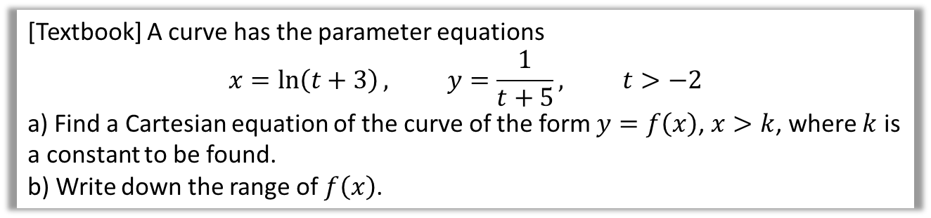

Further Example
[Textbook] A curve has the parameter equations
$$x=\ln\left(t+3\right), y=\frac{1}{t+5}, t>−2$$
a) Find a Cartesian equation of the curve of the form $y=f\left(x\right)$, $x>k$, where $k$ is a constant to be found.
b) Write down the range of $f\left(x\right)$.
? a
$$x=\ln\left(t+3\right) \\ e^{x}=t+3 \\ e^{x}−3=t \\ ∴y=\frac{1}{e^{x}−3+5}=\frac{1}{e^{x}+2}$$
When $t=−2$, $x=\ln\left(−2+3\right)=\ln\left(1\right)=0$
As $t$ increases, $\ln\left(t+3\right)$ increases, therefore $x>0$.
$∴k=0$
b) When $t=−2, y=\frac{1}{−2+5}=\frac{1}{3}$
As $t$ increases, $\frac{1}{t+5}$ decreases, therefore $y<\frac{1}{3}$
A common strategy for domain/range questions is to consider what happens are the boundary value (in this case -2), then since $t>−2$, consider what happens as $t$ increases.
? b

Slide 5
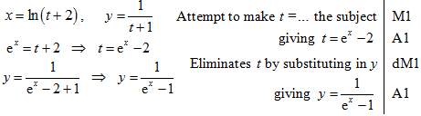
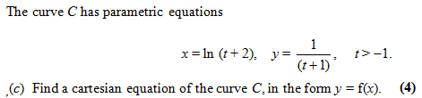
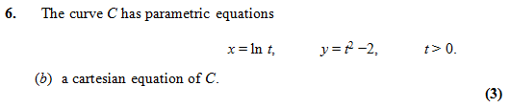

Test Your Understanding
Edexcel C4 Jan 2008 Q7
?
Edexcel C4 Jan 2011
?
$$t=e^{x} \\ y={\left(e^{x}\right)}^{2}−2 \\ =e^{2x}−2$$

Slide 6
Exercise 8.1
Pearson Pure Mathematics Year 2/AS
Page 60

Slide 7
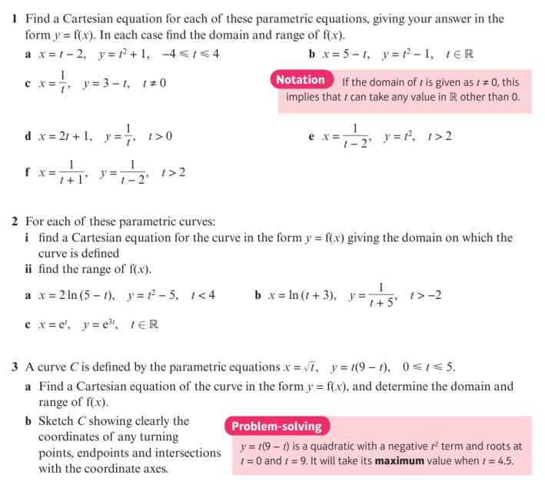
Homework Exercise

Slide 8
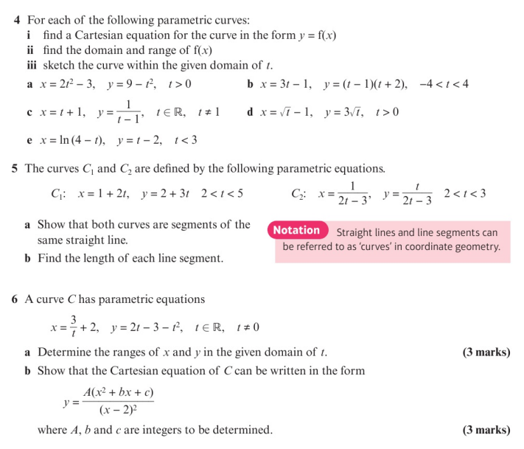
Homework Exercise

Slide 9
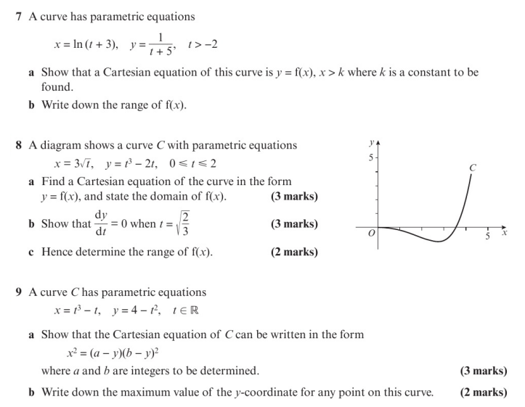
Homework Exercise

Slide 10
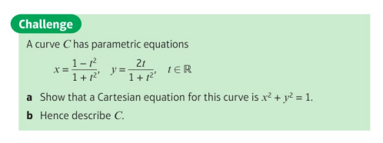
Homework Exercise

Slide 11
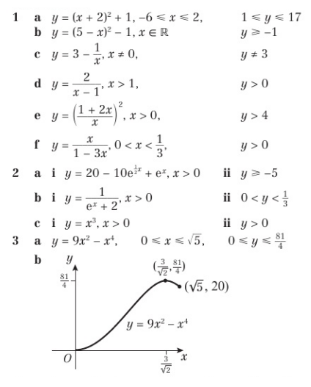
Homework Answers

Slide 12
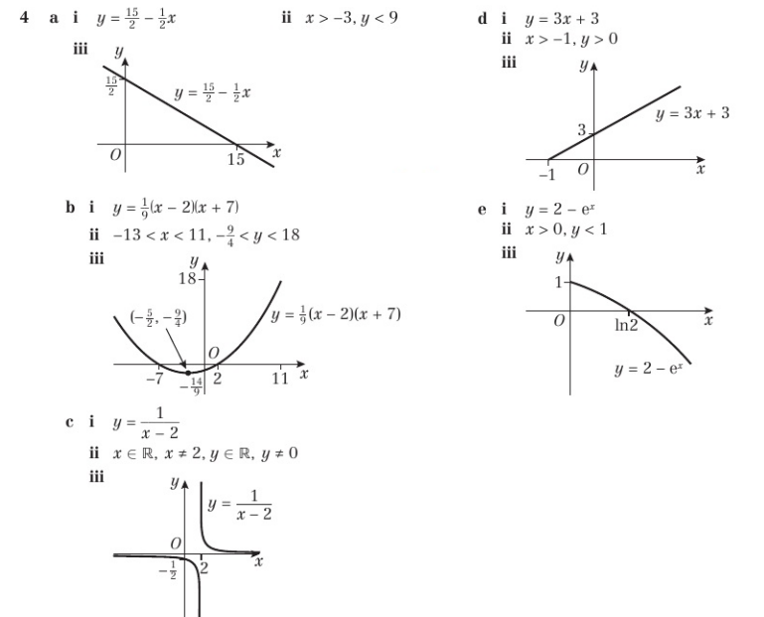
Homework Answers

Slide 13
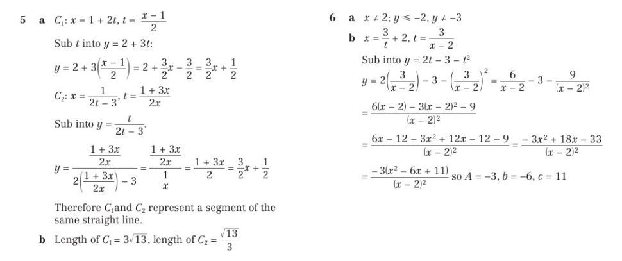
Homework Answers

Slide 14
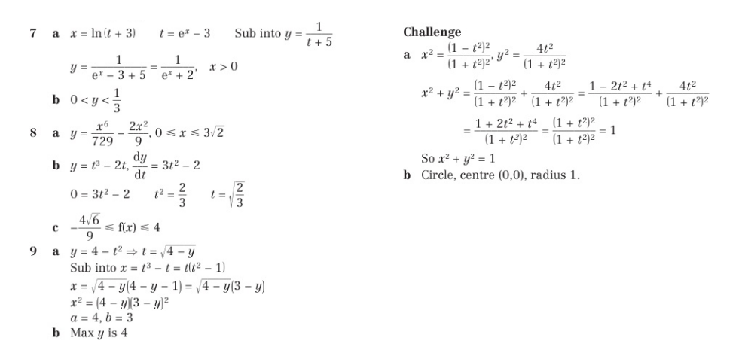
Homework Answers

