Slide 1
M1 Chapter 10: Forces and Motion Vector Forces in 2D

Slide 2
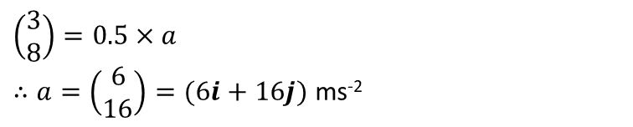
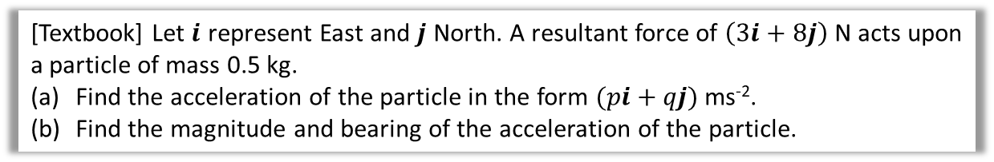

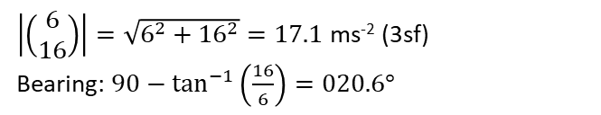
Forces in 2 Dimensions
[Textbook] Let $i$ represent East and $j$ North. A resultant force of $\left(3i+8j\right)$ N acts upon a particle of mass 0.5 kg.
Find the acceleration of the particle in the form $(pi+qj)$ ms⁻².
Find the magnitude and bearing of the acceleration of the particle.
a
$$\left(\begin{matrix}3 \\ 8\end{matrix}\right)=0.5×a$$ $∴a=\left(\begin{matrix}6 \\ 16\end{matrix}\right)=(6i+16j)$ ms⁻²
?
b
?
$\left|\left(\begin{matrix}6 \\ 16\end{matrix}\right)\right|=\sqrt{6^{2}+{16}^{2}}=17.1$ ms⁻² (3sf)
Bearing: $90−\tan^{−1}\left(\frac{16}{6}\right)=020.6°$
16
$$θ$$
6

Slide 3
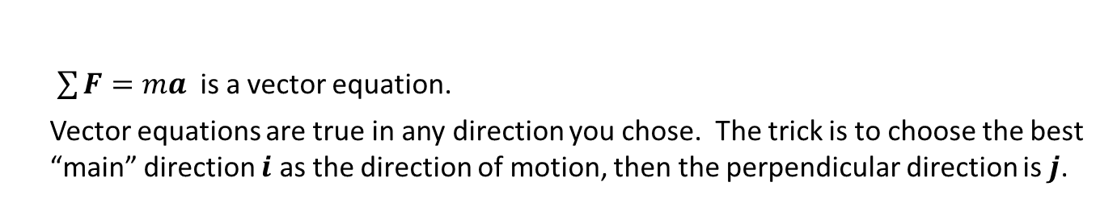
Forces in 2 Dimensions
Vectors have both direction and magnitude, while scalars only have magnitude.
Vector quantity: force, acceleration, velocity, displacement
Scalar only: mass, time
?
?
$\sum{F}=ma$ is a vector equation.
Vector equations are true in any direction you chose. The trick is to choose the best “main” direction $i$ as the direction of motion, then the perpendicular direction is $j$.

Slide 4
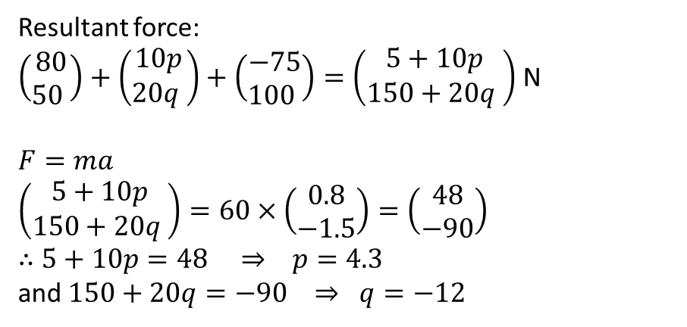
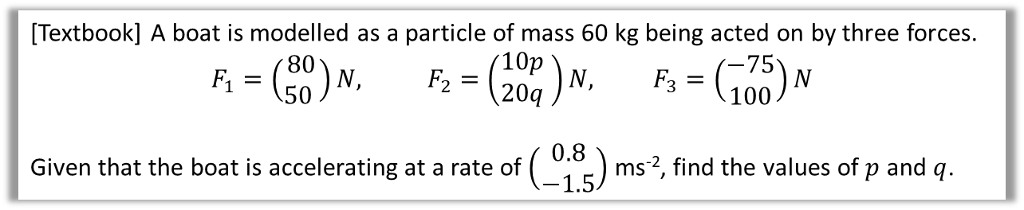
Test Your Understanding
[Textbook] A boat is modelled as a particle of mass 60 kg being acted on by three forces.
$$F_{1}=\left(\begin{matrix}80 \\ 50 \end{matrix}\right)N, F_{2}=\left(\begin{matrix}10p \\ 20q\end{matrix} \right)N, F_{3}=\left(\begin{matrix}−75 \\ 100\end{matrix}\right)N$$
Given that the boat is accelerating at a rate of $\left(\begin{matrix}0.8 \\ −1.5\end{matrix}\right)$ ms⁻², find the values of $p$ and $q$.
?
Resultant force:
$\left(\begin{matrix}80 \\ 50 \end{matrix}\right)+\left(\begin{matrix}10p \\ 20q \end{matrix}\right)+\left(\begin{matrix}−75 \\ 100 \end{matrix}\right)=\left(\begin{matrix}5+10p \\ 150+20q \end{matrix}\right)$ N
$F=ma$
$$\left(\begin{matrix}5+10p \\ 150+20q \end{matrix}\right)=60×\left(\begin{matrix}0.8 \\ −1.5\end{matrix}\right)=\left(\begin{matrix}48 \\ −90\end{matrix}\right)$$
$∴$ $5+10p=48 ⇒ p=4.3$
and $150+20q=−90 ⇒ q=−12$

Slide 5
Classwork Exercise 10.4
Pearson Stats/Mechanics Year 1 Exercise Book
Pages 70-71
Questions 1 to 4.

Slide 6
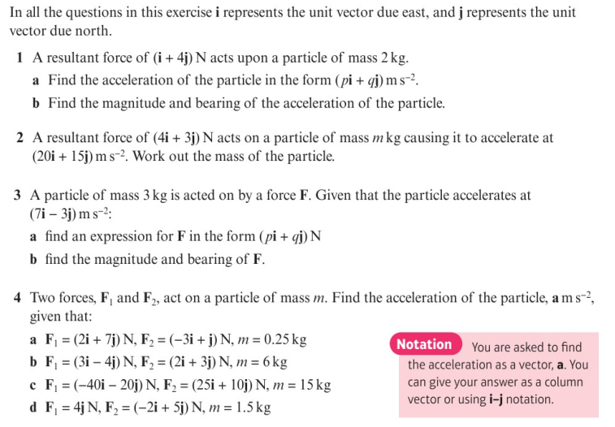
Homework Exercise

Slide 7
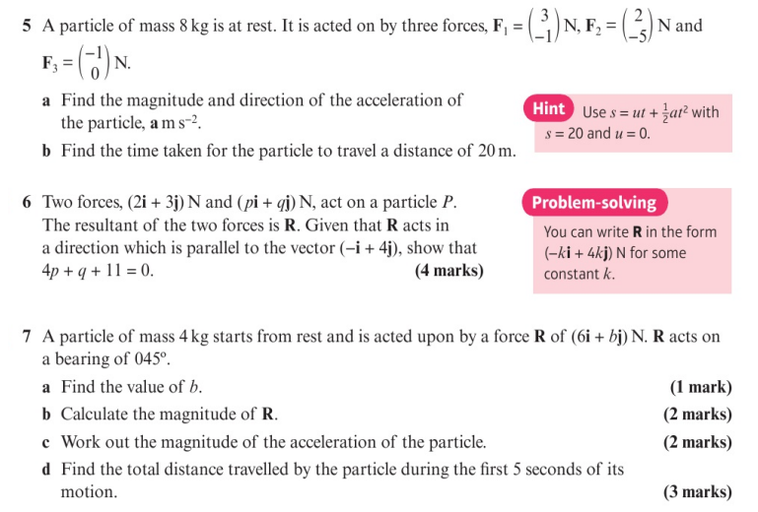
Homework Exercise

Slide 8
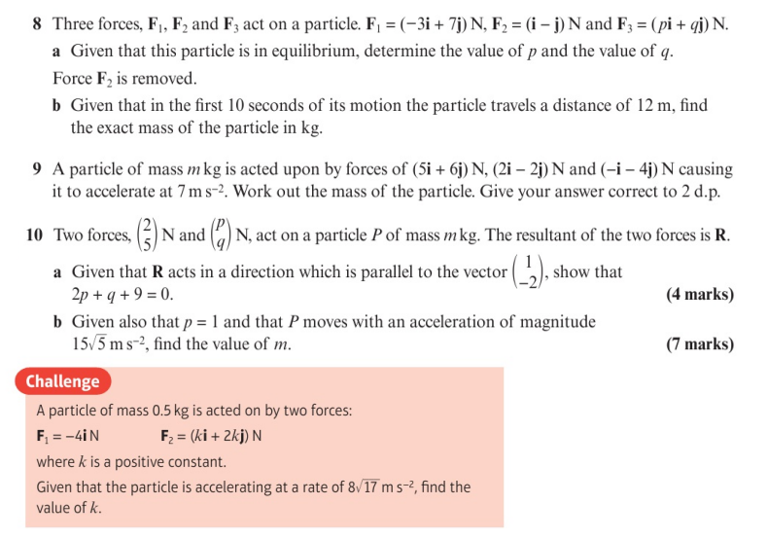
Homework Exercise

Slide 9
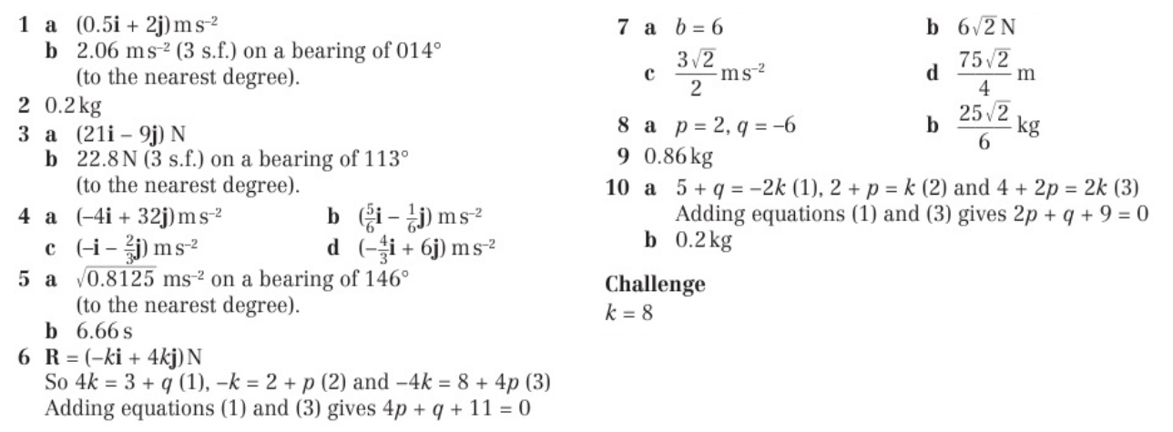
Homework Answers

