Slide 1
P2 Chapter 7: Trigonometric Equations
Trigonometric Solutions

Slide 2

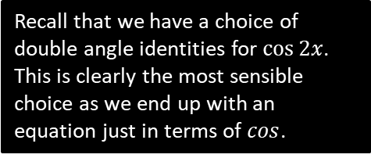
Solving Trigonometric Equations
This is effectively the same type of question you encountered in Chapter 6 and in Year 1, except you may need to use either the addition formulae or double angle formulae.
[Textbook] Solve $3\cos{2x}−\cos{x}+2=0$ for $0≤x≤360°$.
?
$$3\left(2\cos^{2}{x}−1\right)−\cos{x}+2=0 \\ 6\cos^{2}{x}−3−\cos{x}+2=0 \\ 6\cos^{2}{x}−\cos{x}−1=0 \\ \left(3\cos{x}+1\right)\left(2\cos{x}−1\right)=0 \\ \cos{x}=−\frac{1}{3} or\cos{x}=\frac{1}{2}$$
$$x=109.5°, 250.5° x=60°,300°$$
Recall that we have a choice of double angle identities for $\cos{2x}$. This is clearly the most sensible choice as we end up with an equation just in terms of $cos$.

Slide 3

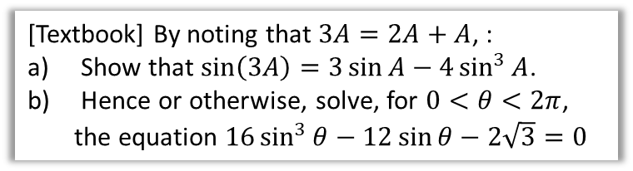

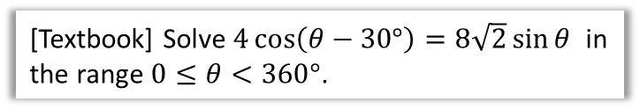
Further Examples
[Textbook] By noting that $3A=2A+A$, :
Show that $\sin\left(3A\right)=3\sin{A}−4\sin^{3}{A}$.
Hence or otherwise, solve, for $0<θ<2π$, the equation $16\sin^{3}{θ}−12\sin{θ}−2\sqrt{3}=0$
[Textbook] Solve $4\cos\left(θ−30°\right)=8\sqrt{2}\sin{θ}$ in the range $0≤θ<360°$.
?
Your instinct should be to use the addition formulae first to break up the $4\cos\left(θ−30°\right)$.
$$4\cos{θ}\cos{30°}+4\sin{θ}\sin{30°}=8\sqrt{2}\sin{θ} \\ 2\sqrt{3}\cos{θ}+2\sin{θ}=8\sqrt{2}\sin{θ} \\ 2\sqrt{3}\cos{θ}=8\sqrt{2}\sin{θ}−2\sin{θ} \\ 2\sqrt{3}\cos{θ}=\left(8\sqrt{2}−2\right)\sin{θ} \\ \frac{2\sqrt{3}}{8\sqrt{2}−2}=\frac{\sin{θ}}{\cos{θ}}=\tan{θ}$$
$θ=20.4°, 200.4°$
Exam Note: A question pretty much just like this came up in an exam once.
$$\sin\left(2A+A\right) \\ =\sin{2A}\cos{A}+\cos{2A}\sin{A} \\ =2\sin{A}\cos{A}\cos{A}+\left(1−2\sin^{2}{A}\right)\sin{A} \\ =2\sin{A}\left(1−\sin^{2}{A}\right)+\sin{A}−2\sin^{3}{A} \\ =2\sin{A}−2\sin^{3}{A}+\sin{A}−2\sin^{3}{A} \\ =3\sin{A}−4\sin^{3}{A}$$
Note that $16\sin^{3}{θ}−12\sin{θ}$
$=−4\left(3\sin{A}−4\sin^{3}{A}\right)=−4\sin{3θ}$.
$$∴−4\sin{3θ}=2\sqrt{3} \\ \sin{3θ}=−\frac{\sqrt{3}}{2}$$
$$3θ=\frac{4π}{3},\frac{5π}{3},\frac{10π}{3},\frac{11π}{3},\frac{16π}{3},\frac{17π}{3} \\ θ=\frac{4π}{9},\frac{5π}{9},\frac{10π}{9},\frac{11π}{9},\frac{16π}{9},\frac{17π}{9}$$
?
?

Slide 4
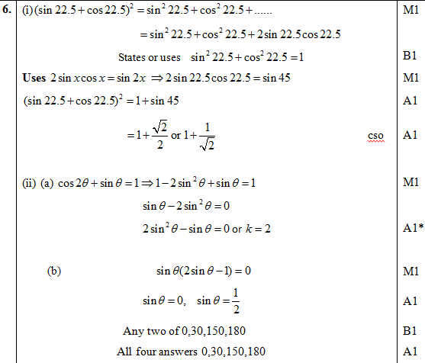
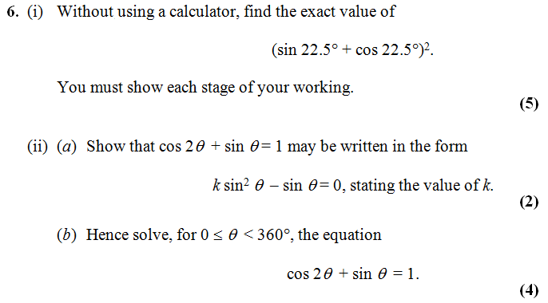


Test Your Understanding
Edexcel C3 Jan 2013 Q6
?
If you finish that quickly…
[Textbook] Solve $2\tan{2y}\tan{y}=3$ for $0≤y<2π$, giving your answer to 2dp.
?
$$2\tan{2y}\tan{y}=3 \\ 2\left(\frac{2\tan{y}}{1−\tan^{2}{y}}\right)\tan{y}=3 \\ … \\ 7\tan^{2}{y}=3 \\ \tan{y}=±\sqrt{\frac{3}{7}} \\ y=0.58, 2.56, 3.72, 5.70$$
Forgetting the $±$ is an incredibly common source of lost marks.

Slide 5
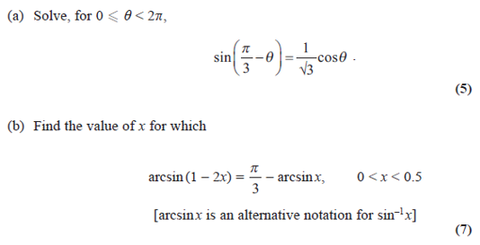
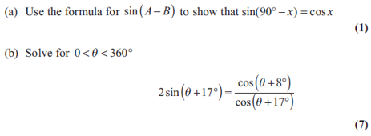
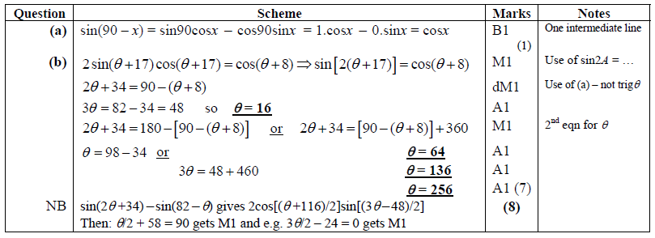
Exercise 7.4
Pearson Pure Mathematics Year 2/AS
Page 51
Extension
2
[AEA 2009 Q3]
[AEA 2013 Q2]
1
?
(Solution on next slide)

Slide 6
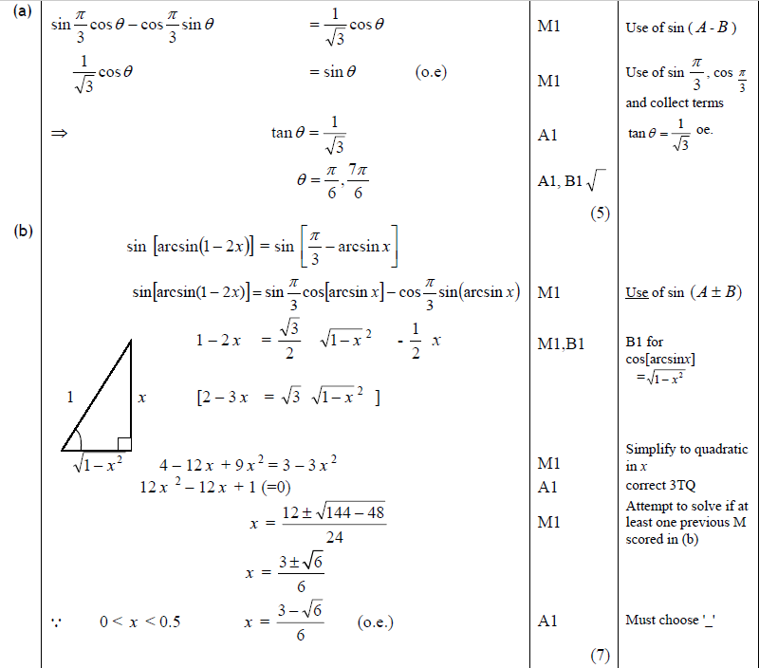
Solution to Extension Question 2

Slide 7
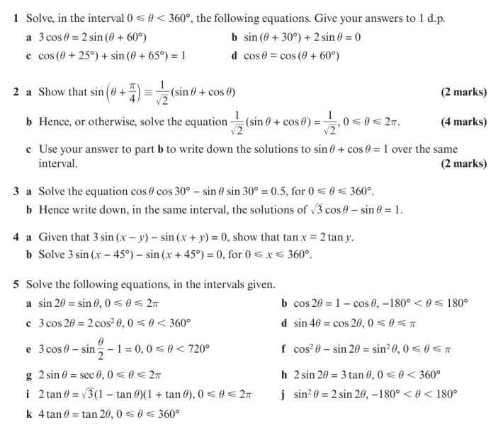
Homework Exercise

Slide 8
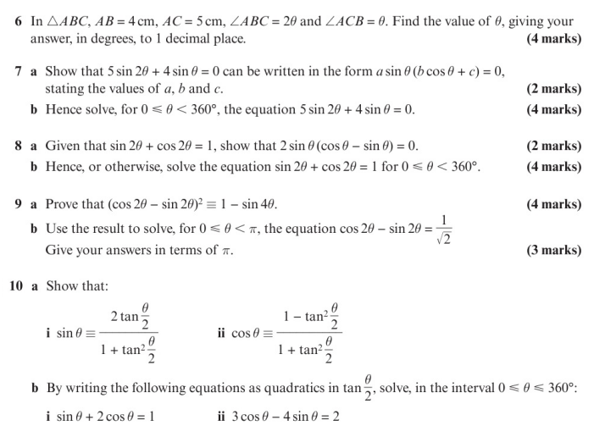
Homework Exercise

Slide 9
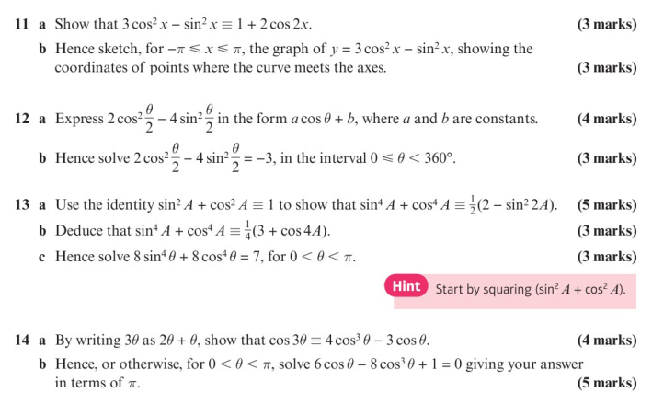
Homework Exercise

Slide 10
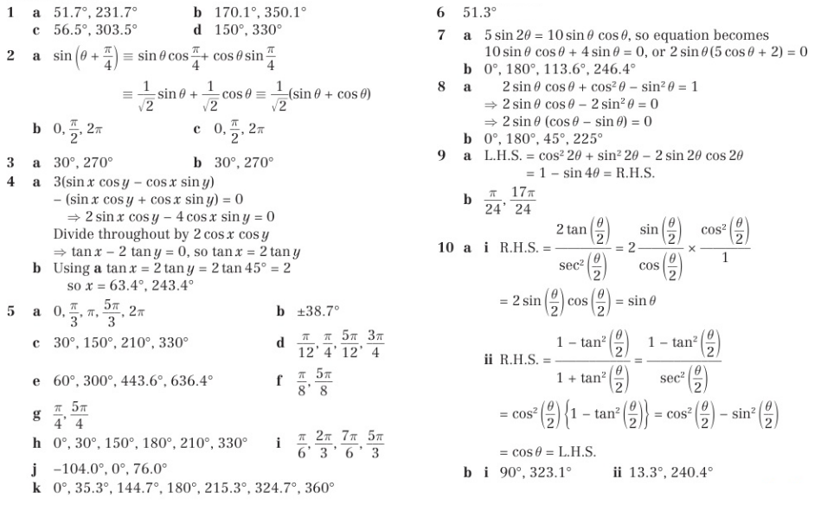
Homework Answers

Slide 11
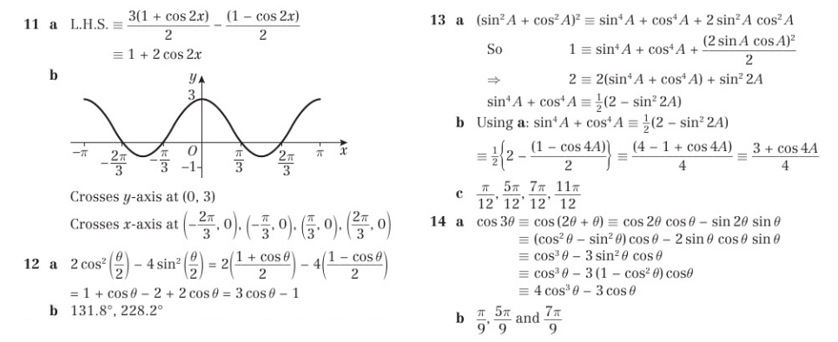
Homework Answers

