Slide 1
P1 Chapter 6: Circles Tangents and Chords

Slide 2
Tangents, Chords, Perpendicular Bisectors
There are two circle theorems that are of particular relevance to problems in this chapter, the latter you might be less familiar with:
tangent
perpendicular bisector
radius
chord
The tangent is perpendicular to the radius (at the point of intersection).
The perpendicular bisector of any chord passes through the centre of the circle.
Why this will help:
If we knew the centre of the circle and the point of intersection, we can easily find the gradient of the radius, and thus the gradient and hence equation of the tangent.
Why this will help:
The first thing we did in this chapter is find the equation of the perpendicular bisector. If we had two chords, and hence found two bisectors, we could find the point of intersection, which would be the centre of the circle.

Slide 3
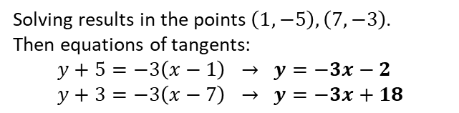


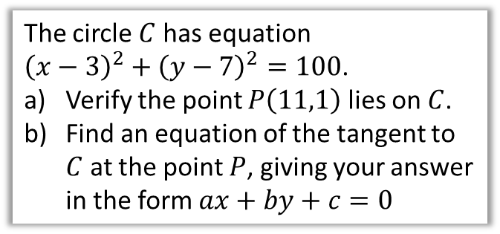

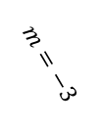
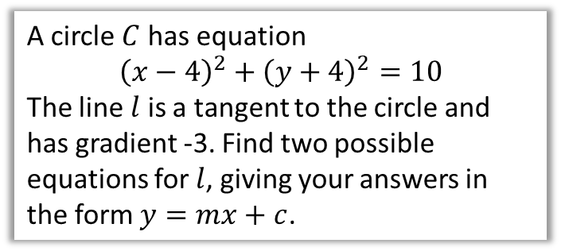
Examples
Note that the GCSE 2015+ syllabus had questions like this, except with circles centred at the origin only.
A circle $C$ has equation $${\left(x−4\right)}^{2}+{\left(y+4\right)}^{2}=10$$
The line $l$ is a tangent to the circle and has gradient -3. Find two possible equations for $l$, giving your answers in the form $y=mx+c$.
The circle $C$ has equation ${\left(x−3\right)}^{2}+{\left(y−7\right)}^{2}=100$.
Verify the point $P\left(11,1\right)$ lies on $C$.
Find an equation of the tangent to $C$ at the point $P$, giving your answer in the form $ax+by+c=0$
?
This time we have the gradient, but don’t have the points where the tangent(s) intersect the radius.
Equation of radius/diameter:
$$y+4=\frac{1}{3}\left(x−4\right) \\ y=\frac{1}{3}x−\frac{16}{3}$$
Intersecting with circle:
$${\left(x−4\right)}^{2}+{\left(\frac{1}{3}x−\frac{16}{3}+4\right)}^{2}=10$$
?
$$m=−3$$
${\left(11−3\right)}^{2}+{\left(1−7\right)}^{2}$ $=8^{2}+6^{2}=100$
Circle centre: $\left(3,7\right)$ Gradient of radius: $m_{r}=\frac{1−7}{11−3}=−\frac{3}{4}$ $∴m_{t}=\frac{4}{3}$ $y−1=\frac{4}{3}\left(x−11\right)$ $3y−3=4\left(x−11\right)$ $3y−3=4x−44$ $4x−3y−41=0$
$$\left(4,−4\right)$$
Tip: Use ‘subscripting’ of variables to make clear to the examiner (and yourself!) what you’re calculating.
Solving results in the points $\left(1,−5\right), \left(7,−3\right)$.
Then equations of tangents:
$$y+5=−3\left(x−1\right) → y=−3x−2 \\ y+3=−3\left(x−7\right) → y=−3x+18$$

Slide 4



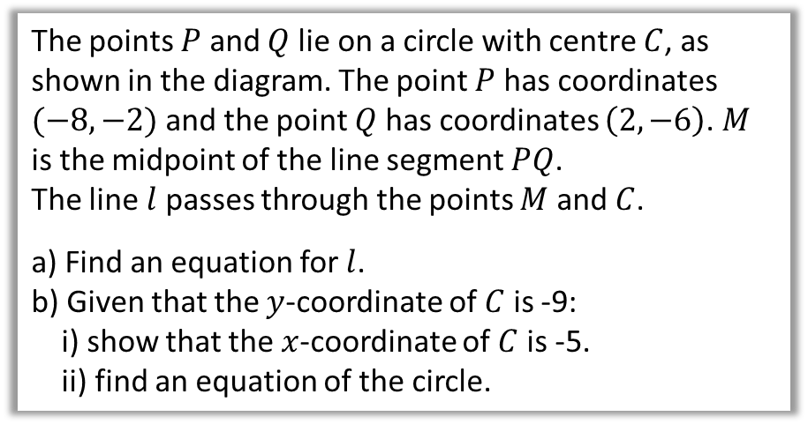

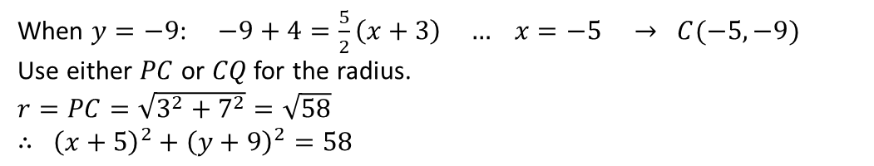



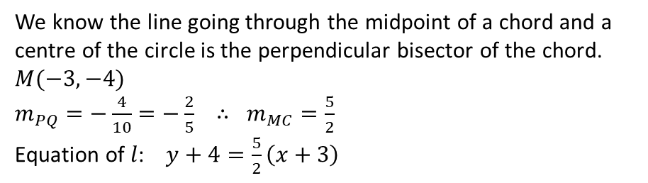
Determining the Circle Centre
$$y$$
The points $P$ and $Q$ lie on a circle with centre $C$, as shown in the diagram. The point $P$ has coordinates $(−8,−2)$ and the point $Q$ has coordinates $\left(2,−6\right)$. $M$ is the midpoint of the line segment $PQ$.
The line $l$ passes through the points $M$ and $C$.
a) Find an equation for $l$.
b) Given that the $y$-coordinate of $C$ is -9: i) show that the $x$-coordinate of $C$ is -5. ii) find an equation of the circle.
$$x$$
$$P\left(−8,−2\right)$$
$$M$$
$$Q\left(2,−6\right)$$
$$C$$
$$l$$
a
We know the line going through the midpoint of a chord and a centre of the circle is the perpendicular bisector of the chord.
$M(−3, −4)$
$m_{PQ}=−\frac{4}{10}=−\frac{2}{5} ∴ m_{MC}=\frac{5}{2}$
Equation of $l$: $y+4=\frac{5}{2}\left(x+3\right)$
?
Exam Tip: If you’re not asked for the equation in a particular form, just leave it as it is.
?
b
When $y=−9$: $−9+4=\frac{5}{2}\left(x+3\right) … x=−5 → C(−5,−9)$
Use either $PC$ or $CQ$ for the radius.
$r=PC=\sqrt{3^{2}+7^{2}}=\sqrt{58}$
$∴ {\left(x+5\right)}^{2}+{\left(y+9\right)}^{2}=58$
c
?

Slide 5

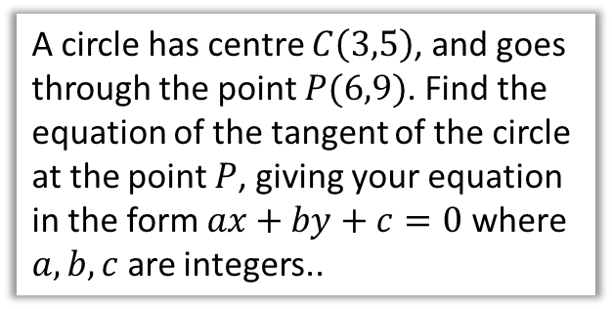

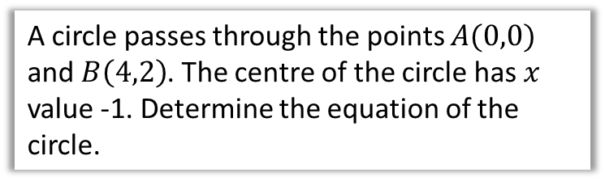
Test Your Understanding
A circle has centre $C\left(3,5\right)$, and goes through the point $P(6,9)$. Find the equation of the tangent of the circle at the point $P$, giving your equation in the form $ax+by+c=0$ where $a,b,c$ are integers..
A circle passes through the points $A(0,0)$ and $B\left(4,2\right)$. The centre of the circle has $x$ value -1. Determine the equation of the circle.
?
$$m_{AB}=\frac{2}{4}=\frac{1}{2} m_{⊥}=−2 \\ M\left(2,1\right)$$
Equation of perpendicular bisector of chord:
$$y−1=−2\left(x−2\right)$$
When $x=−1$:
$$y−1=−2\left(−1−2\right) \\ y−1=6 \\ y=7$$
Centre: $C(−1,7)$
Radius (using length $AC$): $\sqrt{1^{2}+7^{2}}=\sqrt{50}$
$${\left(x+1\right)}^{2}+{\left(y−7\right)}^{2}=50$$
?
$$m_{r}=\frac{4}{3} ∴m_{t}=−\frac{3}{4} \\ y−9=−\frac{3}{4}\left(x−6\right) \\ 4y−36=−3\left(x−6\right) \\ 4y−36=−3x+18 \\ 3x+4y−54=0$$

Slide 6
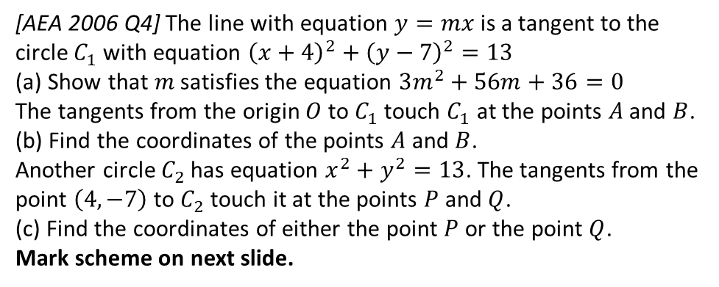

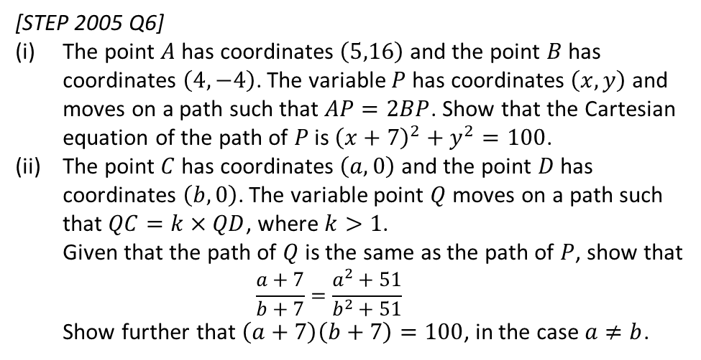
Exercise 6.4
Pearson Pure Mathematics Year 1/AS
Pages 49
Extension:
2
[AEA 2006 Q4] The line with equation $y=mx$ is a tangent to the circle $C_{1}$ with equation ${\left(x+4\right)}^{2}+{\left(y−7\right)}^{2}=13$
(a) Show that $m$ satisfies the equation $3m^{2}+56m+36=0$
The tangents from the origin $O$ to $C_{1}$ touch $C_{1}$ at the points $A$ and $B$.
(b) Find the coordinates of the points $A$ and $B$.
Another circle $C_{2}$ has equation $x^{2}+y^{2}=13$. The tangents from the point $\left(4,−7\right)$ to $C_{2}$ touch it at the points $P$ and $Q$.
(c) Find the coordinates of either the point $P$ or the point $Q$.
Mark scheme on next slide.
1
[MAT 2012 1A] Which of the following lines is a tangent to the circle with equation
$x^{2}+y^{2}=4$?
$x+y=2$
$y=x−2\sqrt{2}$
$x=\sqrt{2}$
$y=\sqrt{2}−x$
Solution: B. Note that we could avoid using algebra by using a suitable diagram and simple use of Pythagoras to get the $y$-intercept.
(This is not a tangent/chord question but is worthwhile regardless!)
3
[STEP 2005 Q6]
The point $A$ has coordinates $\left(5,16\right)$ and the point $B$ has coordinates $\left(4,−4\right)$. The variable $P$ has coordinates $\left(x,y\right)$ and moves on a path such that $AP=2BP$. Show that the Cartesian equation of the path of $P$ is ${\left(x+7\right)}^{2}+y^{2}=100$.
The point $C$ has coordinates $\left(a,0\right)$ and the point $D$ has coordinates $\left(b,0\right)$. The variable point $Q$ moves on a path such that $QC=k×QD$, where $k>1$. Given that the path of $Q$ is the same as the path of $P$, show that $\frac{a+7}{b+7}=\frac{a^{2}+51}{b^{2}+51}$ Show further that $\left(a+7\right)\left(b+7\right)=100$, in the case $a≠b$.
?
Mark scheme on next slide.

Slide 7
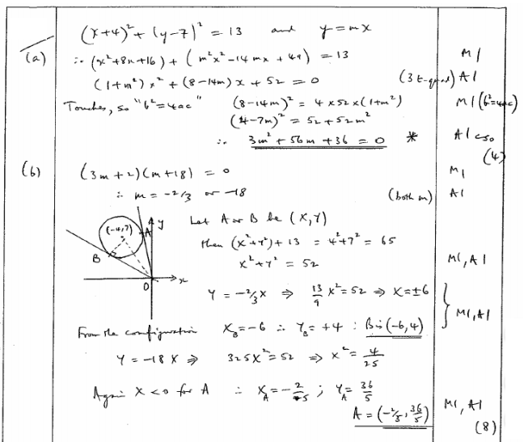
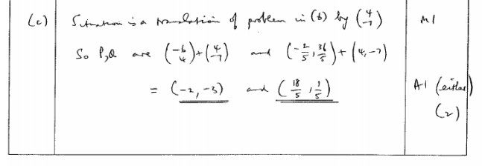
Mark Scheme for Extension Question 2
?
?
?

Slide 8
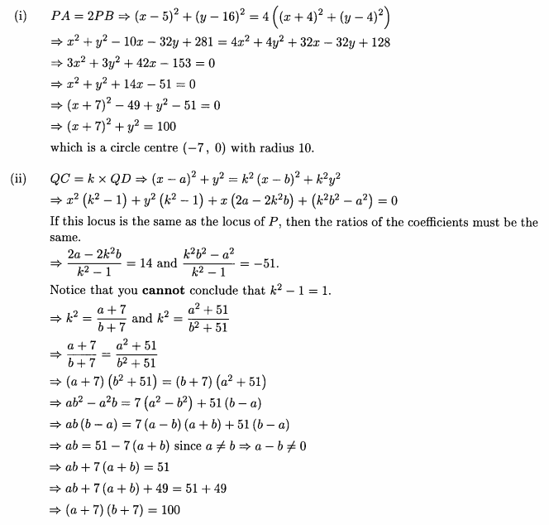
Mark Scheme for Extension Question 3
?
?

Slide 9
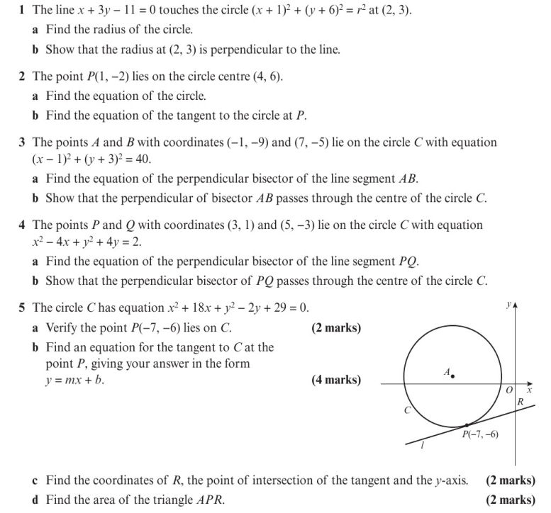
Homework Exercise

Slide 10
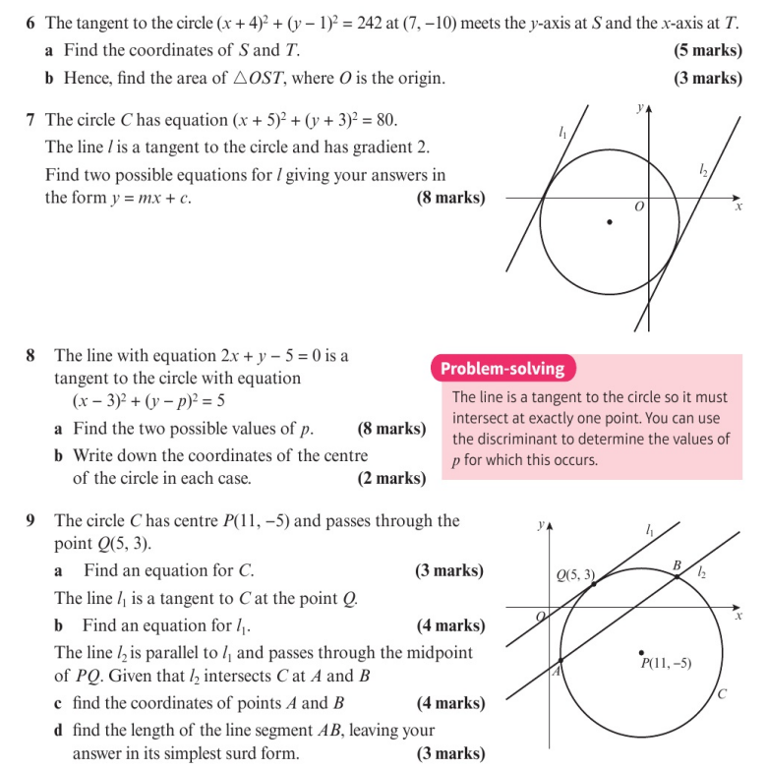
Homework Exercise

Slide 11
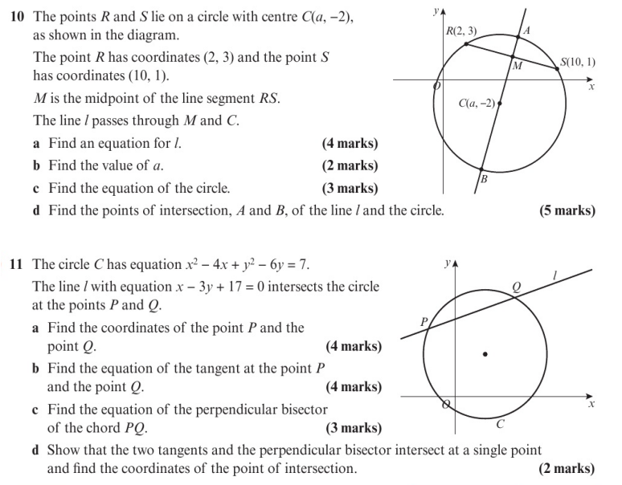
Homework Exercise

Slide 12
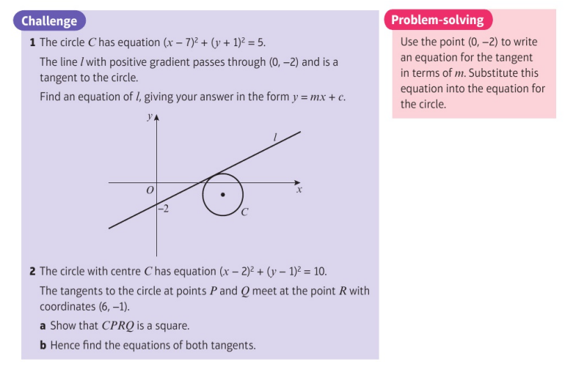
Homework Exercise

Slide 13
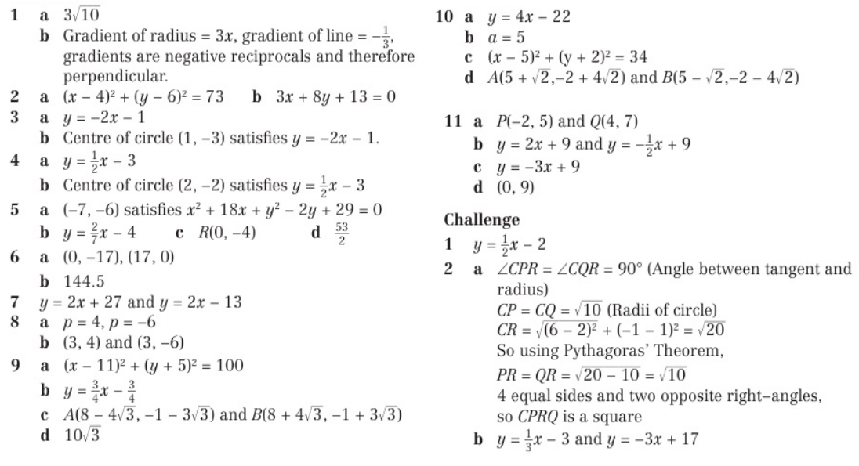
Homework Answers

