Slide 1
P1 Chapter 8: Binomial Expansion Estimation

Slide 2
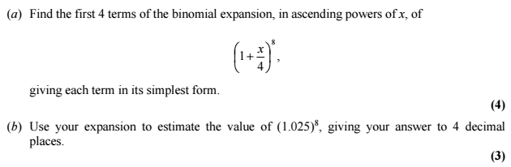

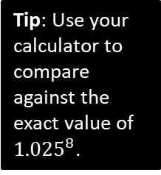

Estimating Powers
Edexcel C2 Jan 2012 Q3
Tip: Use your calculator to compare against the exact value of ${1.025}^{8}$.
a
?
b
Comparing ${1.025}^{8}$ to ${\left(1+\frac{x}{4}\right)}^{8}$, then:
$$1.025=1+\frac{x}{4} \\ 0.025=\frac{x}{4} \\ x=0.1$$
Using our expansion with $x=0.1$:
$$1+2\left(0.1\right)+\frac{7}{4}{\left(0.1\right)}^{2}+\frac{7}{8}{\left(0.1\right)}^{3} \\ =1.2184 to 4dp$$
Why should this be a reasonably good approximation of ${1.025}^{8}$ despite the missing terms in the expansion?
$x^{r}$ becomes increasingly small when $x<1$ as the power increases. Thus the ${0.1}^{4}$ terms and beyond will be negligibly small.
?
$${\left(1+\frac{x}{4}\right)}^{8}=\left(\begin{matrix}8 \\ 0\end{matrix}\right)\left(1^{8}\right) \\ +\left(\begin{matrix}8 \\ 1\end{matrix}\right)\left(1^{7}\right)\left(\frac{x}{4}\right) \\ +\left(\begin{matrix}8 \\ 2\end{matrix}\right)\left(1^{6}\right){\left(\frac{x}{4}\right)}^{2} \\ +\left(\begin{matrix}8 \\ 3\end{matrix}\right)\left(1^{5}\right){\left(\frac{x}{4}\right)}^{3} \\ =1+2x+\frac{7}{4}x^{2}+\frac{7}{8}x^{3}+…$$
?

Slide 3
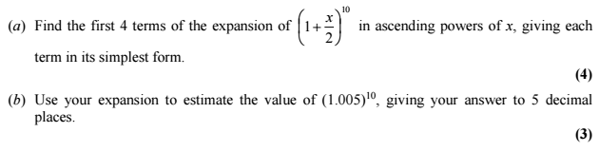
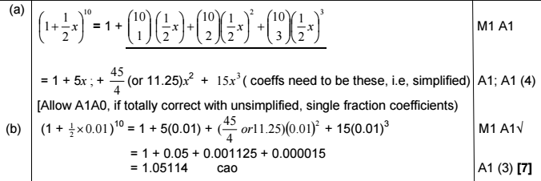
Test Your Understanding
Edexcel C2 Jan 2008 Q3
?
?

Slide 4
Exercise 8.5
Pearson Pure Mathematics Year 1/AS
Page 65

Slide 5
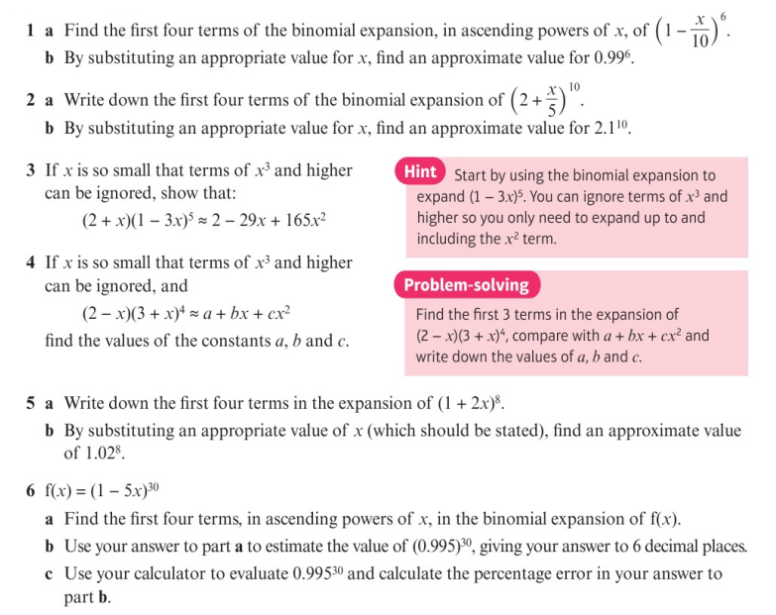
Homework Exercise

Slide 6
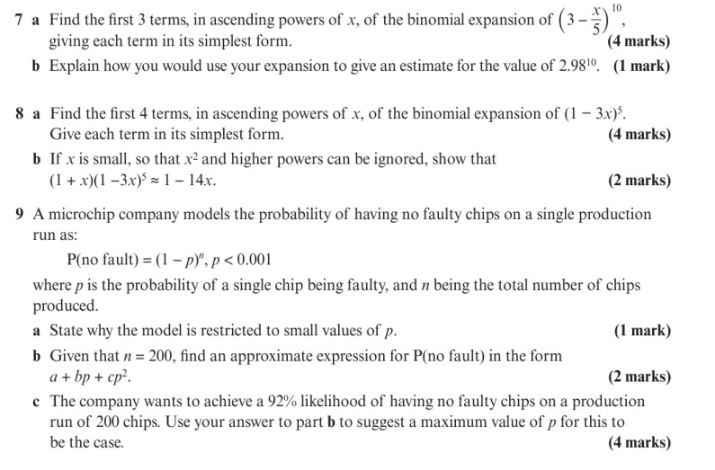
Homework Exercise

Slide 7
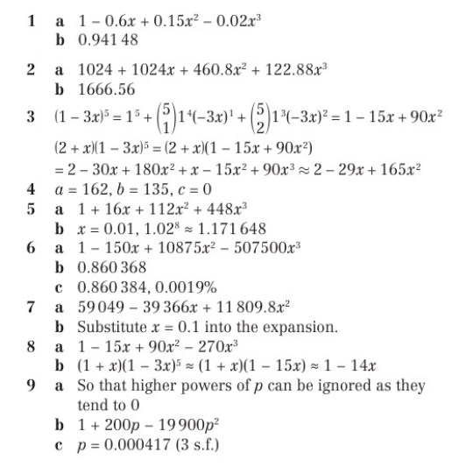
Homework Answers

