Slide 1
P1 Chapter 13: Integration
Indefinite Integrals

Slide 2
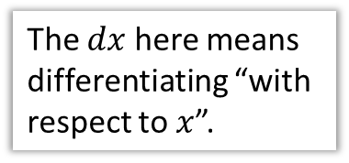
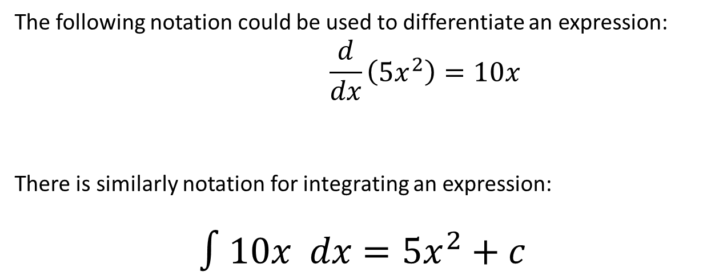
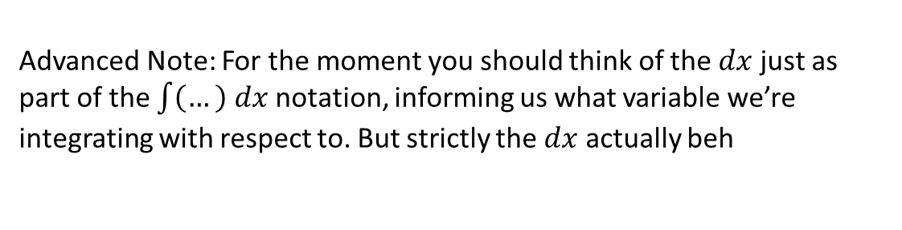
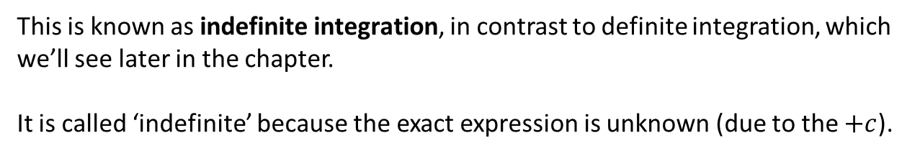
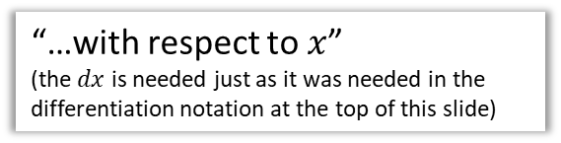
Integration notation
The following notation could be used to differentiate an expression:
$$\frac{d}{dx}\left(5x^{2}\right)=10x$$
There is similarly notation for integrating an expression:
$$∫10x dx=5x^{2}+c$$
The $dx$ here means differentiating “with respect to $x$”.
“Integrate…”
“…with respect to $x$”
(the $dx$ is needed just as it was needed in the differentiation notation at the top of this slide)
“…this expression”
This is known as indefinite integration, in contrast to definite integration, which we’ll see later in the chapter.
It is called ‘indefinite’ because the exact expression is unknown (due to the $+c$).
Advanced Note: For the moment you should think of the $dx$ just as part of the $\int{\left(…\right) dx}$ notation, informing us what variable we’re integrating with respect to. But strictly the $dx$ actually beh

Slide 3
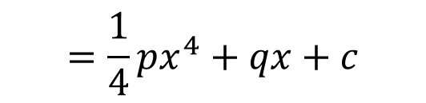

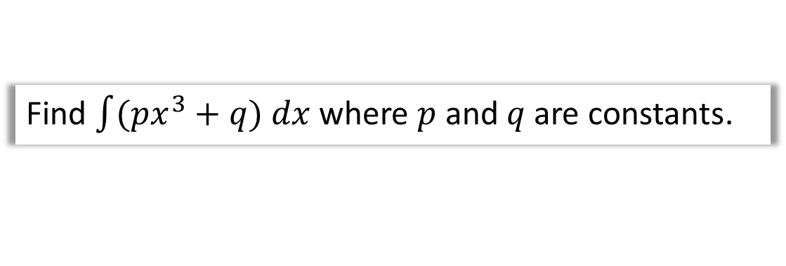
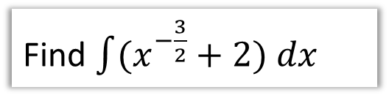


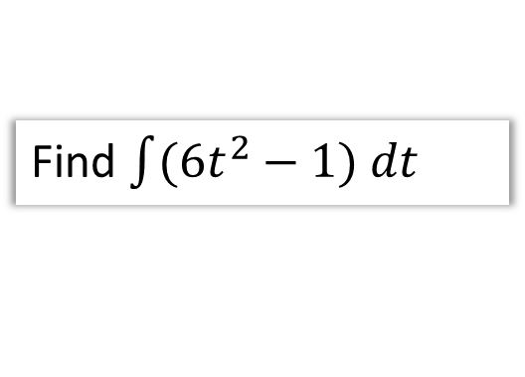
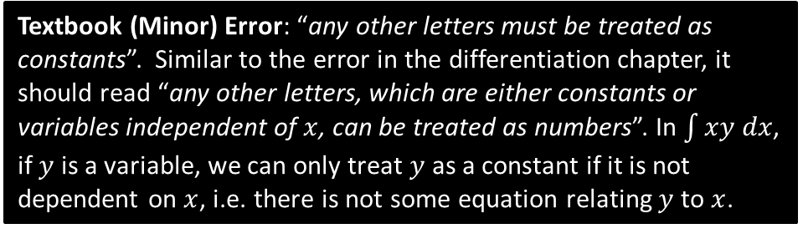
Examples
Fro Note: The brackets are required if there’s multiple terms.
Find $\int{(x^{−\frac{3}{2}}+2) dx}$
?
$$=−2x^{−\frac{1}{2}}+2x+c$$
Find $\int{(6t^{2}−1) dt}$
Note the $dt$ instead of $dx$.
$$=2t^{3}−t+c$$
?
Find $\int{(px^{3}+q) dx}$ where $p$ and $q$ are constants.
$$=\frac{1}{4}px^{4}+qx+c$$
Textbook (Minor) Error: “any other letters must be treated as constants”. Similar to the error in the differentiation chapter, it should read “any other letters, which are either constants or variables independent of $x$, can be treated as numbers”. In $\int{xy dx}$, if $y$ is a variable, we can only treat $y$ as a constant if it is not dependent on $x$, i.e. there is not some equation relating $y$ to $x$.
?

Slide 4


Test Your Understanding
Edexcel C1 May 2014(R) Q4b
?
$$y=2x^{5}+6x^{−\frac{1}{2}} \\ \int{y dx}=\frac{1}{3}x^{6}+12x^{\frac{1}{2}}+c$$

Slide 5
Exercise 13.2
Pearson Pure Mathematics Year 1/AS
Page 105

Slide 6
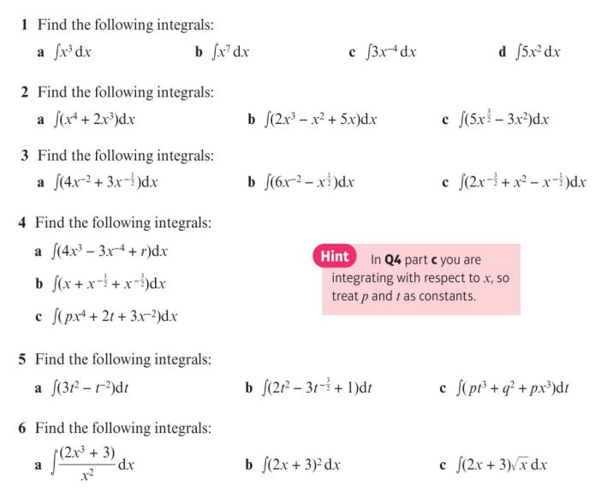
Homework Exercise

Slide 7
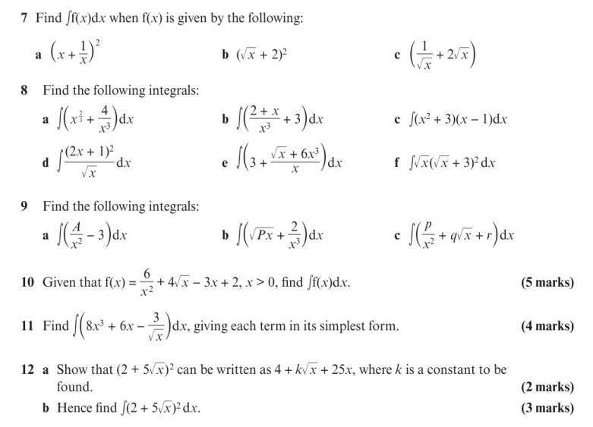
Homework Exercise

Slide 8
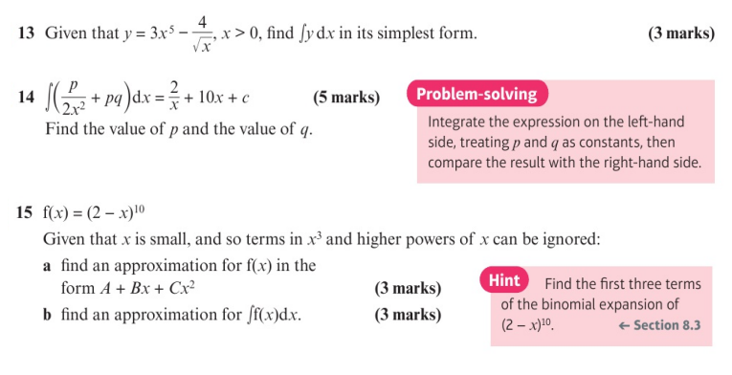
Homework Exercise

Slide 9
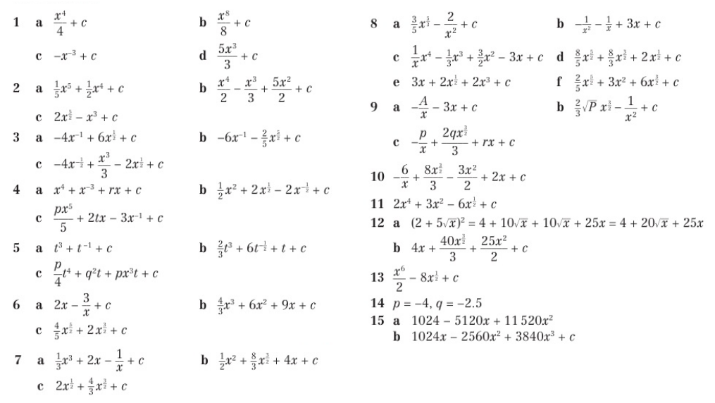
Homework Answers

