Slide 1
P1 Chapter 5: Linear Graphs Parallel and Perpendicular

Slide 2






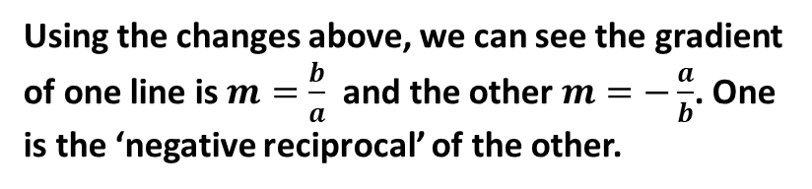


y
4
3
2
1
-1
-2
-3
-4
?
?
$$m=−\frac{1}{3}$$
$$m=\frac{1}{2}$$
$$b$$
$$a$$
?
$$m=3$$
x -5 -4 -3 -2 -1 0 1 2 3 4 5 6
$$a$$
?
$$m=−2$$
$$b$$
Find the gradients of each pair of perpendicular lines. What do you notice?
Using the changes above, we can see the gradient of one line is $m=\frac{b}{a}$ and the other $m=−\frac{a}{b}$. One is the ‘negative reciprocal’ of the other.

Slide 3
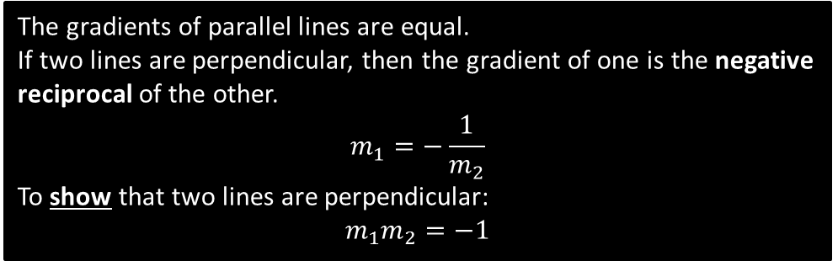
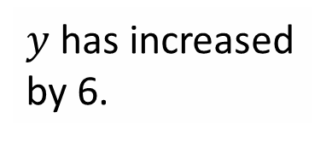
Perpendicular Lines
!
The gradients of parallel lines are equal.
If two lines are perpendicular, then the gradient of one is the negative reciprocal of the other.
$$m_{1}=−\frac{1}{m_{2}}$$
To show that two lines are perpendicular:
$$m_{1}m_{2}=−1$$
Gradient | Gradient of Perpendicular Line
$$2$$ | $$−\frac{1}{2}$$
$$−3$$ | $$\frac{1}{3}$$
$$\frac{1}{4}$$ | -4
$$5$$ | $$−\frac{1}{5}$$
$$−\frac{2}{7}$$ | $$\frac{7}{2}$$
$$\frac{7}{5}$$ | $$−\frac{5}{7}$$
?
?
?
?
?
?

Slide 4
Example Problems
1
A line is goes through the point (9,10) and is perpendicular to another line with equation $y=3x+2$. What is the equation of the line?
$$y−10=−\frac{1}{3}\left(x−9\right)$$
A line $L_{1}$ goes through the points $A\left(1,3\right)$ and $B\left(3,−1\right)$. A second line $L_{2}$ is perpendicular to $L_{1}$ and passes through point B. Where does $L_{2}$ cross the x-axis?
$$\left(5,0\right)$$
Are the following lines parallel, perpendicular, or neither?
$$y=\frac{1}{2}x$$
$$2x−y+4=0$$
Neither. Gradients are $\frac{1}{2}$ and $2$. But $\frac{1}{2}×2=1$, not -1, so not perpendicular.
?
2
?
3
?

Slide 5
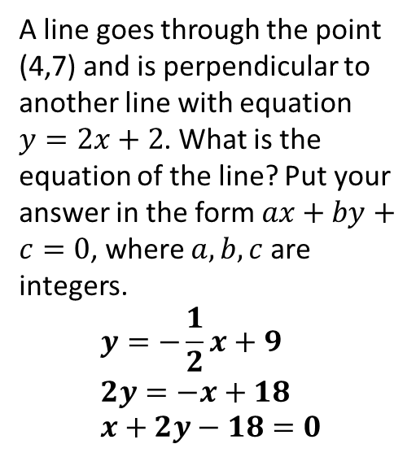




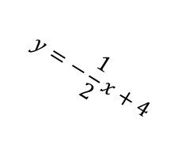

Test Your Understanding
1
A line goes through the point (4,7) and is perpendicular to another line with equation $y=2x+2$. What is the equation of the line? Put your answer in the form $ax+by+c=0$, where $a,b,c$ are integers.
$$y=−\frac{1}{2}x+9 \\ 2y=−x+18 \\ x+2y−18=0$$
2
Determine the point $A$.
$$y$$
$$A$$
$$y=−\frac{1}{2}x+4$$
?
$$x$$
?
Equation of other line: $y=2x$
$$2x=−\frac{1}{2}x+4 \\ 4x=−x+8 \\ 5x=8 →x=\frac{8}{5} \\ y=2×\frac{8}{5}=\frac{16}{5}$$

Slide 6
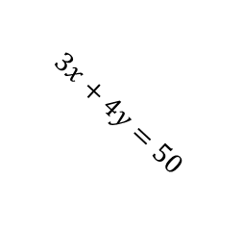
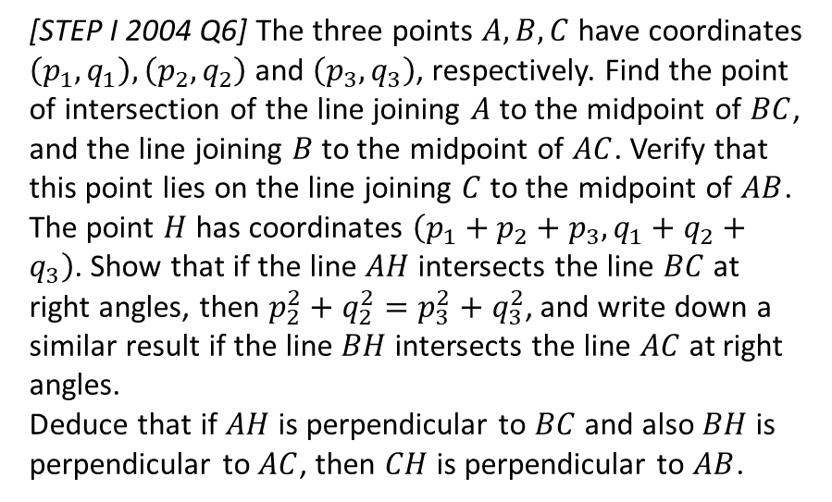

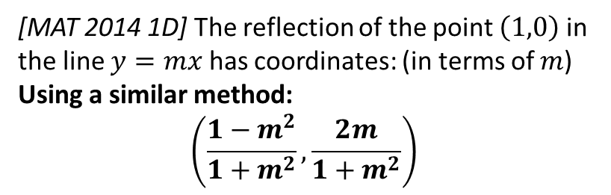


Exercise 5.3
Pearson Pure Mathematics Year 1/AS
Page 39
Extension Problems
2
[MAT 2014 1D] The reflection of the point $\left(1,0\right)$ in the line $y=mx$ has coordinates: (in terms of $m$)
Using a similar method:
$$\left(\frac{1−m^{2}}{1+m^{2}},\frac{2m}{1+m^{2}}\right)$$
1
[MAT 2004 1D]
What is the reflection of the point $\left(3,4\right)$ in the line $3x+4y=50$?
Gradient of $3x+4y=50$ is $−\frac{3}{4}$.
$∴$ Equation of line passing through $(3,4)$ perpendicular to ths line:
$$y−4=\frac{4}{3}\left(x−3\right)$$
Find intersection of two lines to get closest point of $\left(3,4\right)$ to original line:
$$\left(6,8\right)$$
Thus reflected point is $\left(9,12\right)$
?
?
3
[STEP I 2004 Q6] The three points $A,B,C$ have coordinates $\left(p_{1},q_{1}\right),\left(p_{2},q_{2}\right)$ and $\left(p_{3},q_{3}\right)$, respectively. Find the point of intersection of the line joining $A$ to the midpoint of $BC$, and the line joining $B$ to the midpoint of $AC$. Verify that this point lies on the line joining $C$ to the midpoint of $AB$.
The point $H$ has coordinates $\left(p_{1}+p_{2}+p_{3},q_{1}+q_{2}+q_{3}\right)$. Show that if the line $AH$ intersects the line $BC$ at right angles, then $p_{2}^{2}+q_{2}^{2}=p_{3}^{2}+q_{3}^{2}$, and write down a similar result if the line $BH$ intersects the line $AC$ at right angles.
Deduce that if $AH$ is perpendicular to $BC$ and also $BH$ is perpendicular to $AC$, then $CH$ is perpendicular to $AB$.
$$\left(6,8\right)$$
$$\left(3,4\right)$$
$$3x+4y=50$$

Slide 7
Exercise 5.3
Pearson Pure Mathematics Year 1/AS
Page 39

Slide 8
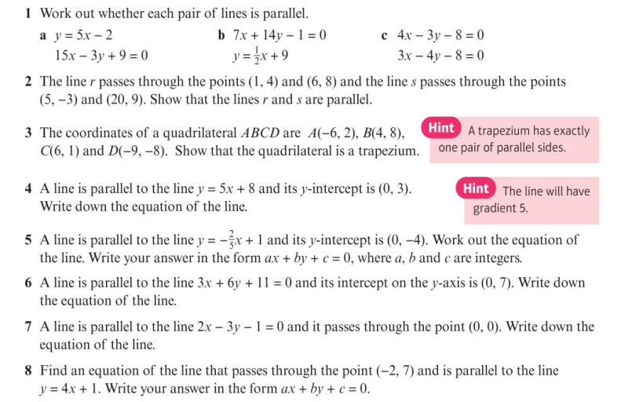
Homework Exercise

Slide 9
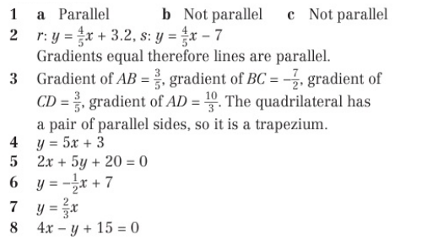
Homework Answers

Slide 10
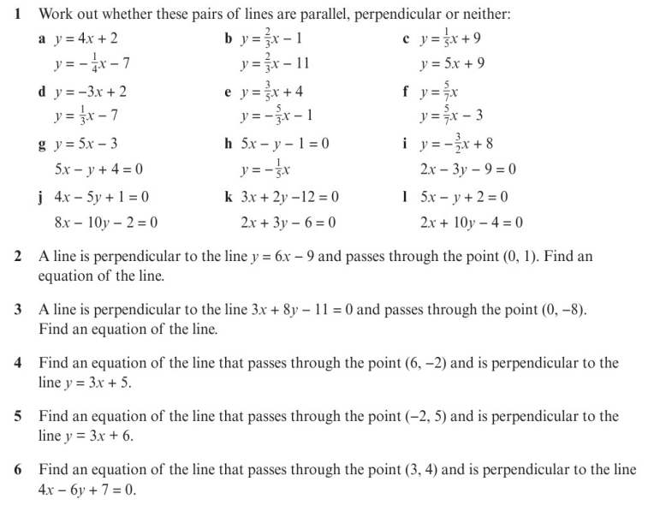
Homework Exercise

Slide 11
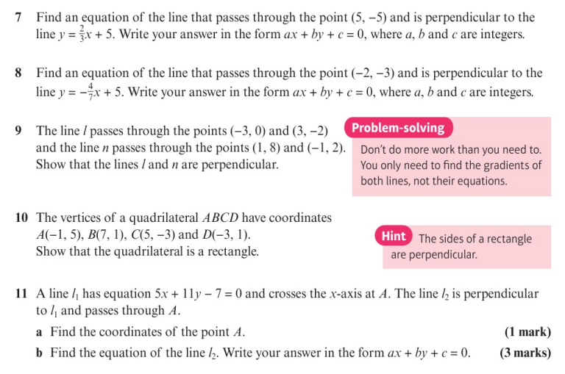
Homework Exercise

Slide 12
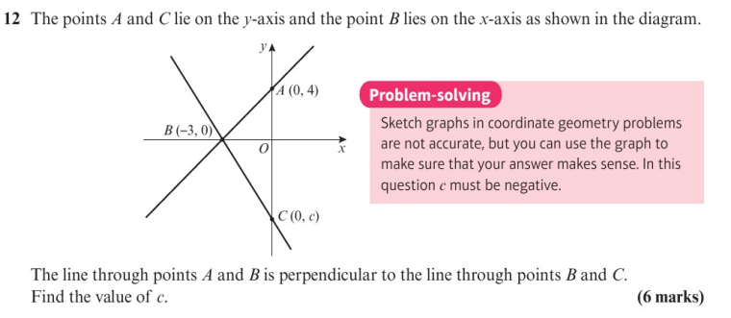
Homework Exercise

Slide 13
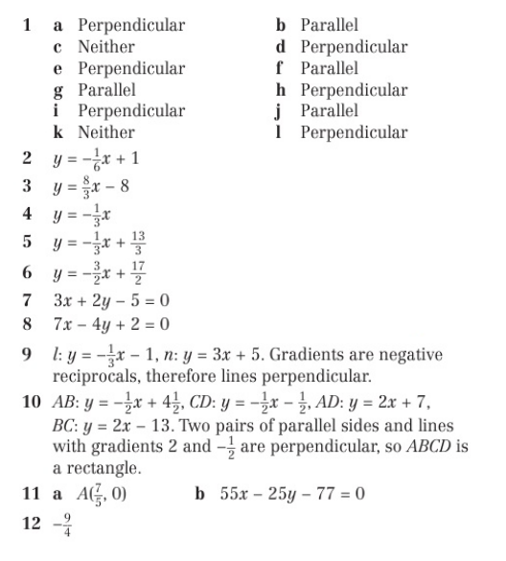
Homework Answers

