Slide 1
P1 Chapter 14: Logarithms Logarithm Laws

Slide 2
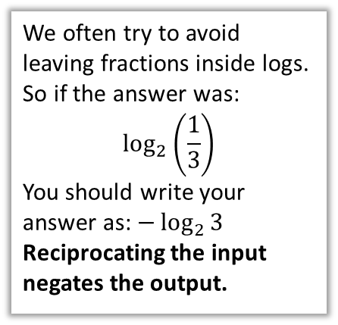
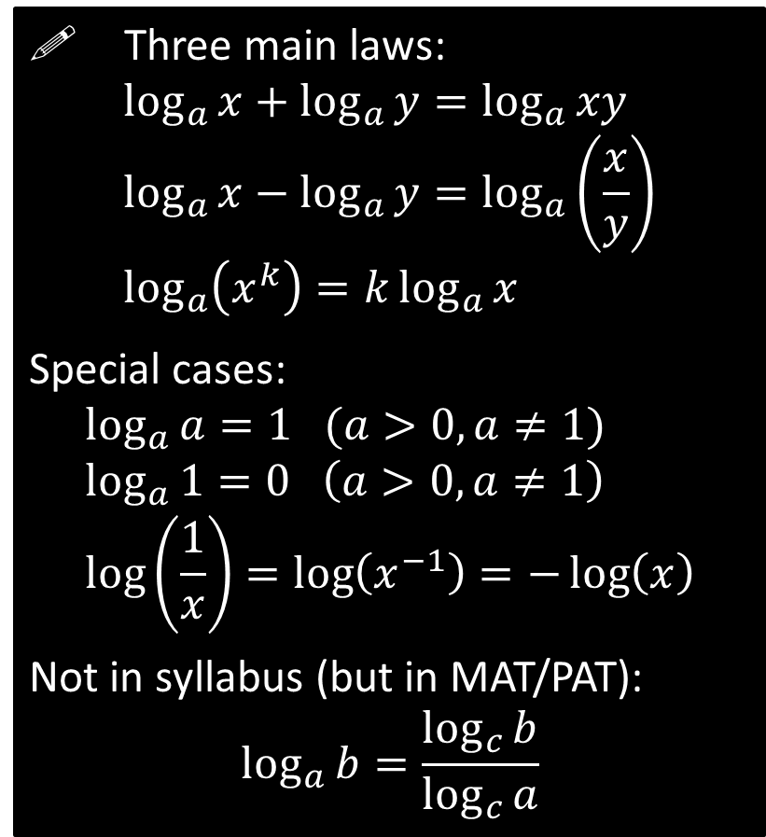
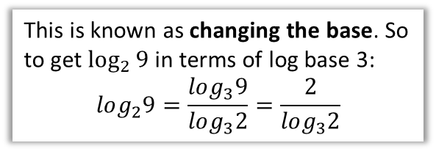
Laws of Logs
! Three main laws:
$$\log_{a}{x}+\log_{a}{y}=\log_{a}{xy} \\ \log_{a}{x}−\log_{a}{y}=\log_{a}\left(\frac{x}{y}\right) \\ \log_{a}\left(x^{k}\right)=k\log_{a}{x}$$
Special cases:
$$\log_{a}{a}=1 (a>0, a≠1) \\ \log_{a}{1}=0 \left(a>0, a≠1\right) \\ \log\left(\frac{1}{x}\right)=\log\left(x^{−1}\right)=−\log\left(x\right)$$
Not in syllabus (but in MAT/PAT):
$$\log_{a}{b}=\frac{\log_{c}{b}}{\log_{c}{a}}$$
The logs must have a consistent base.
i.e. You can move the power to the front.
We often try to avoid leaving fractions inside logs.
So if the answer was:
$$\log_{2}\left(\frac{1}{3}\right)$$
You should write your answer as: $−\log_{2}{3}$
Reciprocating the input negates the output.
This is known as changing the base. So to get $\log_{2}{9}$ in terms of log base 3:
$$log_{2}9=\frac{log_{3}9}{log_{3}2}=\frac{2}{log_{3}2}$$

Slide 3
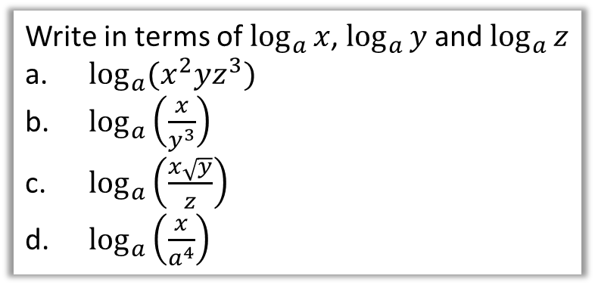
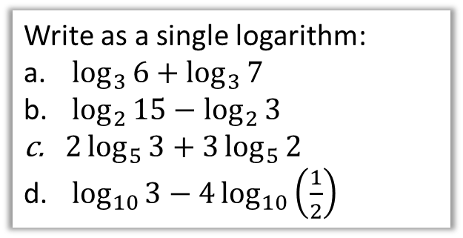


Examples
Write as a single logarithm:
$\log_{3}{6}+\log_{3}{7}$
$\log_{2}{15}−\log_{2}{3}$
$2\log_{5}{3}+3\log_{5}{2}$
$\log_{10}{3}−4\log_{10}\left(\frac{1}{2}\right)$
Write in terms of $\log_{a}{x}$, $\log_{a}{y}$ and $\log_{a}{z}$
$\log_{a}{(x^{2}yz^{3}})$
$\log_{a}\left(\frac{x}{y^{3}}\right)$
$\log_{a}\left(\frac{x\sqrt{y}}{z}\right)$
$\log_{a}\left(\frac{x}{a^{4}}\right)$
$$\log_{3}{42}$$
$$\log_{2}{5}$$
$$\log_{5}{9}+\log_{2}{8}=\log^{5}{72}$$
$$\log_{10}{3}−\log_{10}\left(\frac{1}{16}\right)=\log_{10}48$$
?
$$\log_{a}{(x^{2}yz^{3}})=\log_{a}{(x^{2}})+\log_{a}{y}+\log_{a}{z^{3}} \\ =2\log_{a}{x}+\log_{a}{y}+3\log_{a}{z}$$
$$\log_{a}\left(\frac{x}{y^{3}}\right)=\log_{a}{(x)}−\log_{a}\left(y^{3}\right) \\ =\log_{a}{x}−3\log_{a}{y}$$
$$\log_{a}\left(xy^{\frac{1}{2}}\right)−\log_{a}{z}=\log_{a}{x}+\log_{a}\left(y^{\frac{1}{2}}\right)−\log_{a}{z} \\ =\log_{a}{x}+\frac{1}{2}\log_{a}\left(\frac{1}{2}\right)−\log_{a}{z}$$
$$\log_{a}\left(\frac{x}{a^{4}}\right)=\log_{a}{x}−4\log_{a}{a}=\log_{a}{x}−4$$
a
a
?
b
?
?
b
?
c
?
d
c
?
?
d

Slide 4


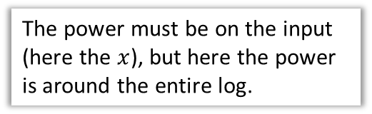
Anti Laws
These are NOT LAWS OF LOGS, but are mistakes students often make:
?
$$\log_{a}\left(b+c\right)=\log_{a}{b}+\log_{a}{c}$$
There is no method to simplify the log of a sum, only the sum of two logs!
✗ FAIL
$${\left(\log_{2}{x}\right)}^{3}=3\log_{2}{x}$$
?
The power must be on the input (here the $x$), but here the power is around the entire log.
✗ FAIL

Slide 5


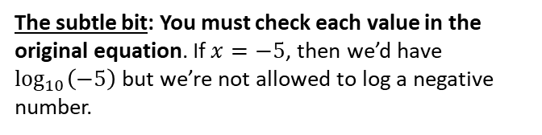
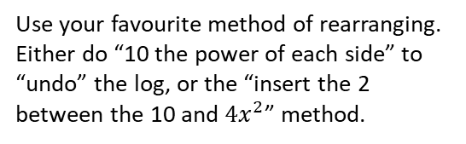
Solving Equations with Logs
Solve the equation $\log_{10}{4}+2\log_{10}{x}=2$
This is a very common type of exam question.
The strategy is to combine the logs into one and isolate on one side.
?
$$\log_{10}{4}+\log_{10}{x^{2}}=2 \\ \log_{10}\left(4x^{2}\right)=2 \\ 4x^{2}={10}^{2} \\ x^{2}=25 \\ x=5$$
We’ve used the laws of logs to combine them into one.
Use your favourite method of rearranging. Either do “10 the power of each side” to “undo” the log, or the “insert the 2 between the 10 and $4x^{2}$” method.
The subtle bit: You must check each value in the original equation. If $x=−5$, then we’d have $\log_{10}\left(−5\right)$ but we’re not allowed to log a negative number.

Slide 6
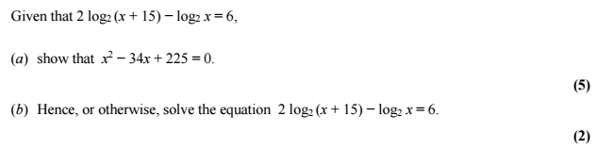

Test Your Understanding
Edexcel C2 Jan 2013 Q6
$$\log_{2}{{\left(x+15\right)}^{2}}−\log_{2}{x}=6 \\ \log_{2}\left(\frac{{\left(x+15\right)}^{2}}{x}\right)=6 \\ 2^{6}=\frac{{\left(x+15\right)}^{2}}{x} \\ 64x={\left(x+15\right)}^{2} \\ 64x=x^{2}+30x+225 \\ x^{2}−34x+225=0$$
$$\left(x−25\right)\left(x−9\right)=0 \\ x=25 or x=9$$
a
?
Those who feel confident with their laws could always skip straight to this line.
?
b
These are both valid solutions when substituted into the original equation.

Slide 7
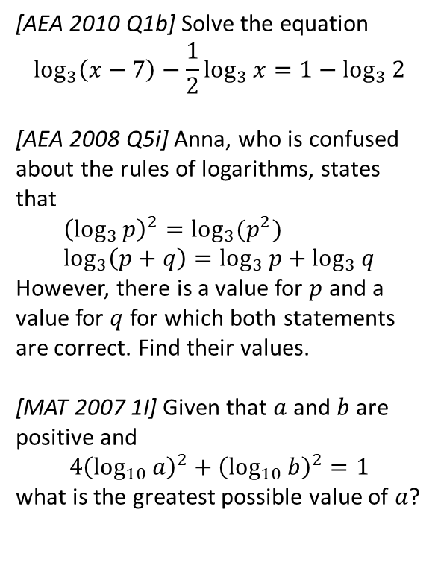
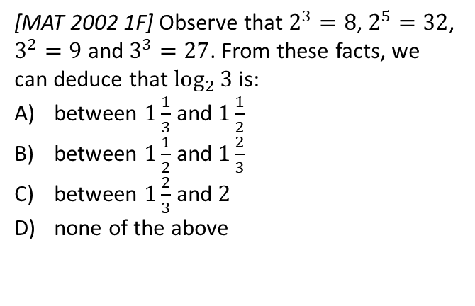
Exercise 14.5
Pearson Pure Mathematics Year 1/AS
Page 117
Extension
[MAT 2002 1F] Observe that $2^{3}=8$, $2^{5}=32$, $3^{2}=9$ and $3^{3}=27$. From these facts, we can deduce that $\log_{2}{3}$ is:
between $1\frac{1}{3}$ and $1\frac{1}{2}$
between $1\frac{1}{2}$ and $1\frac{2}{3}$
between $1\frac{2}{3}$ and $2$
none of the above
4
1
[AEA 2010 Q1b] Solve the equation
$$\log_{3}\left(x−7\right)−\frac{1}{2}\log_{3}{x}=1−\log_{3}{2}$$
[AEA 2008 Q5i] Anna, who is confused about the rules of logarithms, states that
$${\left(\log_{3}{p}\right)}^{2}=\log_{3}{(p^{2}}) \\ \log_{3}\left(p+q\right)=\log_{3}{p}+\log_{3}{q}$$
However, there is a value for $p$ and a value for $q$ for which both statements are correct. Find their values.
[MAT 2007 1I] Given that $a$ and $b$ are positive and
$$4{\left(\log_{10}{a}\right)}^{2}+{\left(\log_{10}{b}\right)}^{2}=1$$
what is the greatest possible value of $a$?
2
These are all strictly non-calculator!
3
Solutions on next slide.

Slide 8



Solutions to Extension Exercises
1
[AEA 2010 Q1b] Solve the equation
$$\log_{3}\left(x−7\right)−\frac{1}{2}\log_{3}{x}=1−\log_{3}{2}$$
Solution: $x=\frac{49}{4}$
[AEA 2008 Q5i] Anna, who is confused about the rules of logarithms, states that
$${\left(\log_{3}{p}\right)}^{2}=\log_{3}{(p^{2}}) \\ \log_{3}\left(p+q\right)=\log_{3}{p}+\log_{3}{q}$$
However, there is a value for $p$ and a value for $q$ for which both statements are correct. Find their values.
First equation:
$${\left(\log_{2}{p}\right)}^{2}=2\log_{3}{p} \\ ∴\log_{3}{p}\left(\log_{3}{p}−2\right)=0 \\ \log_{3}{p}⇒p=1 \\ \log_{3}{p}=2 ⇒ p=9$$
Second equation:
$$\log_{3}\left(p+q\right)=\log_{3}\left(pq\right) \\ ∴p+q=pq ⇒ q=\frac{p}{p−1} ∴p≠1 \\ p=9, q=\frac{9}{8}$$
3
[MAT 2007 1I] Given that $a$ and $b$ are positive and
$$4{\left(\log_{10}{a}\right)}^{2}+{\left(\log_{10}{b}\right)}^{2}=1$$
what is the greatest possible value of $a$?
To make $a$ as large as possible we make ${\left(\log_{10}{b}\right)}^{2}$ as small as possible. Anything squared is at least 0: $b=1$ will achieve this.
$$∴4{\left(\log_{10}{a}\right)}^{2}=1 \\ \log_{10}{a}=±\frac{1}{2} \\ a=\sqrt{10}$$
?
?
2
?
4
[MAT 2002 1F] Observe that $2^{3}=8$, $2^{5}=32$, $3^{2}=9$ and $3^{3}=27$. From these facts, we can deduce that $\log_{2}{3}$ is:
between $1\frac{1}{3}$ and $1\frac{1}{2}$
between $1\frac{1}{2}$ and $1\frac{2}{3}$
between $1\frac{2}{3}$ and $2$
none of the above
Suppose that $\log_{2}{3}>\frac{3}{2}$. Taking 2 to the power of each side:
$$3>2^{\frac{3}{2}} → 3^{2}>2^{3} → 9>8$$
This is true, so answer is not (A).
Next try $\log_{2}{3}>\frac{5}{3}$
$$3>2^{\frac{5}{3}} → 3^{3}>2^{5} → 27>32$$
This is not true, so answer is (B).
?

Slide 9
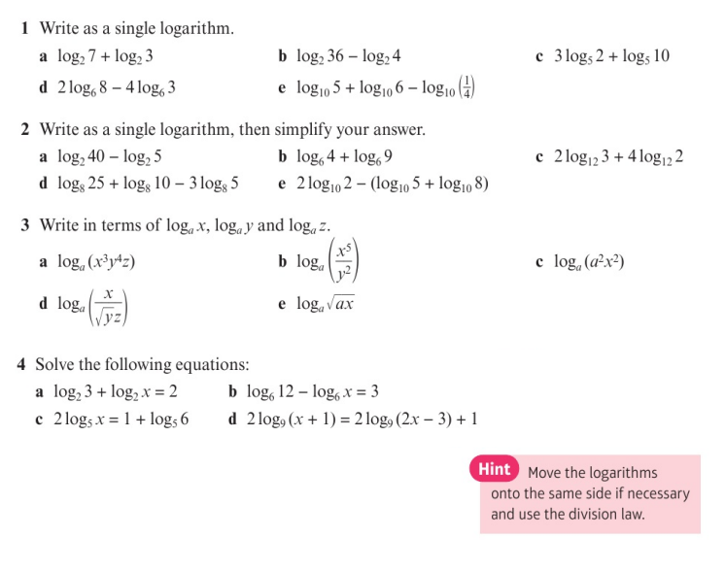
Homework Exercise

Slide 10
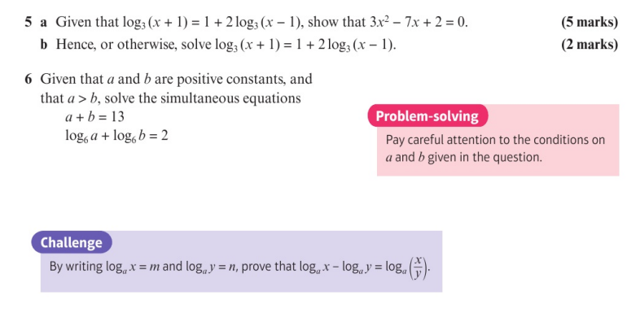
Homework Exercise

Slide 11
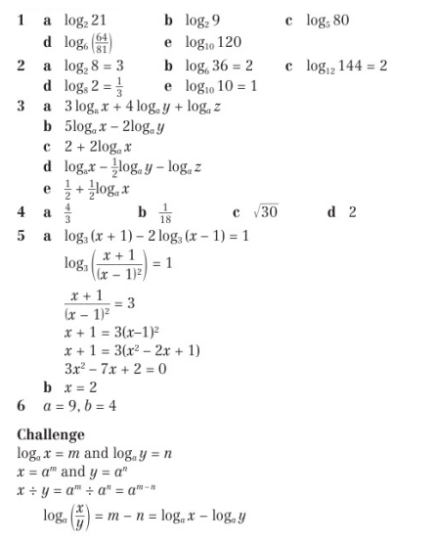
Homework Answers

