Slide 1
P2 Chapter 8: Parametric Equations Points of Intersection

Slide 2

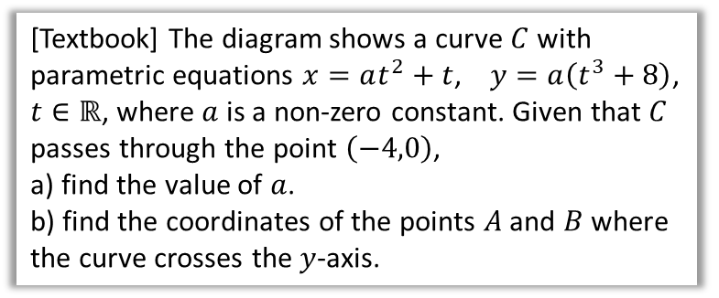


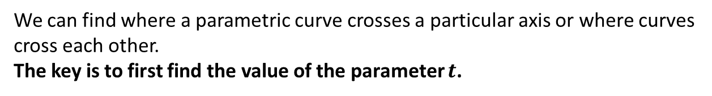






Points of Intersection
We can find where a parametric curve crosses a particular axis or where curves cross each other.
The key is to first find the value of the parameter $t$.
$$y$$
[Textbook] The diagram shows a curve $C$ with parametric equations $x=at^{2}+t$, $y=a\left(t^{3}+8\right)$, $t∈ℝ$, where $a$ is a non-zero constant. Given that $C$ passes through the point $\left(−4,0\right)$,
a) find the value of $a$.
b) find the coordinates of the points $A$ and $B$ where the curve crosses the $y$-axis.
$$C$$
$$−4$$
$$x$$
$$O$$
$$A$$
$$B$$
a
$$−4=at^{2}+t \\ 0=a\left(t^{3}+8\right)$$
From equation (2), because $a≠0$, $t^{3}+8=0 → t=−2$
Substituting into (1):
$$−4=4a−2 → a=−\frac{1}{2}$$
On the $y$-axis, $x=0$:
$$0=at^{2}+t=−\frac{1}{2}t^{2}+t \\ t\left(−\frac{1}{2}t+1\right)=0 \\ t=0 or t=2$$
At $t=0, y=−\frac{1}{2}\left(0^{3}+8\right)=−4 →(0,−4)$ At $t=2, y=−\frac{1}{2}\left(2^{3}+8\right)=−8 →\left(0,−8\right)$
?
b
?

Slide 3

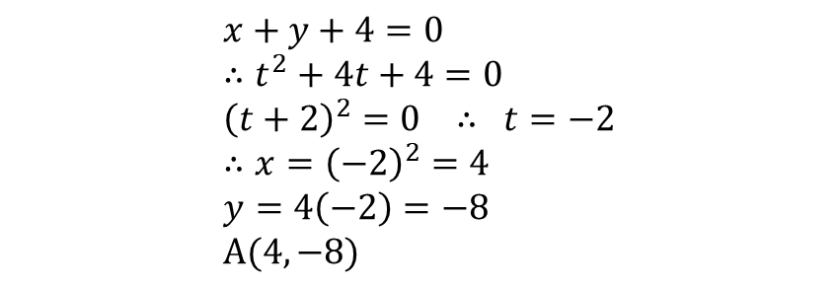


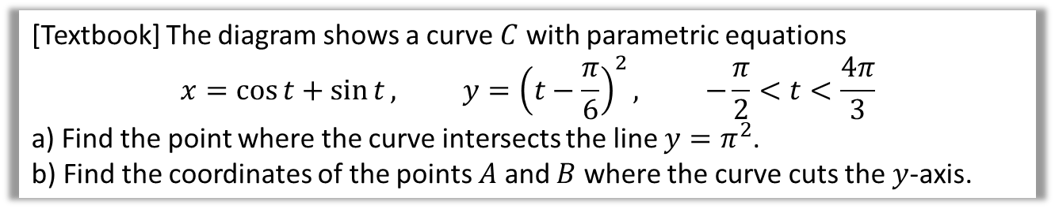
Points of Intersection
[Textbook] A curve is given parametrically by the equations $x=t^{2}, y=4t$. The line $x+y+4=0$ meets the curve at $A$. Find the coordinates of $A$.
$$x+y+4=0 \\ ∴t^{2}+4t+4=0 \\ {\left(t+2\right)}^{2}=0 ∴ t=−2 \\ ∴x={\left(−2\right)}^{2}=4 \\ y=4\left(−2\right)=−8 \\ A(4,−8)$$
Whenever you want to solve a Cartesian equation and pair of parametric equations simultaneously, substitute the parametric equations into the Cartesian one.
[Textbook] The diagram shows a curve $C$ with parametric equations
$$x=\cos{t}+\sin{t}, y={\left(t−\frac{π}{6}\right)}^{2}, −\frac{π}{2}<t<\frac{4π}{3}$$
a) Find the point where the curve intersects the line $y=π^{2}$.
b) Find the coordinates of the points $A$ and $B$ where the curve cuts the $y$-axis.
$$π^{2}={\left(t−\frac{π}{6}\right)}^{2} → t=\frac{7}{6}π or −\frac{5}{6}π$$
(But reject $−\frac{5}{6}π$ as outside domain of $t$)
If $t=\frac{7}{6}π$, $x=−\frac{1+\sqrt{3}}{2}$
$$\left(−\frac{1+\sqrt{3}}{2},π^{2}\right)$$
b
When $x=0$,
$$\cos{t}+\sin{t}=0 \\ \sin{t}=−\cos{t} \\ \tan{t}=−1$$
Since $−\frac{π}{2}<t<\frac{3π}{4}$, $t=−\frac{π}{4} or\frac{3π}{4}$
$$t=−\frac{π}{4} → \left(0,\frac{25π}{144}\right)$$
$$t=\frac{3π}{4} → \left(0,\frac{121π}{144}\right)$$
a
?
?
$$y$$
$$B$$
$$A$$
$$O$$
$$x$$

Slide 4
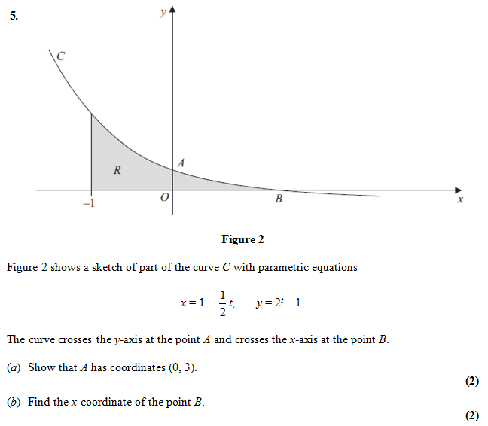


Test Your Understanding
C4 Jan 2013
If $x=0$,
$$0=1−\frac{1}{2}t \\ t=2$$
Then:
$$y=2^{2}−1=3$$
a ?
If $y=0$,
$$2^{t}−1=0 \\ t=0 \\ x=1−\frac{1}{2}\left(0\right)=1$$
b ?

Slide 5
Exercise 8.4
Pearson Pure Mathematics Year 2/AS
Page 63

Slide 6
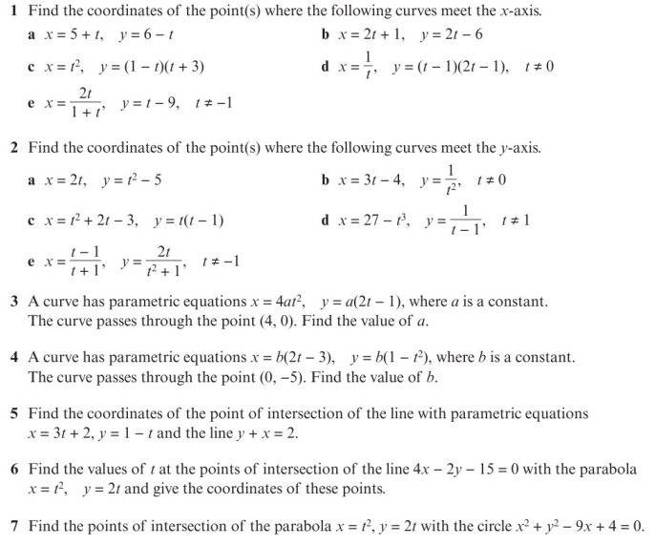
Homework Exercise

Slide 7
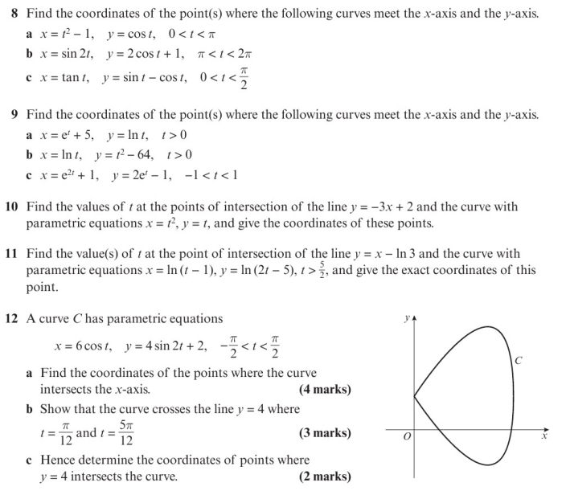
Homework Exercise

Slide 8
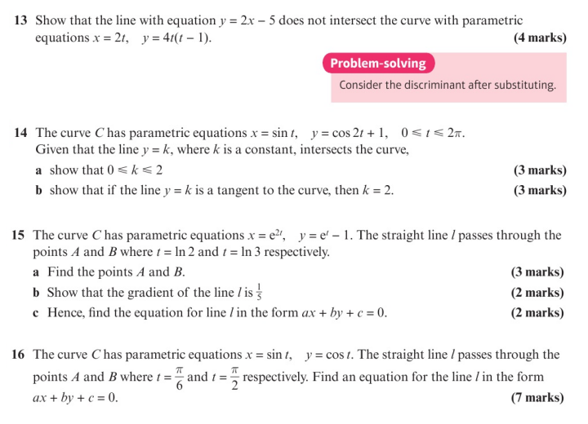
Homework Exercise

Slide 9
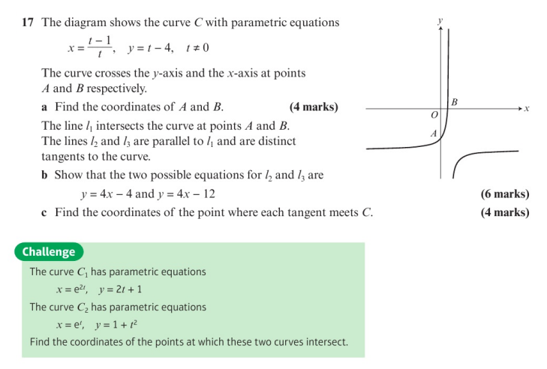
Homework Exercise

Slide 10
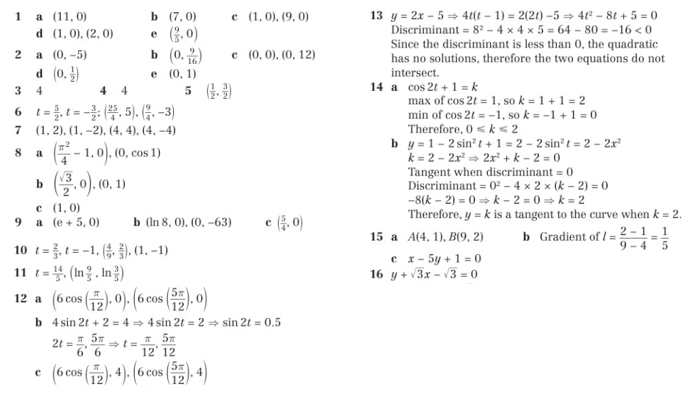
Homework Answers

Slide 11
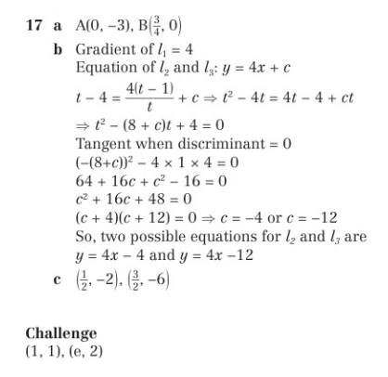
Homework Answers

