Slide 1
M2 Chapter 6: Projectiles Projection at any Angle

Slide 2



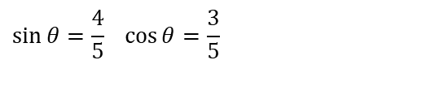

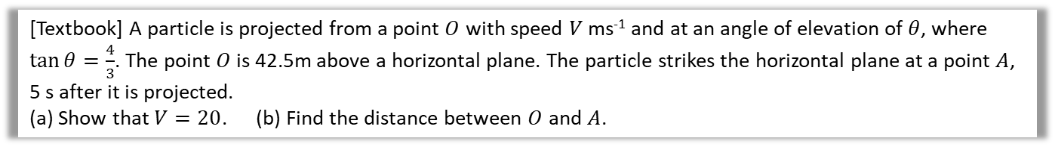







Projected from above ground
[Textbook] A particle is projected from a point $O$ with speed $V$ ms⁻¹ and at an angle of elevation of $θ$, where $\tan{θ=\frac{4}{3}}$. The point $O$ is 42.5m above a horizontal plane. The particle strikes the horizontal plane at a point $A$, 5 s after it is projected.
(a) Show that $V=20$. (b) Find the distance between $O$ and $A$.
? Diagram
(It’s important you draw one!)
a
?
$V$ ms⁻²
$$5$$
$$\sin{θ}=\frac{4}{5} \cos{θ}=\frac{3}{5}$$
$$4$$
$$θ$$
$$θ$$
$$O$$
$$3$$
$$R\left(↑\right): s=−42.5, u=\frac{4}{5}V,v= , a=−9.8, t=5 \\ s=ut+\frac{1}{2}at^{2} \\ −42.5=\frac{4}{5}V×5−4.9×25 \\ … ⇒ V=20$$
Let horizontal distance be $x$ m:
$x=20\cos{θ}×5=\frac{3}{5}\left(20\right)×5=60$ m
Using Pythagoras’ theorem:
$$OA=\sqrt{{42.5}^{2}+{60}^{2}}=73.527…$$
Distance is 74 m to 2sf.
$$42.5m$$
$$t=5$$
$$A$$
b
?
c
?

Slide 3



Time above a given point
[Textbook] A particle is projected from a point $O$ with speed $35$ ms⁻¹ and at an angle of elevation of $30°$. The particle moves freely under gravity. Find the length of time for which the particle is 15 m or more above $O$.
The key is to find the two times at which the particle is 15m above ground. The time above 15m will then be the difference between these times.
$$R\left(↑\right): s=15, u=35\sin{30°=75}, v= , a=−9.8, t=? \\ s=ut+\frac{1}{2}at^{2} \\ 15=17.5t −4.9t^{2} \\ 4.9t^{2}−17.5 t+15=0$$
$t=\frac{10}{7},\frac{15}{7}$
Time above 15m: $\frac{15}{7}−\frac{10}{7}=\frac{5}{7}=0.71$ s (2sf)
?
Use the quadratic solver on your calculator.
Note: The textbook implies you can leave your answer as an exact value of $\frac{5}{7}$. But we have used an approximate value of $g$, to 2 significant figures, so it would not be appropriate to do so.

Slide 4

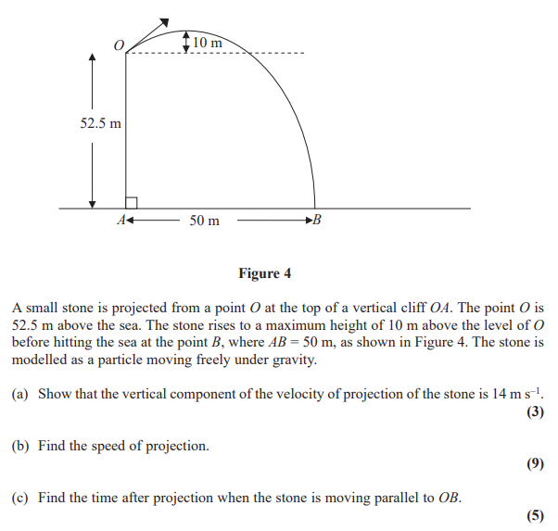
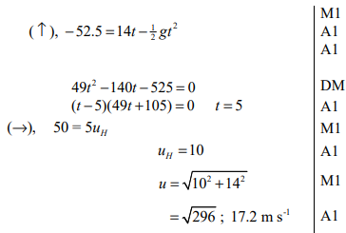
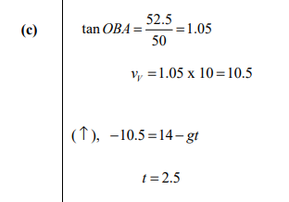
Test Your Understanding
Edexcel M2(Old) May 2012 Q7
a
?
b
?
c
?

Slide 5


Exercise 6.3
Pearson Stats/Mechanics Year 2
Pages 51-52
N
A ball is projected from ground level at an angle of $θ$. Prove that when the ball hits the ground, the distance the ball has travelled along the ground is maximised when $θ=45°$.
(Year 2 differentiation knowledge required)
Let speed be $u_{0}$ and horizontal distance be $x$.
$$R\left(↑\right): s=0, u=u_{0}\sin{θ}, v= ,a=−g,t=? \\ s=ut+\frac{1}{2}at^{2} \\ 0=u_{0}\left(\sin{θ}\right)t−\frac{1}{2}gt^{2}=t\left(u_{0}\left(\sin{θ}\right)−\frac{1}{2}gt\right) \\ t=0 or t=\frac{2\left(\sin{θ}\right)u_{0}}{g}$$
$$R\left(→\right): x=u_{0}cosθ×\frac{2\left(\sin{θ}\right)u_{0}}{g}=\frac{2{\left(u_{0}\right)}^{2}}{g}\sin{θ}\cos{θ} \\ x=\frac{{\left(u_{0}\right)}^{2}}{g}\sin{2θ}$$ $\frac{dx}{dθ}=\frac{2{\left(u_{0}\right)}^{2}}{g}\cos{2θ=0} ⇒ \cos{2θ=0} ⇒ 2θ=90° ⇒ θ=45°$
?
We want to maximise $x$ as $θ$ varies, i.e. $\frac{dx}{dθ}=0$

Slide 6
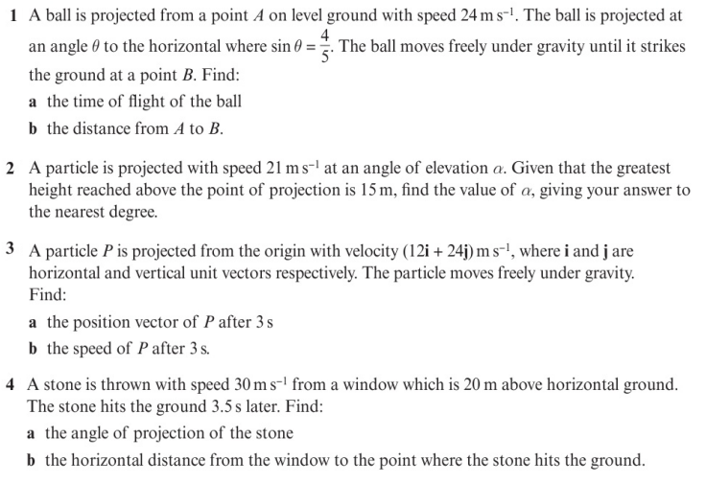
Homework Exercise

Slide 7
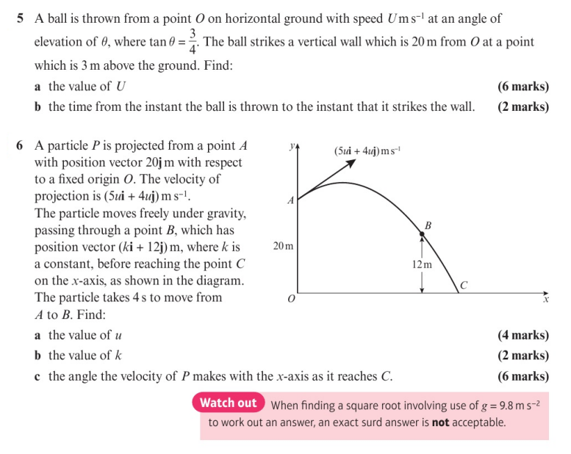
Homework Exercise

Slide 8
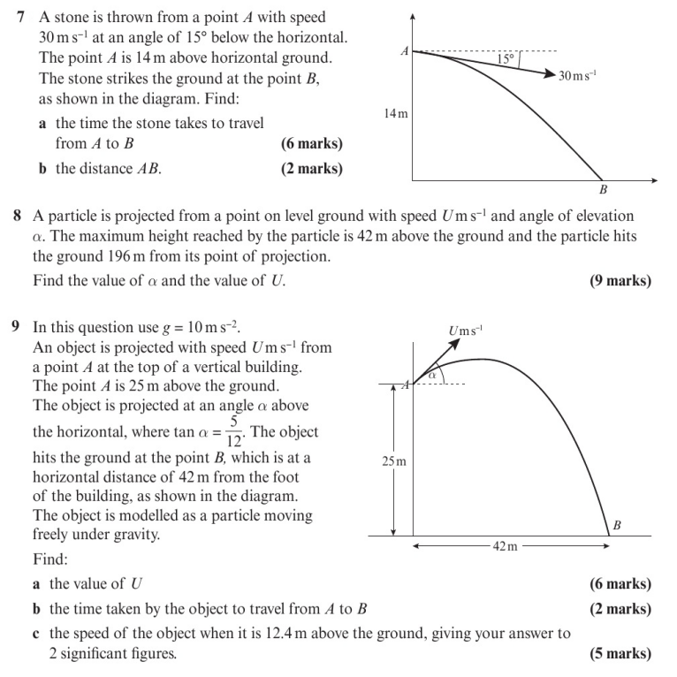
Homework Exercise

Slide 9
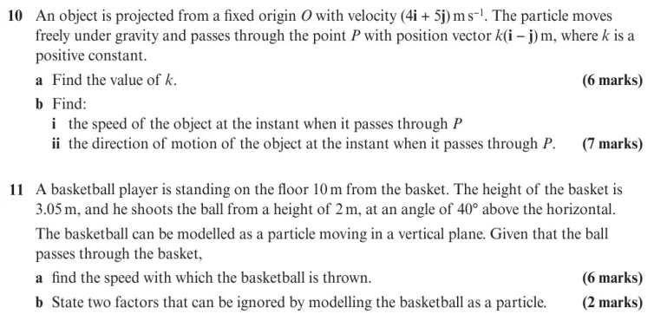
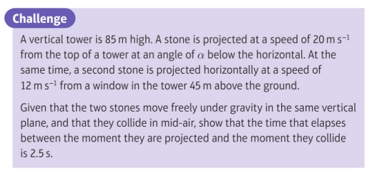
Homework Exercise

Slide 10
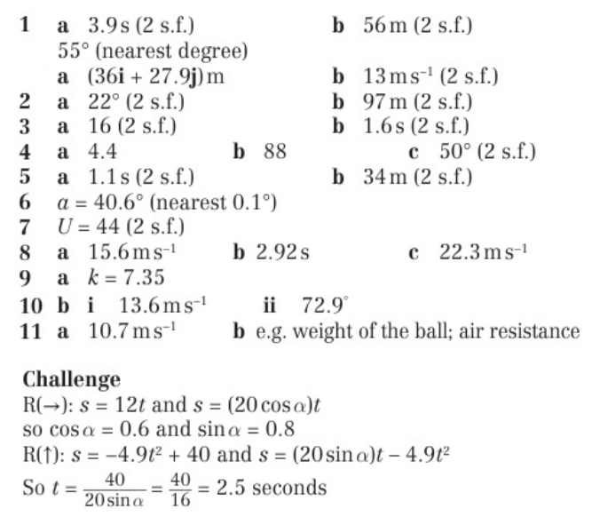
Homework Answers

