Slide 1
Stats1 Chapter 1: Data Collection 1.3 Non-Random Sampling

Slide 2


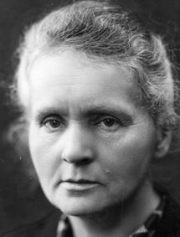
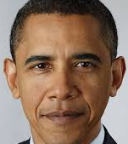
Non-Random Sampling
Famous Lefties
Consider the following scenario: You wish to conduct a survey in the UK on whether being left-handed affects IQ. We need to choose people to assess.
Why would random sampling be problematic?
Because we don’t know the sampling frame, i.e. don’t have a list of all left-handed (and non-left-handed) people in the UK.
?
For this scenario we’d likely use quota sampling, i.e.
As with stratified sampling, divide population into groups according to characteristic of interest, then determine size of each group in sample to reflect proportions within the population.
But instead of random sampling within each group, we actively choose people within each group via suitable means (e.g. advertising), until the ‘quota’ for each group is filled.
A variant of this is opportunity sampling, where we find people at the same time the survey is being carried out (e.g. exit polls at polling stations). This is not a suitable method for the left-handed example, because giving the likely time-consuming nature of assessment coupled with resources required, we’d likely arrange with the people taking part before the actual assessment tasks took place.

Slide 3
Quota & Opportunity Sampling
Type
How to carry out
Advantages
Disadvantages
Quota
Sampling
What is it :
Population divided into groups according to characteristic. A quota of items/people in each group is set to try and reflect the group’s proportion in the whole population. Interviewer selects the actual sampling units.
Allows small sample to still be representative of population.
No sampling frame required.
Quick, easy, inexpensive.
Allows for easy comparison between different groups in population.
Non-random sampling can introduce bias.
Population must be divided into groups, which can be costly or inaccurate.
Increasing scope of study increases number of groups, adding time/expense.
Non-responses are not recorded.
?
?
?
Opportunity/ Convenience Sampling
?
?
?
Sample taken from people who are available at time of study, who meet criteria.
Easy to carry out.
Inexpensive.
Unlikely to provide a representative sample.
Highly dependent on individual researcher.

Slide 4
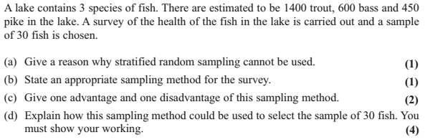
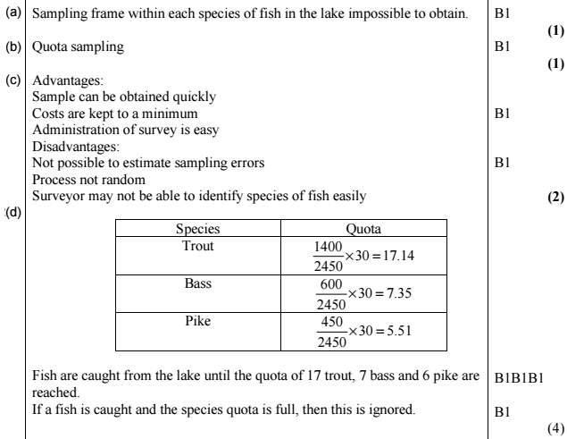
Example Question
Edexcel S3 June 2010 Q2
?
?
?
?

Slide 5
Exercise 1.3
Pearson Statistics & Mechanics Year 1/AS
Pages 3-4

Slide 6
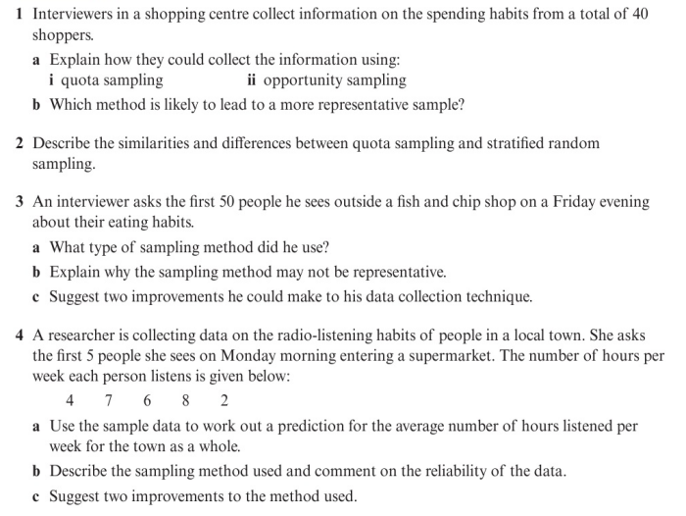
Homework Exercise

Slide 7
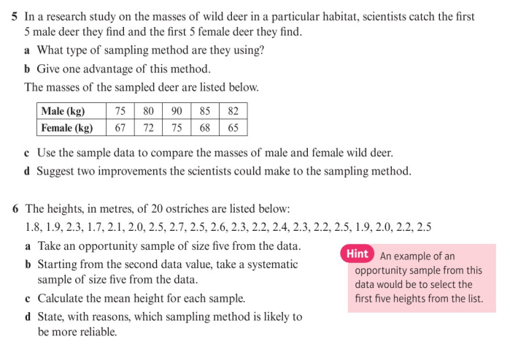
Homework Exercise

Slide 8
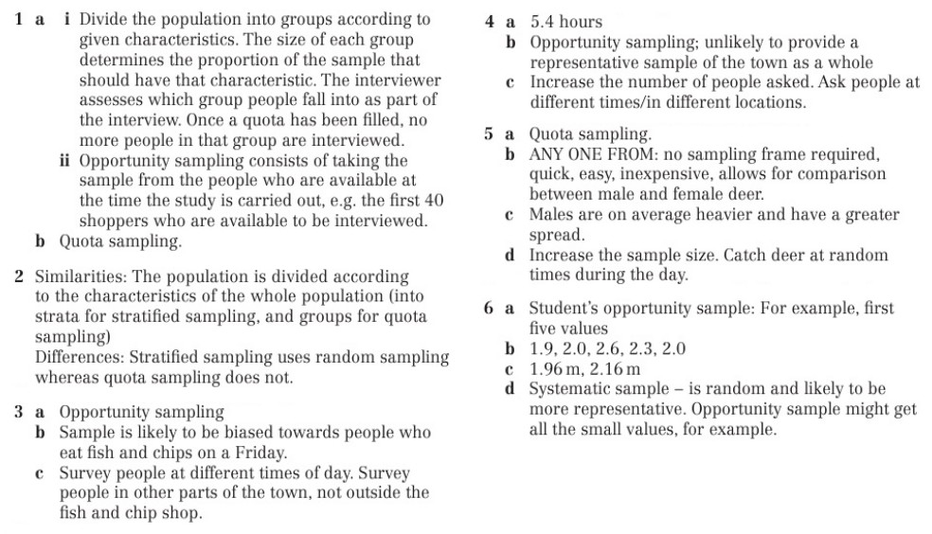
Homework Answers

