Slide 1
P1 Chapter 4: Transforming Graphs Scaling Graphs

Slide 2
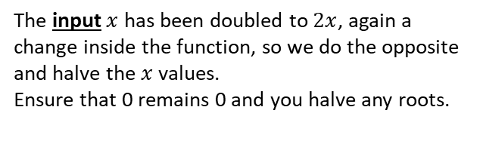
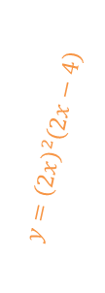
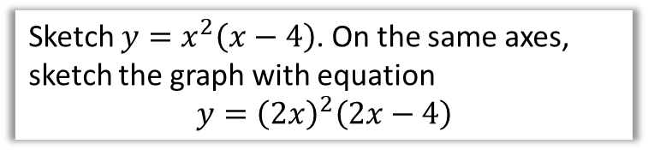
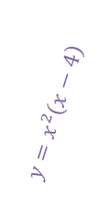


Stretching Graphs
Sketch $y=x^{2}\left(x−4\right)$. On the same axes, sketch the graph with equation
$$y={\left(2x\right)}^{2}\left(2x−4\right)$$
The input $x$ has been doubled to $2x$, again a change inside the function, so we do the opposite and halve the $x$ values.
Ensure that 0 remains 0 and you halve any roots.
?
$$y$$
$$y=x^{2}\left(x−4\right)$$
$$y={\left(2x\right)}^{2}\left(2x−4\right)$$
$$x$$
2
4

Slide 3
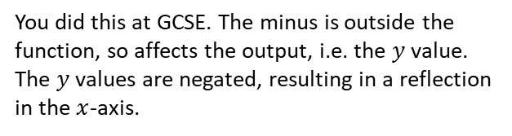


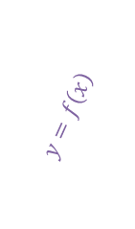

Reflections of Graphs
If $y=x(x+2)$, sketch $y=f(x)$ and $y=−f(x)$ on the same axes.
?
You did this at GCSE. The minus is outside the function, so affects the output, i.e. the $y$ value.
The $y$ values are negated, resulting in a reflection in the $x$-axis.
$$y$$
$$y=f\left(x\right)$$
$$y=−f\left(x\right)$$
$$x$$
-2

Slide 4


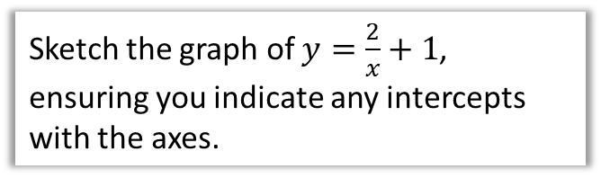
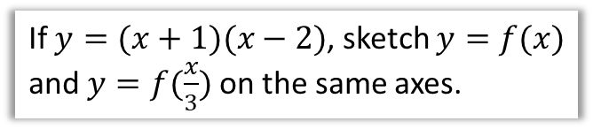


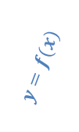

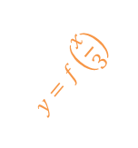

Test Your Understanding
If $y=(x+1)(x−2)$, sketch $y=f(x)$ and $y=f(\frac{x}{3})$ on the same axes.
Sketch the graph of $y=\frac{2}{x}+1$, ensuring you indicate any intercepts with the axes.
?
?
$$y$$
$$y$$
$$y=f(x)$$
$$y=1$$
$$y=f\left(\frac{x}{3}\right)$$
-3
-1
2
6
$$x$$
-2
$$x$$
-2
To get this new root:
$$\frac{2}{x}+1=0 \\ \frac{2}{x}=−1 → x=\frac{2}{−1}=−2$$

Slide 5
Exercise 4.6
Pearson Pure Mathematics Year 1/AS
Page 32

Slide 6
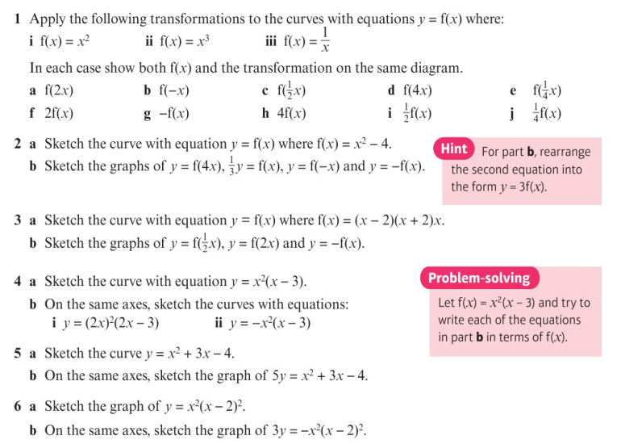
Homework Exercise

Slide 7
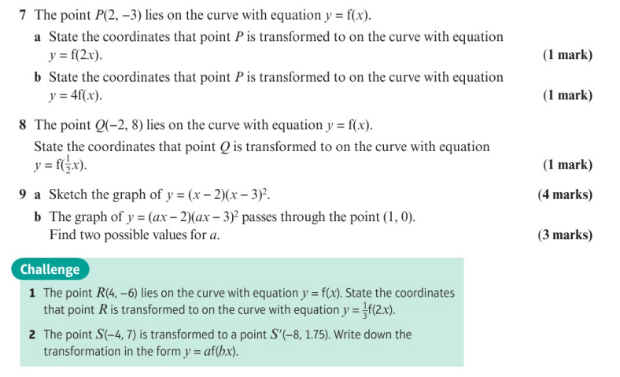
Homework Exercise

Slide 8
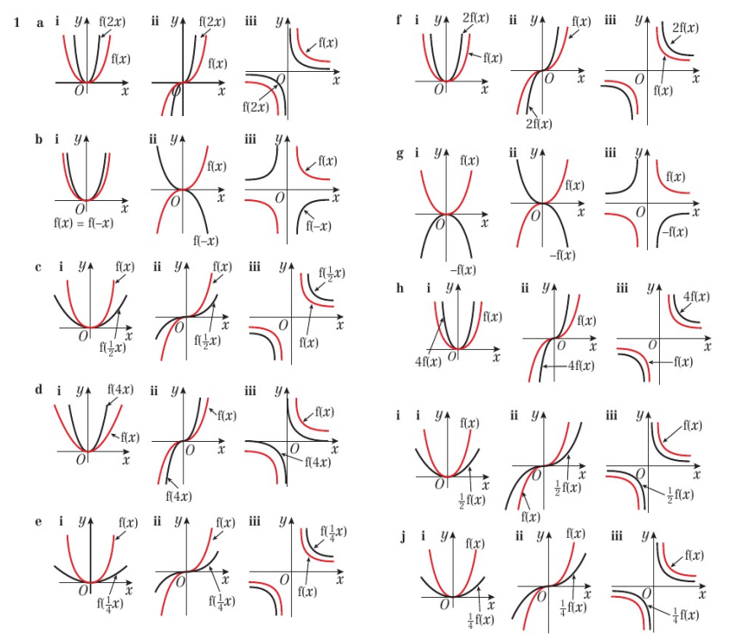
Homework Exercise

Slide 9
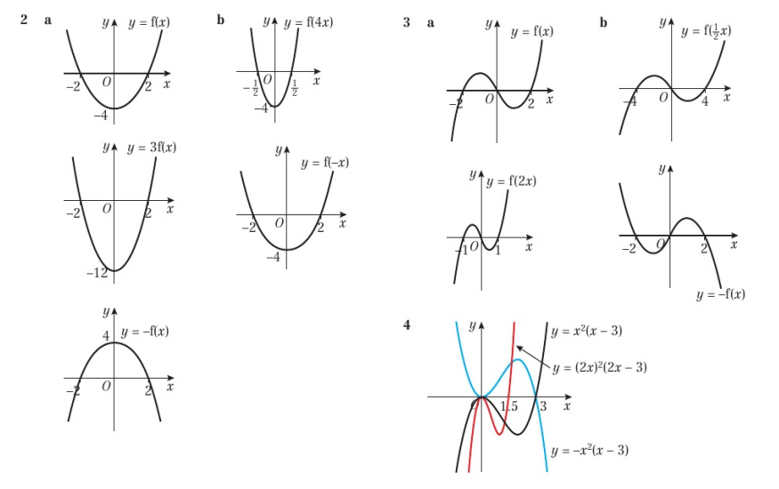
Homework Answers

Slide 10
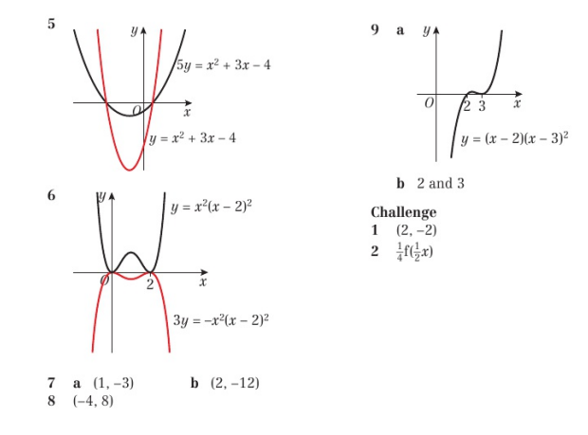
Homework Answers

