Slide 1
P2 Chapter 11: 3D Vectors 3D Coordinates

Slide 2



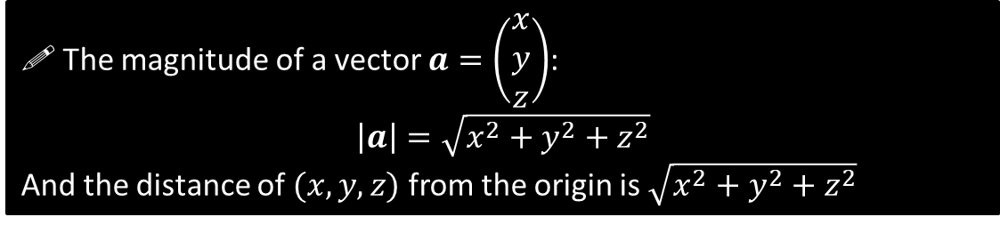


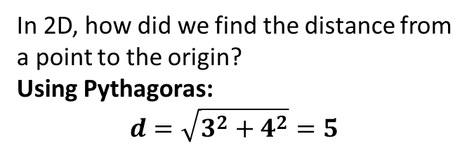



Distance from the origin and magnitude of a vector
$$y$$
In 2D, how did we find the distance from a point to the origin?
Using Pythagoras:
$$d=\sqrt{3^{2}+4^{2}}=5$$
$$\left(3,4\right)$$
?
$$d$$
4
$$x$$
How about in 3D then?
You may be familiar with this method from GCSE. Using Pythagoras on the base of the cuboid:
$$\sqrt{3^{2}+4^{2}}=5$$
Then using the highlighted triangle:
$$\sqrt{5^{2}+12^{2}}=13$$
We could have similarly done this is one go using:
$$\sqrt{3^{2}+4^{2}+12^{2}}=13$$
$$z$$
3
?
$$y$$
$$\left(3,4,12\right)$$
$$x$$
From earlier you will be familiar with the magnitude $|a|$ of a vector $a$ being its length. We can see from above that this nicely extends to 3D:
! The magnitude of a vector $a=\left(\begin{matrix}x \\ y \\ z\end{matrix}\right)$:
$$\left|a\right|=\sqrt{x^{2}+y^{2}+z^{2}}$$
And the distance of $(x,y,z)$ from the origin is $\sqrt{x^{2}+y^{2}+z^{2}}$

Slide 3
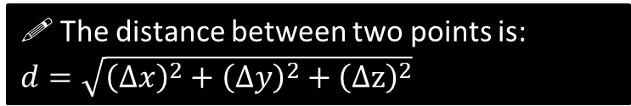







Distance between two 3D points
$$z$$
How do we find the distance between $P$ and $Q$?
It’s just the magnitude/length of the vector between them.
i.e.
$$\left|\vec{PQ}\right|=\left|\left(\begin{matrix}1 \\ −5 \\ −5\end{matrix}\right)\right| \\ =\sqrt{1^{2}+{\left(−5\right)}^{2}+{\left(−5\right)}^{2}}=\sqrt{51}$$
?
$$y$$
$$P\left(3,4,12\right)$$
$$x$$
$$Q\left(4,−1,7\right)$$
! The distance between two points is:
$d=\sqrt{{\left(Δx\right)}^{2}+{\left(Δy\right)}^{2}+{\left(Δz\right)}^{2}}$
$Δx$ means “change in $x$”
Quickfire Questions:
Distance between $(0,4,3)$ and $\left(5,2,3\right).$
$$d=\sqrt{5^{2}+{\left(−2\right)}^{2}+0^{2}}=\sqrt{29}$$
Distance between $(1,1,1)$ and $\left(2,1,0\right).$
$$d=\sqrt{1^{2}+0^{2}+1^{2}}=\sqrt{2}$$
Distance between $(−5,2,0)$ and $\left(−2,−3,−3\right).$
$$d=\sqrt{3^{2}+5^{2}+3^{2}}=\sqrt{43}$$
Tip: Because we’re squaring, it doesn’t matter whether the change is negative or positive.
Distance of $(4,0,−2)$ from the origin:
$$\sqrt{4^{2}+0^{2}+{\left(−2\right)}^{2}}=\sqrt{20}$$
$$\left|\left(\begin{matrix}5 \\ 4 \\ −1\end{matrix}\right)\right|=\sqrt{5^{2}+4^{2}+{\left(−1\right)}^{2}}=\sqrt{42}$$
?
?
?
?
?

Slide 4


Test Your Understanding So Far…
[Textbook] Find the distance from the origin to the point $P(7,7,7)$.
?
$$\sqrt{7^{2}+7^{2}+7^{2}}=7\sqrt{3}$$
[Textbook] The coordinates of $A$ and $B$ are $(5,3,−8)$ and $\left(1,k,−3\right)$ respectively. Given that the distance from $A$ to $B$ is $3\sqrt{10}$ units, find the possible values of $k$.
?
$$\sqrt{4^{2}+{\left(k−3\right)}^{2}+5^{2}}=3\sqrt{10} \\ \sqrt{k^{2}−6k+50}=3\sqrt{10} \\ k^{2}−6k+50=90 \\ k^{2}−6k−40=0 \\ \left(k+4\right)\left(k−10\right)=0 \\ k=−4 or k=10$$

Slide 5
Exercise 12.1
Pearson Pure Mathematics Year 2/AS
Pages 105

Slide 6
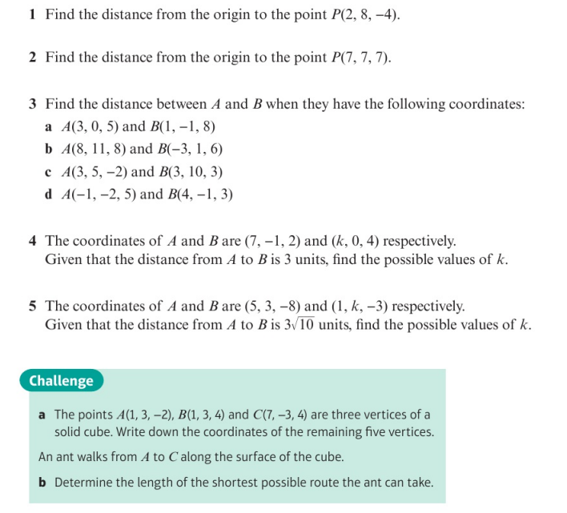
Homework Exercise

Slide 7
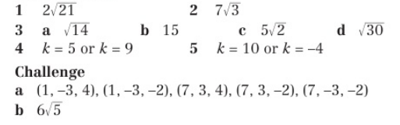
Homework Answers

