Slide 1
P1 Chapter 11: Vectors Geometric Problems

Slide 2








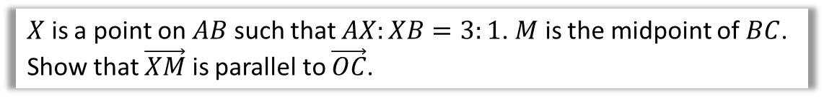


Solving Geometric Problems
$$A$$
$$C$$
$$a$$
$$X$$
$$M$$
$$O$$
$$b$$
$$B$$
$X$ is a point on $AB$ such that $AX:XB=3:1$. $M$ is the midpoint of $BC$.
Show that $\vec{XM}$ is parallel to $\vec{OC}$.
?
For any proof question always find the vectors involved first, in this case $\vec{XM}$ and $\vec{OC}$.
$$\vec{OC}=a+b \\ \vec{XM}=\frac{1}{4}\left(−a+b\right)+\frac{1}{2}a=\frac{1}{4}a+\frac{1}{4}b \\ =\frac{1}{4}\left(a+b\right)$$
$\vec{XM}$ is a multiple of $\vec{OC}$ $∴$ parallel.
The key is to factor out a scalar such that we see the same vector.
The magic words here are “is a multiple of”.

Slide 3




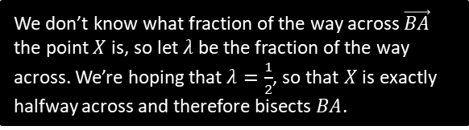




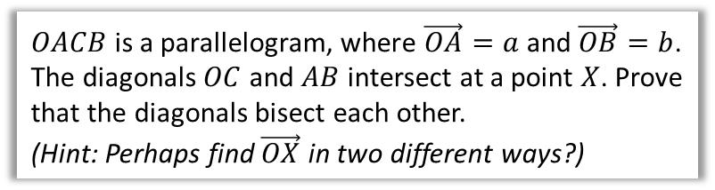

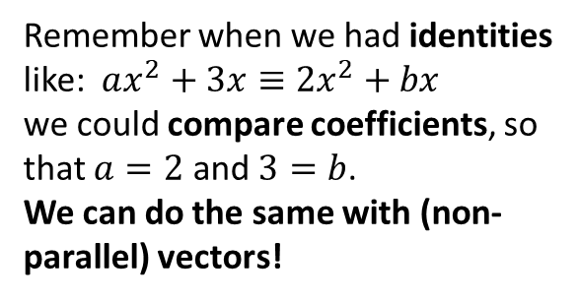
Introducing Scalars and Comparing Coefficients
Remember when we had identities like: $ax^{2}+3x≡2x^{2}+bx$
we could compare coefficients, so that $a=2$ and $3=b$.
We can do the same with (non-parallel) vectors!
$$O$$
$$a$$
$$A$$
$$X$$
$$b$$
$OACB$ is a parallelogram, where $\vec{OA}=a$ and $\vec{OB}=b$. The diagonals $OC$ and $AB$ intersect at a point $X$. Prove that the diagonals bisect each other.
(Hint: Perhaps find $\vec{OX}$ in two different ways?)
$$B$$
$$C$$
By considering the route $O→B→X$:
$$\vec{OX}=b+λ \vec{BA} \\ =b+λ\left(−b+a\right)=b−λb+λa \\ =λa+\left(1−λ\right)b$$
Similarly, considering the line $OC$:
$$\vec{OX}=μ \vec{OC}=μ\left(a+b\right)=μa+μb$$
$$∴μa+μb=λa+\left(1−λ\right)b$$
Comparing coefficients of $a$: $μ=λ$
Comparing coefficients of $b$: $μ=1−λ$
$$∴μ=λ=\frac{1}{2}$$
$∴X$ is the midpoint of each of the diagonals.
?
We don’t know what fraction of the way across $\vec{BA}$ the point $X$ is, so let $λ$ be the fraction of the way across. We’re hoping that $λ=\frac{1}{2}$, so that $X$ is exactly halfway across and therefore bisects $BA$.
We need to use a different scalar constant, this time $μ$.
It is common to use the letters $λ$ and $μ$ for scalars.

Slide 4



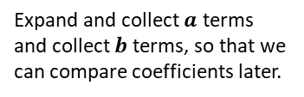


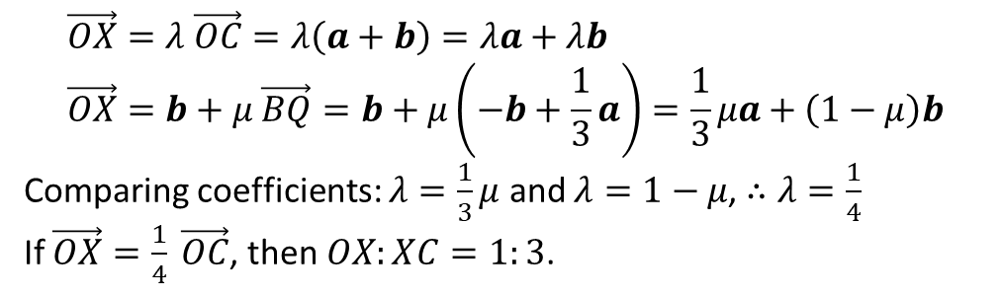

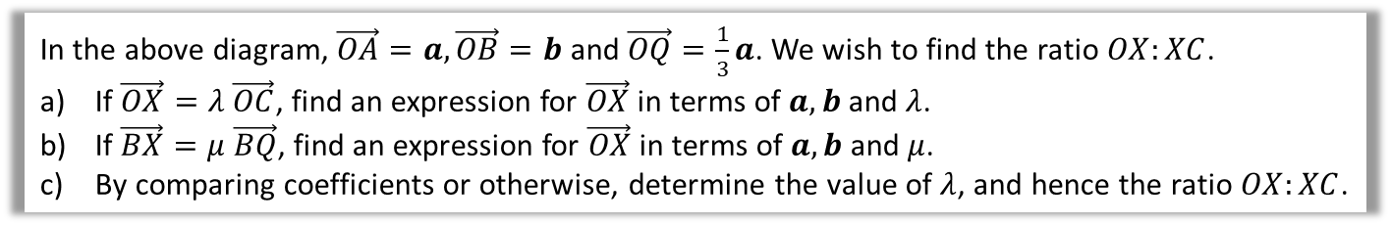


Test Your Understanding
$$a$$
$$O$$
$$Q$$
$$A$$
$$X$$
$$b$$
$$B$$
$$C$$
In the above diagram, $\vec{OA}=a, \vec{OB}=b$ and $\vec{OQ}=\frac{1}{3}a$. We wish to find the ratio $OX:XC$.
If $\vec{OX}=λ \vec{OC}$, find an expression for $\vec{OX}$ in terms of $a,b$ and $λ$.
If $\vec{BX}=μ \vec{BQ}$, find an expression for $\vec{OX}$ in terms of $a,b$ and $μ$.
By comparing coefficients or otherwise, determine the value of $λ$, and hence the ratio $OX:XC$.
$$\vec{OX}=λ \vec{OC}=λ\left(a+b\right)=λa+λb \\ \vec{OX}=b+μ \vec{BQ}=b+μ\left(−b+\frac{1}{3}a\right)=\frac{1}{3}μa+\left(1−μ\right)b$$
Comparing coefficients: $λ=\frac{1}{3}μ$ and $λ=1−μ$, $∴λ=\frac{1}{4}$
If $\vec{OX}=\frac{1}{4} \vec{OC}$, then $OX:XC=1:3$.
a
?
Expand and collect $a$ terms and collect $b$ terms, so that we can compare coefficients later.
b
?
c
?

Slide 5



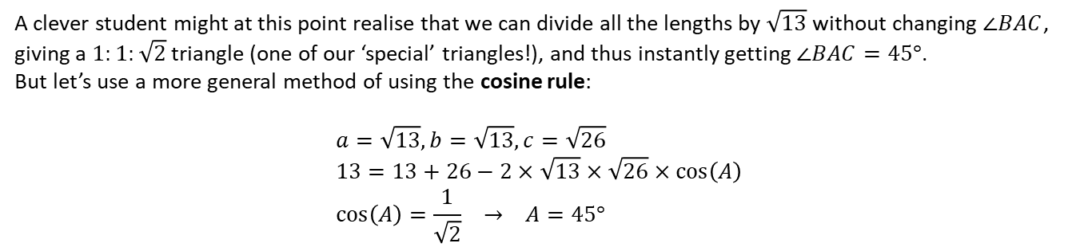







Area of a Triangle
$\vec{AB}=3i−2j$ and $\vec{AC}=i−5j$. Determine $∠BAC$.
?
Strategy: Find 3 lengths of triangle then use cosine rule to find angle.
$$A$$
$$\left(\begin{matrix}3 \\ −2\end{matrix}\right)$$
?
$$\left|\vec{AB}\right|=\sqrt{13}$$
$$B$$
$$\left(\begin{matrix}1 \\ −5\end{matrix}\right)$$
$$\left(\begin{matrix}2 \\ 3\end{matrix}\right)$$
?
?
$$\left|\vec{CB}\right|=\sqrt{13}$$
?
$$\left|\vec{AC}\right|=\sqrt{26}$$
$$C$$
A clever student might at this point realise that we can divide all the lengths by $\sqrt{13}$ without changing $∠BAC$, giving a $1:1:\sqrt{2}$ triangle (one of our ‘special’ triangles!), and thus instantly getting $∠BAC=45°$.
But let’s use a more general method of using the cosine rule:
$$a=\sqrt{13}, b=\sqrt{13}, c=\sqrt{26} \\ 13=13+26−2×\sqrt{13}×\sqrt{26}×\cos\left(A\right) \\ \cos\left(A\right)=\frac{1}{\sqrt{2}} → A=45°$$
?

Slide 6
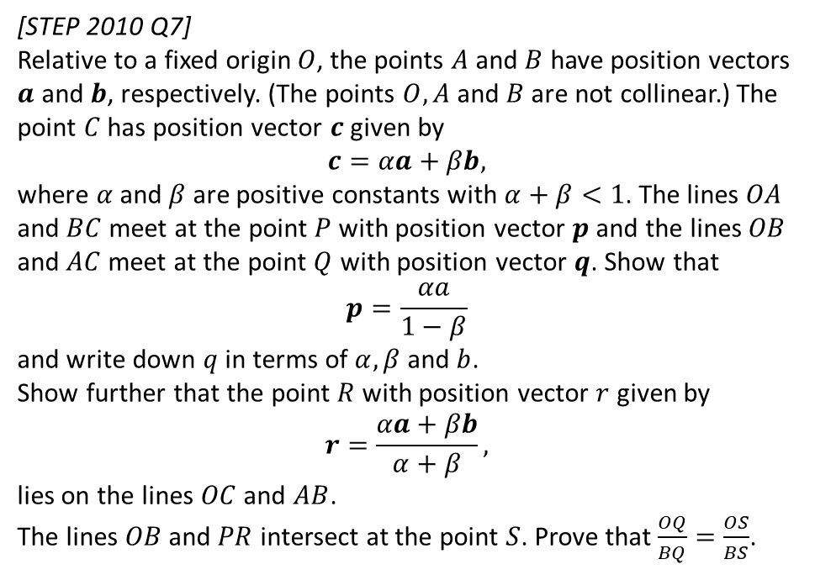
Exercise 11.5
Pearson Pure Mathematics Year 1/AS
Pages 89-90
Extension
1
[STEP 2010 Q7]
Relative to a fixed origin $O$, the points $A$ and $B$ have position vectors $a$ and $b$, respectively. (The points $O, A$ and $B$ are not collinear.) The point $C$ has position vector $c$ given by
$$c=αa+βb,$$
where $α$ and $β$ are positive constants with $α+β<1$. The lines $OA$ and $BC$ meet at the point $P$ with position vector $p$ and the lines $OB$ and $AC$ meet at the point $Q$ with position vector $q$. Show that
$$p=\frac{αa}{1−β}$$
and write down $q$ in terms of $α, β$ and $b$.
Show further that the point $R$ with position vector $r$ given by
$$r=\frac{αa+βb}{α+β},$$
lies on the lines $OC$ and $AB$.
The lines $OB$ and $PR$ intersect at the point $S$. Prove that $\frac{OQ}{BQ}=\frac{OS}{BS}$.
Click here for the solution:
http://www.mathshelper.co.uk/STEP%202010%20Solutions.pdf
(go to Q7)

Slide 7
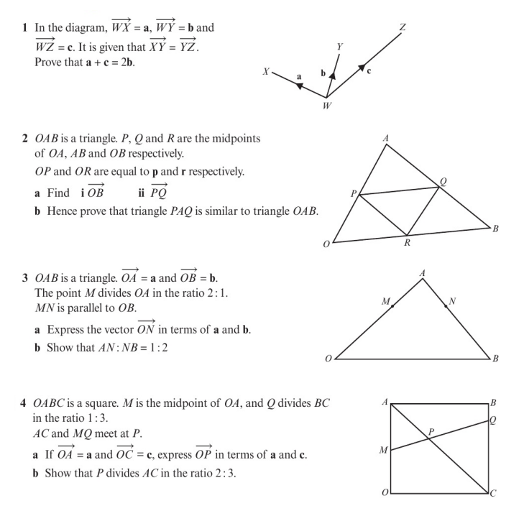
Homework Exercise

Slide 8
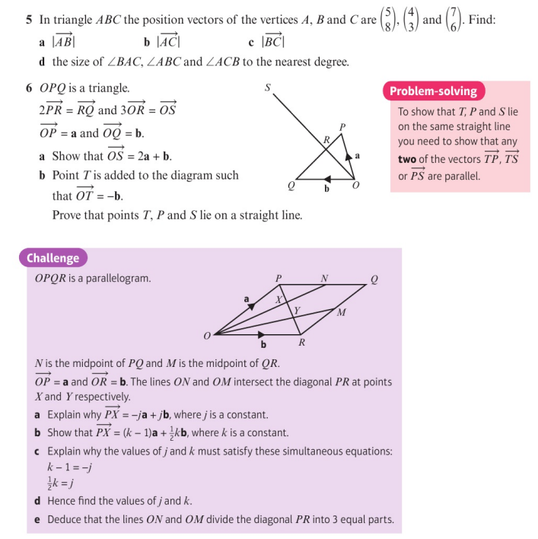
Homework Exercise

Slide 9
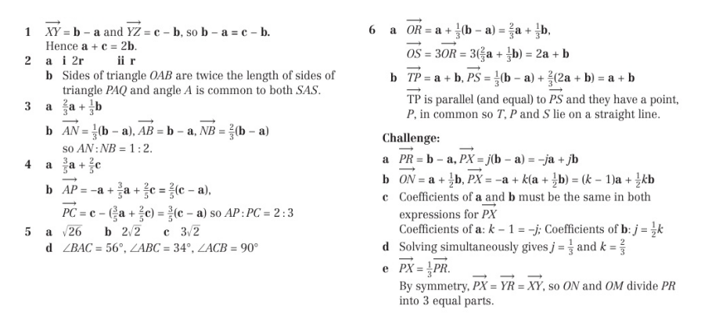
Homework Answers

