Slide 1
P2 Chapter 3: Sequences and Series
Geometric Series

Slide 2
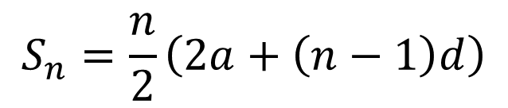

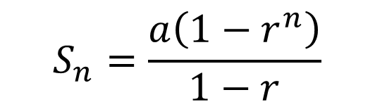
Sum of the first $n$ terms of a geometric series
Arithmetic Series
Geometric Series
?
$$S_{n}=\frac{n}{2}\left(2a+\left(n−1\right)d\right)$$
$$S_{n}=\frac{a\left(1−r^{n}\right)}{1−r}$$
?
Proof:
$$S_{n} =a+ar+ar^{2}+…+ar^{n−2}+ar^{n−1}$$
Mutiplying by $r$:
$$rS_{n}= ar+ar^{2}+… +ar^{n−1}+ar^{n}$$
Subtracting:
$$S_{n}−rS_{n}=a−ar^{n} \\ S_{n}\left(1−r\right)=a\left(1−r^{n}\right) \\ S_{n}=\frac{a\left(1−r^{n}\right)}{1−r}$$
?
Exam Note: This once came up in an exam. And again is a university interview favourite!

Slide 3
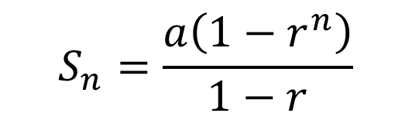

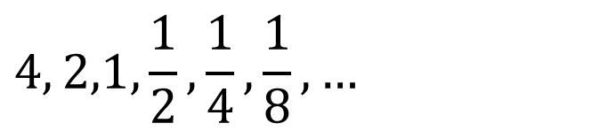
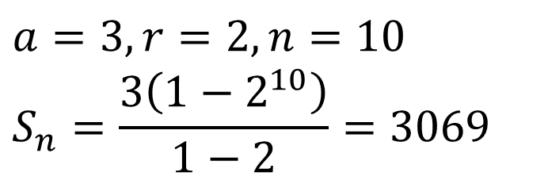

Examples
$$S_{n}=\frac{a\left(1−r^{n}\right)}{1−r}$$
Geometric Series
Find the sum of the first 10 terms.
$$3, 6, 12, 24, 48, …$$
?
?
?
$$a=3, r=2, n=10 \\ S_{n}=\frac{3\left(1−2^{10}\right)}{1−2}=3069$$
?
$$4, 2,1, \frac{1}{2},\frac{1}{4},\frac{1}{8}, …$$
$$a=4, r=\frac{1}{2}, n=10 \\ S_{n}=\frac{4\left(1−{\left(\frac{1}{2}\right)}^{10}\right)}{1−\frac{1}{2}}=\frac{1023}{128}$$
?
?
?
?

Slide 4

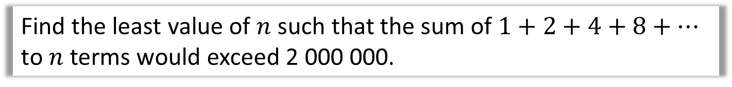

Harder Example
Find the least value of $n$ such that the sum of $1+2+4+8+…$ to $n$ terms would exceed 2 000 000.
?
$$a=1, r=2, n=? \\ S_{n}>2 000 000$$
$$\frac{1\left(1−2^{n}\right)}{1−2}>2 000 000 \\ 2^{n}−1>2 000 000 \\ 2^{n}>2 000 001 \\ n>\log_{2}{2000001} \\ n>20.9$$
So 21 terms needed.
?
$\log_{2}$ both sides to cancel out “2 to the power of”.

Slide 5
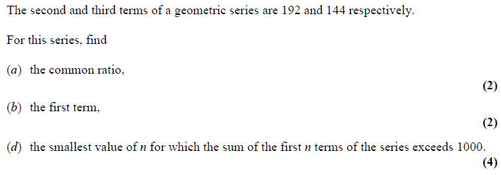
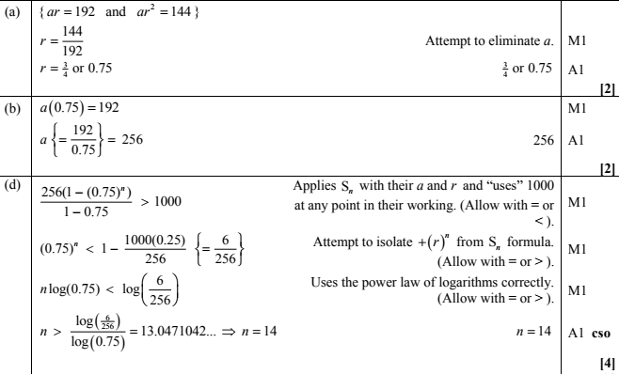
Test Your Understanding
Edexcel C2 June 2011 Q6
?
?
?

Slide 6

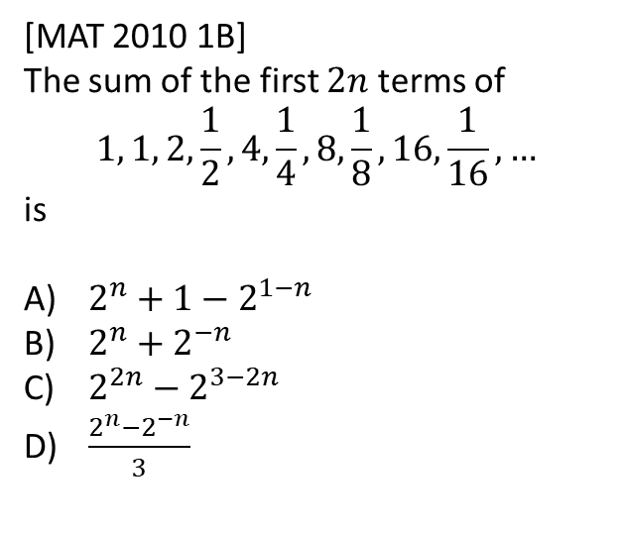
Exercise 3.4
Pearson Pure Mathematics Year 2/AS
Pages 21
Extension
[MAT 2010 1B]
The sum of the first $2n$ terms of
$$1, 1, 2,\frac{1}{2}, 4,\frac{1}{4},8,\frac{1}{8},16,\frac{1}{16},…$$
is
$2^{n}+1−2^{1−n}$
$2^{n}+2^{−n}$
$2^{2n}−2^{3−2n}$
$\frac{2^{n}−2^{−n}}{3}$
?
1
There are interleaved sequences. If we want $2n$ terms, we want $n$ terms of $1, 2, 4, 8, …$ and $n$ terms of $1,\frac{1}{2},\frac{1}{4},…$
For first sequence:
$$S_{n}=\frac{1\left(1−2^{n}\right)}{1−2}=2^{n}−1$$
For second sequence:
$$S_{n}=\frac{1\left(1−{\left(\frac{1}{2}\right)}^{n}\right)}{1−\frac{1}{2}}=\frac{1−2^{−n}}{1/2}=2−2^{1−n}$$
Therefore the sum of both is (A).

Slide 7
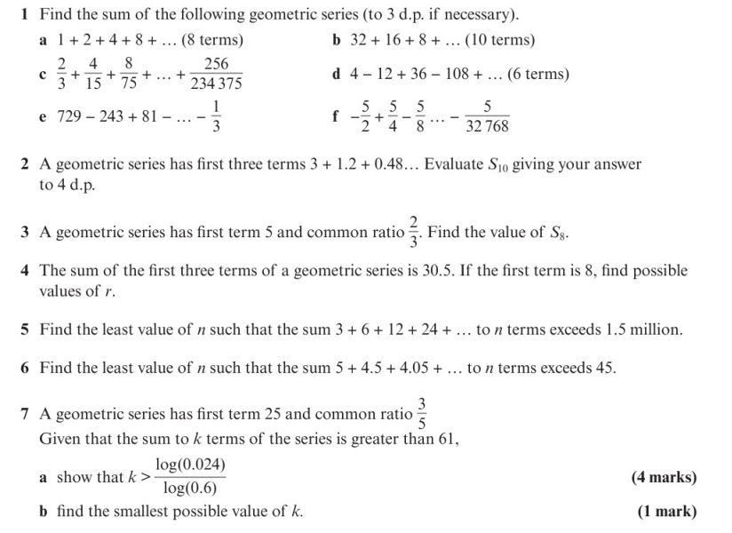
Homework Exercise

Slide 8
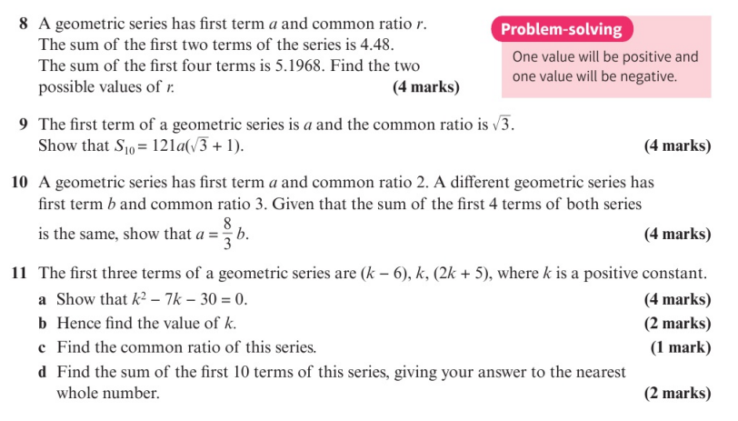
Homework Exercise

Slide 9
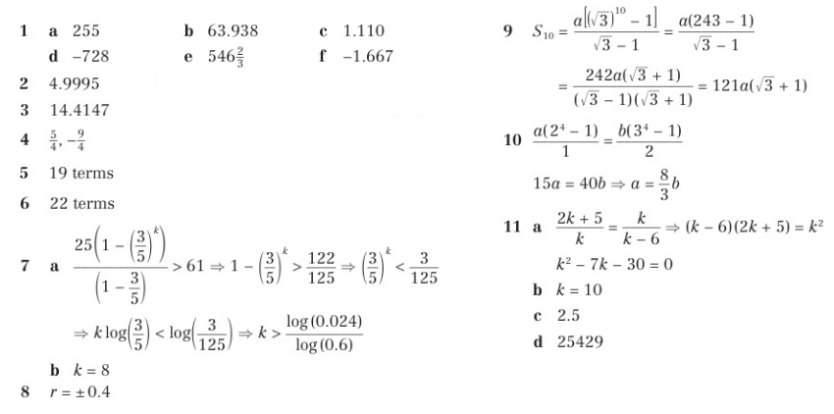
Homework Answers

