Slide 1
P2 Chapter 2: Graphing Functions
3D Functions as Maps

Slide 2
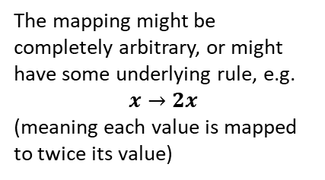
What is a mapping?
Inputs
A mapping is something which maps one set of numbers to another.
The mapping might be completely arbitrary, or might have some underlying rule, e.g.
$$x→2x$$
(meaning each value is mapped to twice its value)
-1
-1
Outputs
0
1
1.7
4.4
2
5
Also notice that one input might map to multiple outputs, or multiple inputs to one output.
Notice also that not all values in the set of inputs necessarily have a mapping to a value in the set of outputs.
3.1
7.2
...
...
! The domain is the set of possible inputs.
! The range is the set of possible outputs.

Slide 3










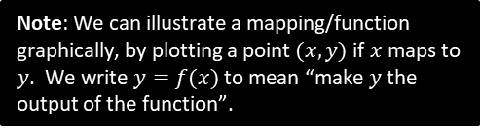
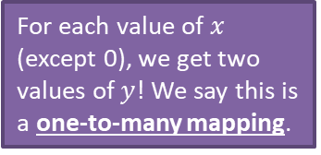




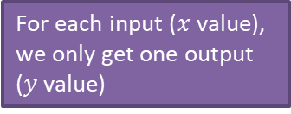
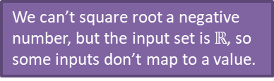
What is a function?
A function is: a mapping such that every element of the domain is mapped to
exactly one element of the range.
?
Notation:
$$f\left(x\right)=2x+1$$
$$f:x→2x+1$$
$f\left(x\right)$ refers to the output of the function.
Function?
Note: We can illustrate a mapping/function graphically, by plotting a point $(x,y)$ if $x$ maps to $y$. We write $y=f(x)$ to mean “make $y$ the output of the function”.
$$y$$
$$y$$
For each value of $x$ (except 0), we get two values of $y$! We say this is a one-to-many mapping.
Tip: Use the ‘vertical ray test’. If a vertically fired ray can hit the curve multiple times, it is NOT a function.
For each input ($x$ value), we only get one output ($y$ value)
$$x$$
No
Yes
$$x$$
$$f\left(x\right)=\sqrt{x}$$
No
Yes
Domain: $x∈ℝ$
No
Yes
We can’t square root a negative number, but the input set is $ℝ$, so some inputs don’t map to a value.
$$f\left(x\right)=2^{x}$$
Domain: $x∈ℝ$
(i.e. all real values)
$$f\left(x\right)=±\sqrt{x}$$
Domain: $x≥0$
No
Yes
No
Yes
$f\left(4\right)=2$ but $f\left(4\right)=−2$ also. This is one-to-many so not a function.

Slide 4





One-to-one vs Many-to-one
While functions permit an input only to be mapped to one output, there’s nothing stopping multiple different inputs mapping to the same output.
Type
Description
Example
?
?
$$y$$
Many-to-one
function
Multiple inputs can map to the same output.
$$y=x^{2}$$
$$f\left(x\right)=x^{2}$$
e.g. $f\left(2\right)=4$
$$f\left(−2\right)=4$$
2
4
$$x$$
-2
You can use the ‘horizontal ray test’ to see if a function is one-to-one or many-to-one.
?
?
One-to-one
function
Each output has one input and vice versa.
$$f\left(x\right)=2x+1$$
5
2
3
7
4
9

Slide 5


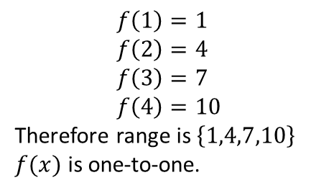


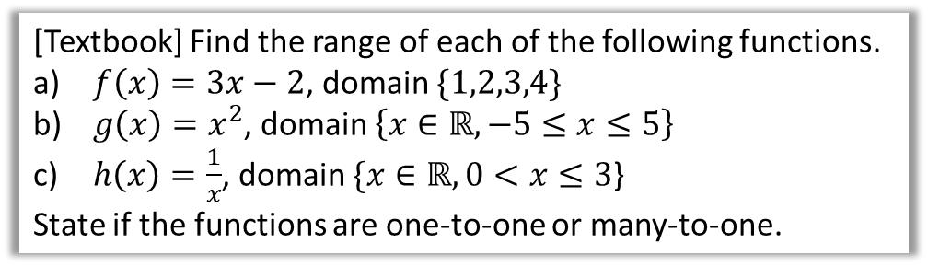




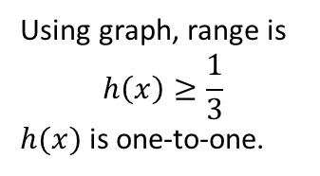

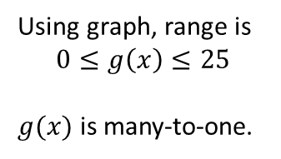


Further Examples
It is often helpful to sketch the function to reason about the range.
[Textbook] Find the range of each of the following functions.
$f\left(x\right)=3x−2$, domain $\{1,2,3,4\}$
$g\left(x\right)=x^{2}$, domain $\left\{x∈ℝ, −5≤x≤5\right\}$
$h\left(x\right)=\frac{1}{x}$, domain $\{x∈ℝ, 0<x≤3$}
State if the functions are one-to-one or many-to-one.
We use $x$ to refer to the input, and $f(x)$ to refer to the output.
Thus your ranges should be in terms of $f(x)$.
?
$$y$$
$$y$$
a
b
?
c
?
$$f\left(1\right)=1 \\ f\left(2\right)=4 \\ f\left(3\right)=7 \\ f\left(4\right)=10$$
Therefore range is $\left\{1,4,7,10\right\}$
$f(x)$ is one-to-one.
$$25$$
$$y=g(x)$$
$$\frac{1}{3}$$
$$x$$
$$3$$
$$x$$
$$−5$$
$$5$$
Using graph, range is
$$0≤g\left(x\right)≤25$$
$g(x)$ is many-to-one.
Using graph, range is
$$h\left(x\right)≥\frac{1}{3}$$
$h(x)$ is one-to-one.

Slide 6



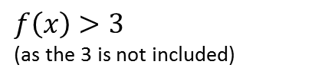



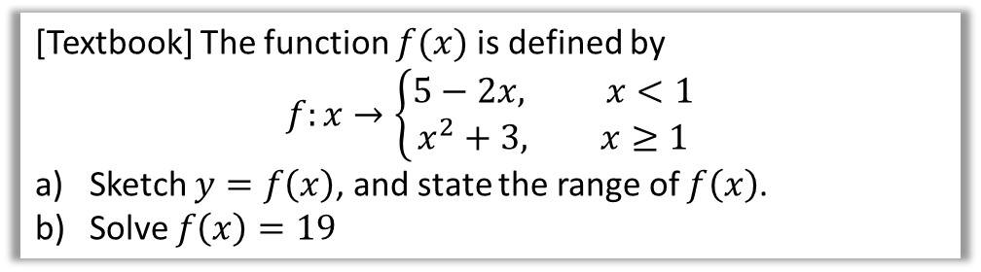

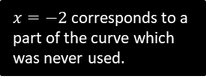








Piecewise Functions
A ‘piecewise function’ is one which is defined in parts: we can use different rules for different intervals within the domain.
[Textbook] The function $f(x)$ is defined by
$$f:x→\left\{\begin{aligned}5−2x, x<1 \\ x^{2}+3, x≥1\end{aligned}\right.$$
Sketch $y=f\left(x\right)$, and state the range of $f\left(x\right)$.
Solve $f\left(x\right)=19$
$$y$$
Using the graph, the range is $f\left(x\right)>3$
When $x≥1$:
$$x^{2}+3=19 \\ x=±4 \\ x=4$$
When $x<1$:
$$5−2x=19 \\ x=−7$$
a
?
b
?
$$y=5−2x$$
$$y=x^{2}+3$$
$$y$$
$$y=x^{2}+3$$
$$19$$
$$5$$
The filled/unfilled circles have the same meaning as with inequalities on a number line – unfilled indicates not included.
$$4$$
$$5$$
$$3$$
$$4$$
$$3$$
$$x$$
$$1$$
$$x$$
$$1$$
$f\left(x\right)>3$
(as the 3 is not included)
$x=−2$ corresponds to a part of the curve which was never used.

Slide 7


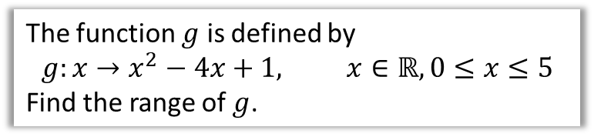


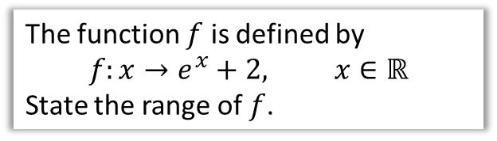





Test Your Understanding
Edexcel C4 June 2012 Q6a
Edexcel C4 June 2010 Q4d
The function $f$ is defined by
$$f:x→e^{x}+2, x∈ℝ$$
State the range of $f$.
The function $g$ is defined by
$$g:x→x^{2}−4x+1, x∈ℝ, 0≤x≤5$$
Find the range of $g$.
$$y$$
Hint: Identify the minimum point first, as this may or may not affect the range.
Extra Hint: Carefully consider the stated domain.
?
$$y=2$$
?
$$y$$
$$x^{2}−4x+1 \\ ={\left(x−2\right)}^{2}−4+1 \\ ={\left(x−2\right)}^{2}−3$$
So minimum point is $(2,−3)$
At two end points of curve:
$$f\left(0\right)=1 \\ f\left(5\right)=6$$
Therefore range:
$$−3≤f\left(x\right)≤6$$
$$x$$
$$(5,6)$$
$$1$$
$$x$$
$$f\left(x\right)>2$$
$$\left(2,−3\right)$$
Notice the range doesn’t include 2, as the line never reaches the asymptote.

Slide 8
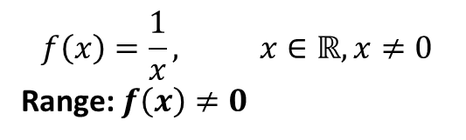
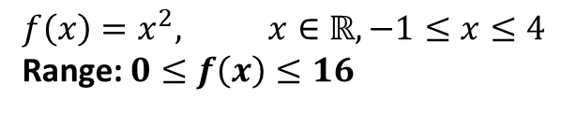
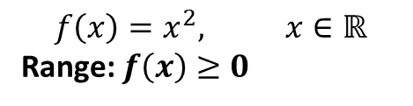
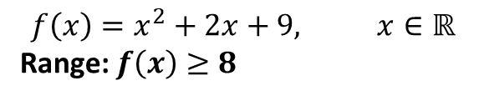
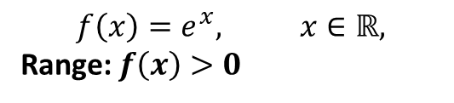
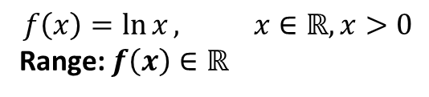
Summary of Domain/Range
It is important that you can identify the range for common graphs, using a suitable sketch:
$$f\left(x\right)=\frac{1}{x}, x∈ℝ, x≠0$$
Range: $f\left(x\right)≠0$
$$f\left(x\right)=x^{2}, x∈ℝ$$
Range: $f\left(x\right)≥0$
?
?
$$f\left(x\right)=\ln{x}, x∈ℝ, x>0$$
Range: $f\left(x\right)∈ℝ$
$$f\left(x\right)=e^{x}, x∈ℝ,$$
Range: $f\left(x\right)>0$
?
?
$$f\left(x\right)=x^{2}+2x+9, x∈ℝ$$
Range: $f\left(x\right)≥8$
?
Be careful in noting the domain – it may be ‘restricted’, which similarly restricts the range. Again, use a sketch!
$$f\left(x\right)=x^{2}, x∈ℝ, −1≤x≤4$$
Range: $0≤f\left(x\right)≤16$
?

Slide 9


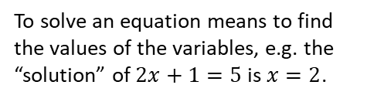
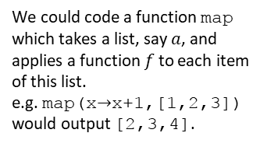
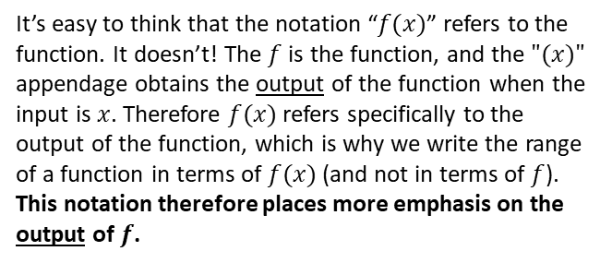

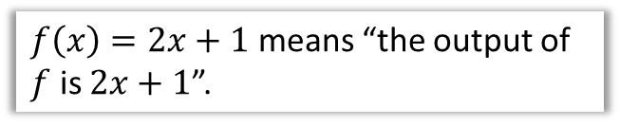

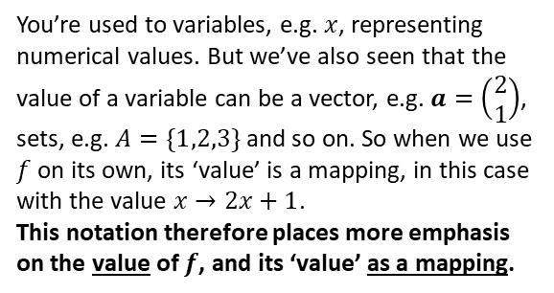
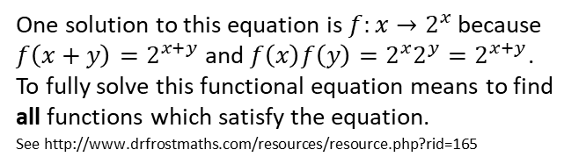
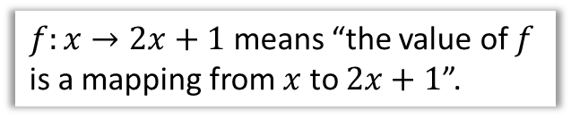

Just for your interest…
What is the difference between the notation
$f\left(x\right)=2x+1$ and $f:x→2x+1$?
$f:x→2x+1$ means “the value of $f$ is a mapping from $x$ to $2x+1$”.
To solve an equation means to find the values of the variables, e.g. the “solution” of $2x+1=5$ is $x=2$.
You’re used to variables, e.g. $x$, representing numerical values. But we’ve also seen that the value of a variable can be a vector, e.g. $a=\left(\begin{matrix}2 \\ 1\end{matrix}\right)$, sets, e.g. $A=\{1,2,3\}$ and so on. So when we use $f$ on its own, its ‘value’ is a mapping, in this case with the value $x→2x+1$.
This notation therefore places more emphasis on the value of $f$, and its ‘value’ as a mapping.
Consequence 1
To solve a functional equation means to find the ‘values’ of $f$.
Solve $f\left(x+y\right)=f\left(x\right)f\left(y\right)$
One solution to this equation is $f:x→2^{x}$ because $f\left(x+y\right)=2^{x+y}$ and $f\left(x\right)f\left(y\right)=2^{x}2^{y}=2^{x+y}$.
To fully solve this functional equation means to find all functions which satisfy the equation.
See http://www.drfrostmaths.com/resources/resource.php?rid=165
Consequence 2
$f\left(x\right)=2x+1$ means “the output of $f$ is $2x+1$”.
A bit of Computer Science!
In many programming languages, we can pass functions as the parameters of a method, when a variable is allowed to have a function as its value.
It’s easy to think that the notation “$f(x)$” refers to the function. It doesn’t! The $f$ is the function, and the $"(x)"$ appendage obtains the output of the function when the input is $x$. Therefore $f(x)$ refers specifically to the output of the function, which is why we write the range of a function in terms of $f(x)$ (and not in terms of $f$).
This notation therefore places more emphasis on the output of $f$.
We could code a function map which takes a list, say $a$, and applies a function $f$ to each item of this list.
e.g. map(x$→$x+1,[1,2,3])
would output [2,3,4].
function map(f, a) {
let b be a new list
for(i from 1 to size(a)) {
b_{i} = f(a_{i})
}
return b
}

Slide 10
Exercise 2.2
Pearson Pure Mathematics Year 2/AS
Page 7

Slide 11
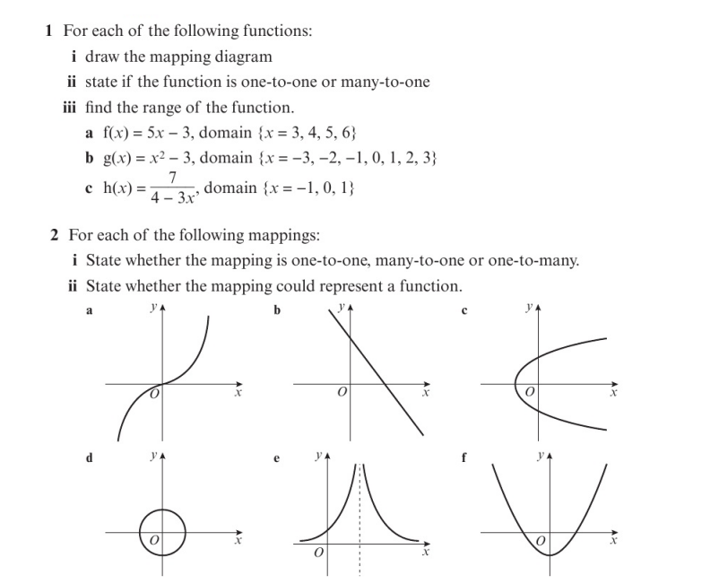
Homework Exercise

Slide 12
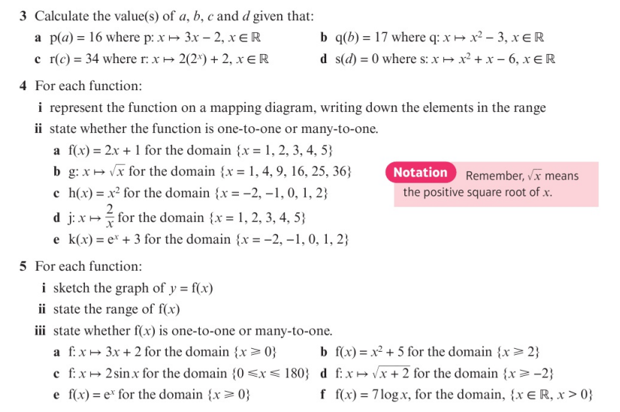
Homework Exercise

Slide 13
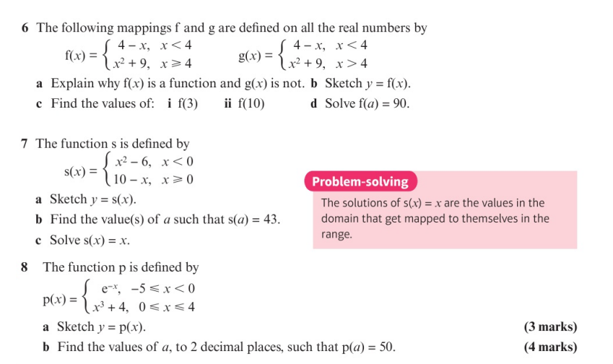
Homework Exercise

Slide 14
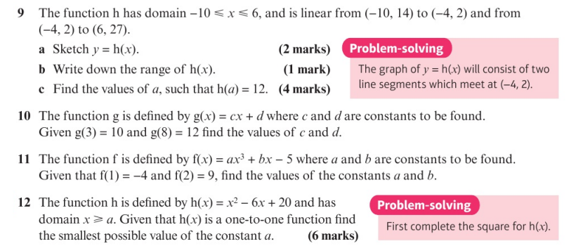
Homework Exercise

Slide 15
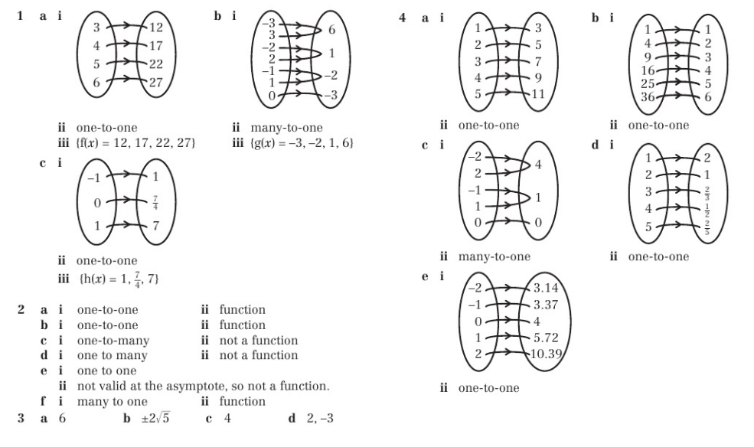
Homework Answers

Slide 16
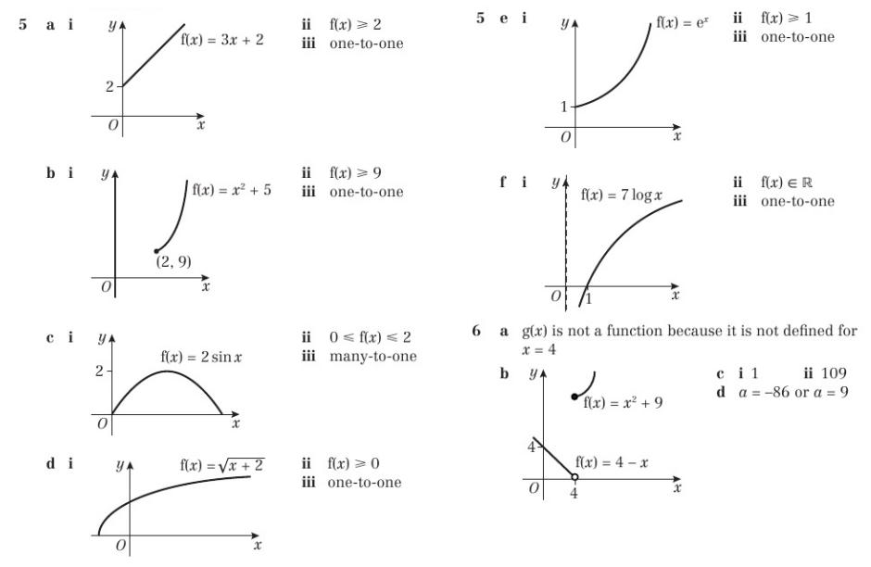
Homework Answers

Slide 17
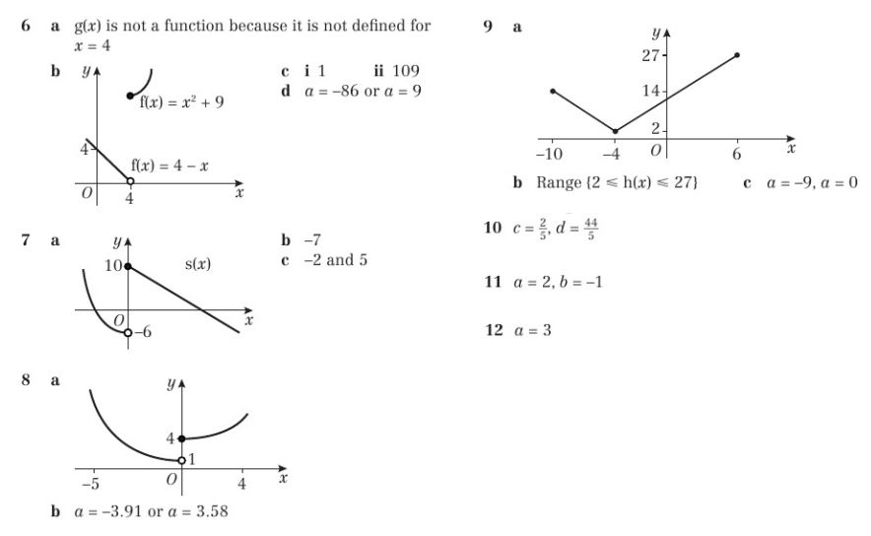
Homework Answers

